Slide 1

CAMPUS KNOWLEDGE PLATFORM
Cohort Connect
Bridging the Gap Between Seniors & Juniors
Team Members.
Rokhiya
Likhitha
Keerthana
Vyshnavi
A campus-oriented social networking & knowledge-sharing platform for students, faculty, and institutions.
Presented by Team CohortConnect • PS-116

Slide 2




Problem Statement
No Guidance Platform
Knowledge Gets Lost
First-year students lack a dedicated platform to connect with seniors for mentorship and guidance.
Valuable senior experiences — interview tips, internships, hackathons — never reach juniors effectively.
Scattered Communication
Missed Opportunities
Campus information is fragmented across WhatsApp, emails, and notice boards with no central hub.
Students miss internships, hackathons, and government exams due to lack of timely, structured alerts.

Slide 3






Solution Overview
CohortConnect — A campus platform where seniors share knowledge, institutions post updates, and students grow together.
Post & Share
AI Content Gen
Leaderboard
LinkedIn-style posts with images, videos (≤3 min), PDFs, and resource links.
Generate event posters & videos from a short prompt using integrated AI tools.
Gamified rankings based on likes, comments, shares, views & post quality.
Messaging
Smart Reminders
AI Verification
Real-time 1-on-1 messaging via Socket.IO for direct student communication.
Deadline notifications sent 1 day & 6 hours before saved post deadlines.
AI verifies authenticity of global opportunities (hackathons, internships).

Slide 4
Workflow & Technology Stack
Platform Workflow
Technology Stack
1
Frontend
User registers & sets up profile
Vite@latest
React 18
React Router v6
Axios
CSS3
JavaScript
2
Browse feed or create a post
Backend
3
Add media, tags, deadline & publish
Express.js
Node.js
MongoDB Community Server
Mongoose
JWT
Bcryptjs
Node-schedule
JavaScript
4
AI verifies global event authenticity
Database
5
Community engages: like, comment, share
MongoDB Community Server
Flask
Python
6
Saved post deadline → push notification
Math animation engine

Slide 5
Workflow & Technology Stack
Platform Workflow
Technology Stack
1
Frontend
User registers & sets up profile
Vite@latest
React 18
React Router v6
Axios
CSS3
JavaScript
2
Browse feed or create a post
Backend
3
Add media, tags, deadline & publish
Express.js
Node.js
MongoDB Community Server
JWT
Node-schedule
JavaScript
4
AI verifies global event authenticity
Database
5
Community engages: like, comment, share
MongoDB Community Server
Flask
Python
6
Saved post deadline → push notification
Manim animation engine

Slide 6
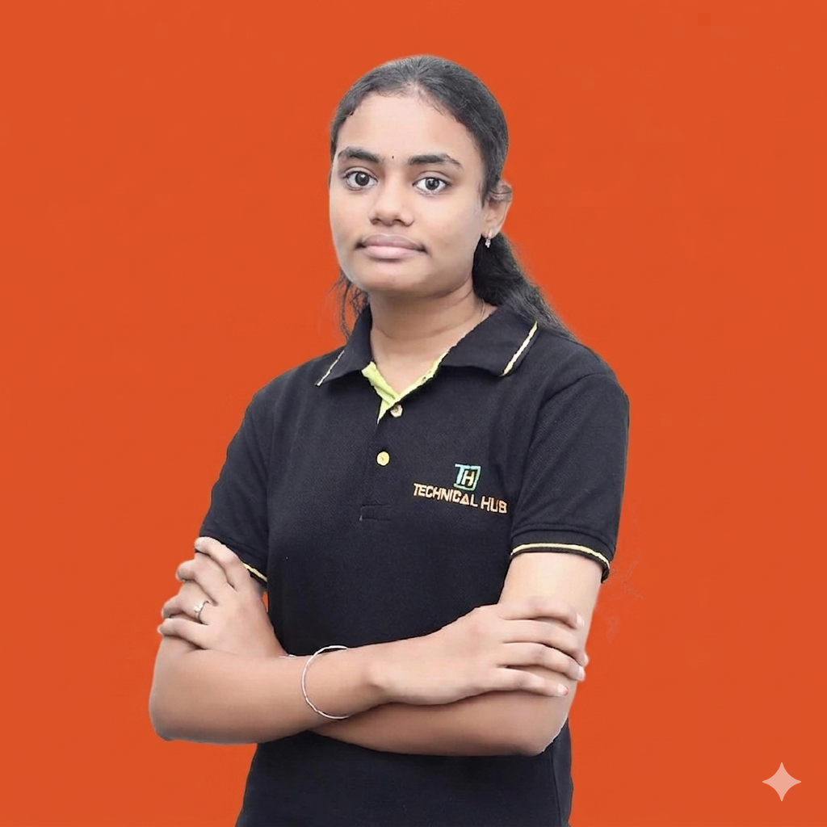



Meet the Team
Keerthana
Likhitha
Rokhiya
Vyshnavi
Full Stack Developer
UI/UX Designer
AI Integration
Backend & DevOps
Key Learnings
✔ Designing scalable full-stack web architectures
✔ Integrating AI APIs for content generation & verification
✔ Building real-time communication with Socket.IO
✔ Implementing gamification for user engagement
✔ Workflow automation using n8n for notifications
Thank You!
Questions & Feedback Welcome
CohortConnect | Connecting Campus Communities | 2025

