Slide 1

Task 1: Web scraping to gain company insights

Slide 2
Presenter
Mujahidul Islam
BSc. In Computer Science and Engineering
(Major in Data Science)
(2020-2024)
East West University, Dhaka, Bangladesh

Slide 3
Introduction
Web scraping is the process of automatically extracting large amounts of data from websites. For this project, we scraped user reviews from British Airways’ profile on Airline Quality to analyze customer satisfaction and gather insights on service quality, seat comfort, staff behavior, and other factors. This data provides valuable insights for understanding customer experience and identifying improvement areas for the airline.

Slide 4
Objective
The main objective of this web scraping project is to:
Gather authentic customer feedback on British Airways’ services.
Analyze reviews across various parameters such as Seat Comfort, Cabin Staff Service, Ground Service, Value for Money, and Route.
Derive insights to understand user satisfaction and pain points, which can be used to inform improvements and enhance the customer experience.

Slide 5
Key Steps of Web Scraping
Identify the Data Source
Set Up the Scraper
Extract and Clean Data
Analyze and find insight of Data
Save Data
..

Slide 6
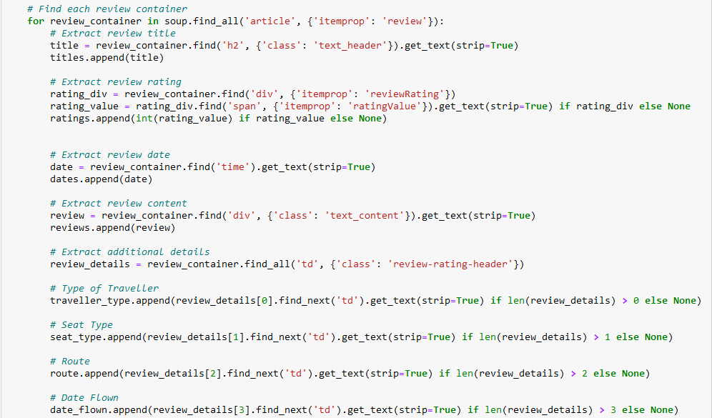
Visuals of Scrapping
..

Slide 7
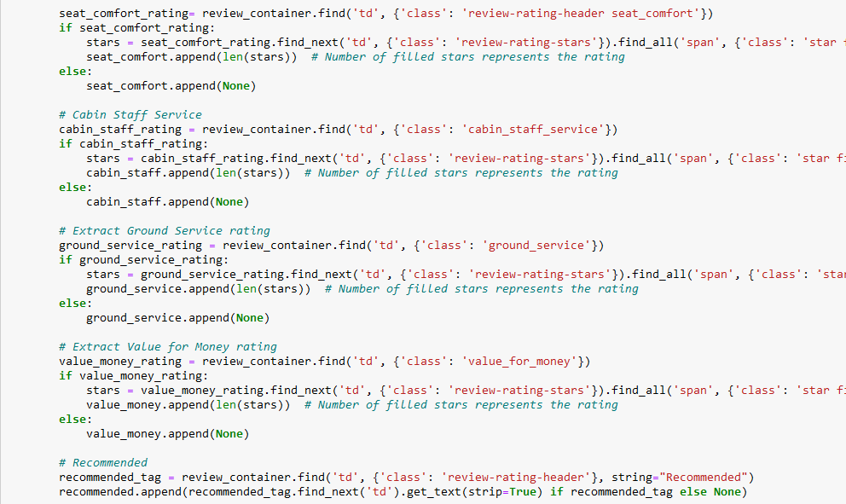
Visuals of Scrapping
..

Slide 8
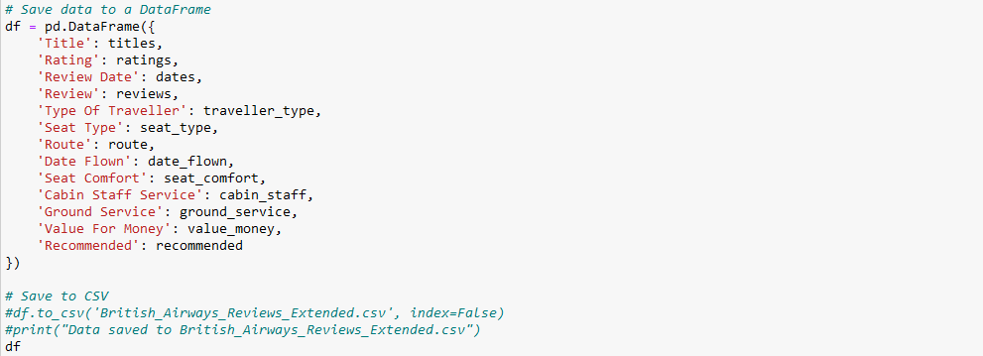
Visuals of Scrapping
..

Slide 9
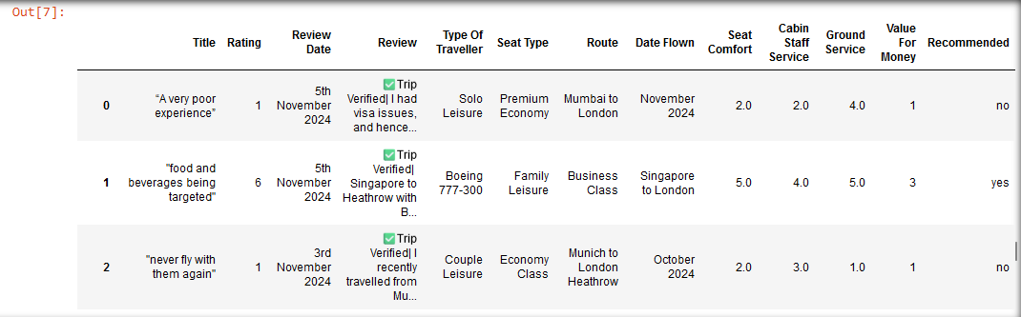
Dataset
..

Slide 10
Cleaning and Processing
Lowercase all text
Remove extra whitespaces
Remove unwanted characters
Spelling Correction
Perform Sentiment Analysis

Slide 11
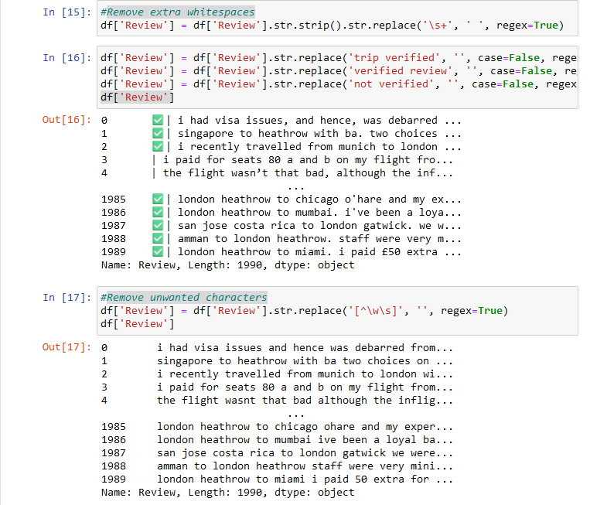
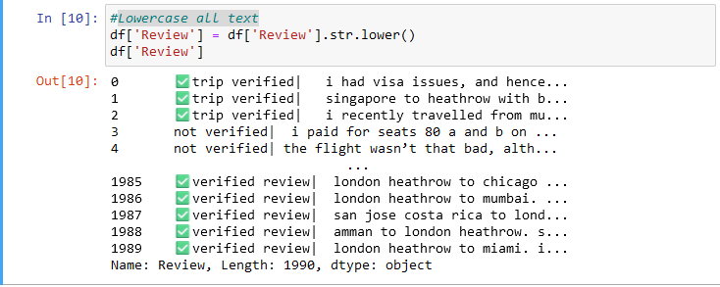

Visuals of Cleaning

Slide 12
Analysis (Based on Review)
Perform Sentiment Analysis
Apply sentiment analysis to each review
Optional: classify the sentiment as positive, negative, or neutral
Apply the polarity function to create a new 'Polarity' column
Apply the classification function to create a new 'Sentiment' column

Slide 13
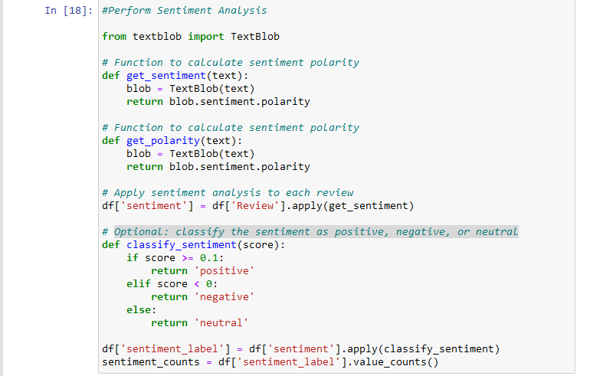
Visuals of Analysis

Slide 14
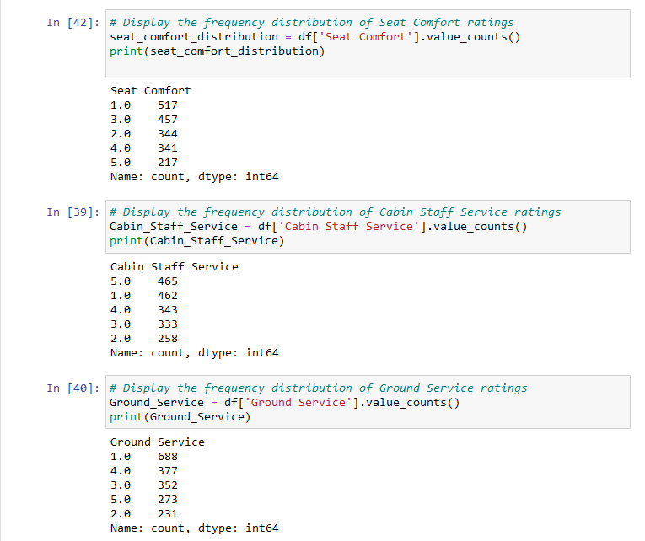
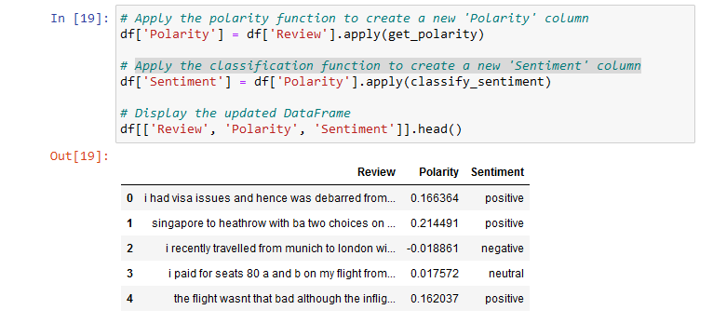
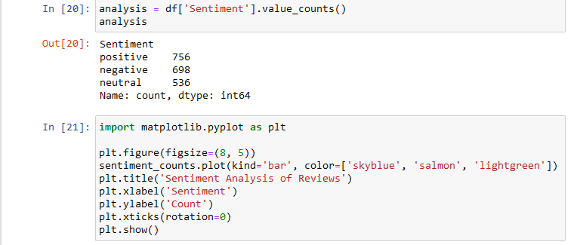
Visuals of Analysis

Slide 15
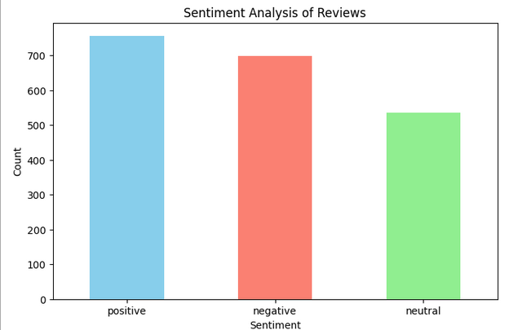
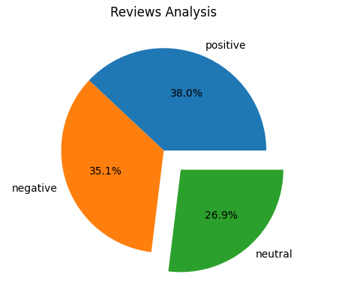
..
..

Slide 16
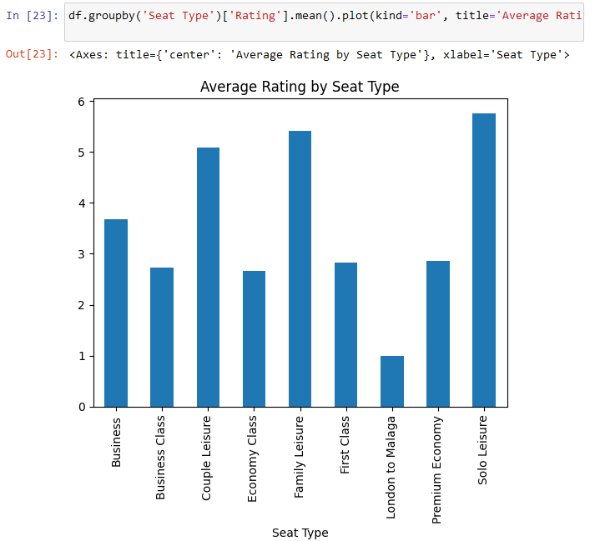
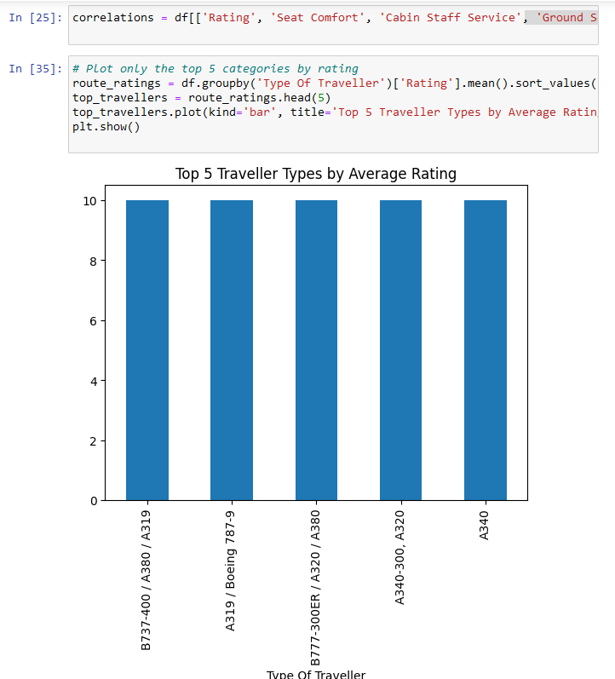
Analysis (Based on other columns)
..

Slide 17
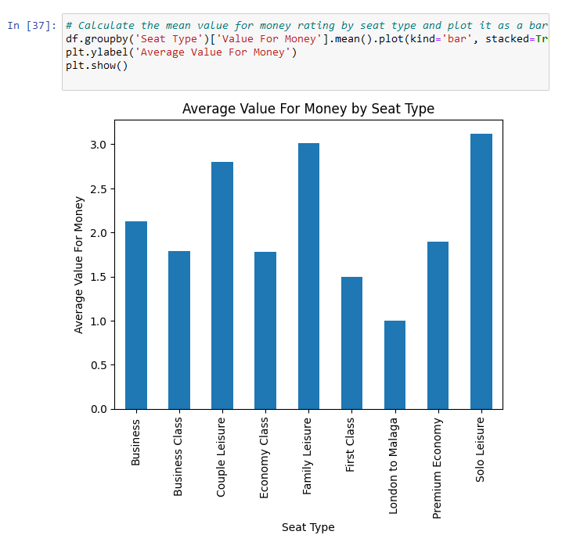
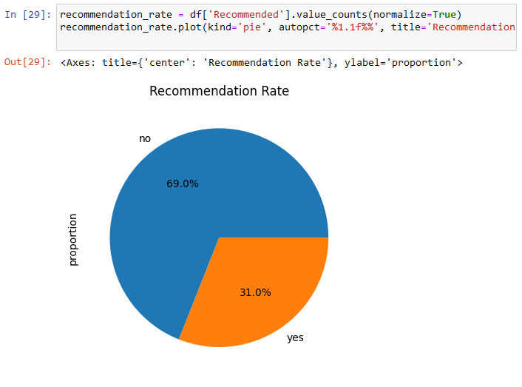

Slide 18
Thank You

