Slide 1
Task 2: Predicting customer buying behavior

Slide 2
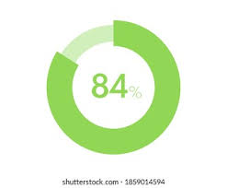
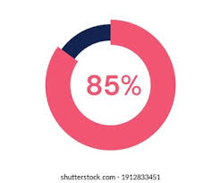
Result Analysis
Accuracy of RandomForestClassifier is 84%
Accuracy of XGBoostClassifier is 85%
AUC Score of RandomForestClassifier is 57%
AUC Score of XGBoostClassifier is 52%

Slide 3
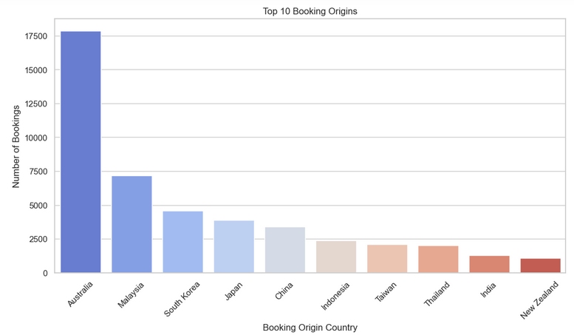
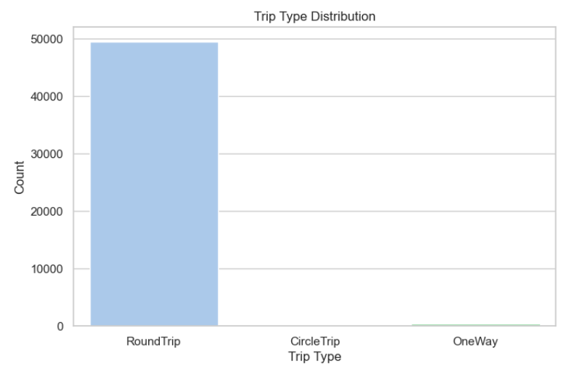
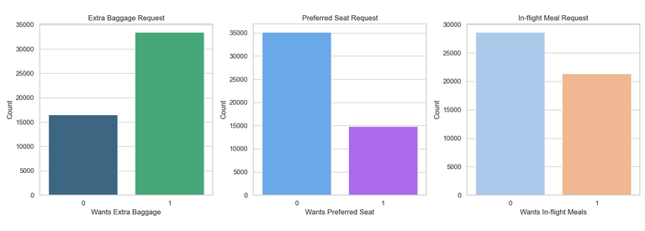
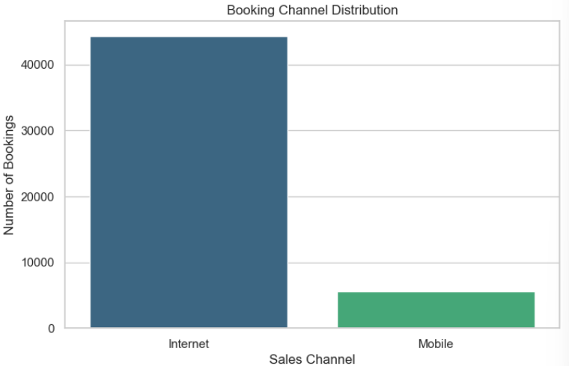

Slide 4
Thank You

