Slide 1

Mutual Fund Analytics Capstone Project Bluestock Fintech Capstone Program
Prepared By: Bhavya Sri Rokkala
June 2026

Slide 2

PROBLEM STATEMENT & OBJECTIVES
Problem Statement
• Mutual fund data is available across multiple datasets. • Investors require insights into performance, risk, and investor behavior. • Raw data alone cannot support informed investment decisions.
Objectives
• Build ETL Pipeline • Create SQLite Database • Perform Data Analysis • Calculate Performance Metrics • Analyze Investor Behavior • Compare Against Benchmarks • Develop Interactive Dashboard

Slide 3

DATA SOURCES
Datasets Used
• NAV History Data • Investor Transactions Data • Fund Master Data • Benchmark Data • SIP and AUM Data • Portfolio Holdings Data
Technologies Used
• Python • Pandas • SQLite • Power BI • Matplotlib

Slide 4

PROJECT ARCHITECTURE
Project Workflow
Raw CSV Files ↓ ETL Pipeline ↓ SQLite Database ↓ Analytics & Insights ↓ Power BI Dashboard
Key Stages
• Data Extraction • Data Cleaning • Data Transformation • Data Analysis • Visualization

Slide 5
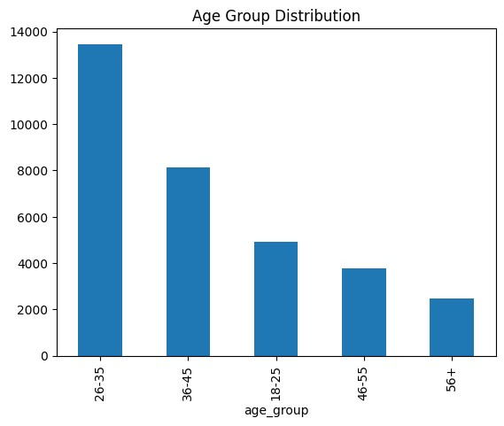
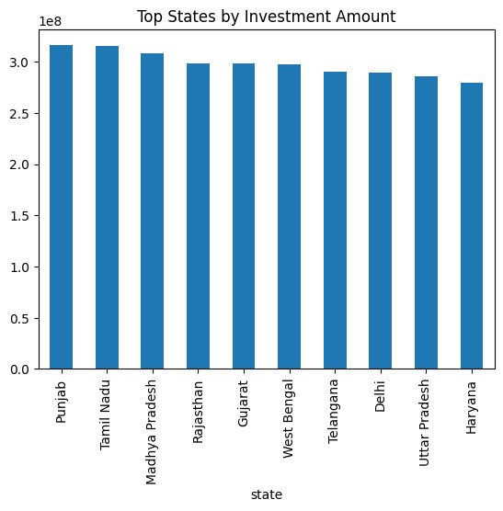
EDA HIGHLIGHTS
EDA Analysis Performed
• Age Group Distribution • Gender Distribution • Income Analysis • State-wise Investments • Transaction Type Analysis • City Tier Distribution
Key Insights
• Investment activity varies across age groups. • State-wise investment patterns show regional differences. • SIP transactions dominate overall activity.

Slide 6
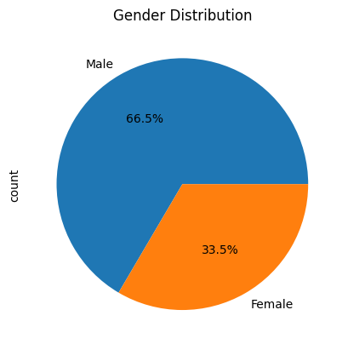

INVESTOR ANALYTICS
Investor Analysis
Key Findings
• Demographic Analysis • Gender Distribution • City Tier Analysis • State-wise Investments • SIP vs Lumpsum Analysis
• SIP investments dominate investor transactions. • Metro cities contribute significant investments. • Different age groups show different investment behavior.

Slide 7
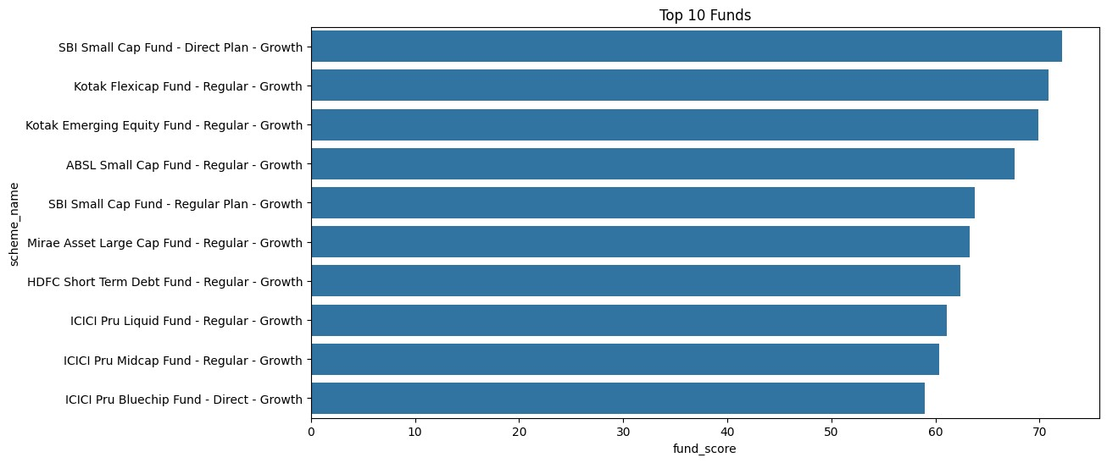
PERFORMANCE ANALYTICS
Key Findings
Metrics Calculated
• CAGR • Sharpe Ratio • Sortino Ratio • Alpha • Beta • Maximum Drawdown
• Top funds achieved better risk-adjusted returns. • Sharpe Ratio helped identify strong performers. • Risk-adjusted performance varied significantly.

Slide 8
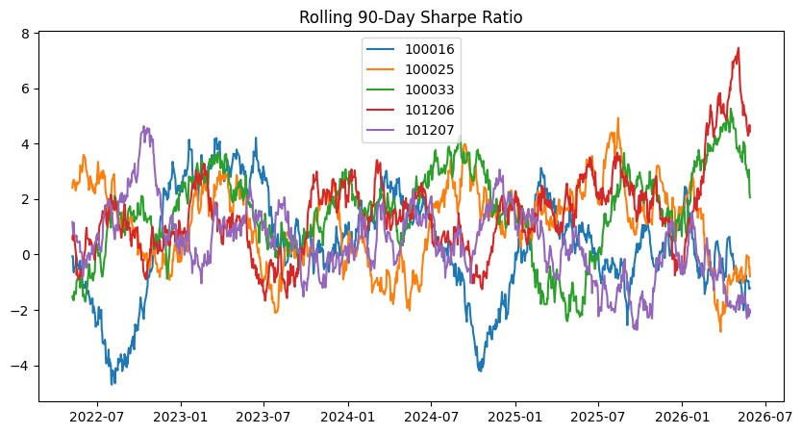
RISK ANALYTICS
Advanced Analytics
• Value at Risk (VaR) • Conditional VaR (CVaR) • Rolling Sharpe Ratio • Volatility Analysis
Key Findings
• High VaR indicates greater downside risk. • Rolling Sharpe measures performance consistency. • Volatility varies significantly across funds.

Slide 9
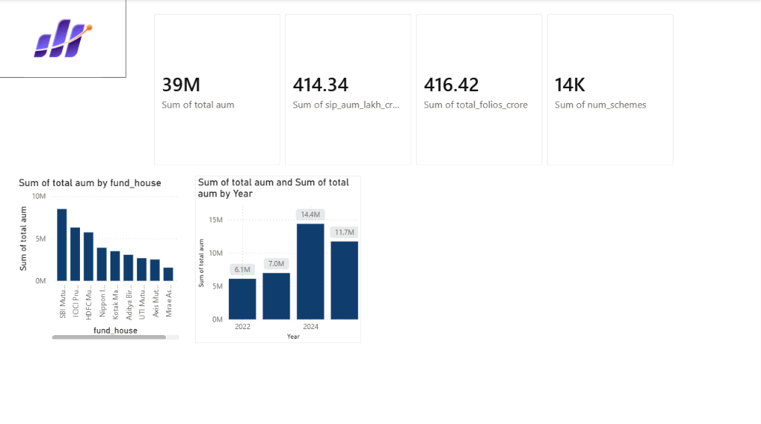
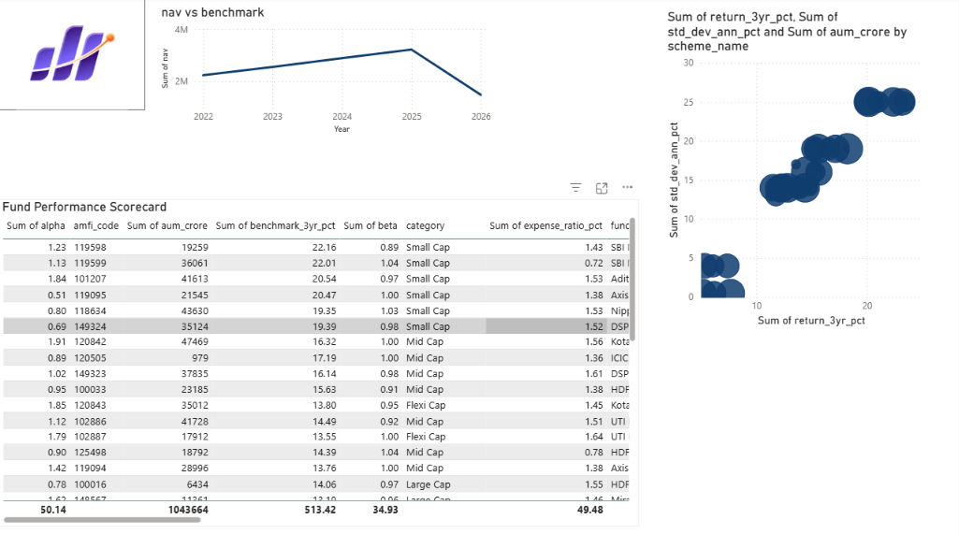
DASHBOARD OVERVIEW (PAGE 1 & PAGE 2)
Fund Performance
• Fund Comparison • Performance KPIs • Return Analysis
Industry Overview • Total AUM • Total SIP Inflows • Total Folios • Industry Trends

Slide 10
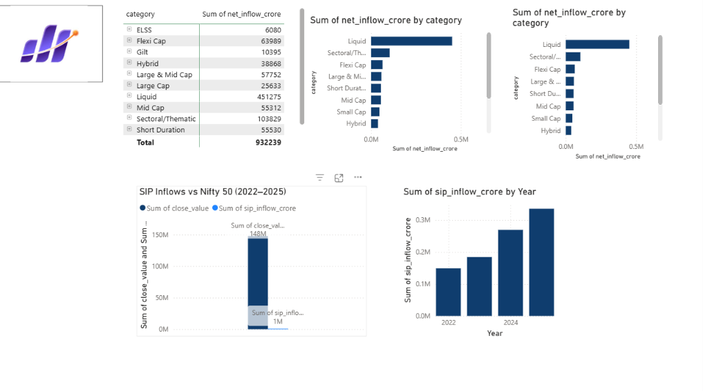
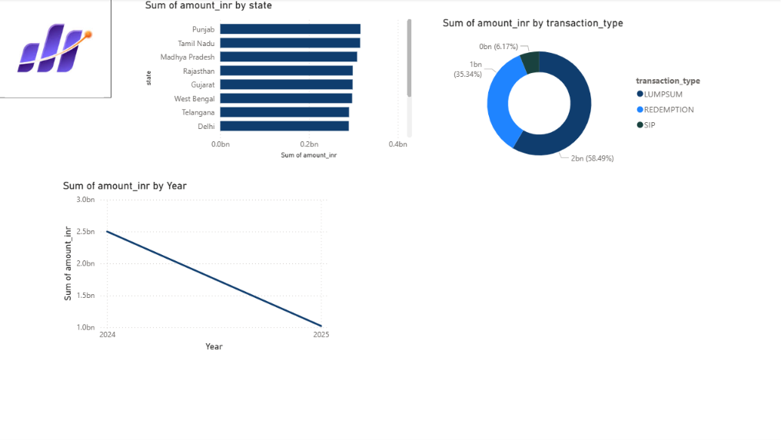
DASHBOARD OVERVIEW (PAGE 3 & PAGE 4)
Investor Insights
• Demographic Analysis • State-wise Investments • Transaction Trends
Risk Analytics
• Benchmark Comparison • Risk Metrics • Fund Volatility

Slide 11

KEY FINDINGS
• Top-performing funds achieved higher Sharpe Ratios. • SIP investments dominated investor activity. • Benchmark tracking varied across funds. • High volatility did not always generate higher returns. • Risk-adjusted metrics improved fund evaluation. • Investor behavior differed across age groups and regions.

Slide 12


