Slide 1


CODA
COntinual Decomposed Attention-based Prompting for Rehearsal-Free Continual Learning

Slide 2
Introduction
Introduces end-to-end training mechanism which increases plasticity.
Expanding the prompt size does not increase the plasticity in L2P and Dual Prompt.
Replace the prompt pool with a decomposed prompt that consists of a weighted sum of learnable prompt components.
Introduce a novel attention-based component-weighting scheme

Slide 3
PRIOR WORKs
PROMPT POOL
K
V
K, V
K
K, V
V
V,V
Query
K, V
K, V
Query
MODEL
K
K, V
V
K, V
K, V
VK
K, V
V

Slide 4
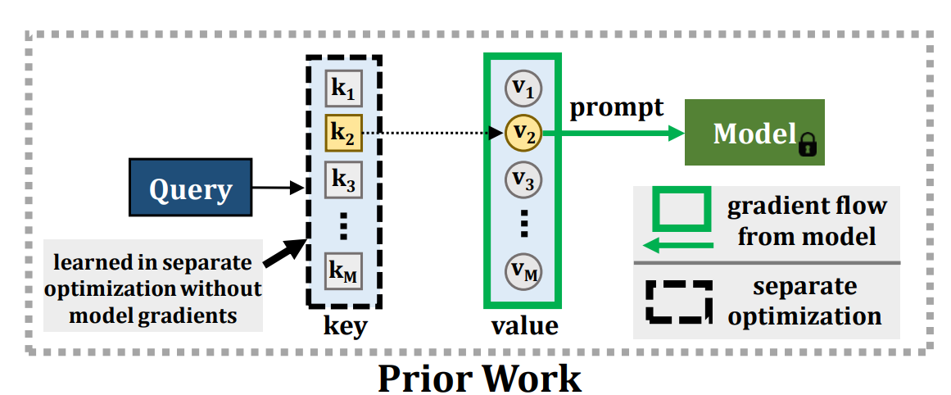
L2P & Dual PROMPT
bl
introduce a novel attention-based component-weighting scheme

Slide 5
INTRODUcTIon
a1
c11
◉
a2
c2
Query
Attention
a3
+
c3
a4
c4
MODEL

Slide 6
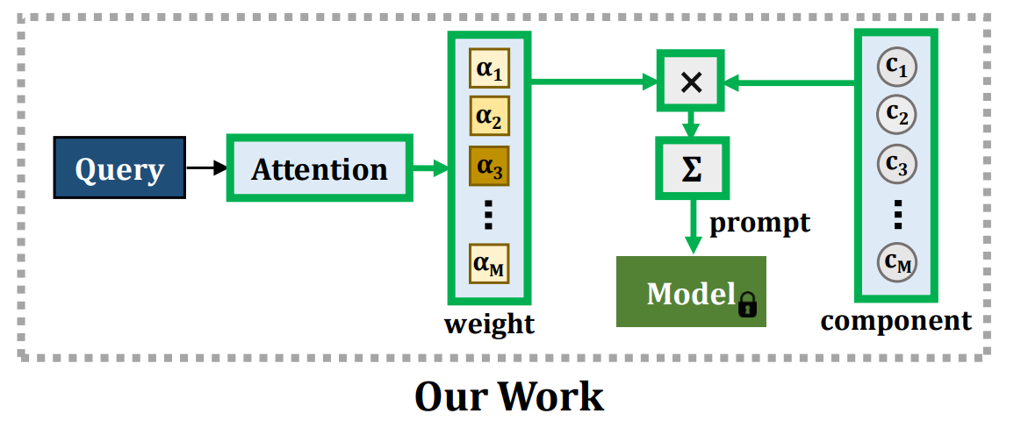
CODA

Slide 7



Prompt Formation
An that is end-to-end differentiable, which increases the ability to learn a new task with higher accuracy.
Prompt parameter p with a weighted summation over the prompt components.
Weighting vector
Each Pm has a corresponding attention vector Am in addition to the key Km. This allows the query to focus on certain features from the high dimensional.

Slide 8


Attention and ORTOGONALITy
A feature selection scheme is used by introducing simple attention.
A is a learnable parameter
Visit a new task , freeze current components and expand the set, only updating the new components.
To reduce interference between existing and new knowledge, an orthogonality constraint to P , K, and A.

Slide 9
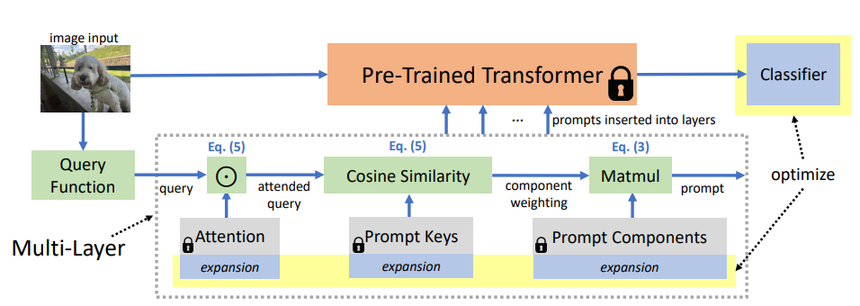
Model

Slide 10

LOSS
Full optimization loss
Unfrozen components
This method often has slightly higher average forgetting compared to DualPrompt
This method has a larger capacity to learn new tasks, and thus we can sacrifice marginally higher forgetting.

Slide 11
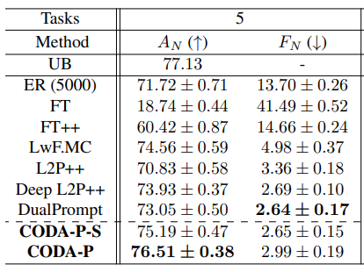
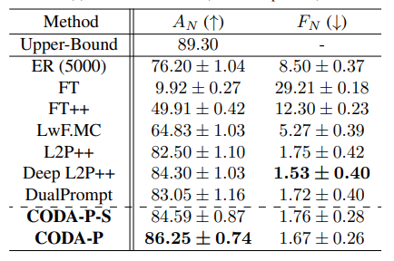
Results
ImageNet-R
CIFAR-100
Ablation study shows freezing and orthogonality are crucial to this approach.

