Slide 1


DUAL PROMPT
Complementary Prompting for Rehearsal-free Continual Learning

Slide 2
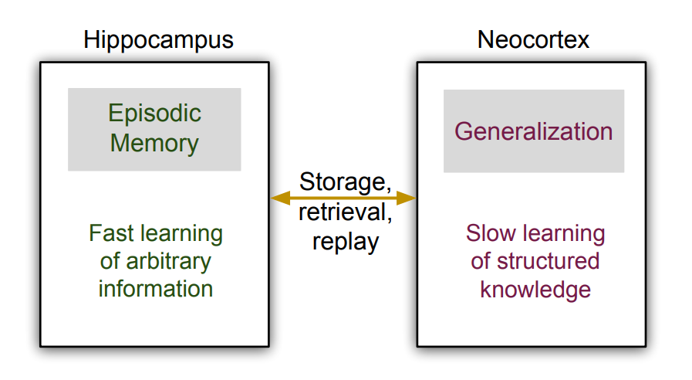
Introduction
In L2P, one single prompt pool is designed to transfer knowledge from one task to another, without distinguishing between the common features among all tasks versus the features that are unique to each task.
Complementary Learning Systems (CLS) suggests that humans learn continually via the synergy between two learning systems.
Thus, they are able to learn task-specific knowledge separately without interference while leveraging task-invariant knowledge to have greater learning capacity to learn future tasks better.
Hippocampus: Focuses on learning pattern-separated representation on specific experiences
Neocortex : Focuses on learning more general and transferable representation from experience sequences

Slide 3
Introduction
However, previous CLS-driven methods still decouple or expand the backbone parameters learn the two kinds of knowledge.
Dual Prompt directly decouples the higher-level prompt space, which turns out to be more effective and memory efficient that conventional methods which focus on the lower-level latent representation space.
Here they empirically discover that properly attaching prompts to the backbone model is crucial to the effectiveness of continual learning.
Dual Prompt is architecture-based method and only require negligible amount of parameters (0.2% − 0.6% of full model size).
Dual Prompt aims at more challenging class-incremental setting, and focus on pre-trained transformer-based models.

Slide 4



Prompt-based learning
It was first proposed in NLP for transfer learning, by adding extra instruction for pre-trained models to perform downstream tasks conditionally.
Prompt tuning is a technique used in NLP that involves attaching a set of prompt parameters to pre-trained transformer-based language models.
Prompts are usually prepended to the input sequence to instruct the model prediction.
L := Sequence Length
PRETRAINED BACKBONE
L := Sequence Length
PROMPT
L_{p} =3
INPUT SEQUENCE

Slide 5
Dual Prompt
f
ViT
Attaching G-Prompt to the i^{th} MSA layer
MSA
i^{th} Layer
h_{g}^{(i)} = ƒ _{prompt}(g, h^{(i)})
MSA
i = N
f_{prompt}
.
.
.
.
.
.
.
.
.
MSA
i = 1
Lg =3
…
h^{(i)}=the input embedding feature of the i^{th} MSA layer
g є R^{Lg X D}
h^{(i)}
Input embedding feature
G-Prompt

Slide 6
E-Prompt
E = {e_{t}} ^{T} _{t=1} : set of task-dependent parameters
T : total number of task.
e_{t} is associated with a task-specific key k_{t} є R^{D} , which is also a learnable parameter that aims to capture representative features of a task.
For an input example from the t-th task, to attach E-Prompt to the j-th MSA layer, we apply the prompting function in a similar way
e_{t} є R^{Le X D}
MSA
j^{th} Layer
h_{e}^{(j)} = ƒ _{prompt}(e, h^{(j)})
f_{prompt}
…
e_{t} є R^{Le X D}
h^{(i)}

Slide 7
MATCH LOss
Update the corresponding k_{t} to match the feature of the input instance via a matching loss L_{match}, such that k_{t} becomes “closer” to examples from the t-th task than other keys.
query function: q(x) = f(x)[0] (the feature vector corresponding to [class] token )
f : pre-trained model
γ : cosine similarity
L_{match}(x, k_{t}) = γ(q(x), k_{t}) x є D_{t}
For a test example x, we simply choose the best matched task key index via
argmin_{t} γ(q(x), k_{t})

Slide 8
Prompt attaching: where and how?
It is crucial to explore where and how to attach both types of prompts.
Different layers of the backbone have different levels of feature abstraction.
Therefore, when learning tasks sequentially, some layers of representations can have higher responses to task-specific knowledge than others, vise versa for task-invariant knowledge.
For multi-layered, G-Prompt and E-Prompt and have layered indices (start_{g}, end_{g}) and (start_{e}, end_{e}) respectively.
These indices could be totally different or non-overlapping and chosen empirically on validation set.
Assumption chosen indices of MSA layers to attach prompts are contiguous.
ƒ_{prompt} directly affects how the high-level instructions in prompts interact with low-level representations.
Thus, well-designed prompting function is also vital for the overall continual learning performance.
Pro-T and Pre-T prompting technique is being followed.

Slide 9
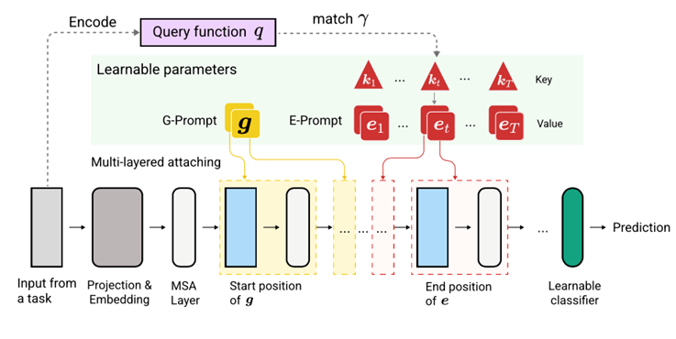
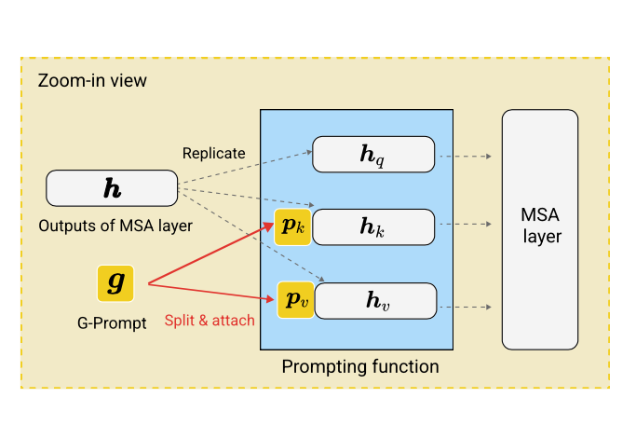

MODEL & LOSS FUNCTION
h_{q,} h_{k,} h_{v} : input to MSA

Slide 10
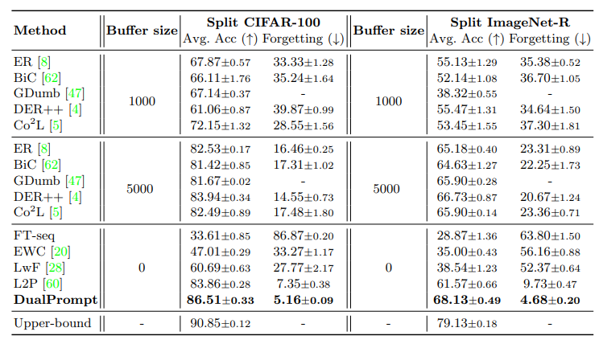
Results on class-incremental learning

Slide 11
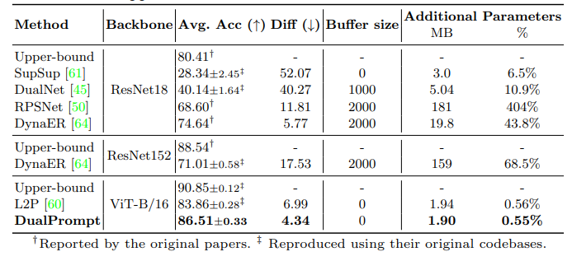
Comparison with architecture-based methods on Split CIFAR-100

Slide 12
Key TAKE AWAY
Take continual learning as Complementary Learning Systems (CLS)
Assumptions:
Task boundary are discrete in nature.
MSA are head have continuous indices.
Prompt are only pre-pended at the beginning .

