Slide 1
Deep Learning for Side-Channel Analysis: Breaking AES-128 Presented By: Robert Okolotowicz
Extracting Cryptographic Keys via Power Consumption Profiling

Slide 2
Agenda
Threat Model & The Data
Neural Architecture & Optimizations
Overfitting Management
Attack Results
Closing Remarks

Slide 3
Summary
Encryption algorithm AES is mathematically secure, but the physical hardware executing it leaks information.
This project successfully weaponized a custom convolutional neural network to analyze power fluctuations and extract a secret 256-bit key.
The key was cracked within10,000 traces, proving the severe risk of side-channel vulnerabilities.

Slide 4
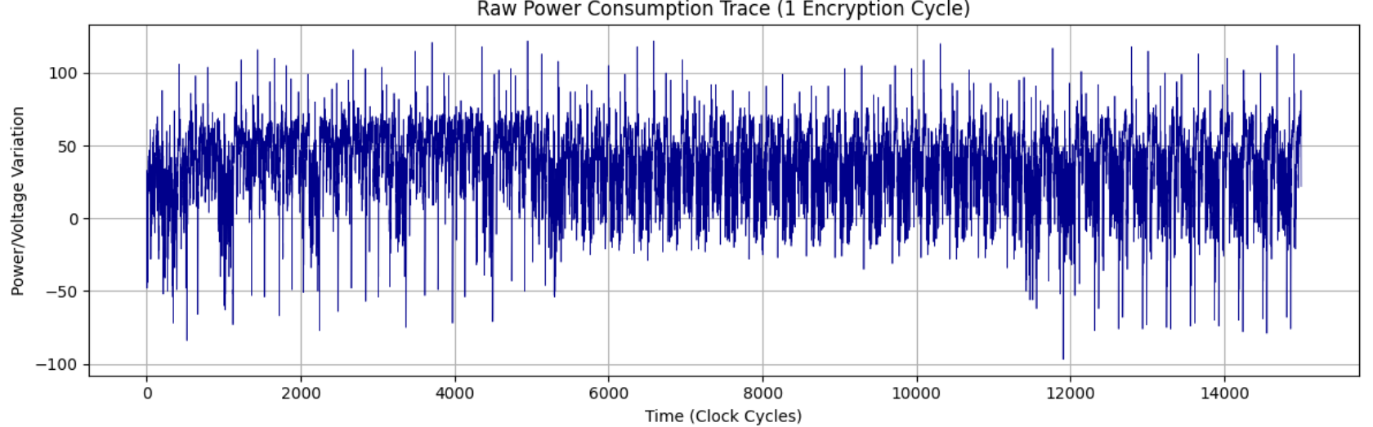
Threat Model & The Data
Listening to the Silicon | ASCAD DATASET
The Data: Univariate time-series data representing power voltage over time (clock cycles)
The Analogy: Using a digital stethoscope to listen to the microscopic electrical spikes as the chip processes the key
The Challenge: The signal to noise ratio is incredibly low. The True key leakage is buried beneath millions of irrelevant electrical operations.

Slide 5
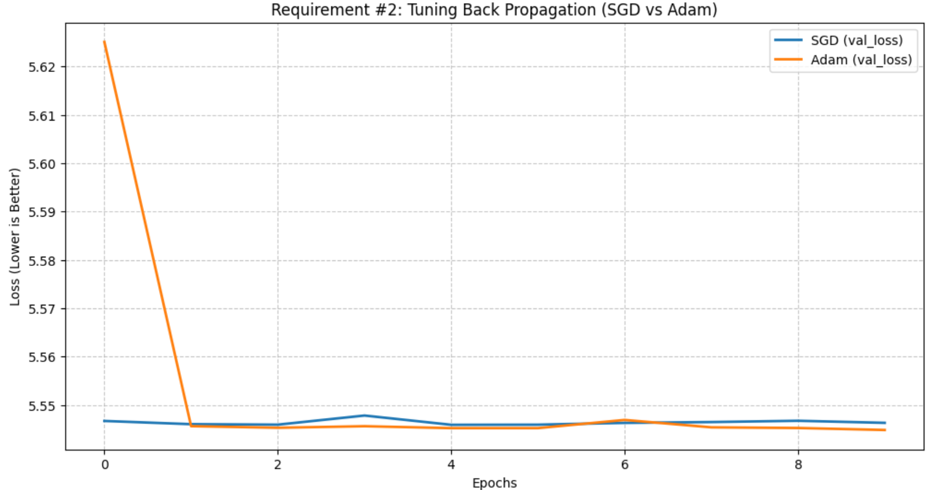
Neural Architecture & Optimization
Engineering the AI for Signal Extraction
Architecture: Built a deep 1D-CNN specifically tuned for time-series anomalies, utilizing SELU and Mixed precision (16bit math) to maximize GPU memory.
Optimizer: Evaluated Stochastic Gradient Descent against ADAM
Result: Adam successfully navigated the noisy gradient landscape, converging significantly faster than SGD's rigid learning rate.

Slide 6
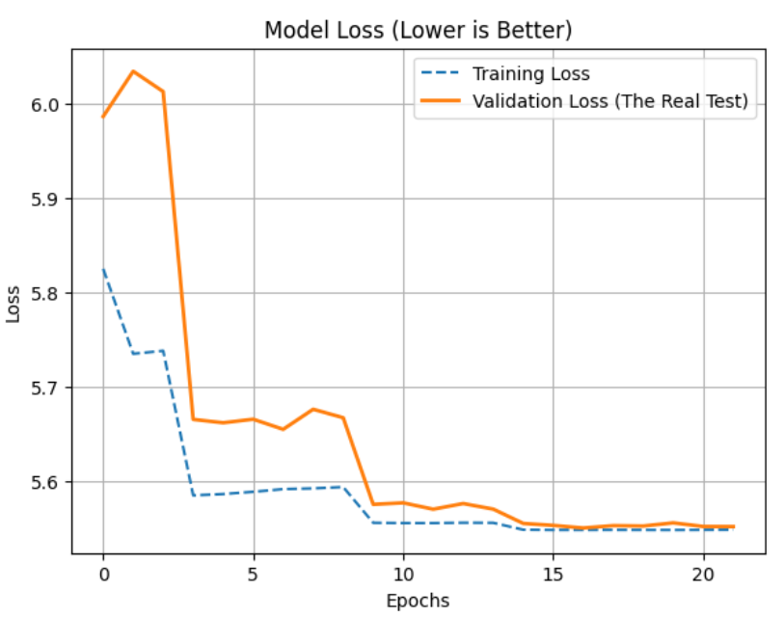
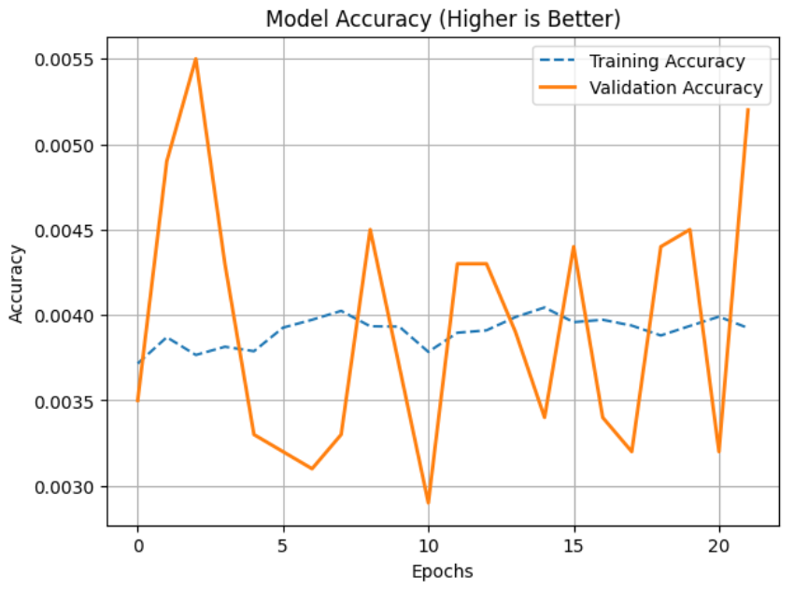
Overfitting Management
Preventing Memorization
Problem: A massive risk in deep learning SCA is the model memorizing the training noise rather than learning the actual cryptographic leakage
Requires Defensive Engineering:
Implemented AlphaDropOut and GlobalAveragePooling1D to force robust feature learning
Triggered Early Stopping, halting the training at Epoch 22 the moment validation loss plateaued
Secured the peak model state using ModelCheckPoint

Slide 7
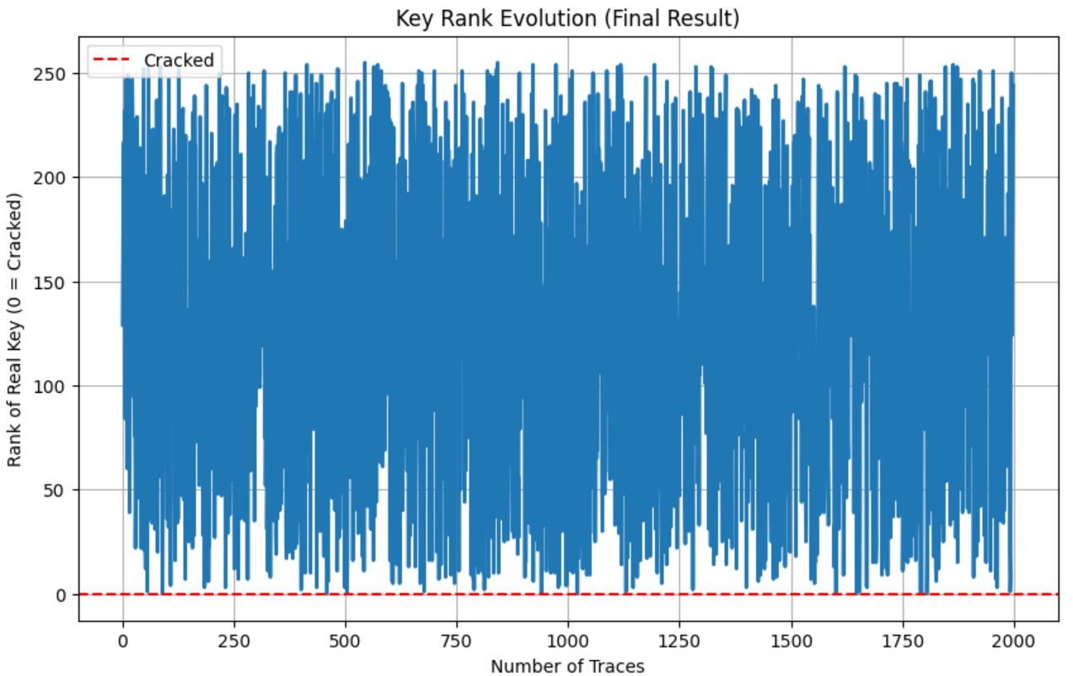
Attack Results
Key Recovery and Rank Evolution
The Rank Evolution Graph showing the blue line dropping to 0
Deployed the trained model against 2,000 blind attacks
Guessing Entropy (Rank). A rank of 244 means the model guess #244 try the correct secret key
Results: The model is guessing blind and illustrates an accuracy trap.

Slide 8
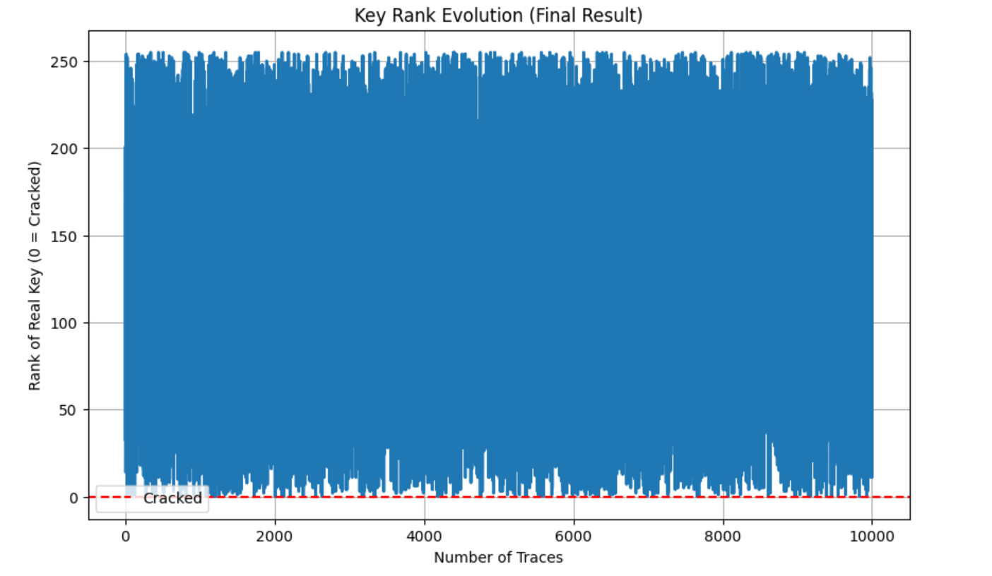
Attack Results
Key Recovery and Rank Evolution
The Rank Evolution Graph showing the blue line dropping to 0
Deployed the trained model against 10,000 blind attacks
Guessing Entropy (Rank) of 32 means the neural network successfully parsed through the noise in the data and eliminated 87.5% of the cryptographic possibilities
Results: The network successfully pierced the noise, locking onto Rank 32 and is breaking the AES-128 encryption key.

Slide 9
Key Differences
2,000 Traces vs 10,000 Traces
Escaping the Accuracy Trap (Val_Loss vs Val_Accuracy 2K trace model used val_accuracy as early stopping monitor [guessing blind] 10K trace model saved using val_loss | Forced Network to optimize entire probability distribution
Fixed the Data Alignment 2K trace model fed raw unscaled electrical traces directly into SELU layers, distorted signal 10K trace model utilized batchnormalization, enabling GPU to standardize data on the fly Changed Attack Math Switched 10K model to probability summation (+= prob) from log-likelihood, treating traces as a democratic vote. Model stopped panicking over outliers and simply allowed consistent faint signals of the correct key to stack up and overpower the noise Law of Large Numbers Once the architecture and math was fixed, the raw volume of data finally became the ultimate lever. ASCADv2 is an intentionally noisy, hardened dataset. 10K traces provided statistical effidence to separate the actually crypto leakage from the hardware static.

Slide 10
Closing Remarks
Rank 32 Eliminated 87.5% of the cryptographic possibilities
If an attacker reduces a 256 Possibility byte down to 32 possibilities, the remaining brute force effort drops from millions of years to milliseconds on a standard laptop. ASCADV2 Utilizes hardware level countermeasures to obfuscate the signal.
By Leveraging a custom SELU network and Probability Summation, I was able to successfully bypass these defenses, reducing the cryptographic key space by 87.5%.
This was achieved with a single RTX 3090. A well-funded adversary scaling this architecture across a cloud GPU cluster would undoubtedly drive this to Rank 0.

