Slide 1
Welcome to our presetation
on
Word Dictionary
CSE207 Sec2

Slide 2
Course instructor
Maheen Islam
Assistant Professor, Dept. of Computer Science and Engineering (CSE)
East west University

Slide 3
Group Members
Kamrul Hasan Id: 2018-1-60-039
Katura Gania Khushbu Id: 2017-3-60-074

Slide 4
Index
Project descripsion
Algorithm
Output
conclusion

Slide 5
Project Descripsion
Dictionary means a reference book listing alphabetically terms or names important to a particular subject or activity along with discussion of their meanings and applications. We have to build a Dictionary by Binary Search Tree. The Dictionary should have different functionalities such as add new word, search word, delete word and find similar meaning word.

Slide 6
Algorithm part-1
//Star Dictionary program
insert words and it's meaning respectively from file;
Loop:
Show main menu
if(insert)
Take word and Meaning
if(exist)
Print "The word is already exist";
else
Adding the word
Print "The word is added";
else if(search)
Take a word
if(found)
print "word and it's meaning";
print "synonym word(s) " ( if exist)
else
print "Suggestion word(s) " (if exist)

Slide 7
Algorithm part-2
else if(Delete)
Take word to be deleted
if(exist)
Deleting
print "The word is deleted"
else
Print "The word does not exist";
else if(exit)
Print "THANK YOU";
break;
else
print "Invalid option"
continue ;
end of loop
Update file
//End of program

Slide 8
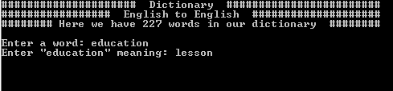
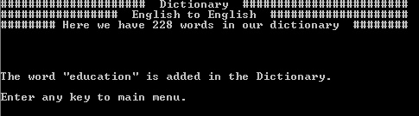
Output
Insert:

Slide 9
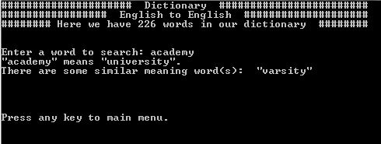
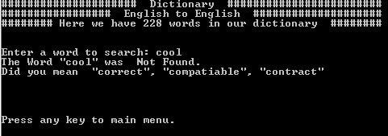
Output
Search:

Slide 10
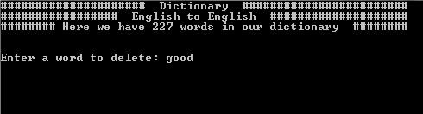
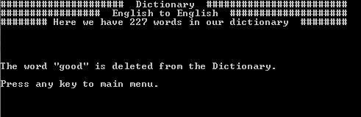
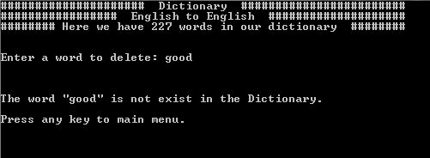
Output
Delete:

Slide 11
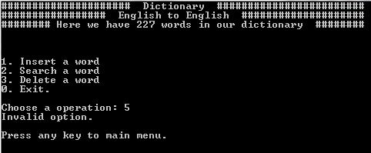
Output
Invalid option:

Slide 12
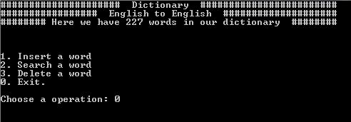
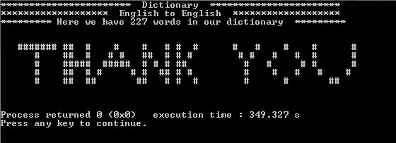
Output
Exit:

Slide 13
Conclusion
We used Binary Search Tree in C language to build our Dictionary. We felt some limitation at the time of build this Dictionary. It can't match lower case and upper case letter. It's some operation has O(n) time complexity. It has not a good user interface. It's just a normal English to English Dictionary. We can't control file at run the program. For real life use, we can use database management System in this Dictionary. If we can store meaning words in another Binary Search Tree and make link between them then it's time complexity will be O(log n) .

Slide 14
