Slide 1
FOUNDATIONAL ARCHITECTURE & REPRESENTATION LEARNING
1
2
From understanding to judgment
3
4
Nine foundation papers, five ideas, and how to use them to predict a model before you train it
5
Roksana Mirzaei · October 2026
Read the summary page ↗
Open the Papers Atlas ↗
Notes:
Opening. This talk closes the foundational architecture section. We have gone through the maths of nine papers. Today is about what we carry away from that: five ideas that keep coming back, and how to use them to predict how a model will behave, what it will cost and where it will break. Two companion files: the summary page has every detail and number from this talk, and the Papers Atlas is the interactive family tree of the papers. Both are linked on this slide and at the end.

Slide 2
We learned the math. So what?
UNDERSTANDING
JUDGMENT
Explain and rebuild a mechanism
Pick a mechanism under constraints and predict the consequence
“I can derive online softmax and code FlashAttention's forward pass.”
“Decode is memory-bound, so batching will help and a GPU with more FLOPs won't.”
Implementations are everywhere. Judgment is the missing piece, and it is what separates an engineer from a parrot.
Notes:
Understanding means you can explain and rebuild a mechanism. Judgment means you can choose one under real constraints and predict the consequence before you see it. You can find a thousand implementations online. What you cannot download is the ability to look at a new design and say what it will do. That is what this talk is about.

Slide 3
The goal: predict before you spend a GPU hour
1
2
3
Then design the experiment that checks it
How will it behave?
What will it cost?
Where will it break?
Training stability, what it learns, what it can and can't see
FLOPs, memory, tokens per second
Long context, small data, scale, production edge cases
Use research the way an engineer uses physics: to predict, then to measure.
Notes:
This is the goal of the whole exercise, and of the summary page. Before spending a single GPU hour I want to answer three questions about any model: how it will behave, what it will cost, and where it will break. Then I design the cheapest experiment that could prove me wrong. We will end the talk by doing exactly this on a hypothetical paper.

Slide 4
Where we've been: the Papers Atlas
An interactive family tree of the foundation papers. Click any paper to see its mechanism diagram, a worked example and the maths, with arrows showing which idea it inherited.
The nine papers we studied in depth
Transformer
ResNet
BERT
2017
2015
2018
Live tip: click GPT-2, then Mamba, and compare their mechanism cards.
GPT-2
ViT
Scaling laws
2019
2020
2020
Open the Papers Atlas ↗
MoE
FlashAttention
Mamba
2017
2022
2023
Notes:
Quick recap of where we have been. Open the Atlas here if you want to show the tree live: it is the HTML file in the same folder as this deck. Click a node such as GPT-2 or Mamba to show its mechanism card. These nine are the ones we went through in depth. Everything else in the tree, like LLaMA, Swin or Mixtral, is a variation on them.

Slide 5
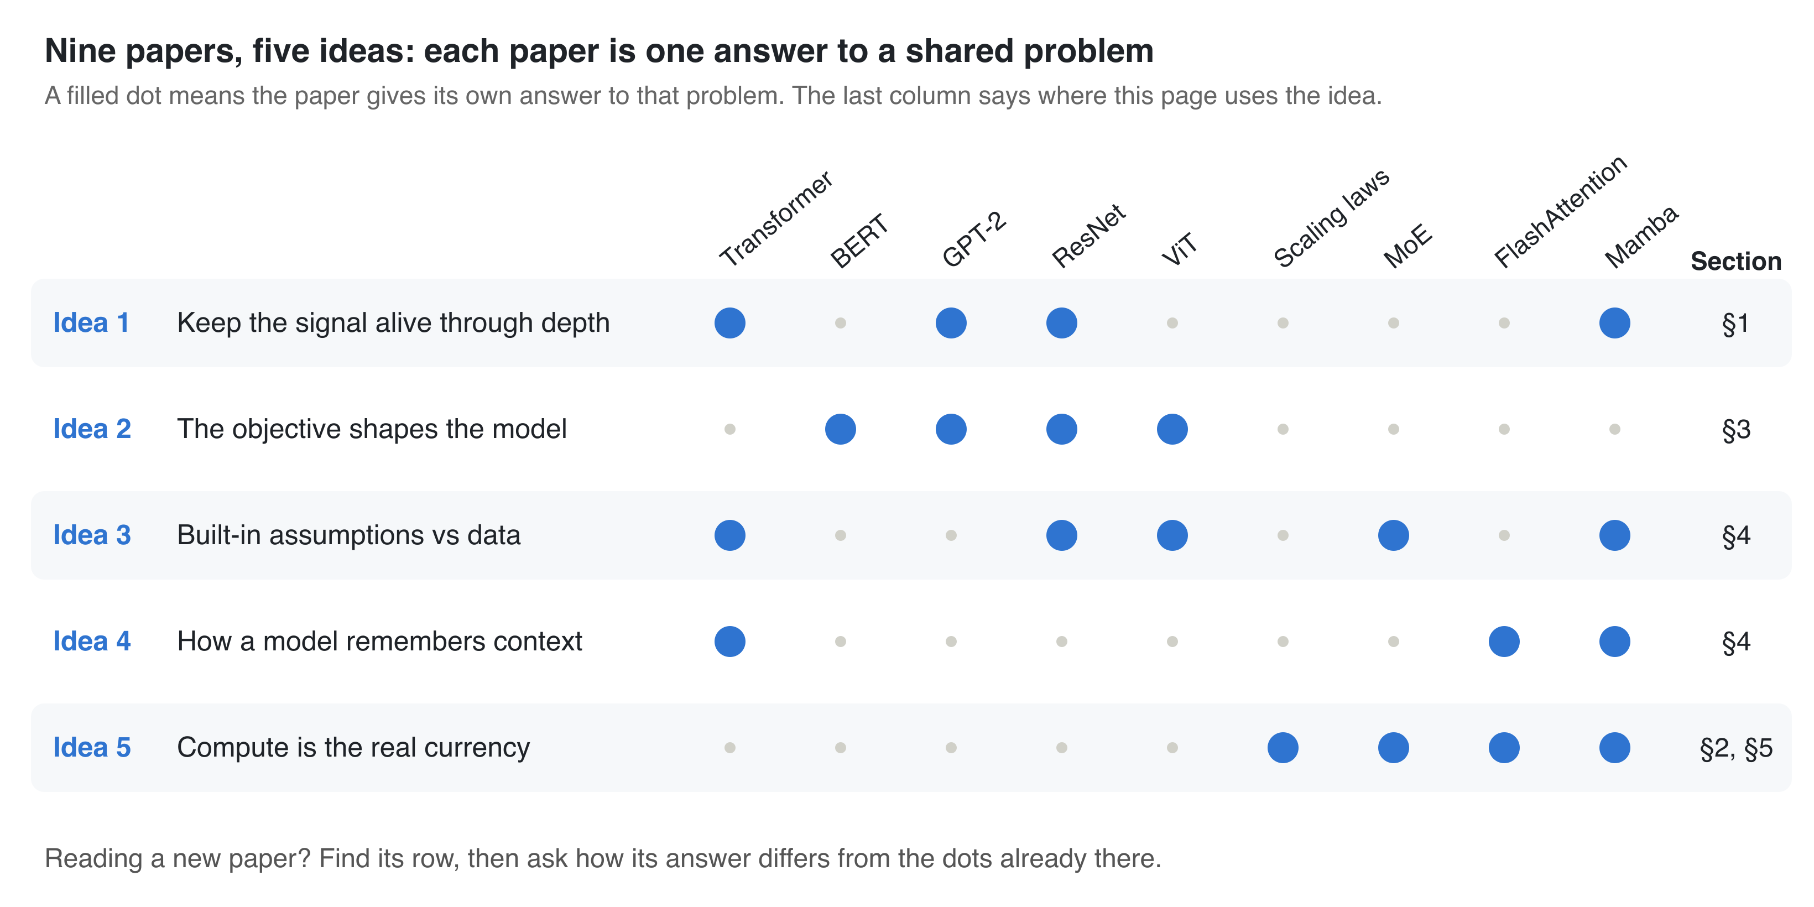
Nine papers, five ideas
In the summary: the map ↗
Notes:
This is the core picture. Each row is a problem every model has to solve. Each dot is a paper giving its own answer to it. Mamba shows up in four rows, which is why it felt like so much to learn. When you read a new paper, find its row first, then ask how its answer differs from the dots already there. That turns a new paper into a diff against something you already know.

Slide 6
Five problems every model has to solve
Keep the signal alive through depth
What keeps activations and gradients at a sane scale as the model gets deeper?
1
The objective shapes the model
What exactly does the loss reward, and what behaviour will follow?
2
Built-in assumptions vs data
What does this model assume, and do I have enough data to not need it?
3
How a model remembers context
How much state does it keep per token of history, and what does reading it cost?
4
Compute is the real currency
Is this limited by compute or by memory bandwidth?
5
Notes:
Each idea comes with one question. These five questions are the take-home. By the end of the talk each one will have a concrete engineering decision attached to it. Order in the talk: Idea 1 with LayerNorm, Idea 5 with GPU memory, Idea 2 with encoders and decoders, then Ideas 3 and 4 through production failures, and finally we put all five together.

Slide 7
Inside the ideas, five motifs keep coming back
Skip connection
Gating
Store vs recompute
ResNet, LSTM cell state, Pre-LN, the residual stream
LSTM gates, SwiGLU, Mamba's gate branch, the MoE router
Gradient checkpointing, FlashAttention backward, Mamba's scan
Conditional computation
Normalising scale
MoE, sparse attention, Mamba's input-dependent selection
BatchNorm, LayerNorm, RMSNorm, QK-norm
When a paper looks new, it is often one of these in a new place.
Notes:
One level below the ideas, the same building blocks repeat. Skip connections appear from ResNet to the LSTM cell state. Gating appears from LSTMs to SwiGLU to the MoE router. Store versus recompute is how FlashAttention and Mamba both save memory. Spotting these is the fastest way to read a new architecture.

Slide 8
1
IDEA 1
Keep the signal alive through depth
The question to ask: What keeps activations and gradients at a sane scale as the model gets deeper?
Notes:
First idea: keeping the signal alive through depth. The engineering decision it drives most often is where to put the normalisation layer.

Slide 9
Small scale errors compound over 48 layers
IDEA 1
1.1⁴⁸ ≈ 97×
THE FIX: SKIP CONNECTIONS
x₃ = x₀ + F₁ + F₂ + F₃
10% growth per layer: activations explode
Each block adds to the residual stream instead of overwriting it.
The original input is still in the output, untouched.
The gradient flows back through the skips without being multiplied, so it reaches layer 1 at full strength.
0.9⁴⁸ ≈ 0.006
10% shrink per layer: gradients vanish
In the summary: §1 LayerNorm ↗
Notes:
A deep network is a long chain. A 10 percent change per layer becomes 97 times after 48 layers, or 0.006 in the other direction. Gradients travel the same chain, so they explode or vanish the same way. ResNet's skip connection fixes this: each block adds its work on top of the stream, so the original input and the gradient both pass through untouched. Without skips, 48 layers with a derivative of 0.5 each gives 0.5 to the 48, which is effectively zero, and the early layers stop learning.

Slide 10
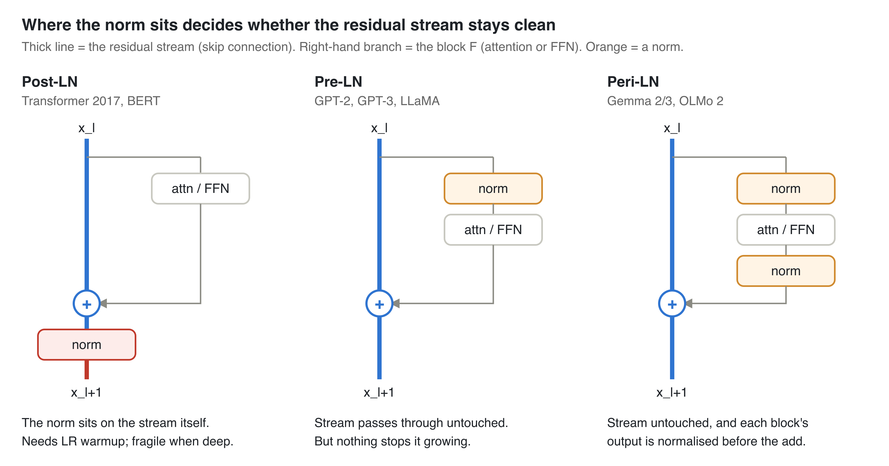
Where the norm sits decides how a model trains
IDEA 1
Post-LN
Only to reproduce a BERT-era model. Needs warmup; fragile when deep.
Pre-LN
The default, with RMSNorm. Stable from step 1.
Peri-LN
When Pre-LN shows loss spikes at scale.
Look for one thing: does the plain x pass outside every norm? That is the clean gradient path.
In the summary: §1 LayerNorm ↗
Notes:
Three answers to the same question. Post-LN, from the original Transformer and BERT, puts the norm on the stream itself, so the input gets rescaled at every layer. Xiong et al. 2020 showed this makes gradients near the output large at init, which is why it needs learning-rate warmup. Pre-LN, from GPT-2 on, moves the norm inside the branch, so the stream stays clean. The catch: nothing ever rescales the stream, so its norm grows with depth, deep layers do less, and huge activations can cause loss spikes. Peri-LN, used in Gemma 2 and 3, also normalises each block's output before the add. My recommendation: Pre-LN with RMSNorm by default, Peri-LN output norm and QK-norm if you see spikes.

Slide 11
Every paper answers Idea 1 its own way
IDEA 1
ResNet
x + F(x)
Transformer
QKᵀ / √dₖ
Skip connections give the gradient a direct route to early layers.
Without it, scores have variance ≈ dₖ, softmax saturates and gradients die.
GPT-2
Pre-LN + 1/√N init
Mamba
Ā = exp(ΔA), A < 0
Each of N blocks adds variance to the stream, so scale their output weights down.
The decay always stays between 0 and 1, so the recurrence can't blow up.
Notes:
This is what I mean by syncing the papers to the ideas. Four papers, four different mechanisms, one shared problem: keep the scale sane. The scaled dot product is the one people forget: a dot product of two d_k dimensional vectors has variance around d_k, so without dividing by root d_k the softmax becomes nearly one-hot and its gradients vanish.

Slide 12
Catch it in the per-layer logs, before the loss curve
IDEA 1
Problem | What you see in the per-layer logs
Post-LN blowing up | Very large gradient norms in the top layers in the first few hundred steps
Pre-LN stream growing | Activation norm climbing steadily with layer number
Loss spike coming | One layer's activation norm suddenly jumping
ASK ABOUT ANY NEW ARCHITECTURE
Does x pass through untouched somewhere?
If a norm sits on the skip, expect warmup and fragility at depth.
What stops the residual stream growing?
If nothing does, expect lazy deep layers and loss spikes at scale.
Log activation and gradient norm per layer: a forward hook and a loop over named_parameters. The code is on the summary page.
In the summary: §1 logging code ↗
Notes:
This is how Idea 1 becomes something you do on Monday. When a run diverges or stalls, check scale first. Each failure shows up in per-layer norms before the loss curve looks bad. The two questions on the right predict how a new architecture will train before you run it.

Slide 13
5
IDEA 5
Compute is the real currency
The question to ask: Is this limited by compute or by memory bandwidth?
Notes:
Idea 5. Capability is bought with FLOPs and bytes. The trap is to count only FLOPs. On a GPU, the bytes you move are often the real bill.

Slide 14
The GPU does 295 FLOPs in the time it reads 1 byte
IDEA 5
989 TFLOP/s
3.35 TB/s
295 FLOPs/byte
H100 dense BF16 compute
HBM memory bandwidth
the ridge point: compute ÷ bandwidth
Above 295 FLOPs/byte: compute-bound
Only fewer or cheaper FLOPs help (FP8, smaller model).
Below: memory-bound
Only moving fewer bytes helps. A GPU with more FLOPs but the same bandwidth won't speed it up.
In the summary: §2 HBM vs SRAM ↗
Notes:
A GPU has two memories. HBM is big and off-chip, 80 GB on an H100, and holds weights, activations and the KV cache. SRAM is tiny and on-chip, next to the compute units. Everything has to be read from HBM into SRAM to be computed on. Divide compute by bandwidth and you get about 295. That gives a one-number test called arithmetic intensity: FLOPs divided by bytes moved. Above 295, you are compute-bound. Below, the GPU is idle waiting for memory.

Slide 15
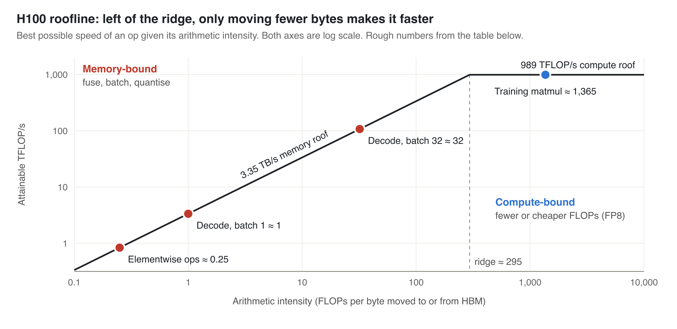
The roofline tells you which fix will work
IDEA 5
Low GPU utilisation?
Ops are below the line: fuse, batch, move fewer bytes.
Faster inference?
Decode is memory-bound: quantise and batch. Prefill is the opposite.
Picking a GPU?
Serving: bandwidth first. Large-batch training: FLOPs.
Reading a paper?
GQA, MLA, KV quantisation and fusion are about bytes, not FLOPs.
In the summary: §2 roofline ↗
Notes:
The roofline. Find your op's intensity on the x-axis: the line above it is the fastest it can ever run. Elementwise ops and batch-1 decode sit far left, memory-bound. A big training matmul sits on the flat compute roof. Notice that batching slides the decode dot to the right: read the weights once, use them for 32 tokens. You rarely need an exact number; a rough guess like each weight is used once per token, so about one FLOP per byte, is enough.

Slide 16
Worked example: decoding Llama-2-7B at batch 1
IDEA 5
13.5 GB
÷ 3.35 TB/s
≈ 250 tok/s
weights (6.74B × 2 bytes)
every weight read once per token
ceiling; you'll measure less
That one division explains the standard serving tricks:
int4 weights
Batch 32 requests
FlashAttention
4× fewer bytes
up to ~4× faster decode
read weights once, emit 32 tokens
close to 32× throughput
intermediates stay in SRAM
no HBM round trips
In the summary: §2 worked example ↗
Notes:
Here is Idea 5 as arithmetic. Each new token is one forward pass that reads every weight once. 13.5 gigabytes divided by 3.35 terabytes per second gives a ceiling of about 250 tokens per second. Compute barely matters: 13.5 GFLOPs per token is nothing for this chip. So quantising to int4 gives up to 4x, and batching 32 requests gives close to 32x throughput, until KV cache reads or compute take over. That is exactly what continuous batching in vLLM exploits. It also explains why prefill feels different: prefill is a big parallel matmul, compute-bound, and sets time to first token. Decode is memory-bound and sets tokens per second.

Slide 17
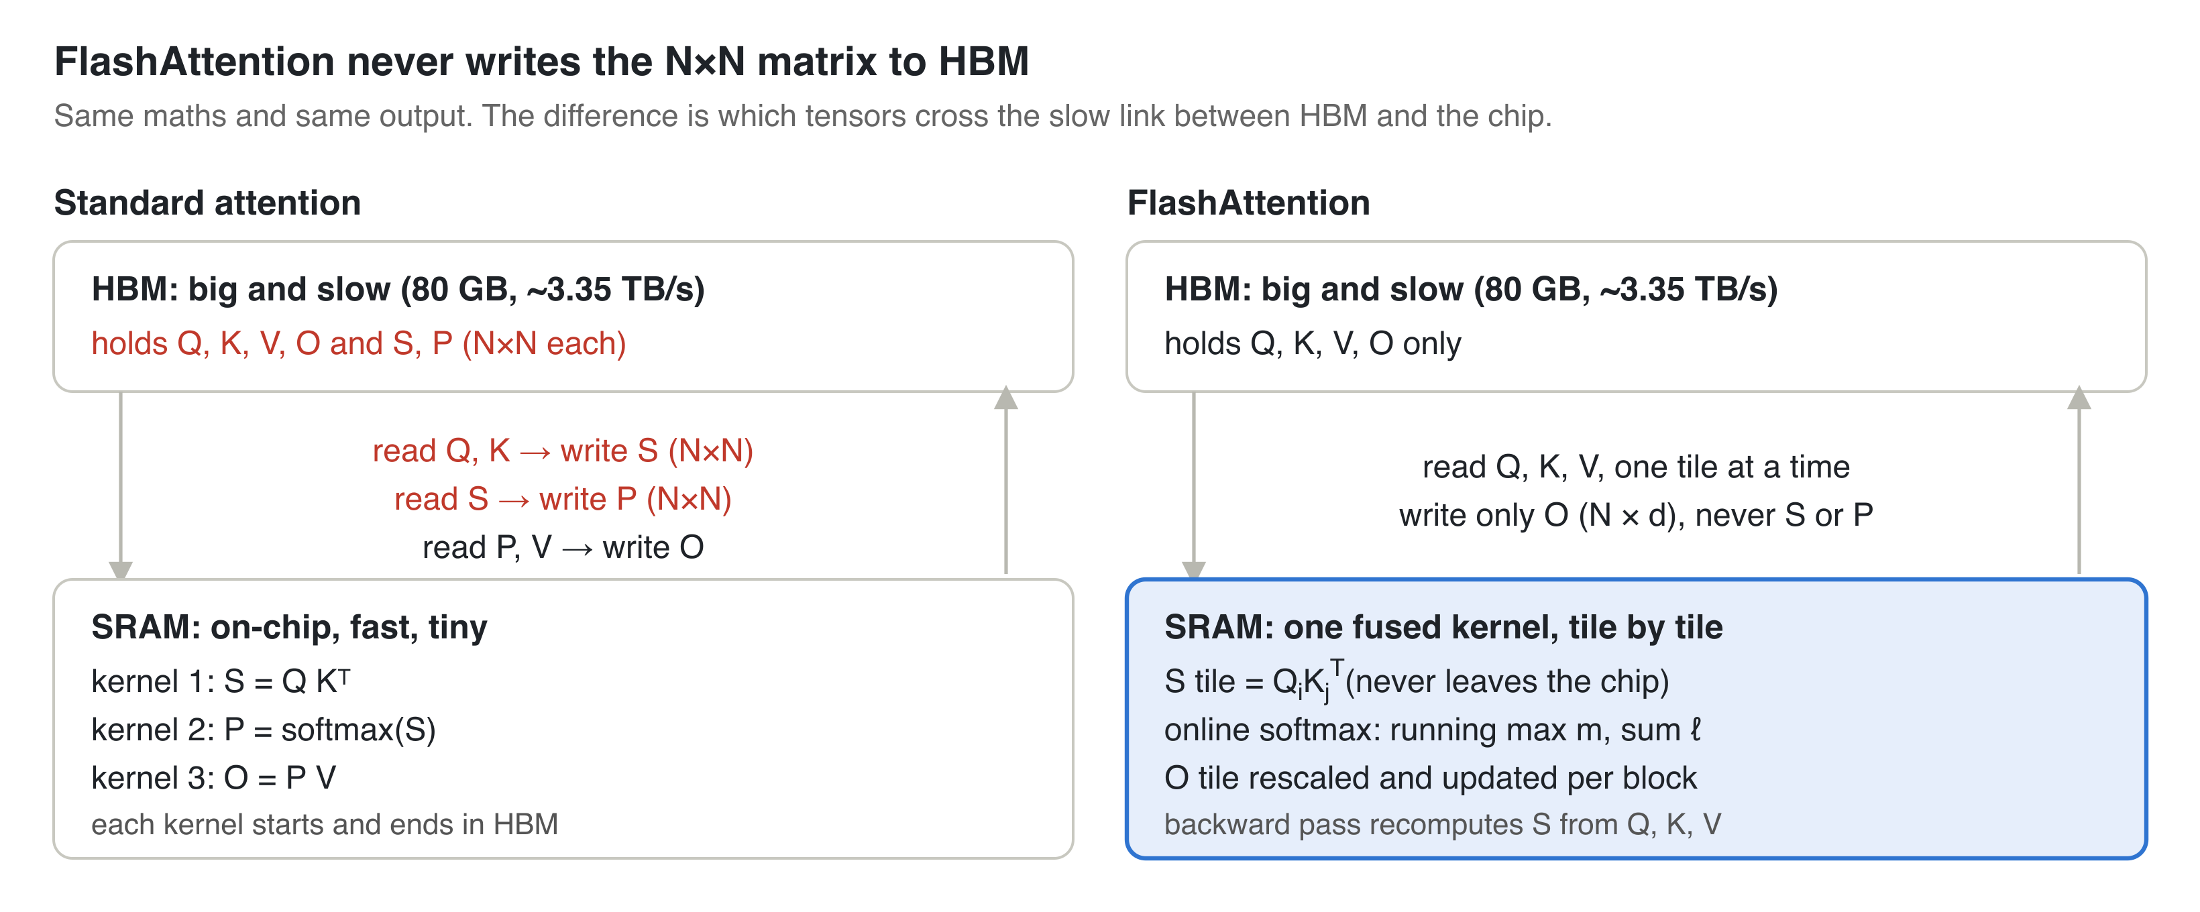
FlashAttention: same FLOPs, far fewer bytes
IDEA 5
Exact, not an approximation
Same output as standard attention.
Memory linear in N
The N×N matrix never exists in HBM.
Up to 7.6× faster attention
Reported on GPT-2, purely by moving fewer bytes.
In the summary: §2 FlashAttention ↗
Notes:
Standard attention runs three kernels. The N by N score matrix S and the probability matrix P are written to HBM and read back. At N equals 8192 that is 67 million scores per head, about 134 megabytes in FP16, for every head in every layer. FlashAttention fuses everything into one kernel, works in tiles that fit in SRAM, and writes only the output O. In the backward pass it recomputes the scores instead of storing them: more FLOPs, far fewer bytes, faster overall. Note what it does not change: what attention remembers. That is Idea 4, coming later.

Slide 18
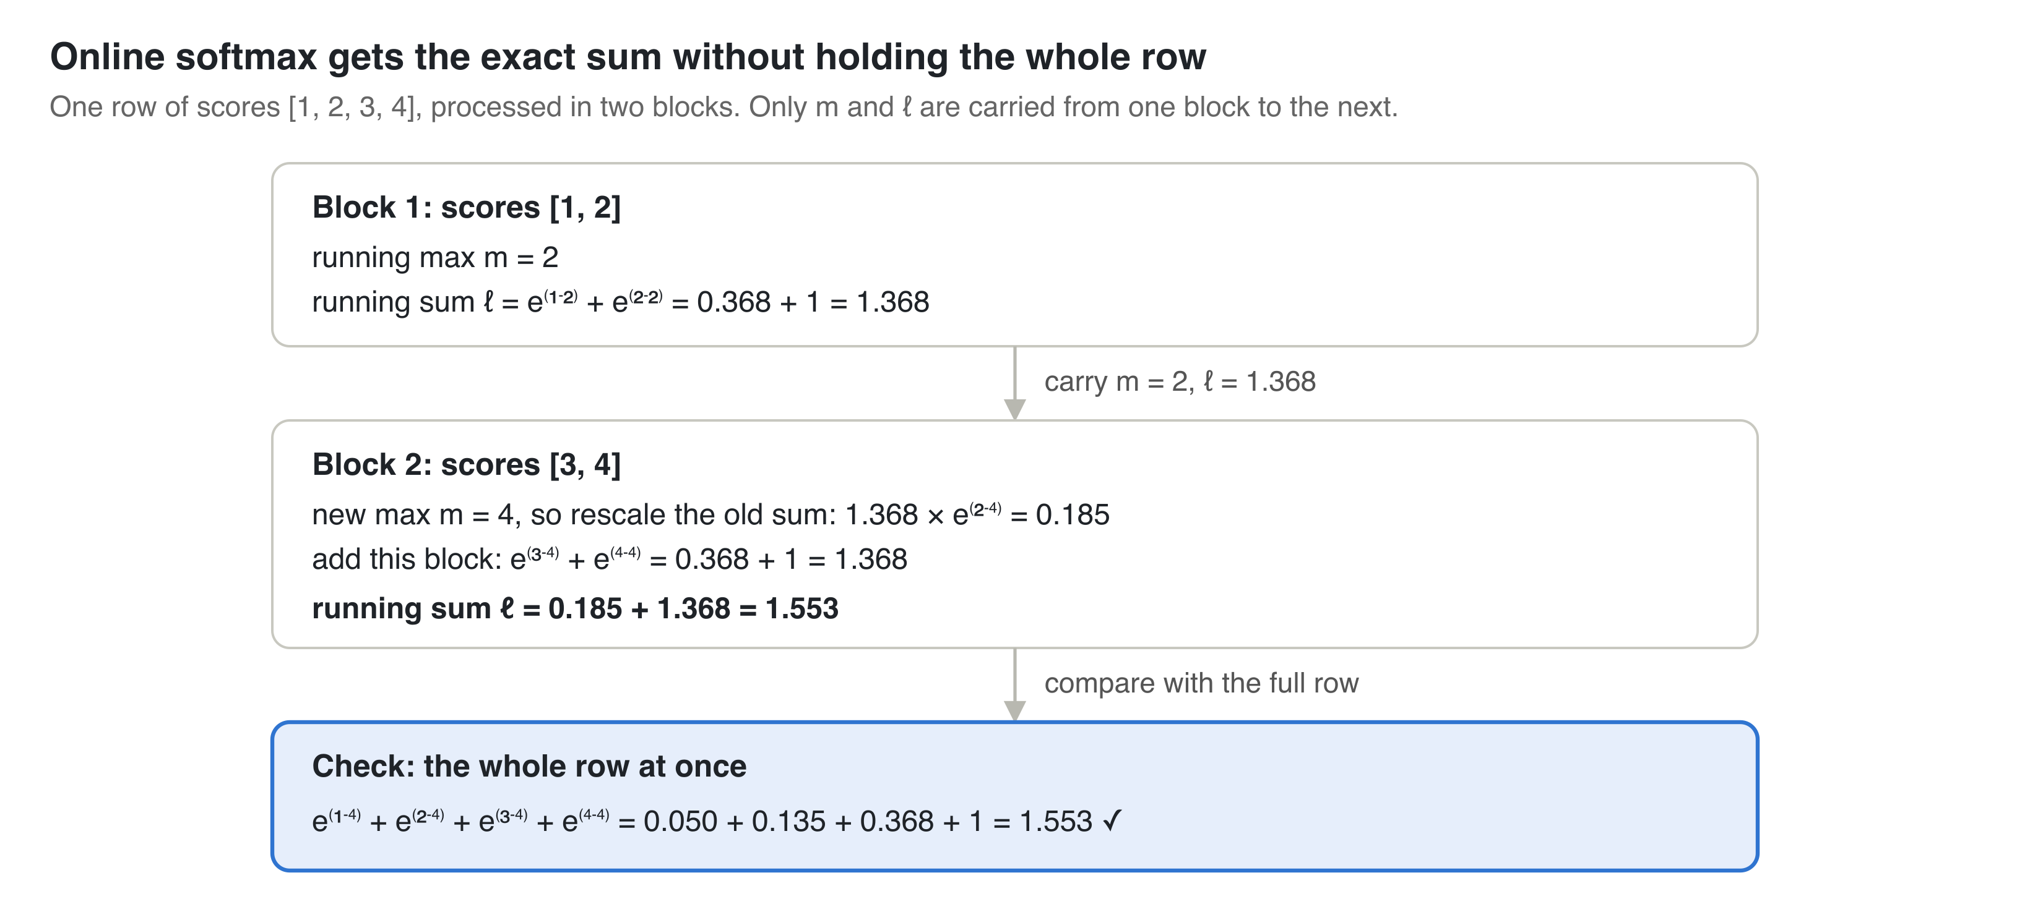
The trick that makes it possible: online softmax
IDEA 5
Carry only two numbers per row
the running max m and running sum ℓ.
When the max changes, rescale the old sum by e^(old m − new m).
Softmax didn't look splittable. This makes it split exactly.
In the summary: §2 online softmax ↗
Notes:
Walk through the numbers. One row of scores, 1 2 3 4, processed in two blocks. Block one: max is 2, sum is 1.368. Block two: the max becomes 4, so we rescale the old sum by e to the minus 2 and add the new terms. We get 1.553, exactly the same as summing the whole row at once. Only m and l travel between blocks. This is the mathematical idea in the paper; the tiling is the engineering.

Slide 19
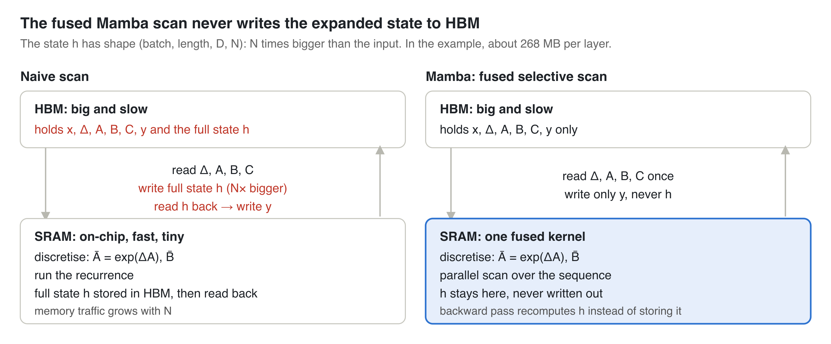
Mamba uses the same trick for its scan
IDEA 5
~N×
less memory traffic (16× at N = 16)
The expanded state is N times bigger than the input. The fused kernel keeps it in SRAM and writes only y back to HBM.
In the summary: §2 Mamba ↗
Notes:
Mamba's selective state space model keeps a state of size N per channel, so the expanded state is N times bigger than the input. At length 2048, 4096 channels and N equals 16 that is about 268 megabytes per layer if you write it to HBM. Because delta, B and C depend on the input, Mamba can't use S4's convolution shortcut, so it must run a scan. The fused kernel loads the small inputs, runs the parallel scan in SRAM, writes only the output y, and recomputes the states in the backward pass. Same pattern as FlashAttention.

Slide 20
The recipe for making anything faster
IDEA 5
1
2
3
4
5
6
Find the slow op
Find the big intermediate
Split the math exactly
Fuse and tile
Recompute in backward
Check and measure
Profile; check arithmetic intensity
N×N scores; the N× state
Online softmax; associative scan
One kernel, tiles fit in SRAM
Keep small stats, rebuild the rest
Match the reference; plot vs length
Step 3 is the real idea. The rest is engineering.
Try the cheap options first: torch.compile, PyTorch's scaled_dot_product_attention and FlexAttention. Write a Triton kernel only if those don't cover it.
In the summary: §2 the recipe ↗
Notes:
FlashAttention and Mamba followed the same six steps. Find the slow op and check it is memory-bound. Find the tensor that is much bigger than inputs and outputs. Then the hard part: rewrite the maths so partial results combine exactly. Fuse into one kernel, recompute in the backward pass, and check against a simple reference. Day to day you will rarely write a kernel, but you will decide batch size, quantisation, the attention backend, and why MFU is low, and this recipe explains all of those.

Slide 21
2
IDEA 2
The objective shapes the model
The question to ask: What exactly does the loss reward, and what behaviour will follow?
Notes:
Idea 2. The architecture decides what a model can represent. The loss decides what it actually learns to do. BERT and GPT-2 use almost the same block.

Slide 22
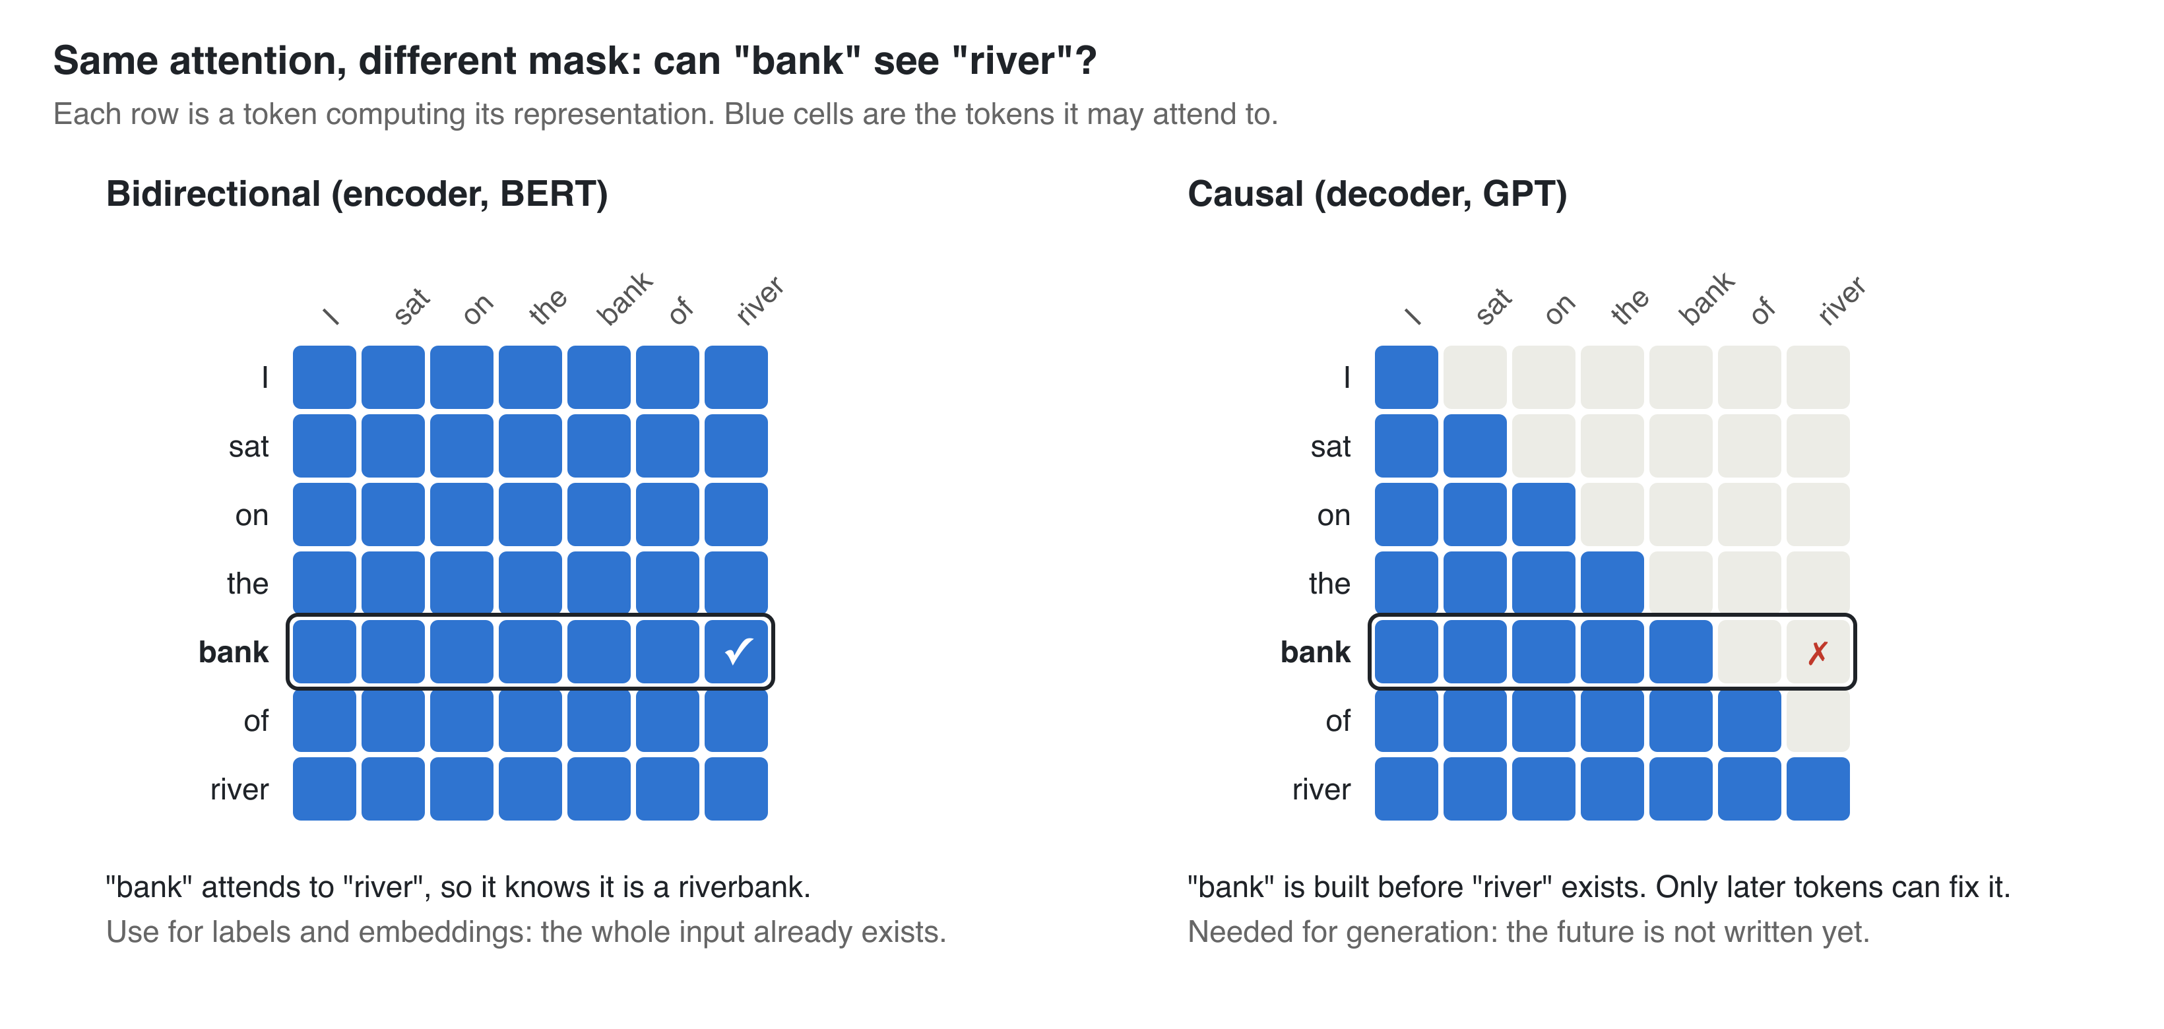
Same attention, different mask
IDEA 2
Output is a label or embedding?
The input already exists. Use bidirectional.
Output is generated text?
The future isn't written yet. Use causal.
In the summary: §3 encoder or decoder ↗
Notes:
The attention maths is identical in BERT and GPT. The only difference is the mask. In a causal model, the hidden state for bank is built before river is visible, so it can't tell a riverbank from a money bank. In an encoder, bank attends to river directly. A decoder can still classify by reading the last token, which has seen everything, but every earlier position only saw its left context.

Slide 23
Pick the architecture by the output
IDEA 2
Use case | Output | Good default
Classification, sentiment, NER | Label per text or token | Fine-tuned encoder (ModernBERT, DeBERTa)
Retrieval for RAG | One embedding per text | Bi-encoder (Sentence-BERT, E5)
Reranking top-k | Score per (query, doc) | Cross-encoder
Speech-to-text, translation | Text from another input | Encoder-decoder (Whisper, T5)
Chat, code completion | Generated text | Decoder-only (GPT, LLaMA, Qwen)
The loss predicts behaviour too
Hallucination is what next-token loss rewards: a plausible continuation, not a true one.
BERT trains on only ~15% of tokens. GPT-2 trains on every token.
At volume, start with a fine-tuned encoder. Use an LLM when you need reasoning, generation or zero-shot.
In the summary: §3 the use-case table ↗
Notes:
The practical rule as a table. For classification or retrieval at millions of items, a fine-tuned encoder of 100 to 400 million parameters is cheap and strong. Many of the strongest embedding models now come from decoder LLMs: more accurate, but tens of times more expensive per item, so measure whether you need the gain. On the right, the objective predicting behaviour: hallucination is exactly what next-token loss rewards, and a base model doesn't follow instructions until it is instruction-tuned.

Slide 24
IDEAS 2 TO 5 IN PRODUCTION
Most “weird” LLM behaviour traces back to one idea
The question to ask: Which of these will my product hit first, and is the fix in the model, the data or the system around it?
Notes:
Now the payoff in production. If you know the design choice behind a failure, you can predict it before a user files a bug.

Slide 25
Symptom, cause, fix: name the idea
Symptom | Root cause | Mitigation | Idea
Long prompts slow; OOM at long context | O(n²) prefill; KV cache grows | RAG, prefix caching, GQA/MLA | 4
Facts in the middle get missed | Attention favours start and end | Key info first or last | 4
Confident hallucinations | Loss rewards likely, not true | Grounding, verification, evals | 2
Knows “A is B”, not “B is A” | Only ever trained left to right | Fine-tune on both directions | 2
Can't count letters | BPE tokens, not characters | Tool use: run code | 3
Poor from scratch on small data | Weak inductive bias | Fine-tune a pretrained model | 3
Fails hard problems answered directly | Same compute per token | Reasoning tokens (CoT) | 5
Latency floor per output token | Decode is memory-bound | Batching, quantisation, speculative decoding | 5
In the summary: §4 production limits ↗
Notes:
Eight production symptoms, each tied to one idea. The first two rows are Idea 4, how the model remembers context. Lost in the Middle is Liu et al. 2023. Hallucination and the Reversal Curse, Berglund et al. 2023, are Idea 2, the objective. Letter counting and small-data failure are Idea 3, built-in assumptions: BPE decides the model never sees single characters. The last two are Idea 5: the same compute per token regardless of difficulty, and memory-bound decoding. Ideas 3 and 4 don't have their own section yet, so the next two slides cover them.

Slide 26
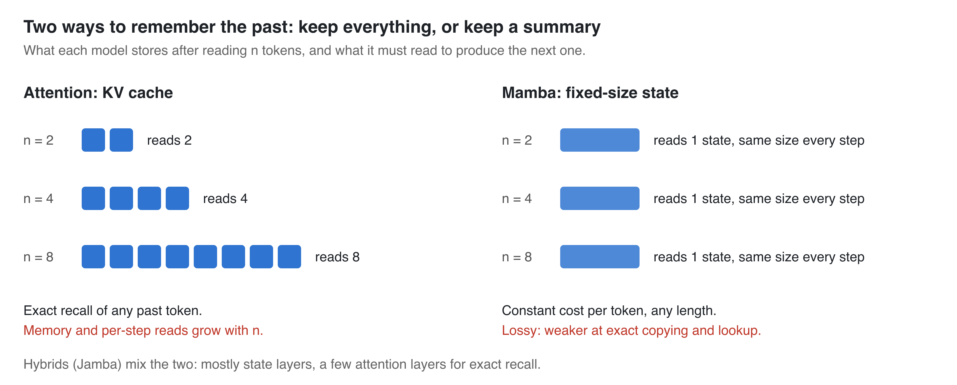
Two ways to remember the past
IDEA 4
Exact retrieval matters?
Code, RAG, long documents: favour attention.
Very long or streaming input?
Some loss is fine: favour SSMs or hybrids like Jamba.
Mamba's real contribution: what gets written into the state depends on the input.
In the summary: §4 Idea 4 ↗
Notes:
Idea 4. Attention keeps K and V for every past token. Lookup is exact, but prefill is quadratic, the cache grows with every token, and every decode step reads all of it. Mamba compresses history into a fixed-size state: constant cost per step at any length, but lossy, so weaker at exact copying and recall. Hybrids like Jamba use mostly Mamba layers plus a few attention layers for exact recall. FlashAttention doesn't change any of this; it only computes attention more efficiently.

Slide 27
Assumptions save data, then become a ceiling
IDEA 3
ResNet (CNN)
Assumes locality and weight sharing. Very data-efficient.
ViT
Assumes almost nothing. Loses to ResNet on ImageNet-1k alone; wins after pretraining on JFT-300M.
Transformer
word order via positional encoding; BPE units
Mamba
history fits in a fixed-size state
MoE
inputs fall into groups experts can own
Rule: little data, buy assumptions. Lots of data, drop them. And check recipes were equal before you believe an architecture win.
In the summary: §4 Idea 3 ↗
Notes:
Idea 3. Every architecture assumes something. When it's right, it saves data; with lots of data it becomes a ceiling. ResNet versus ViT is the classic example. The last point matters for reading papers: ConvNeXt showed that a ResNet with a modern training recipe and design tweaks can match Swin. So before you believe an architecture win, check the training recipes were equal.

Slide 28
Six numbers to cost a design before you build it
IDEA 5
C ≈ 6ND
16 B/param
0.5 MiB/token
Training FLOPs
Training memory with Adam
KV cache, Llama-2-7B FP16
Llama-2-7B: ≈ 8.1×10²² FLOPs, a normal 39% MFU
7B needs ≈ 112 GB: shard it
4K tokens = 2 GiB; GQA-8 is 4× smaller
BW ÷ bytes
46.7B / 12.9B
20 tok/param
Decode ceiling
MoE: total vs active
Chinchilla optimum
tokens/s ≤ bandwidth ÷ (weights + KV)
Mixtral: pay memory for all, compute for few
serving models train far past it on purpose
In the summary: §5 estimates ↗
Notes:
Ideas 5 and 4 in numbers. Before anyone writes code, someone asks: will it fit, and what will it cost? Six estimates. Training compute 6ND: Llama-2-7B gives 8.1 times 10 to the 22, and Meta's reported 184,320 A100 hours works out to 39 percent MFU, which is normal, so the formula holds. If you're off by 10x you've missed a term. KV cache: 2 times layers times KV heads times head dim times bytes. The MoE caveat: it is only cheap per token when the batch keeps all experts busy.

Slide 29
PUTTING IT TOGETHER
Predict, then measure
The question to ask: Can I predict what this paper's model will do, and how would I check?
Notes:
Now we use all five ideas at once on a paper we have never seen.

Slide 30
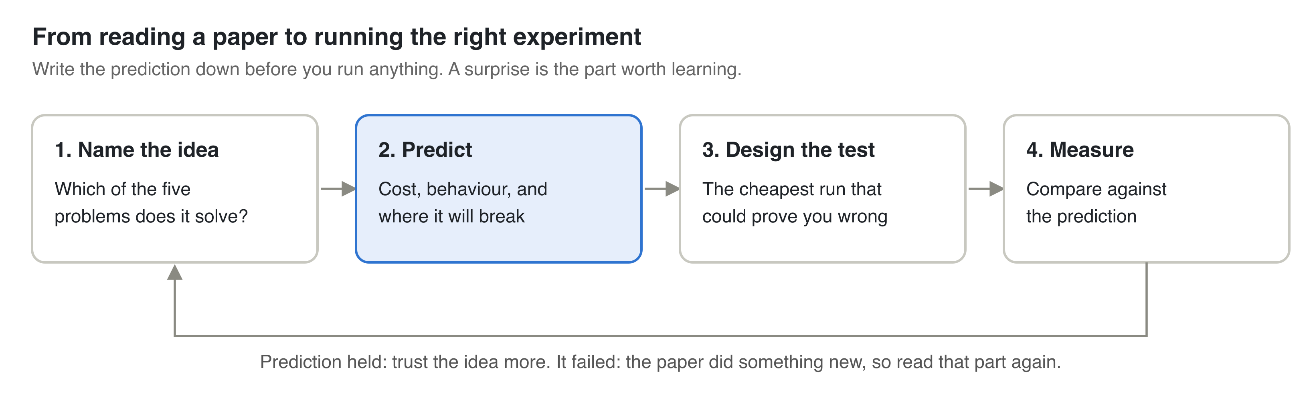
From reading a paper to running the right experiment
Write the prediction down before you run anything. If it held, trust the idea more. If it failed, the paper did something new: that's the part worth reading closely.
In the summary: §6 predict, then measure ↗
Notes:
The loop. Name the idea the paper answers. Predict its cost, behaviour and failure modes. Design the cheapest test that could prove you wrong. Measure and compare. The key habit is writing the prediction down first. Otherwise every result looks obvious in hindsight.

Slide 31
Worked example: a hypothetical new SSM paper
“Our state-space model matches a same-size Transformer at 1.3B, and decodes 5× faster at 64K context.”
1 Name
2 Predict
3 Test
4 Measure
Architecture: Idea 4 (fixed state)
Speed claim: Idea 5
Big win at 64K, little at 2K (KV is small there)
Weaker exact recall as length grows
Equal recipe? (Idea 3)
Stable at depth? (Idea 1)
Tokens/s vs length, 1K to 64K, vs Transformer + FlashAttention + GQA
Recall probe at several lengths
Perplexity at equal tokens and recipe
Speedup only past ~16K and recall drops: the ideas predicted it
Recall holds: that's the new thing to study
In the summary: §6 worked example ↗
Notes:
A hypothetical paper, not a real one. Name: the architecture is an answer to Idea 4, the speed claim is Idea 5. Predict: decode is memory-bound, so at 64K the Transformer reads a huge KV cache every step and a fixed state wins big; at 2K the cache is small next to the weights, so expect little speedup. A fixed state is lossy, so expect similar perplexity but weaker exact recall. Check the recipe was equal, Idea 3, and ask what keeps the state bounded at depth, Idea 1. Test: three cheap experiments. Measure: if the speedup only shows past about 16K and recall drops with length, the five ideas predicted the paper. If recall holds, that's genuinely new.

Slide 32
Five questions to ask any new model
1
What keeps activations and gradients at a sane scale as the model gets deeper?
2
What exactly does the loss reward, and what behaviour will follow?
3
What does this model assume, and do I have enough data to not need it? Were the recipes equal?
4
How much state does it keep per token of history, and what does reading it cost?
5
Is this limited by compute or by memory bandwidth? What do the six estimates say?
Read the summary page ↗
Open the Papers Atlas ↗
Thank you. Questions?
Notes:
The whole talk in five questions. Run through them in five minutes before reading a paper's experiments section. Everything here, with all numbers, code and sources, is on the summary page. The Atlas has the family tree. Then take questions.

