Slide 1


CRISIS MANAGMENT
In Social Media Era

Slide 2
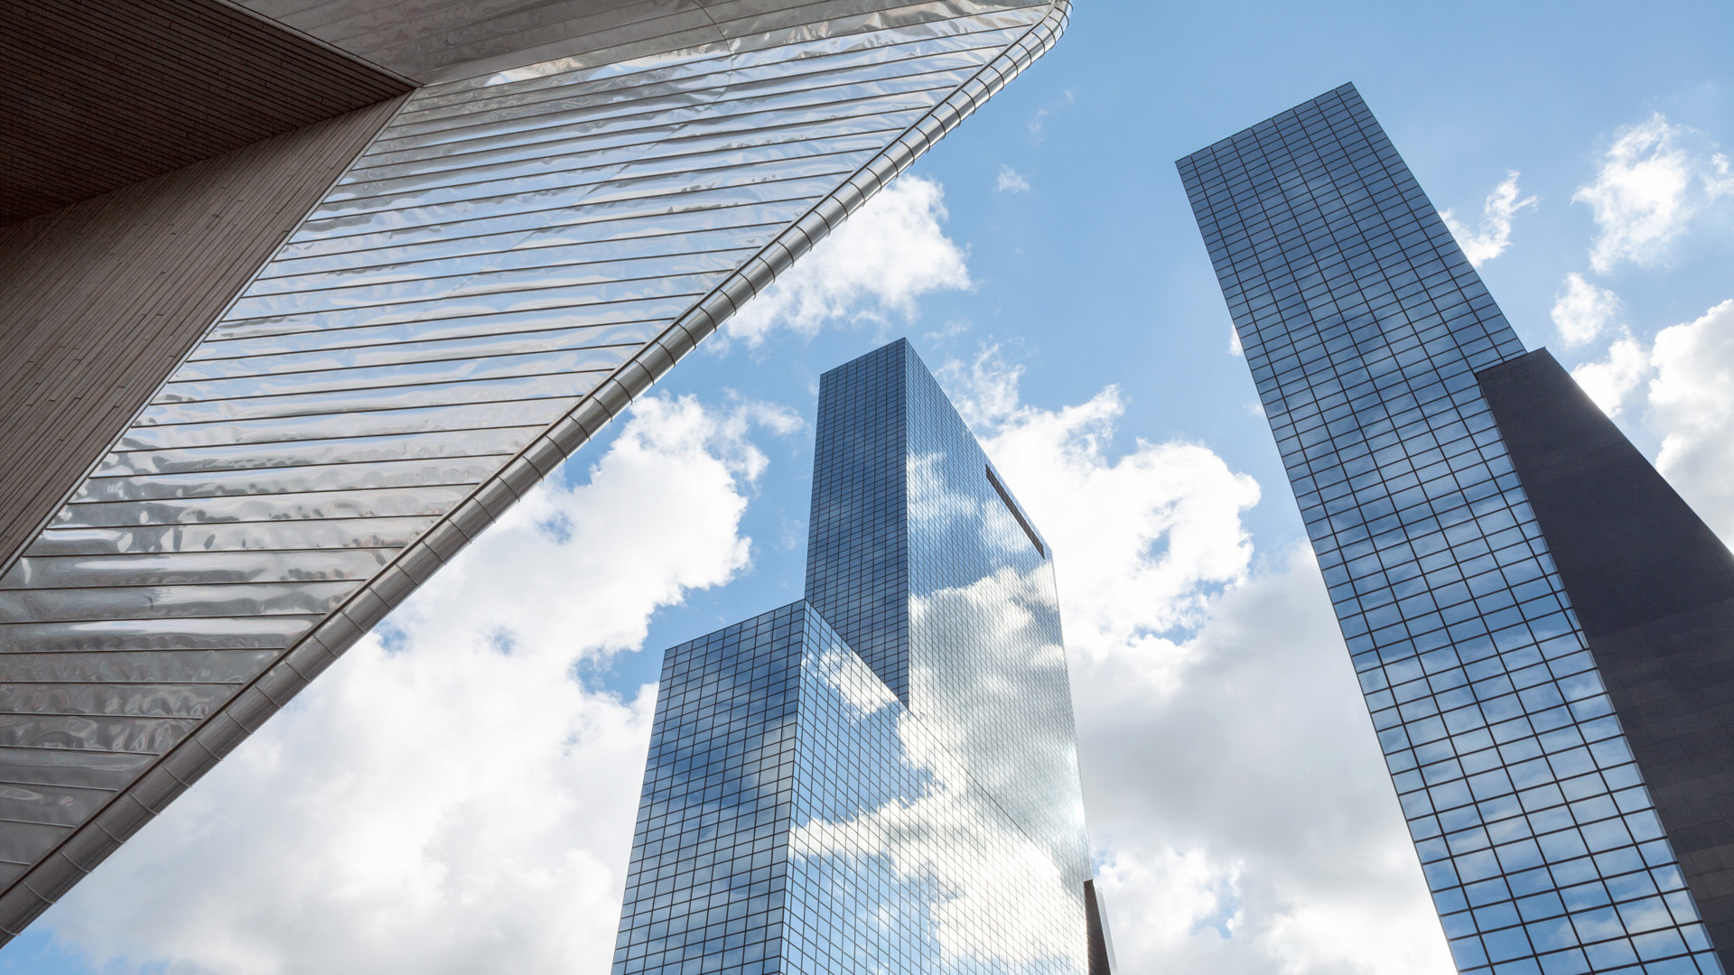
CRISIS MANAGEMENT LANDSCAPE
An overview on Crises in Vietnam

Slide 3
QUẢN LÝ VÀ TRUYỀN THÔNG MXH CHO TỪNG DỰ ÁN MỚI
MỞ BÁN
BÀN GIAO CĂN HỘ
THIẾT LẬP BQL
Thiết lập fanpage để tiếp thị và chào bán dự án
Thiết lập nhóm cư dân chính thức do Chủ Đầu Tư và công ty Quản Lý vận hành
Tạo môi trường chính thức để CĐT, công ty Quản Lý, đơn vị Xây Dựng giao tiếp và giải quyết các vấn đề của khách hàng, vốn tăng cao khi nhận nhà
Cung cấp các thông báo chính thức về việc sinh hoạt và vận hành trong dự án
Lắng nghe, lường trước, và quản lý các rủi ro & tiêu cực từ khách hàng
Thiết lập các hoạt động sinh hoạt cư dân ban đầu (như các sự kiện, các cuộc thi, phong trào cư dân, ...)
Chuyển giao quyền quản lý nhóm cư dân chính thức cho Ban Quản Lý do cư dân bầu lên
Tiếp tục thiết lập và duy trì các hoạt động lâu dài và đăng tải thông tin trên 2 kênh group cư dân chính thức và không chính thức
Thiết lập nhóm cư dân không chính thức (với danh nghĩa do cư dân lập nhưng CĐT đứng sau)
Tạo môi trường để khách hàng tiềm năng và khách hàng trao đổi, giải đáp thắc mắc nhằm tránh lan ra ngoài
Tạo nơi để CĐT với tư cách là 1 thành viên có thể cung cấp thông tin và giải đáp thắc mắc cho khách hàng
Lắng nghe, lường trước, và quản lý các rủi ro & tiêu cực từ khách hàng
Thiết lập gói retainer lắng nghe liên tục và quản lý cộng đồng và phòng chống rũi ro & quản lý tiêu cực (Crisis Management) cho toàn dự án trên các kênh MXH (facebook, diễn đàn, tin tức online, ...)

Slide 4
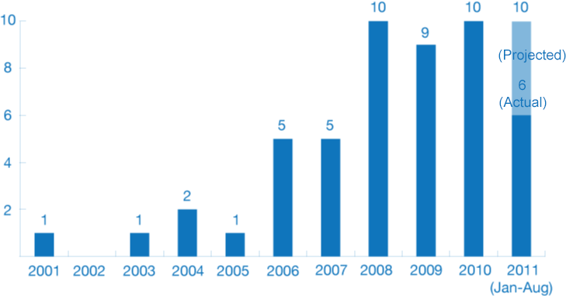
CRISES RISE FAST GLOBALLY
The quantity of social crises increased by
10 times
from 2001 to 2011
Source: Altimeter, Social Business Readiness, August 2011

Slide 5
IT IS EVEN MUCH FASTER IN VIETNAM
16+
The quantity of social crises increased by
16 times from 2005 to 2016
Chinsu Fish Source, Samsung Galaxy Note 7, Vietnam Airlines Security, VCB, VP Bank, MSB, Formosa, VinaCyber, Novaland, Hoa Send Group, Lotteria, Thu Minh’s Husband, Vinhomes Golden River, VTV 60 Phút Mở, BV Hoàn Mỹ
10
3
C2 Green Tea, Dumex, Home Credit, VietjetAir, Kinh Đô Fullmoon, Babycare Tissue, Kangaroo, Agribank
2
2
1
ACB Rumor, Phở 24
THP Zero Degrees Green Tea, TH True Milk, Prudential Agent
Chinsu Soy Sauce
Vedan Polution, Vietnamworks DB
2005
2008
2012
2014
2015
2016

Slide 6
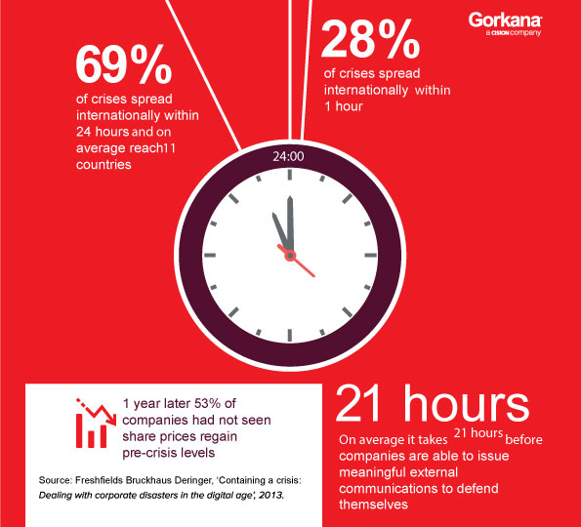
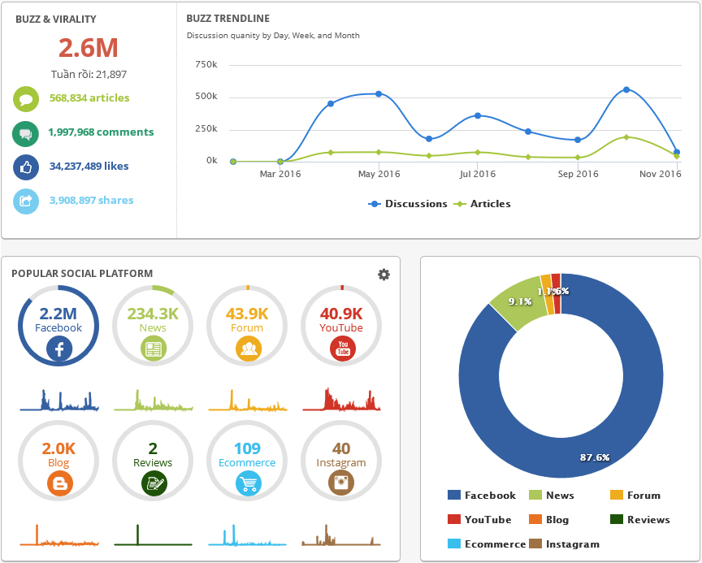
NOT ONLY QUANTITY, SPEED IS ALSO MUCH FASTER
Global Crisis Spreading Speed
Formosa Hà Tĩnh Crisis

Slide 7
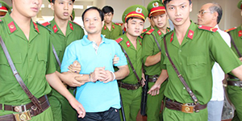
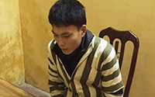





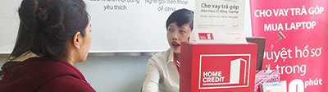
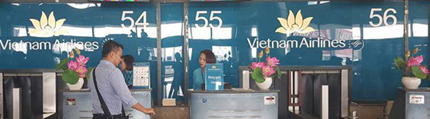

EITHER SMALL OR BIG MATTERS CAUSE CRISES
BIG matters most likely lead to crisis
But the number of crisis that come from accumulated SMALLER MATTERS increases lately
Accumulated small incidents that make the consumers perceive that they are not respected.
Several small defects in service within a short period could also create huge impact on the.
Multiple effort just focus on the brand's benefit would create an converge reaction from customers.
Small issues that face a powerful party could result in big matter.

Slide 8
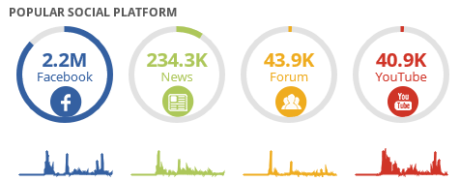
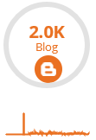
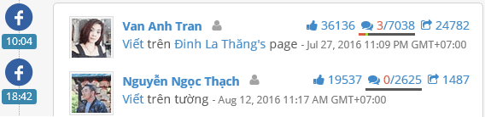

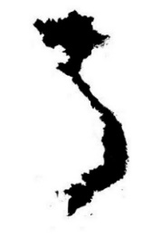
WHY?
Not that hard to see the common destination - almost all crisis’s traffic get boomed and peaked in SOCIAL MEDIA.
Social media empowers and even creates influencers then bonds them seamlessly with the community.
Wiping out differences in timing and distance, social platforms helps spreading crisis faster than ever before.
TOP FIVE CITIES
WHERE THEY ENGAGED?
HO CHI MINH CITY 18.5%
NORTH
43%
HANOI 17.8%
CENTRAL
22%
HIGHLAND
5%
DA NANG 6.4%
SOUTH
29%
NGHE AN 5.6%
QUANG NINH 3.5%

Slide 9
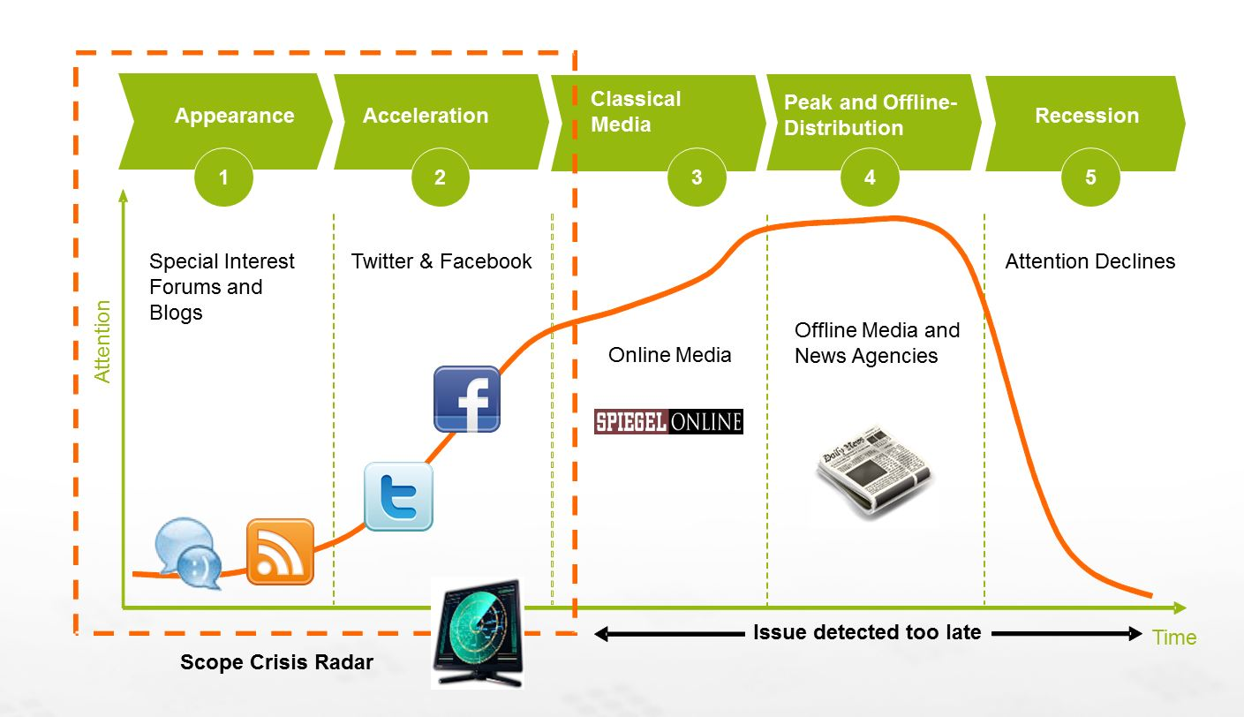
HOW DOES A CRISIS GET INTO BEING?
New post on:
Forums
Facebook profile
Youtube
Blog page
Online News
Post get shared quickly on facebook and forums.
The public attention
gets decreased by time
or gets distracted by occurrence of other hot topics.
Traditional media (Newspaper, Television, Radio, ..) start to participate.
Catch attentions from online news publisher then articles started to be written and delivered either online and offline ...

Slide 10


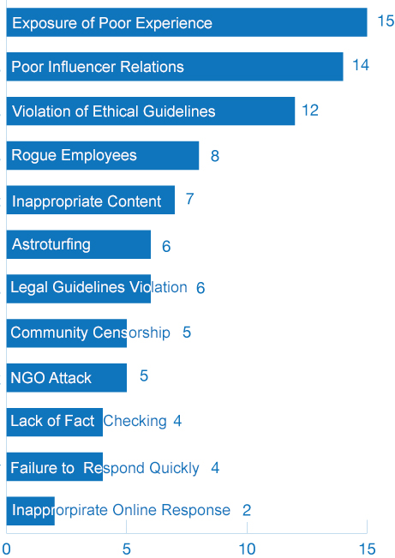









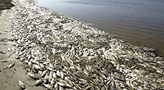

COMMON CAUSES FOR CRISIS IN VIETNAM
Product & Service Quality
Poor or defected products and service quality without appropriate actions to improve.
Core Operations Matters
Defects in various steps within the operation process, popularly falling into Sales Management, Customer Service, Customer Data Management.
Brand Attitude
Aggressiveness against the consumer, sole media lobbying tendency, over-action to protect the brand from problems.
Leadership Reputation
Nepotism, bribery, sex are common problems that knock down leadership reputation and negatively impact the brand.
Public Interest Violation
Environment pollution and traditional product category invasion.
Popular Causes of Crises
Source: Altimeter

Slide 11
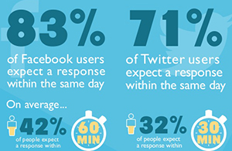

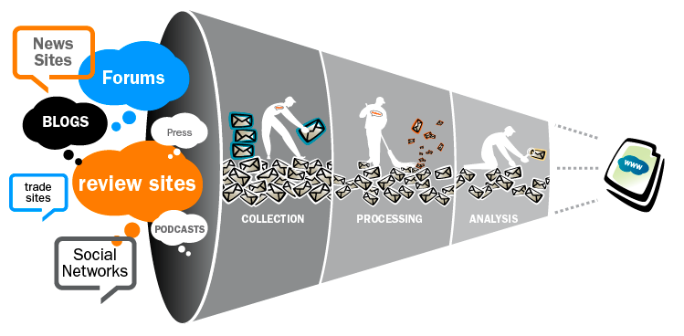
THE ROLE OF SOCIAL MEDIA CRISIS MANAGEMENT
While Traditional Media is NEGOTIABLE through Media Relation Social Media is ALMOST UNABLE to NEUTRALIZE and consequently the consumer has BIGGER VOICE and MORE POWER. So it is ESSENTIAL to,
Listen & Understand
Act Faster & Always On
Take Good Care Of
The Community

Slide 12
SOCIAL MEDIA CHANGE THE SITUATION
“In the 21st century, a social media savant can do more harm than a trial attorney.”
Jonathan Bernstein
Bernstein Crisis Management Inc.

Slide 13
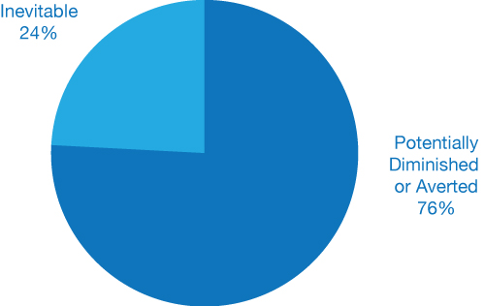
PREVENTION IS THE BEST SOLUTION
Once the crisis happens the chance to resolve it fully is ZERO and there is always consequences.
So it is important to TRACK, UNDERSTAND, and ANTICIPATE in advance
Your Brand’s Social Health
Your Competitor’s Crises
Brand Health and Crises from Relevant
Product/Service Category to Yours
Source: Altimeter
More than three-fourths of social media crises may have been diminished or averted.

Slide 14
CRISIS MANAGEMENT SERVICES
Thorough Crisis Management Solution by

Slide 15
YOU.DIGITAL CRISIS MANAGEMENT FRAMEWORK
BEFORE CRISIS
DURING CRISIS
AFTER CRISIS
Crisis Monitoring
Situation
& Source Analysis
Identify Strategy
Planning
& Execution
Measurement & lesson learnt
Prepare in advance for crisis management
Grasp in depth view of the crisis and the level of seriousness
Crisis resolution direction
Thorough crisis management execution
Lessons withdrawn and prevention actions identified

Slide 16

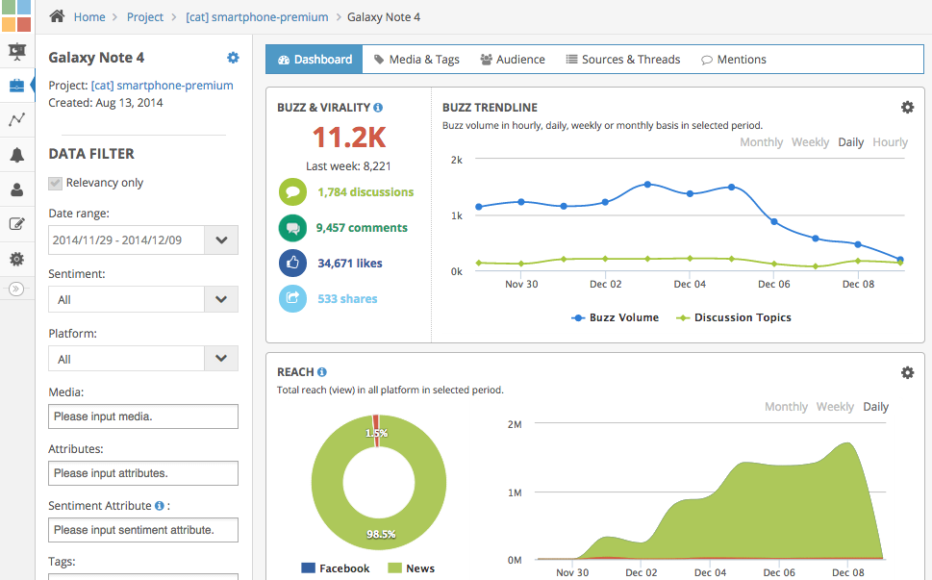


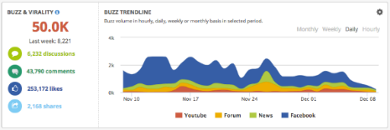
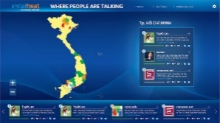
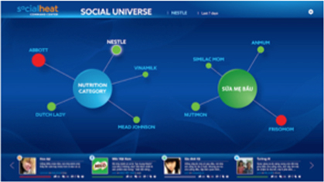
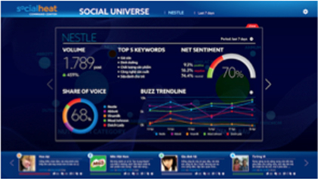
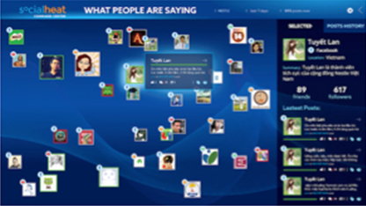
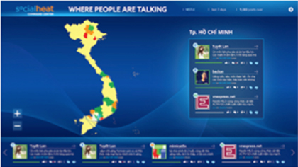
BEFORE CRISIS - MONITORING
Listening
Understand
Social Media Listening
Social Media
Command Center
Brand, Campaign Tracking & Category Insight
Crisis Monitoring – Customer Service

Slide 17
DURING CRISIS - ANALYSIS, STRATEGY, PLANNING
ANALYSIS – a thorough analysis of all relevent facet to assess the nature of the problem through social media data
STRATEGY – with full understanding of the situation & expertise a through strategy will be drafted at with the following elements,
Strategic resolution
Crisis management board
Tailored crisis management process
Crisis levels map
Content direction plan
PLANNING & EXECUTION – human mistakes are well controlled and action speed is improved by a clear execution plan with daily, weekly, and monthly reports

Slide 18
AFTER CRISIS- ANALYSIS, STRATEGY, PLANNING
MEASUREMENT – the brand health check will tell clearly what level of resolution achieved
LESSON LEARNT – from resolution level measured, prevention suggestions for short comings and insufficient KPIs is developed
EXIT CONSOLIDATION– generally in order to close the crisis management case, against prevention suggestions, some marketing communication activities will need to be implemented.

Slide 19
WHY YOU.DIGITAL CRISIS MANAGEMENT SERVICES?
EXPERIENCE - With 4 years of always-on listening & brand report for international and local brands, we Understand the Consumer and so capable of producing strategic solution for the crisis
EXPERTISE - We focus on Social Media, which is supreme in opinion leading in Vietnam, and have good connection to crisis driven parties,
Deep relation with channels (facebook fanpages, forums, blogs)
Business relation to social media publishers
Seamless connection with social KOLs
RELATIONSHIP - We are Backed up with strategic partner in data source investigation & resolution,
Newspaper Publisher relation (up to Central Propaganda Committee)
Authorities relation: PC46 (Economic Crime Police), PC50 (Online Crime Police), A87 (Information Police)
Cyber Security Agents (SEO, Security Experts, Hackers, ...)
AUTOMATED TOOLS - We owned tools (SocialHeat, SocialCare, SocialCRM) and resources (seeders, KOLs, ...) that can manage, direct, and engage with social community massively and effectively
PROCESS & METHODOLOGY - We own a crisis management frameworks that can fully control and forecasted every details (crisis level, possible cases, contingency plan, appropriate content directions) that can minize interaction timing with brands and so guarantee factest actions with highest precision

Slide 20
SERVICES
Crisis Management System Consultancy
Crisis Management
Crisis Management & Marcom Integration Consultancy
Customer Service, Marketing Communication, and General Operation Model Investigation
Crisis Management Mechanism Consultancy against the Current System
Plan Development, Management, and Execution
Overall Strategy Consultancy
Planning & Execution
Content Development
Media Relation
Social Media Buying
KOL Selection
SEO & Search
Integration consultancy
Integration Marketing Campaign Development
Integration Marketing Campaign Execution

Slide 21









CLIENTS

Slide 22
CASE STUDY
Those that
gets involved with

Slide 23
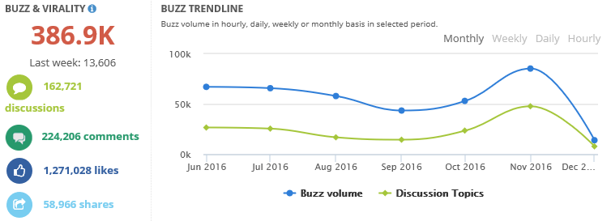
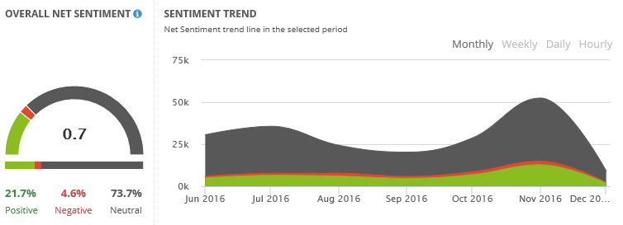
BEFORE CRISIS – FPT TELECOM
PROBLEM
Due to cost factor increasing FPT Telecom is to increase service fee. Anticipating customer behavior and aiming at a smooth rolling out of the new service fee, FPT Telecom introduced the program of "Bandwidth Increased, Favorable Service Fee Adjusted" which gave current customer a considerable amount of internet bandwidth at a very favorable additional fee. However, the challenge identified was how to recognize, receive, and serve fully every feedback from the customers both through business channels and social media.
SOLUTION
You.Digital put together a thorough solution to the challenge including,
- Using SocialHeat to monitor all social media conversations.
- Putting together the strategy and master plan to take care of the customer's feedbacks operating upon the seamless collaboration between You.Digital and FPT Telecom teams.
- Anticipating worst cases and preparing resolution and content direction for all those cases.
Operation the crisis management plan and generate regular reports to management.
RESULT
Despite of high peaks where the quantity of feedbacks increasing to huge numbers, the campaign was closed safe and sound with all KPI met against the defined plan.

Slide 24
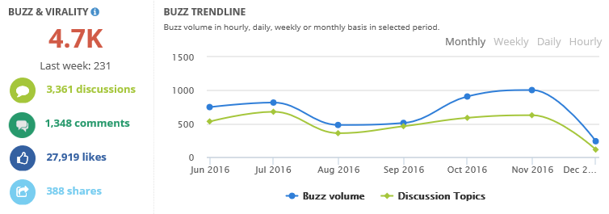
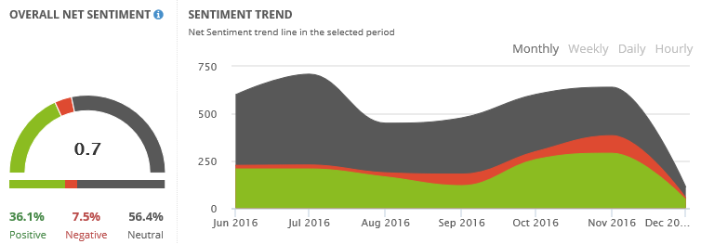
DURING & AFTER CRISIS – NOVALAND GALAXY 9 APARTMENT
PROBLEM
Despite of high reputation in property quality and service, eventually cosmetic mistakes during the operation of modern high end apartment are inevitable. Unfortunately, these small incidents become big matters if falling into some particular situations. The case of Model Trang Tran living in Galaxy 9 Apartmen is an example. From the anger and worry that her daughter was frightened in an false fire alarm, Trang made an video clip of almost 60 minutes posting into Facebook sharing her feeling. Within 2 hours, the post received thousands of interactions ramping up quickly to several tens of thousands together with several thousands of shares.
SOLUTION
With the statistic and information drawn from SocialHeat, You.Digital analyzed the matter and proposed a strategic resolution to the situation that based upon direct reconciliation between Novaland and Trang Tran as following,
- Find the mediator and make the appointment between Trang Tran and Novaland Top Management.
- Listen to her problems and her requests.
- Discuss and propose resolution.
- Put together an automated mechanism to resolve similar problems happening afterwards.
RESULT
Trang Tran took down her post after the meeting, relevant discussions therefore get to and end. The most important thing is Novaland and Trang Tran found a mutual understanding and get closer to do mutual social activities together.

Slide 25
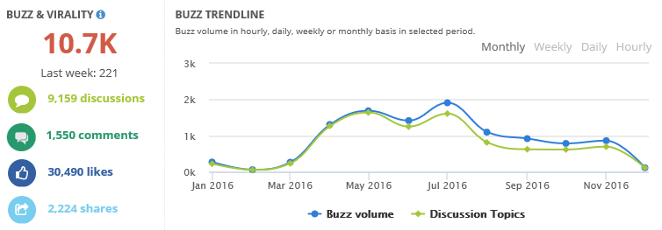
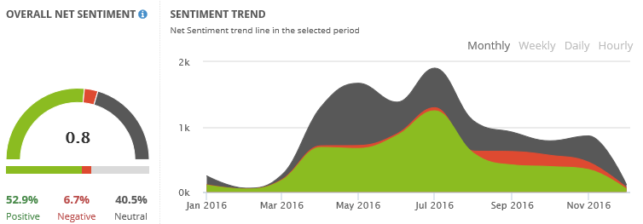
DURING CRISIS– NAM LONG FLORA ANH ĐÀO
PROBLEM
Minor matter during the completion of an apartment is almost inevitable in big construction projects. However, from the customer perspective any mistakes made to their beloved apartment are all big matters. Such a case happened at Flora Anh Dao Apartment and the customer created excessive tension despite of the fact that the investor acquired high reputation and was willing to take full responsibility.
SOLUTION
To handle the customer's excessive attitude and reaction, the strategy is to have authorities investigate and propose the resolution and conform to what ever the formal resolution decided is. The sole important thing left is how to fully express the investor's good will to the relevant customer and all audience from the community. From that a communication plan was developed to handle the crisis with two activities,
- Updating the community through social media with every latest details from the incident from a honest perspective.
- Perform prompt feedbacks to any relevant discussions or requests.
RESULT
With the effective support from SocialHeat and the team behind it, the resolution plan has been performed at best quality. The customer was compensated adequately according to official conclusion from the investigation authority and the investor's spirit of responsibility was also well communicated to the community.

Slide 26
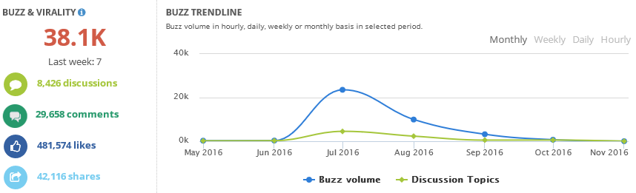
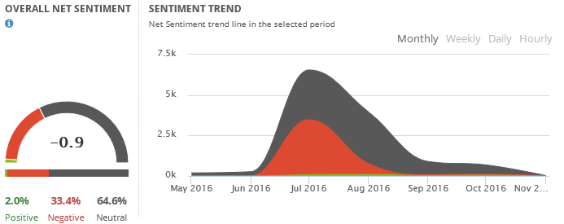
DURING CRISIS– M BANK
PROBLEM
There is an incident in which Ms. H, who is a Congress Woman, was reported to violate the Vietnam Congress rule of eligibility since she's got two citizenship. The whole social media burst out with discussions upon this matter with a huge discussion volume up to 38k of mentions. Then came and spread contents upon the fact that Ms. H and her husband take the highest investment & position in the M. Bank. The M. Bank anticipated the situation and quickly select You.Digital to work from the very early stage of the crisis to develop a strategic plan to manage the crisis.
SOLUTION
By using SocialHeat, the whole situation was analyzed. Data and trends shows that there is a hidden party attacking M. Bank by leveraging the incident of Ms. H. Recognizing that his is an defaming intention, the strategy was drawn with two major activities,
- Investigating and monitoring the hidden party and their activities, then report to the highest management to solve it politically.
- Following and control discussion on social media relevant to the topic by various tactics including level of crisis & case anticipation, content development in advance, seeding, media relation, SEO, and including black-hat activities.
RESULT
The crisis was control and all relevant media was isolated without any unexpected damage. After 3 months, the crisis completely went down and the bank got almost no damage from the crisis.

Slide 27

Thank
For Your Interest

