Slide 1
Master Presentation Topic
Prepared by: Queenie Nguyen
26 December 2018

Slide 2

Salient Features

Slide 3

Salient Features
Manage Academics Operation
Manage Exams
Manage user: staff, student, parent and others…
Manage Library
Manage payroll
Fee Management
Others : Alumni, Visitor Management, Transport Management, Hostel Management…
Notes:
Tr

Slide 4
Manage Academics Operation
Manage Academics Operation:
  Certificates
  Transfers
  Timetable
  Offline Exams
  Class Attendance Report
  Class Marks Report
  Students List
    Students Completed List
    Students Detained List

Slide 5
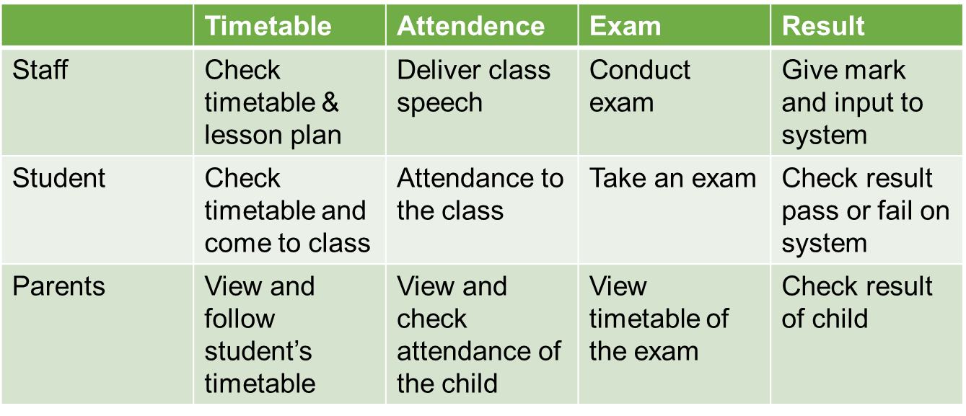
Admin Workflow
Admin
I.Create Staff
II.Create course, subject, lesson
III.Create timetable
IV.Create test& exam (online/ offline)
V.Admit student
VI.Create parents’s account
VII. Payment

Slide 6
ADMIN

Slide 7
I. Create Staff
Create account
Update profile detail
Create timetable
Asset assigning
Assignment for staff
Check staff’s attendance
Pay salary
1
2
3
4
5
6
General details
Personal details
Contact details
Allocate staff to course
Supply equipment for staff
Check deadline

Slide 8
II.Create Course
Master set up
Create academic years
Create course or course list
Create subject master
Allocate subject to course
1
2
3
5
4
Create subject topic
6
Allocate staff to subject

Slide 9
III.Create timetable
Start
Academic operations
Timing set
Create timetable
Set time for date everyweek
Create time for subject topic
Select academic year, course, program.
Drap&drop staff to timetable

Slide 10
IV.Create test& exam(online/offline)
Start
Create categories
Question bank
Create Quiz
Exam series
Offline exam categories
Update result
Category name
Description
Add list of question
Select quiz type (online/ offline)
Edit to update total exams & questions
Type of test: half yearly, unit test…
Inform result
Done

Slide 11
V. Admit students
Start
Admission student
Accept
Create account
Allocate student to course
View student’s report
Yes
No
Get info
Take care

Slide 12
VI.Create parents’s account
Start
Create account
View child’s course
View child’s learning
Check result
Payment report
1
2
3
4
5
Follow child’s staff
Exam
Lesson
View analysis result
Paid or unpaid

Slide 13
VII. Payment
Admin
1
2
3
Payroll
Expenses
Fee management
Salary template
Manage salary
Make payment
Reports
Expense category&list
Overall report
Fee particulars
Others feature
Reports

Slide 14
Parents workflow
Parents
1
2
3
4
Check child’s learning management
Check child’s subscription
Check child’s exam & analyst result
Check and create conversation with staff or everyone by message
Subject categories
Lesson series
Buy lesson
Follow child’s process
Can buy exam on behalf of his child
Check time and number of question in the exam
Message
View the children detailed reports
Compose
Check time &plan type of subject: start date& end date...
View status of subject: pending or success..
Contact to support
Select user, fill subject and text message
Done
Paid
Successed
Failed

Slide 15
Student workflow
Student
1
2
3
4
5
6
Check timetable
View series lesson & subject
Come to class and check attendance
Check assignment
Take an exam:
online or offline
Fee details: check fee schedules&fee history
Message with staff or friend if want to ask question
Result: pass or fail
Pass
Next course
View attendance report
Upload exercise before deadline
Analysis by subject &exam
Transfers
Fail
Payment
Successed
Contact to support
Failed

Slide 16
Staff workflow
Choose preferred subject
Ok
Allocate to course
Check timetable
Check lesson plan
View student list
Check attendance
Create Assignment
Yes
No
Yes
Pre
Cannot access to course
No
Done
Remark or note student
All student
Selected student
Update credits and approve
In time
Result
Deadline
Check assignment
Cannot receive file from student
Expired

Slide 17
Thank You!

