Slide 1
Exploratory Analysis of Hotel Booking and Marketing Data
Analysis and presentation: Roland Nagy
Date: 12. 02. 2024.

Slide 2
Contents
01.
Goals
02.
Analysis Results
Search Data and Conversion Analysis
PPC Cost Analysis
03.
Proposals
Notes:
Color codes: https://mycolor.space/?hex=%23F7F9F7&sub=1

Slide 3
01.
Goals

Slide 4
Goals
01.
Processing and analysis of marketing and booking data from MORGENS for various hotels, with a view to optimising hotel booking opportunities.
Notes:
A WRFT flyball csapat elmúlt évi eredményeinek feldolgozása egy általános összefoglaló céljából, szem előtt tartva
általános képet kapni a saját csapatainak és kutyáinak az elmúlt évi teljesítményéről.
A cél, hogy az elemzéseket felhasználva a jövőben még jobb teljesítményt nyújthasson a csapat

Slide 5
Goals
01.
Interpreting results:
The observation presented is generally true for all three hotels, if no further separation is made
Notes:
A WRFT flyball csapat elmúlt évi eredményeinek feldolgozása egy általános összefoglaló céljából, szem előtt tartva
általános képet kapni a saját csapatainak és kutyáinak az elmúlt évi teljesítményéről.
A cél, hogy az elemzéseket felhasználva a jövőben még jobb teljesítményt nyújthasson a csapat

Slide 6
02.
Analysis results

Slide 7
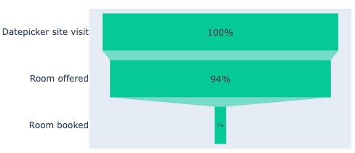
02.
Funnel analysis
Normal funnel behaviour for each hotel
The worst final conversion is for Hotel 3
Hotel 3
5%

Slide 8
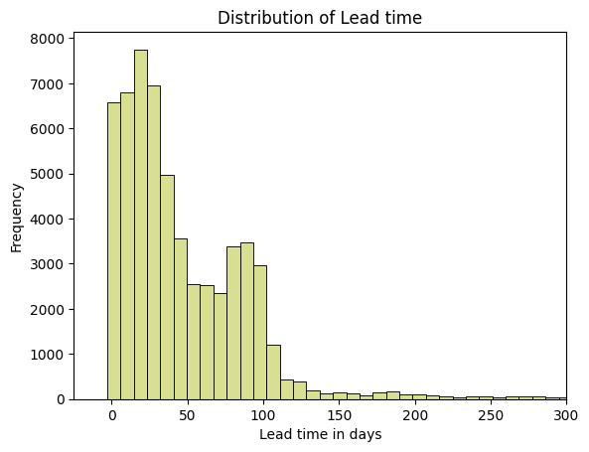
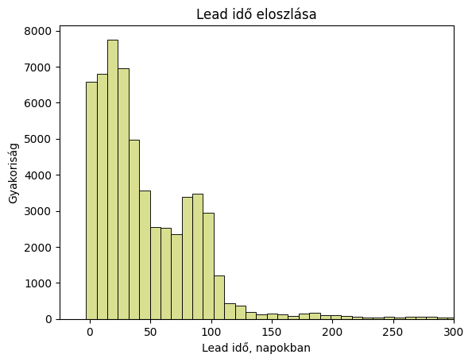
02.
Search trends
On average, bookings are made up to 100 days in advance.
Arrivals most often fall on Thursday or Friday.
Longer vacations are booked earlier.

Slide 9
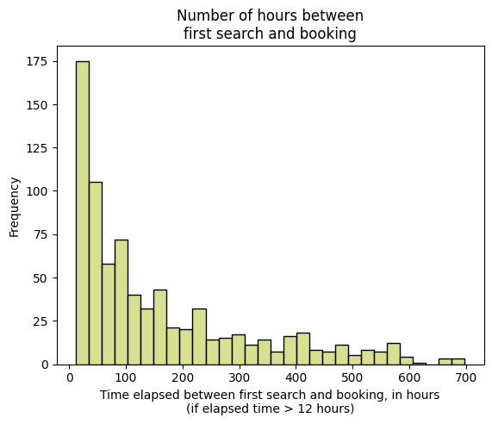
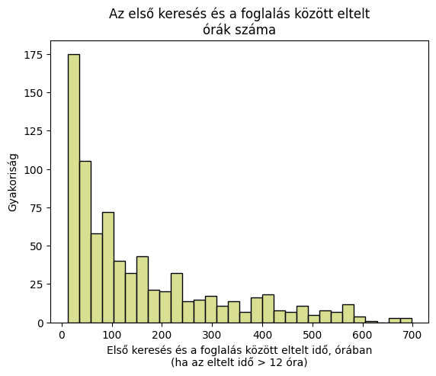
02.
Search trends
Many users return to the booking site days later to finalize their reservations.

Slide 10
02.
Lead Time-Based Segmentation
Day 0
Day 7
Day 30
Day 90
Lead Time:
Last Minute
Short Term
Medium Term
Long Term
Notes:
Lead idő alapú szegmentálás:
Last minute: < 7 nap
Rövidtávú: 7 és 30 nap között
Középtávú: 30 és 90 nap között
Hosszútávú: > 90 nap

Slide 11
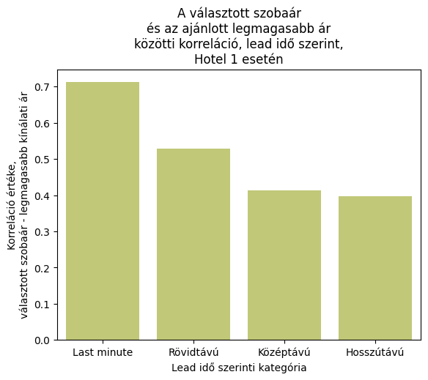
02.
Lead Time-Based Segmentation
Correlation of the selected room price with the highest available price
For hotel 1, book first for low rates with long lead times

Slide 12
02.
Lead Time-Based Segmentation
The longer the booking period, the earlier the reservation is made.
Last-minute bookings have a low probability of including children.
Families with children generally book earlier.
Conversion rates improve the earlier a booking is made.
Last minute keresés esetén a legrosszabb
Hotel ID | Lead time category | Number of nights | Probability of having a child | Average conversion [%]
Hotel 1 | Last minute | 2,0 | 0,2 | 6
 | Short term | 2,5 | 0,4 | 5
 | Medium term | 2,5 | 0,4 | 8
 | Long term | 2,9 | 0,4 | 13
Hotel 2 | Last minute | 1,7 | 0,2 | 4
 | Short term | 2,4 | 0,4 | 5
 | Medium term | 2,6 | 0,3 | 9
 | Long term | 2,9 | 0,3 | 8
Hotel 3 | Last minute | 1,9 | 0,1 | 2
 | Short term | 2,4 | 0,3 | 4
 | Medium term | 2,6 | 0,2 | 6
 | Long term | 2,8 | 0,2 | 8
Notes:
A rossz napokon, amikor kevés a foglalás az ár alacsonyabb jóval, mint amikor sok a foglalás

Slide 13
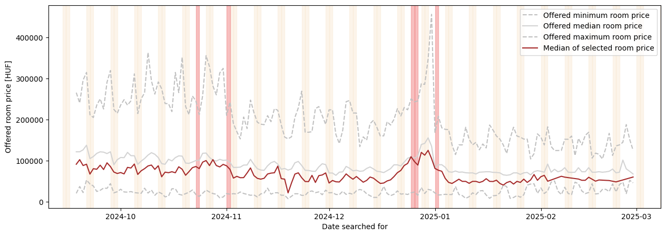
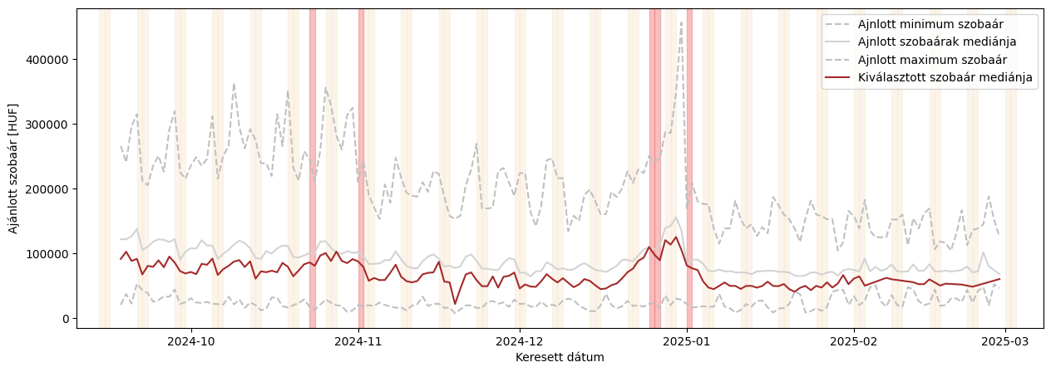
02.
Choice between offers
The median price per night of the selected room is usually lower than the median offer price
What influences the booking price and the choice between offers?
Notes:
Ünnepnapokon és hétvégén rendszerint magasabb kategóriájú szobát választanak

Slide 14
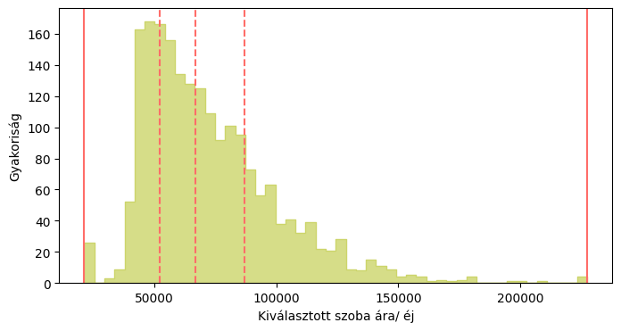
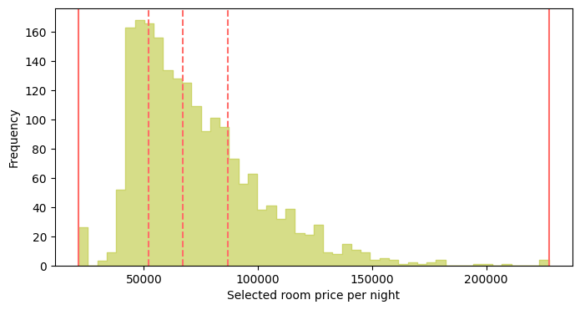
02.
Monetary segmentation
Monetary segmentation:
Selected based on average room price per night:
By quartile, into 4 parts
Low
Medium
High
Premium

Slide 15
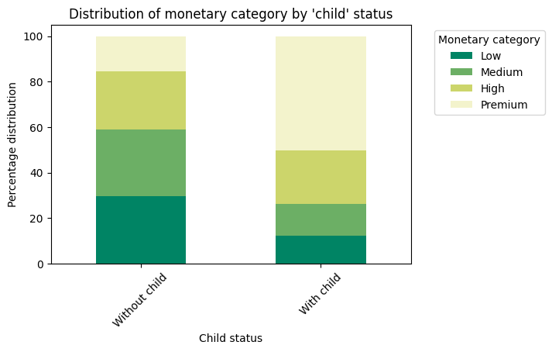
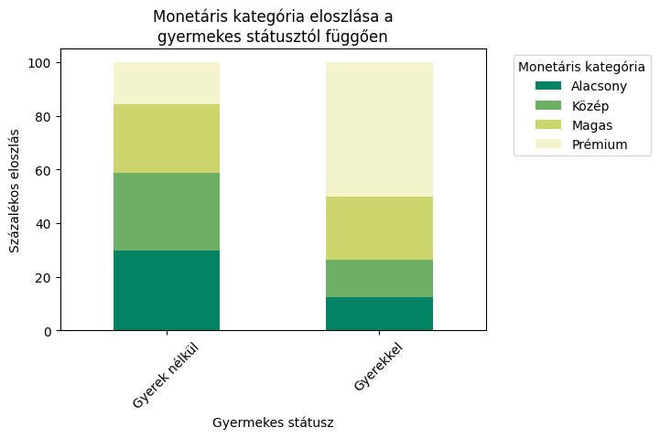

Monetary segmentation
02.
The monetary category of the reservation depends mainly on the number of children
If you have at least 1 child, the chances of choosing a room in the top category increase significantly
This is a common phenomenon, but mostly for hotel 1
Children make the difference when booking

Slide 16
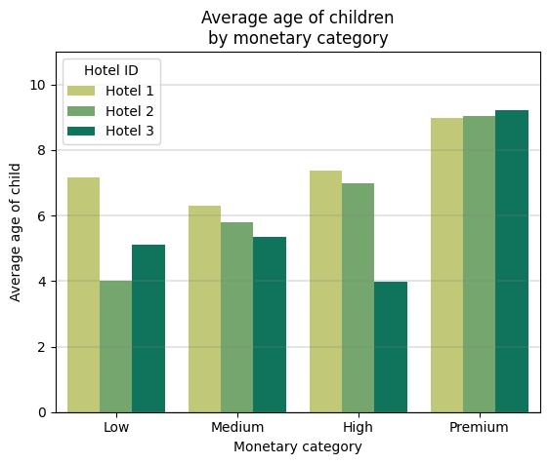
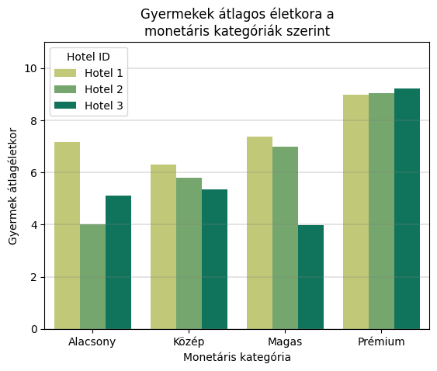
Bookings with children
02.
The older the child, the more likely a high-value booking is.
Conversion rates are higher without children.
The average upsell rate is also higher without children.
A 2. és 3. hotel esetén több, mint kétszeres a különbség

Slide 17
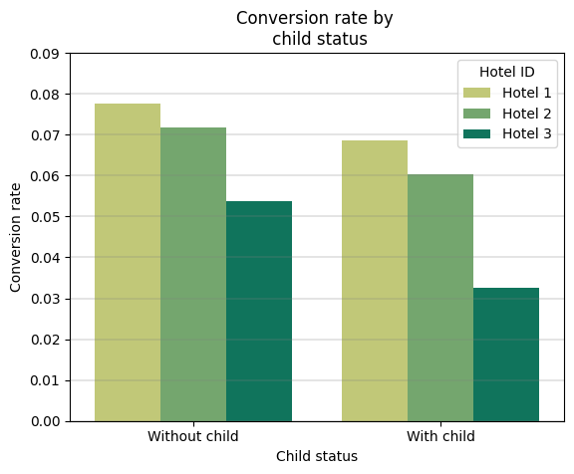

Bookings with children
02.
The older the child, the more likely a high-value booking is.
Conversion rates are higher without children.
The average upsell rate is also higher without children.
A 2. és 3. hotel esetén több, mint kétszeres a különbség

Slide 18
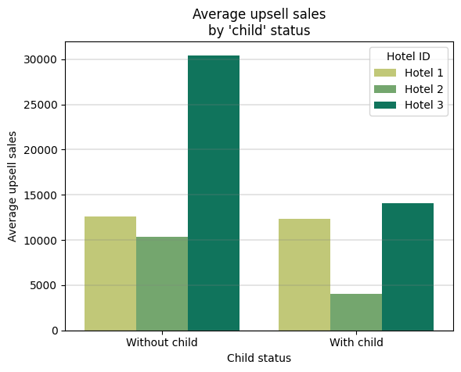
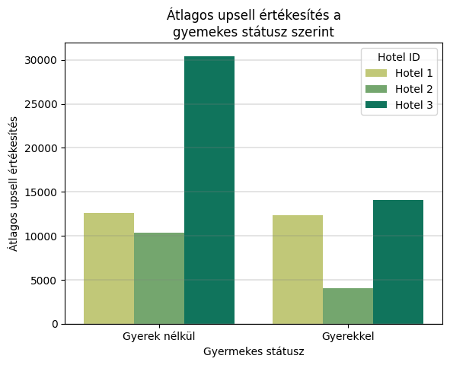
Bookings with children
02.
The older the child, the more likely a high-value booking is.
Conversion rates are higher without children.
The average upsell rate is also higher without children.
The difference is more than double for hotels 2 and 3

Slide 19
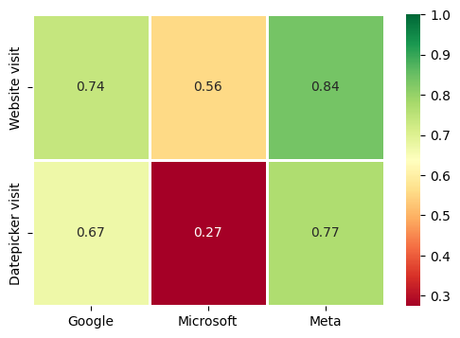
PPC Advertising Costs - Visitors
02.
Correlation between PPC spending and access to date picker interface
The best correlation between PPC spend and reach rate of date selection platform is Meta, followed by Google, then Microsoft
Microsoft significantly differs from the others in the correlation between CPC spending and the number of visitors
p-value < 0.001
Notes:
- a továbbiakban megnéztem, hogy mi okozhatta ezen eltéréseket

Slide 20
02.
PPC Advertising Costs - Conversion
In terms of conversion rates, Meta performs exceptionally poorly.
Additionally, the PPC cost per conversion is extremely high for Meta.
Hotel ID | UTM source | Average conversion [%] | PPC spend per conversion [HUF]
Hotel 1 | Google | 6,7 | 13 085
 | Meta | 0,6 | 373 032
 | Microsoft | 10,1 | 29 909
Hotel 2 | Google | 5,8 | 15 581
 | Meta | 0,5 | 482 741
 | Microsoft | 9,3 | 18 735
Hotel 3 | Google | 3,8 | 15 588
 | Meta | 0,6 | 235 354
 | Microsoft | 3,2 | 91 901
Notes:
Meta összevonás: Facebook, instagram

Slide 21
02.
PPC Advertising Costs - Conversion
Guests from Meta UTM sources have higher average booking prices, but this does not offset the higher PPC costs.
Hotel ID | UTM source | Average final booking price [HUF]
Hotel 1 | Google | 161 158
 | Meta | 243 574
 | Microsoft | 113 912
Hotel 2 | Google | 170 883
 | Meta | 185 734
 | Microsoft | 168 323
Hotel 3 | Google | 157 867
 | Meta | 175 604
 | Microsoft | 110 283
Notes:
Meta összevonás: Facebook, instagram

Slide 22
03.
PROPOSALS

Slide 23
Main proposal 1
03.
1
Regarding to PPC Advertising
When not to advertise – As the rooms will fill up automatically in high demand periods
Advertise between 10 and 50 days in lead time
Meta is an informing and demand generator site, where the PPC costs can be much higher
However, the optimization of Meta and Microsoft advertisements are recommended

Slide 24
Main proposal 2
03.
2
Regarding to booking with children
Encourage higher-priced room offers for guests without children
Improve conversion rates for families with children
Develop upsell products tailored to the needs of families with children (Hotel 2 and 3)

Slide 25
Thank you for your attention!

