Slide 1
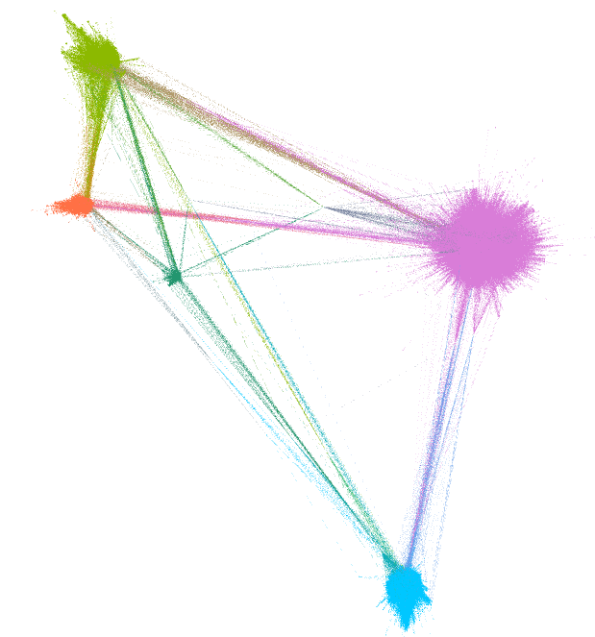
tensorflow
react
flutter
bootstrap
vue

