Slide 1
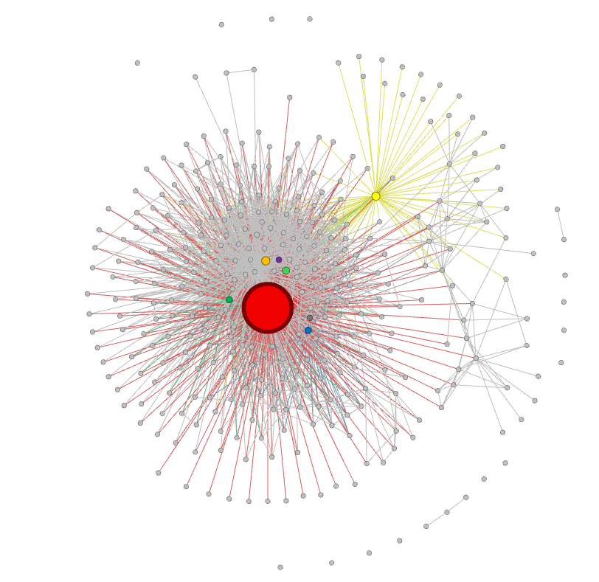
Alphabet
TensorFlow
Meta
Nvidia
Intel
MobileIron
IBM
AMD
Others

