Slide 1



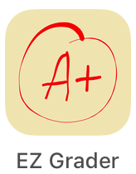
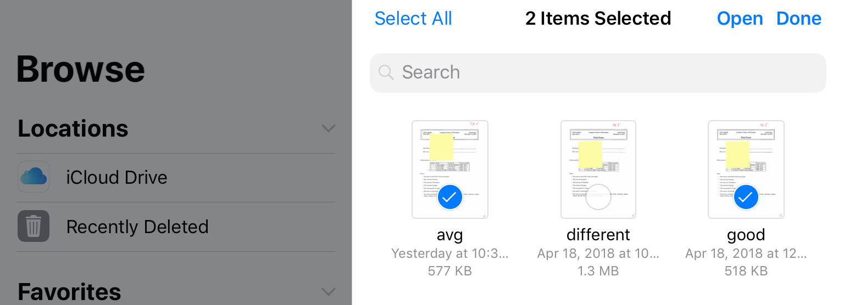
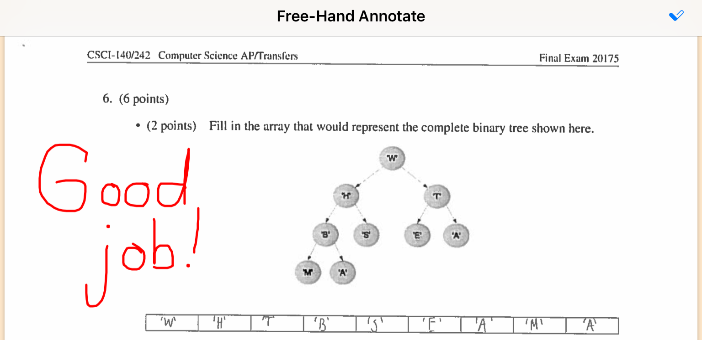
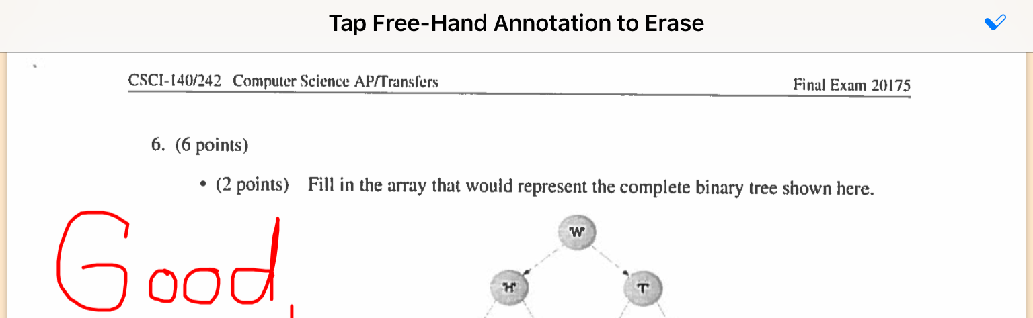
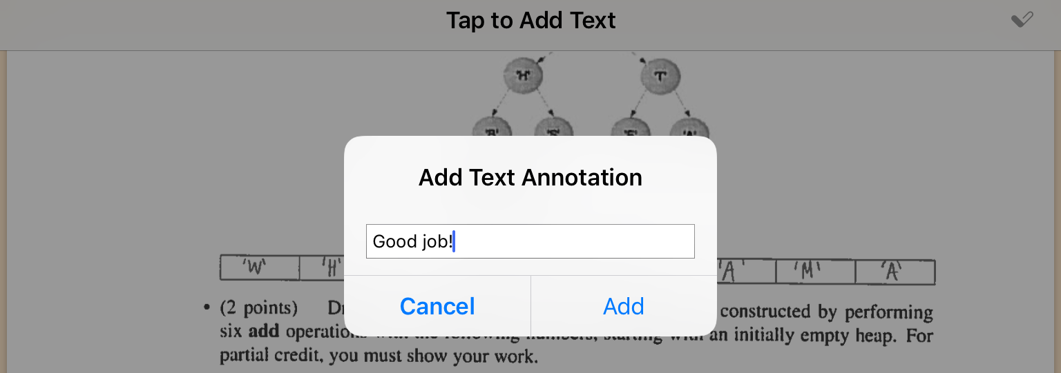
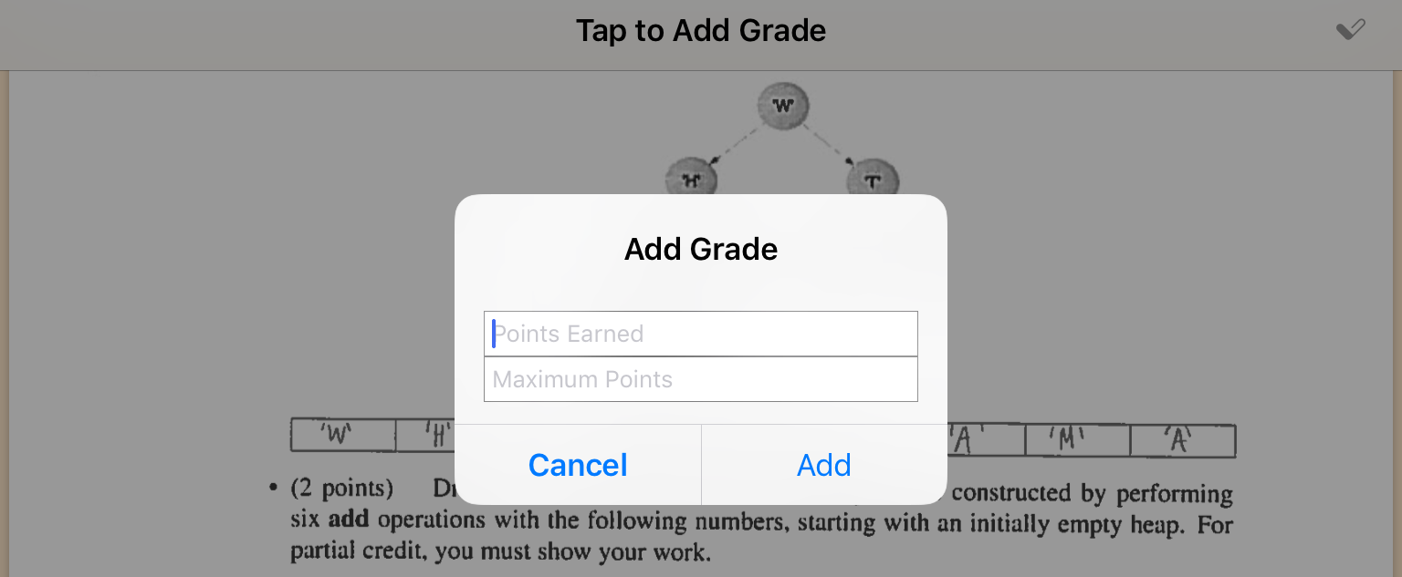
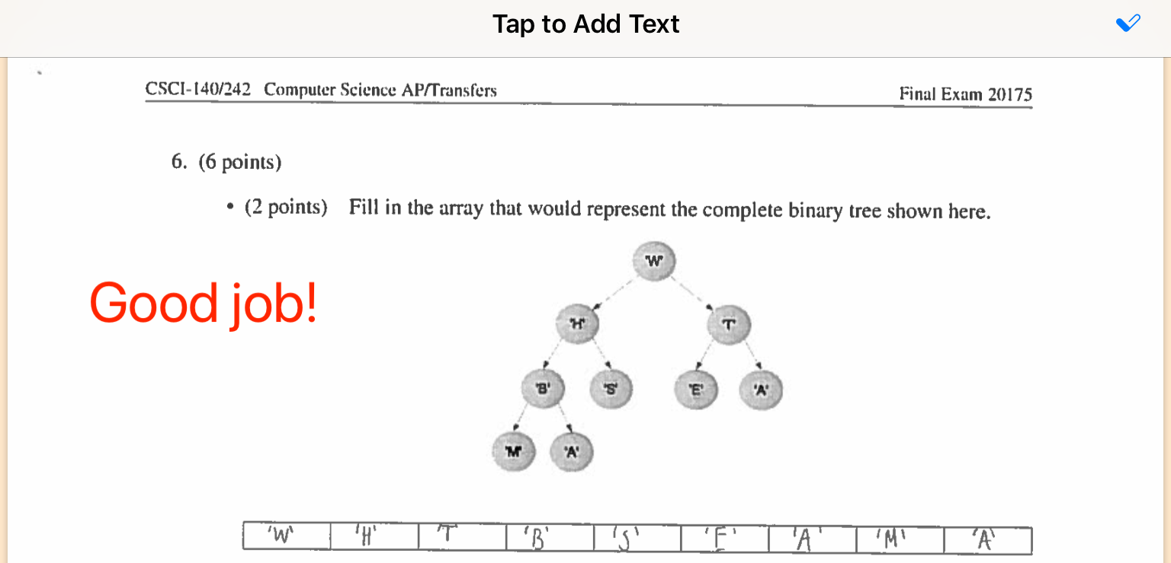
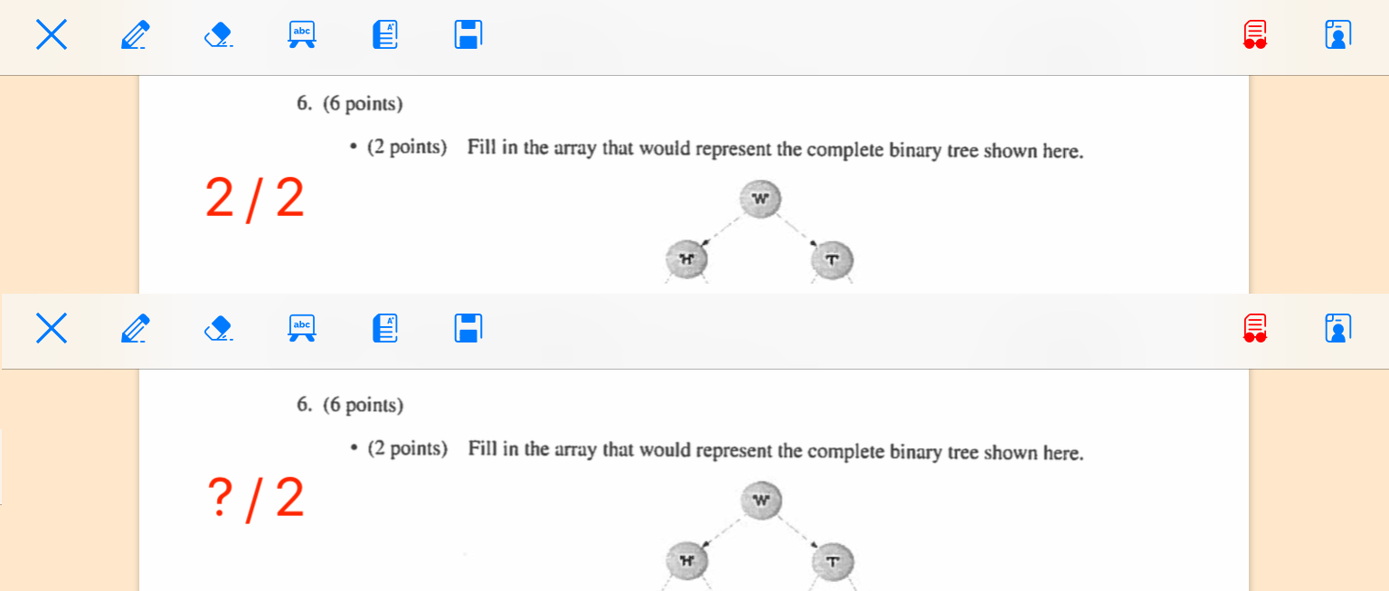
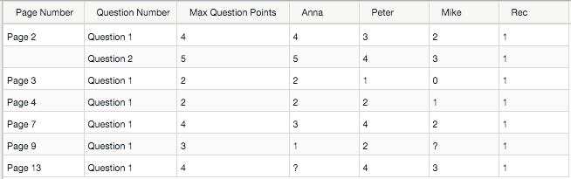
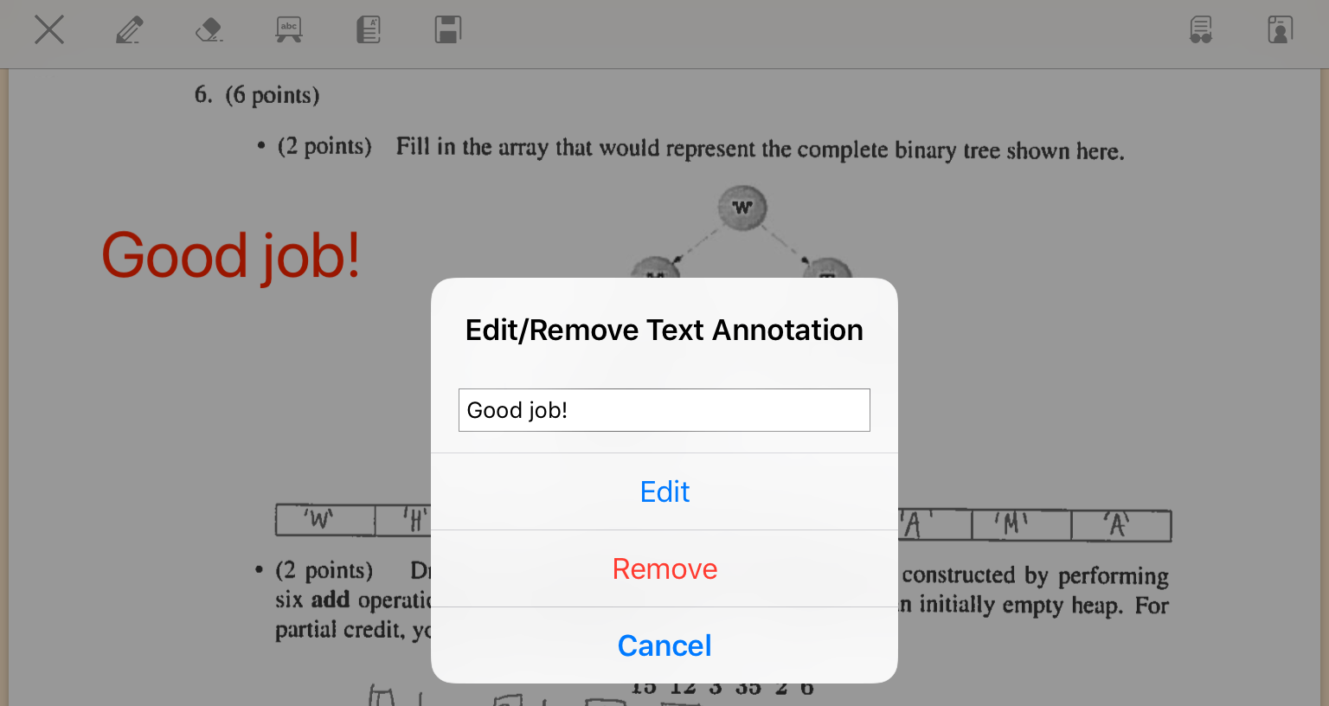
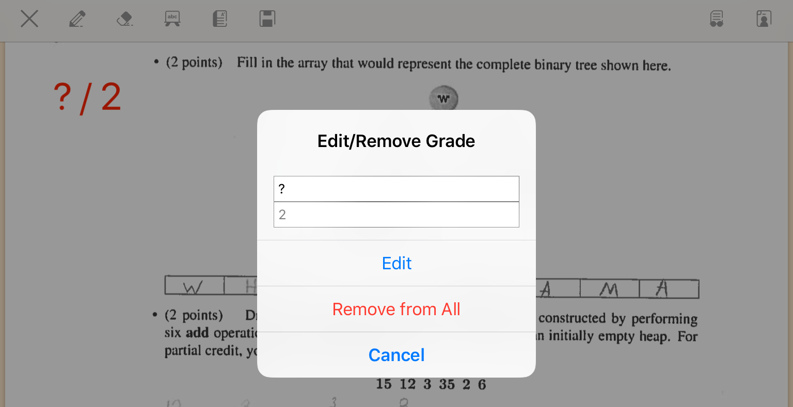
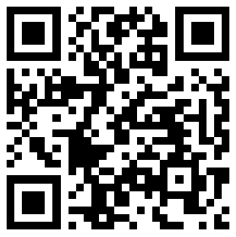
EZ Grader – iOS App for Grading Structured Assignments
Rolandas Burbulis rxb4548@rit.edu
Advisor: Dr. James Heliotis
What is EZ Grader?
EZ Grader is an iPad/iPhone application that allows instructors to grade structured student assignments.
What is a structured assignment?
Structured content assignments are assignments where each student’s assignment consists of the same number of pages, and the questions, question order, question positioning, and space to write/select the answers is identical in the corresponding pages of all students. Most exams and quizzes are structured.
How can EZ Grader help instructors improve the course experience?
Instructors often rely on memory when it comes to tracking how well the students did against specific questions. EZ Grader provides a tabular view of each student’s performance against each question, allowing instructors to quickly identify potentially problematic questions. This insight may lead to re-visiting problematic topics in class, grading particular questions on a curve and/or modifying those questions in future assignments, leading to an improved course experience for all.
Do the assignments to be graded need to be in a certain file format?
Yes, EZ Grader expects assignments to be graded to be in PDF format.
How do I import PDF files into EZ Grader?
EZ Grader allows the user to select files to be graded from iCloud Drive.
What is the framework that EZ Grader uses to display and manipulated PDFs?
EZ Grader uses PDFKit, released for iOS in WWDC 2017.
Instructor scans in student assignments to be graded as PDF documents and places them in their iCloud Drive
PDFKit
PDFKit provides a PDFView, which holds a PDFDocument, which holds the pages as PDFPage types, to which PDFAnnotation types can be added.
PDFAnnotation types
Ink, free text, circle, highlight, line, many others.
Bezier path
EZ Grader uses ink PDFAnnotation for free-hand annotations. An ink annotation is represented by a Bezier path, which is essentially just a set of coordinates which are connected to form a curve. When user begins to touch the screen a “move” to a point is performed on the Bezier path. As the user’s touch moves, a line is drawn from the previous touch location to the current touch location, creating a curve representing the user’s screen trace.
User selects PDF documents to grade from iCloud Drive
User taps when done
free-hand annotating
User taps when done
erasing free-hand annotations
User erasing free-hand annotations
User free-hand annotating
EZ Grader navigation bar
Per page view mode (default) - page one of all students is presented first, followed by page two, etc.
Per student view mode – entire assignment of a student is presented, followed by the entire assignment of the next student, etc.
User adding text annotation
User adding grade
User taps when done
adding text annotations
Grade added to tapped location; maximum points portion of the grade is also added for all students
Text annotation added to tapped location
The combined document is split into its constituent student documents and each document is saved. A CSV file is also created tabulating the entered grades for each student (? means the grader did not yet enter a grade)
User tapped text annotation to edit/remove it
User tapped grade to edit this grade or remove it from all students
App navigation bar icons made by Freepik from www.flaticon.com

