Slide 1
Perl exercise session

Slide 2
Objectives
Additional programming experience

Slide 3
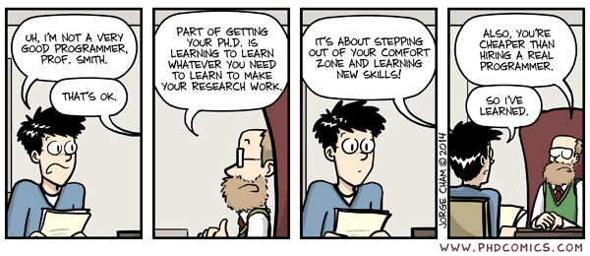

Slide 4


Slide 5
Chuck Norris facts of programming
You are about as forgetful as the average programmer
The average programmer achieves 10 lines of code per day
christin: you need to learn how to figure out stuff yourself.
how do i do that

Slide 6
How to get help yourself
Rubberducking
Prepare to ask Donald Knuth / Jeff Leek / Lothar Krause
Work in groups

Slide 7
Before you ask
Read the man or help page or the official documentation well before turning to Google
Use stack exchange, forums and related resources carefully [ http://stackoverflow.com/questions/18469686/how-to-split-files-using-perl ]
Write down what you want to achieve in # comments

Slide 8
More well meant advice
Run your program often, particularly when beginning
Read the error message carefully and interpret it
Be careful about white space

Slide 9
How do I get help?
  perldoc perl (general info, TOC)
  perldoc perlop (operators like +, *)
  perldoc perlfunc (functions like chomp: > 200!)
  perldoc perlretut (regular expressions: /ABC/)
  perldoc perlreref (regular expression reference)
  perldoc -f chomp (what does chomp function do?)
  perldoc Getopt::Long (learn about a Perl module)
Type q to quit when viewing help pages,
Space bar for next page
Perl in a Day - Introduction

Slide 10
File Handles
Opening a File:
  open (SRC, “my_file.txt”);
Reading from a File
  $line = <SRC>; # reads up to a newline
  # character
Closing a File: close(SRC);

Slide 11
File Handles
Opening a file for output:
  open (DST, “>my_file.txt”);
Opening a file for appending
  open (DST, “>>my_file.txt”);
Writing to a file:
  print DST “Printing a line.\n”;
Safeguarding against opening a non existent file
  open (SRC, “file.txt”) or die “Could not open file.\n”;

Slide 12
File Test Operators
Check to see if a file exists:
  if ( -e “file.txt”) {
  # The file exists!
  }
Other file test operators:
  -r readable
  -x executable
  -d is a directory
  -T is a text file

Slide 13
Quick Program with File Handles
Program to copy a file to a destination file
  #!/usr/local/bin/perl -w
  open(SRC, “file.txt”) or die “Could not open source file.\n”;
  open(DST, “>newfile.txt”);
  while ( $line = <SRC> ) {
  print DST $line;
  }
  close SRC;
  close DST;

Slide 14
Some Default File Handles
STDIN : Standard Input
  $line = <STDIN>; # takes input from # stdin
STDOUT : Standard output
  print STDOUT “File handling in Perl is sweet!\n”;
STDERR : Standard Error
  print STDERR “Error!!\n”;

Slide 15
Chomp and Chop
Chomp : function that deletes a trailing newline from the end of a string.
    $line = “A line of text\n”;
    chomp $line; # removes the new line character
    print $line; # prints “A line of # text” without returning
Chop : function that chops off the last character of a string.
    $line = “A line of text”;
    chop $line;
    print $line;#prints “A line of tex”

Slide 16
Time
Time in Unix systems is counted in seconds since January 1st, 1970 GMT (the Epoch)
The command localtime gives the seconds since the Epoch
Localtime evaluated in scalar context gives a convenient time

Slide 17
Exercise
Count the composition of a FASTA formatted file (should work for proteins and DNA)
Run the file on test input that you created manually to know whether your counting is correct
  You automatically compare the test output and your manually created output!
Find the fasta sequence of a gene. Test your script
Evaluate the time required for small files
How much memory is your program consuming?
Run the file on the gaia cluster on the human genome
Write a program to count the composition of all k-mers

