Slide 1
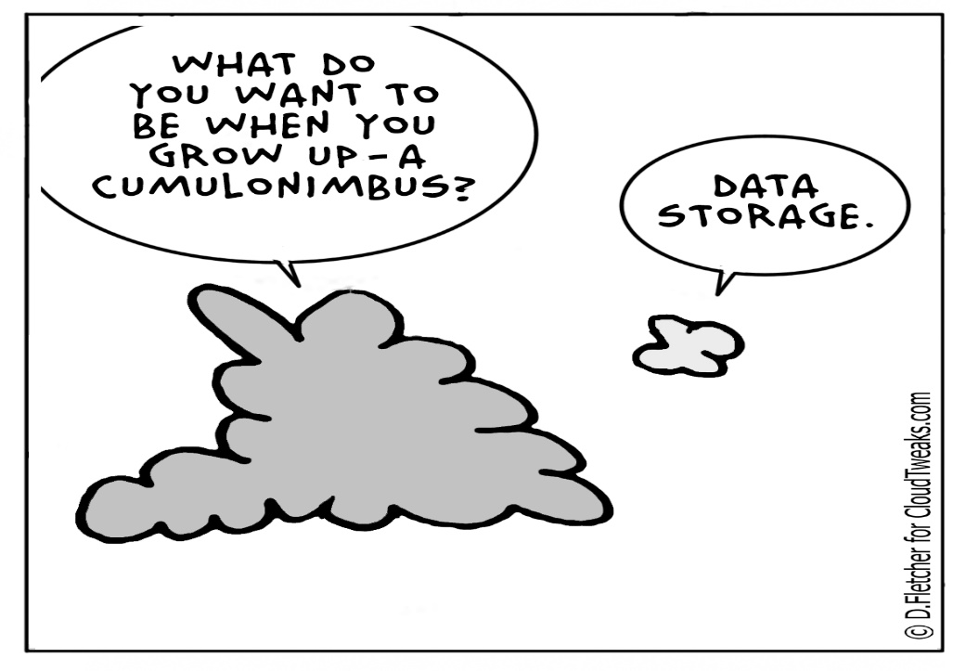
Azure Storage
Cloud Computing – Entwickeln von Applikationen mit Hilfe der Windows Azure Plattform

Slide 2
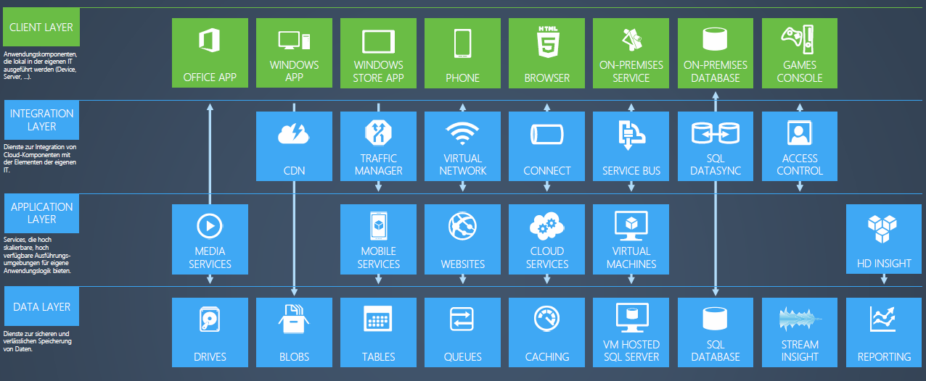
Azure Services
Grafik: Microsoft

Slide 3
Windows Azure Storage
Cloud Storage - Anywhere and anytime access
Blobs, Tables and Queues (and Files)
Highly Durable, Available and Massively Scalable
Easily build “internet scale” applications
More than 10 trillion stored objects
1 Million request/sec on average
Pay for what you use
Exposed via easy and open REST APIs
Client libraries in .NET, Java, Node.js, Python, PHP, Ruby

Slide 4
Windows Azure Data Storage Concepts
Container
Blobs
https://<account>.blob.core.windows.net/<container>
Account
Table
Entities
https://<account>.table.core.windows.net/<table>
Queue
Messages
https://<account>.queue.core.windows.net/<queue>

Slide 5
Blobs
Simple interface to store and retrieve files in cloud
Data sharing – share documents, pictures, video, music, etc.
Big Data – store raw data/logs and compute/map reduce over data
Backups – data and device backups

Slide 6
Tables
Massively scalable and extremely easy to use NoSQL system that auto scales
Key-value lookups at scale
Store user information, device information, any type of metadata for your service

Slide 7
Queues
Provides a reliable messaging system
Decouple components/roles
Web role to worker role communication
Allows roles to scale independently
Implement scheduling of asynchronous tasks
Implement persistent messaging
Building process/work flows

Slide 8




Storing Data on Microsoft Azure
Microsoft Azure Storage

Slide 9

Storing Data on Microsoft Azure
Microsoft Azure Storage
Highly Durable Storage

Slide 10
Increased Availability with Replication
Geo-Replicated Storage
WEST
DC
EAST
DC
> 400 miles
continuous storage geo-replication
Microsoft Azure Storage

Slide 11
Storage Security
Windows Azure Storage provides simple security for calls to storage service
HTTPS endpoint
Digitally sign requests for privileged operations
Two 512bit symmetric keys per storage account
Can be regenerated independently
More granular security via Shared Access Signatures
Notes:
Slide Objective
Describe security principles
Speaking notes
Simple shared secret security
Can use HTTP or HTTPS to access
Use HTTP for public content
Use HTTPS for secure content (i.e. where using es or Shared Access Signatures)
Two 512bit keys
Keys used to sign priv requests
Two keys supports rolling of keys
E.g. if one key is compromised can use the second key while first is regenerated
More on SAS’s soon
Notes
More on Security on Day 3
http://social.msdn.microsoft.com/Forums/en-US/windowsazure/thread/1e023e8d-0ff9-472e-bcc1-05400a41466c
http://blogs.msdn.com/b/usisvde/archive/2010/05/21/best-practices-for-data-storage-security-on-windows-azure.aspx

Slide 12
Shared Access Signatures
Fine grain access rights to blobs and containers
Sign URL with storage key
Revocation
Use short time periods and re-issue
Use container level policy that can be deleted
Two broad approaches
Ad-hoc
Policy based
Notes:
Slide Objective
Introduce Shared Access Signatures
Speaker Notes
Shared Access Signatures provide access rights to containers and blobs at a more granular level than by simply setting a container’s permissions
Grant users access to a specific blob or to any blob within a specified container for a specified period of time.
Specify what operations a user may perform on a blob that's accessible via a Shared Access Signature.
Use HTTPS to protect the signature (it is like a short dated password)
Two approaches
Ad-hoc Use for very short dated single use scenarios
Policy based Use for longer dated revocable permission sets
Always endeavour to use Least Permission set possible
Notes
http://msdn.microsoft.com/en-us/library/ee395415.aspx

Slide 13
Ad Hoc Signatures
Create Short Dated Shared Access Signature
Signedresource Blob or Container
AccessPolicy Start, Expiry and Permissions
Signature HMAC-SHA256 of above fields
http://...blob.../pics/image.jpg? sr=c&st=2009-02-09T08:20Z&se=2009-02-10T08:30Z&sp=w &sig= dD80ihBh5jfNpymO5Hg1IdiJIEvHcJpCMiCMnN%2fRnbI%3d
Notes:
Slide Objective
Understand Ad-Hoc Shared Access signatures
Speaker Notes
Ad-hoc Use for very short dated single use scenarios
Include all permissions and expiry in the signed URL
Can only revoke by deleting the blob or waiting for expiry
Use very short dated URLs
Notes
http://msdn.microsoft.com/en-us/library/ee395415.aspx

Slide 14
Policy Based Signatures
Create Container Level Policy
Specify StartTime, ExpiryTime, Permissions
Create Shared Access Signature URL
Signedresource Blob or Container
Signedidentifier Optional pointer to container policy
Signature HMAC-SHA256 of above fields
Use case
Providing revocable permissions to certain users/groups
To revoke: Delete or update container policy
http://...blob.../pics/image.jpg? sr=c&si=MyUploadPolicyForUserID12345 &sig=dD80ihBh5jfNpymO5Hg1IdiJIEvHcJpCMiCMnN%2fRnbI%3d
Notes:
Slide Objective
Understand Ad-Hoc Shared Access signatures
Speaker Notes
Policy Based
Points to a Container level policy
User where want a longer dated permission with ability to revoke
Include all permissions and expiry in the signed URL
Can only revoke by deleting the blob or waiting for expiry
Use very short dated URLs
Notes
http://msdn.microsoft.com/en-us/library/ee395415.aspx

Slide 15
Types of Authentication
Symmetric Shared Key
Shared Access Signatures
Public (Blob service)

Slide 16
Symmetric Shared Key
Provides read/write/delete access to all resources
Create a well known string for each request
Date time
Canonical resource name
HTTP method
etc.
Use any one of the two 512 bit secret keys provided
Signature = HMAC-SHA 256(string to sign)

Slide 17
Shared Access Signatures (SAS)
Owner of resource creates a pre-authenticated token
Provide parameters for access: permissions, time range, resource(s)
Parameters can be stored on container (revocable by changing parameters) or embedded in Uri (revocable only by changing secret keys)
Owner shares tokens with only the users who require access
Token provides time limited and restricted access to resources to anyone who has access to token

Slide 18
Public (Blob service only)
Read only access available
Owner can provide listing access too

Slide 19
API
<configuration>
<appSettings>
<add key="StorageConnectionString„
value="DefaultEndpointsProtocol=https;
AccountName=storagesample;
AccountKey=nYV0gln9fT7bvY+rxu2iWAEyzPNITGkhM88J8HUoyofpK7C8fHcZc2kIZp 6cKgYRUM74lHI84L50Iau1+9hPjB==" />
</appSettings>
</configuration>

Slide 20
API
// Retrieve storage account from connection string.
CloudStorageAccount storageAccount = CloudStorageAccount.Parse(
CloudConfigurationManager.GetSetting("StorageConnectionString"));
// Create the blob client.
CloudBlobClient blobClient = storageAccount.CreateCloudBlobClient();
// Retrieve reference to a previously created container.
CloudBlobContainer container = blobClient.GetContainerReference("mycontainer");
// Retrieve reference to a blob named "myblob".
CloudBlockBlob blockBlob = container.GetBlockBlobReference("myblob");
// Create or overwrite the "myblob" blob with contents from a local file.
using (var fileStream = System.IO.File.OpenRead(@"path\myfile"))
{
blockBlob.UploadFromStream(fileStream);
}

Slide 22
Persistent VM Disks
Persistent disks for VMs in Azure
Disks are VHDs stored in Azure Blobs
VM see the VHD/Blob as a disk
Reads translated to GETs, writes to PUTs
Blob protected by write-lease
Reads from the blob (and snapshots) still allowed
Metrics and analytics
Disks are backed by scalable Windows Azure Storage Infrastructure
Higher # of outstanding IOs gets better throughput

Slide 23
02 | Architecture
Andrew Edwards | Principal SDE
Jai Haridas | Principal Development Manager

Slide 24
Module Overview
Design Goals
Windows Azure Storage Stamps
Architecture Layers inside Stamps

Slide 25
Design Goals
Highly Available with Strong Consistency
Provide access to data in face of failures/partitioning
Durability
Replicate data several times within and across regions
Scalability
Need to scale to zettabytes
Provide a global namespace to access data around the world
Automatically scale out and load balance data to meet peak traffic demands
Additional details can be found in the SOSP paper:
“Windows Azure Storage: A Highly Available Cloud Storage Service with Strong Consistency”, ACM Symposium on Operating System Principals (SOSP), Oct. 2011

Slide 26
Windows Azure Storage Stamps
Access blob storage via the URL: http://<account>.blob.core.windows.net/
Storage
Location
Service
Data access
LB
LB
Storage Stamp
Storage Stamp
Front-Ends
Front-Ends
Partition Layer
Partition Layer
Inter-stamp (Geo) replication
DFS Layer
DFS Layer
Intra-stamp replication
Intra-stamp replication

Slide 27
Architecture Layers inside Stamps
Front-end Layer
REST front-end (blob, table, queue)
Authentication/authorization
Metrics/logging
Partition Layer
Understands our data abstractions, and provides optimistic concurrency
Massively scalable index
Log Structured Merge Tree
Each log (stream) is a linked list of extents
Distributed File System Layer
Data persistence and replication (JBOD)
Data is stored into a file called extent, which is replicated 3 times across different nodes (UDs/FDs)
Append-only file system
Front-End Layer
Index
Partition Layer
M
Distributed File System

Slide 28
Dynamic Load Balancing – Partition Layer
Spreads index/transaction processing across partition servers
Master monitors traffic load/resource utilization on partition servers
Dynamically load balance partitions across servers to achieve better performance/availability
Does not move data around, only reassigns what part of the index a partition server is responsible for
Front-End Layer
Index
Partition Layer
M
Distributed File System

Slide 29
Dynamic Load Balancing – DFS Layer
DFS Read load balancing across replicas
Monitor latency/load on each node/replica; dynamically select what replica to read from and start additional reads in parallel based on 95% latency
DFS write load balancing
Monitor latency/load on each node; seal the replica set with an overloaded node, and switch to a new extent on another set of nodes to append to
DFS capacity load balancing
Lazily move replicas around to ensure the disks and nodes have equal amount of data on them
Important for avoiding hot nodes/disks
Front-End Layer
Partition Layer
M
Distributed File System

Slide 30
03 | Authentication
Andrew Edwards | Principal SDE
Jai Haridas | Principal Development Manager

Slide 31
Module Overview
Types of Authentication
Choosing the right authentication
Designing your service for security

Slide 32
Choosing Right Authentication Method
Symmetric Shared Key Authentication
Trusted service that owns the storage accounts
Shared Access Signature (SAS)
3rd party services
Mobile device applications
Restricted access for services
Public (Blob service only)
CDN access
Browser based access

Slide 33
Designing Your Service For Security
How to store Secret keys/Shared Access Signature (SAS) tokens?
Persist only encrypted key/token
Use cert to decrypt the encrypted key in the application
Certs available only on required nodes
How to transfer SAS tokens?
Use HTTPS to transfer SAS tokens
How often should I change my Secret keys/SAS tokens?
Automate the process to enable changing it frequently
Always be ready to revoke SAS tokens or change Secret keys/SAS tokens

Slide 34
Designing Your Service For Security (continued…)
How do I rotate Secret Keys/SAS tokens?
Two 512 keys provided.
Push configuration change to all services to use one of them
Other key can be changed using service management API

Slide 35
Designing Your Service For Security (continued…)
What should I consider when using SAS tokens?
Maintain sufficient buffer for start time and end time because of clock skew
Avoid setting start time if access should start right away
Provide right granularity of permissions
Restrict resource access
If a blob needs to be shared, no point sharing container
Limit spk, srk, epk, erk as required

Slide 36
Designing Your Service For Security (continued…)
What should I consider for a SAS token distribution service?
Ensure authenticating the service requesting SAS token
Use HTTPS
Be cognizant to storage REST version
Semantics for SAS Token can change from version
Beneficial if the service can generate token for at least n-1 version

