Slide 1
Azure SQL Databases
Cloud Computing – Entwickeln von Applikationen mit Hilfe der Azure Plattform

Slide 2
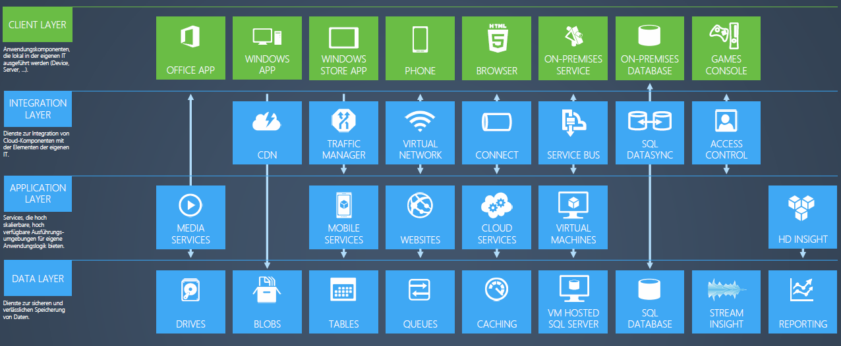
Azure Services
Grafik: Microsoft

Slide 3

Windows Azure Data Management — Overview
NON-RELATIONAL
RELATIONAL
0100110100101010100101000111010100100101
Blob Storage
Tables
SQL Server in a VM
SQL Database
A cloud storage service offering the simplest way to store large amounts of unstructured text or binary data, such as video, audio and images, and for creating virtual hard drives in the cloud.
A NoSQL key/value store that provides simple access to semi-structured data at a lower cost for applications that do not need robust querying capabilities
A full-featured instance of SQL Server running in a Windows Azure Virtual Machine for quickly and easily running or testing SQL Server applications in the cloud
A feature-rich, fully managed relational database service that offers a highly productive experience with business-ready capabilities built on SQL Server technology
Best for inexpensive, scalable storage of data
Best for inexpensive, scalable storage of semi-structured data
Best for existing and new applications needing full SQL Server feature set
Best for new cloud applications needing relational capabilities and high availability

Slide 4
Options for Relational Data Services in the Cloud
INFRASTRUCTURE AS A SERVICE (IaaS)
PLATFORM AS A SERVICE (PaaS)
SQL Server in a Windows Azure Virtual Machine
Windows Azure SQL Database
DB
Full Control & Flexibility
Simplified Administration
Highly Customized Environment
Eliminate Hardware Costs
Decrease Time to Market
Fully Managed Service
Eliminate Hardware & Administrative Costs
Build Modern Apps

Slide 5
Options for Relational Data Services in the Cloud
INFRASTRUCTURE AS A SERVICE (IaaS)
PLATFORM AS A SERVICE (PaaS)
SQL Server in a Windows Azure Virtual Machine
Windows Azure SQL Database
DB
Full Control & Flexibility
Simplified Administration
Move Existing Apps
Development & Test
Hybrid HA & Disaster Recovery
Cloud-designed Business Apps
Websites & Mobile Apps
Extend On-Premises Apps

Slide 6
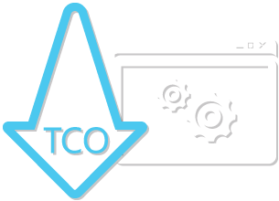


SQL Server in a Windows Azure Virtual Machine
Low TCO for Existing Apps
Full SQL Server Capability
Flexibility & Control
Managed Infrastructure
No App Changes Required
Familiar Development tools
Library of VM Templates
High Availability of Database with AlwaysOn Availability Groups
Advanced Security (Transparent data encryption & auditing)
Full Business Intelligence Functionality
Full Control of Virtual Machine
Common Identity (Active Directory Integration)
Fully Managed Infrastructure
99.95% SLA for Virtual Machine
Single Pane of Glass to Manage with System Center 2012

Slide 7


Move Existing Apps
SQL Serve in a Windows Azure VM
Option 1
Option 2
Reduce or eliminate hardware costs and maintenance
VHD
Database
Virtual Machine
Get database portability across on-premises and cloud with compatible virtualization
P2V
V2V
Windows Server Hyper-V VHD
No application changes required7 –simply virtualize and move
Non-Virtualized
Virtualized

Slide 8
Develop & Test New Apps
SQL Serve in a Windows Azure VM
Leverage consistent tools, with SQL Server Management Studio & SQL Server Data Tools
TEST
Spin up VMs in minutes with a gallery of ready-to-use images at your fingertips
Virtual Machine
Develop
Deploy
Save money by shutting down development and testing VMs when not in use
SQL Server Data Tools
On-Prem

Slide 9
Hybrid HA & Disaster Recovery
SQL Serve in a Windows Azure VM
Remove the costs of licensing & maintaining HA secondaries
Windows Azure Virtual Machine
SQL Server AlwaysOn Secondaries
Leverage cloud benefits for scale and high availability of secondaries
APPLICATION
Streamline HA setup and reduce downtime in the case of on-premises failure
SQL Server AlwaysOn Primary, On-premises
On-Prem

Slide 10
Creating a SQL Server Azure VM [Greg]

Slide 11
Windows Azure SQL Database
Business-class
SQL Server Technology
IT & Dev
Productivity
DB
Built-in HA secondaries and 99.9% SLA on the database
Reserved capacity for powerful & predictable performance
Dynamic scale out of 1,000s of DBs
Fully managed service (no patching of DB or OS)
Extends familiar SQL Server technology
Relational database engine for transactional integrity
Consistent DB objects; tables, views, stored procedures
Database app portability to and from on-premises
Integration within SQL Server Management Studio
PowerShell support to manage at scale
Visual Studio to build once and deploy anywhere

Slide 12
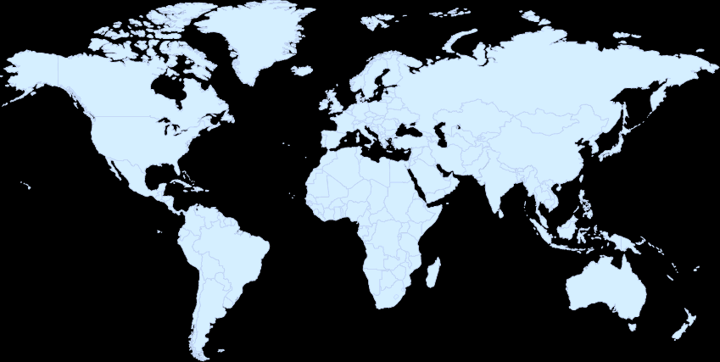
SQL Database High Availability
Single Logical
Database
Multiple Physical Replicas
Firewall
Primary
TDS
Automatic HA built-in
One primary node, two online replicas
Writes are replicated to online secondaries
Transactional integrity maintained with replication
No database downtime even with Azure system patches
Replica 2
Replica 3

Slide 13
SQL Azure Compatibility
Currently Supported
Not Currently Supported
Tables, indexes and views
Stored Procedures
Triggers
Constraints
Table variables, session temp tables (#t)
Spatial types, HierarchyId
Data Types
Sparse Columns, Filestream
Partitions
Filegroups
Full-text indexes
SQL-CLR
SQL Server Agent
SQL Server Management Objects
Tables require clustered indexes

Slide 15
SQL Database Scale Out
Massive Scale
Engage 1000s of nodes within the cluster
Simplified Development and Administration
Robust programming & connectivity model for creating dynamic applications
10 GB DB
10 GB DB
10 GB DB
10 GB DB
10 GB DB
10 GB DB
100 GB Database
Simplified Multi-tenant Database Tiers
Multi-tenancy provides great efficiencies by increasing density of tenants per database
Applications don’t have to make a static decision about tenant placement
10 GB DB
10 GB DB
10 GB DB
10 GB DB
10 GB DB
10 GB DB
1,000 TPS
10,000 TPS

Slide 16
SQL Database Premium Edition
Web & Business editions
Primary
Secondary
Secondary
Customer databases share hardware resources
Workload demands vary by customer DB, and by day
Unpredictable performance
Premium edition w/ reserved capacity
Primary
Secondary
Secondary
Fixed amount of reserved capacity for SQL Database primary and 2 built-in replicas
Ideal for business-class applications:
have high peak loads
support many concurrent requests
require low latency
Offered in two sizes for preview: P1 & P2
Primary
Secondary
Secondary
Primary
Secondary
Secondary

Slide 17



Business Apps. Scalable & Global.
DB
Windows Azure SQL Database
Fast time-to-market with point-and-click simplicity & familiar developer tools
Scale your business with the cloud
Only way to cost-effectively meet peak demands
Non-relational data
Relational data
Reduce or eliminate hardware & maintenance costs
Azure Storage
SQL Database
Data Collection
Data Collection
“During the on sale for a big event we have tens of thousands of people online ready to grab their tickets. With Azure we can pay for the capacity just when we need it”
Transactional Processing
DB
DB
DB
Elastic scale, big data, small data
Scale In/Out to Meet Workload

