Slide 1
Azure Traffic Manager
Cloud Computing – Entwickeln von Applikationen mit Hilfe der Azure Plattform

Slide 2
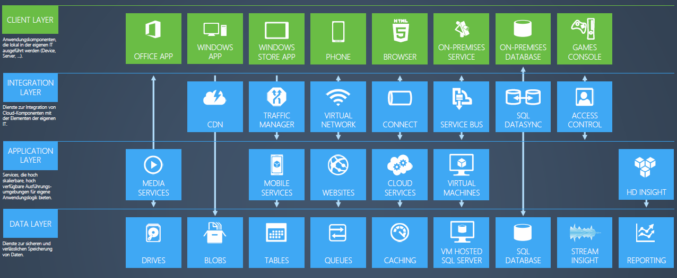
Azure Services
Grafik: Microsoft

Slide 3
Agenda
Technical Overview
Performance
Disaster Recovery
Upgrade Code and Test

Slide 4
Traffic Management Fundamentals
Performance
Failover
Geomapping
Ratio
Directs the user to the “best”/”closest” deployment
One deployment is primary
Traffic is redirected to another deployment if the primary goes down
Allows users from defined geographic locations to be directed to particular deployment
Sends traffic to different deployments based on fixed ratio (N/M)
Example:
Direct the user to the “best” deployment between US South and West Europe
Example:
All traffic is directed to US North; if it goes down, send all traffic to US South
Example:
all users from US -> US North, all users from Asia -> US North, all users from Europe ‑> West Europe
Example:
Direct 20% of user traffic to US South and 80% to US North.

Slide 5
Policy Building Blocks
Deployment Health
Customer metadata
Policy
Network Intelligence
GeoIP data
Geographic
Performance
Ratio
Failover

Slide 6
Technical Overview

Slide 7
a.root-servers.net …
k.root-servers.net
1
Q: What is www.contoso.com?
A: Ask ns1/2.contoso.com
2
Users’ LDNS IP=99.88.77.66

Slide 8
a.root-servers.net …
k.root-servers.net
ns1.contoso.com
ns2.contoso.com
3
Q: What is www.contoso.com?
A: CNAME to www-contoso.trafficmgr.com
1
Q: What is www.contoso.com?
A: Ask ns1/2.contoso.com
4
2
Users’ LDNS IP=99.88.77.66

Slide 9
a.root-servers.net …
k.root-servers.net
ns1.contoso.com
ns2.contoso.com
3
Q: What is www.contoso.com?
A: CNAME to www-contoso.trafficmgr.com
1
Q: What is www.contoso.com?
A: Ask ns1/2.contoso.com
4
2
5
Q: What is www-contoso.trafficmgr.com?
Users’ LDNS IP=99.88.77.66
DNS Server

Slide 10
a.root-servers.net …
k.root-servers.net
ns1.contoso.com
ns2.contoso.com
3
Q: What is www.contoso.com?
A: CNAME to www-contoso.trafficmgr.com
1
Q: What is www.contoso.com?
A: Ask ns1/2.contoso.com
4
2
5
Q: What is www-contoso.trafficmgr.com?
Users’ LDNS IP=99.88.77.66
DNS Server
Policy Engine
www-contoso policy
“choose the best performing deployment” between:
Deployment A
Deployment B
Deployment C
Traffic Manager

Slide 11

a.root-servers.net …
k.root-servers.net
ns1.contoso.com
ns2.contoso.com
3
Q: What is www.contoso.com?
A: CNAME to www-contoso.trafficmgr.com
1
Q: What is www.contoso.com?
A: Ask ns1/2.contoso.com
4
2
5
Q: What is www-contoso.trafficmgr.com?
Users’ LDNS IP=99.88.77.66
DNS Server
Policy Engine
20ms
80ms
Deployment C (Down)
www-contoso policy
“choose the best performing deployment” between:
Deployment A
Deployment B
Deployment C
IP=33.44.55.66
Traffic Manager
Deployment A
US North
Deployment B
West Europe
IP=11.22.33.44
IP=22.33.44.55

Slide 12
a.root-servers.net …
k.root-servers.net
ns1.contoso.com
ns2.contoso.com
3
Q: What is www.contoso.com?
A: CNAME to www-contoso.trafficmgr.com
1
Q: What is www.contoso.com?
A: Ask ns1/2.contoso.com
4
2
5
Q: What is www-contoso.trafficmgr.com?
6
Which deployments are up?
Users’ LDNS IP=99.88.77.66
DNS Server
Policy Engine
What are the regions for deployments A and B?
7
What is the network distance between IP 99.88.77.66 and the US North and West Europe regions?
20ms
80ms
8
Deployment C (Down)
www-contoso policy
“choose the best performing deployment” between:
Deployment A
Deployment B
Deployment C
IP=33.44.55.66
Traffic Manager
Deployment A
US North
Deployment B
West Europe
IP=11.22.33.44
IP=22.33.44.55

Slide 13
a.root-servers.net …
k.root-servers.net
ns1.contoso.com
ns2.contoso.com
3
Q: What is www.contoso.com?
A: CNAME to www-contoso.trafficmgr.com
1
Q: What is www.contoso.com?
A: Ask ns1/2.contoso.com
4
2
5
Q: What is www-contoso.trafficmgr.com?
A: 11.22.33.44
6
Which deployments are up?
9
What are the regions for deployments A and B?
Users’ LDNS IP=99.88.77.66
DNS Server
Policy Engine
7
What is the network distance between IP 99.88.77.66 and the US North and West Europe regions?
20ms
80ms
8
Deployment C (Down)
www-contoso policy
“choose the best performing deployment” between:
Deployment A
Deployment B
Deployment C
IP=33.44.55.66
Traffic Manager
Deployment A
US North
Deployment B
West Europe
IP=11.22.33.44
IP=22.33.44.55

Slide 14
Performance

Slide 15



Performance Load Balancing
North America Region
Europe Region
Asia Pacific Region
130ms
30ms
240ms
www.contoso.com

Slide 16
Performance Load Balancing
North America Region
Europe Region
Asia Pacific Region
20ms
30ms
40ms
www.contoso.com
→ www-contoso.ctp.trafficmgr.com

Slide 17
Geo-distributed WA Application
Subscription
Region A – US North
www.cloudapp.net
Role 1
api.cloudapp.net
Role 1

Slide 18
Geo-distributed WA Application
Subscription
Region A – US North
Region B – East Asia
www.cloudapp.net
www2.cloudapp.net
Role 1
Role 1
api.cloudapp.net
api2.cloudapp.net
Role 1
Role 1

Slide 19
Geo-distributed WA Application
Subscription
Region A – US North
Region B – East Asia
api.contoso.com
CNAME
www.contoso.com
CNAME
www-contoso.ctp.trafficmgr.com
www.cloudapp.net
www2.cloudapp.net
Role 1
Role 1
api.cloudapp.net
api2.cloudapp.net
Role 1
Role 1

Slide 20
Geo-distributed WA Application
Subscription
Region A – US North
Region B – East Asia
api.contoso.com
CNAME
www.contoso.com
api-contoso.ctp.trafficmgr.com
CNAME
www-contoso.ctp.trafficmgr.com
www.cloudapp.net
www2.cloudapp.net
Role 1
Role 1
api.cloudapp.net
api2.cloudapp.net
Role 1
Role 1

Slide 21
Disaster Recovery

Slide 22
Disaster Recovery
North America Region
Europe Region
Asia Pacific Region
20ms
30ms
20ms
40ms
30ms
40ms
www.contoso.com
monitor http/80 → /probe.htm
→ www-contoso.ctp.trafficmgr.com

Slide 23
Disaster Recovery – 8 Minute MTR
North America Region
Europe Region
Asia Pacific Region
20ms
120ms
40ms
www.contoso.com
→ www-contoso.ctp.trafficmgr.com

Slide 24
Health Polling Updates DNS
DNS TLL
3
30sec
6
5
7
Traffic decreases
8
Traffic manager Monitoring status
<5sec
>5sec
<5sec
2
10
1
GET /prob.htm:80
200 OK
GET …
200 OK
Try 1
Try 2
Try 3
Try n
GET …
200 OK
GET …
Actual status of Hosted Service
Online
Offline
Online
4
9
Key
Monitor check
Time

Slide 25
Upgrade Code and Test

Slide 26
Upgrade Your WA Application
Subscription
Region A – US North
Region B – East Asia
api.contoso.com
CNAME
api-contoso.ctp.trafficmgr.com
api.cloudapp.net
api2.cloudapp.net
Role 1
Role 1

Slide 27
Upgrade Your WA Application
Subscription
Region A – US North
Region B – East Asia
api.contoso.com
CNAME
api-contoso.ctp.trafficmgr.com
api.cloudapp.net
api2.cloudapp.net
Role 1
Role 1

Slide 28
Upgrade Your WA Application
Subscription
Region A – US North
Region B – East Asia
api.contoso.com
CNAME
api-contoso.ctp.trafficmgr.com
api.cloudapp.net
api2.cloudapp.net
Upgraded Role 1
Role 1

Slide 29
Upgrade Your WA Application
Subscription
Region A – US North
Region B – East Asia
api.contoso.com
CNAME
api-contoso.ctp.trafficmgr.com
api.cloudapp.net
api2.cloudapp.net
Test application
Upgraded Role 1
Role 1

Slide 30
Upgrade Your WA Application
Subscription
Region A – US North
Region B – East Asia
api.contoso.com
CNAME
api-contoso.ctp.trafficmgr.com
api.cloudapp.net
api2.cloudapp.net
Upgraded Role 1
Role 1

Slide 31
Manageability
Windows Azure Portal
REST Administrative API (Dec 2011 CTP)
Windows Azure PowerShell Cmdlets (2.1 Release)

Slide 32
Summary
Globally distributed highly available DNS service
Integrated with Windows Azure
Provides a platform for a better user experience
Provides a platform for building highly available and scalable applications

Slide 33
Traffic Manager
demo

