Slide 1
Azure API Management
Cloud Computing – Entwickeln von Applikationen mit Hilfe der Azure Plattform

Slide 2
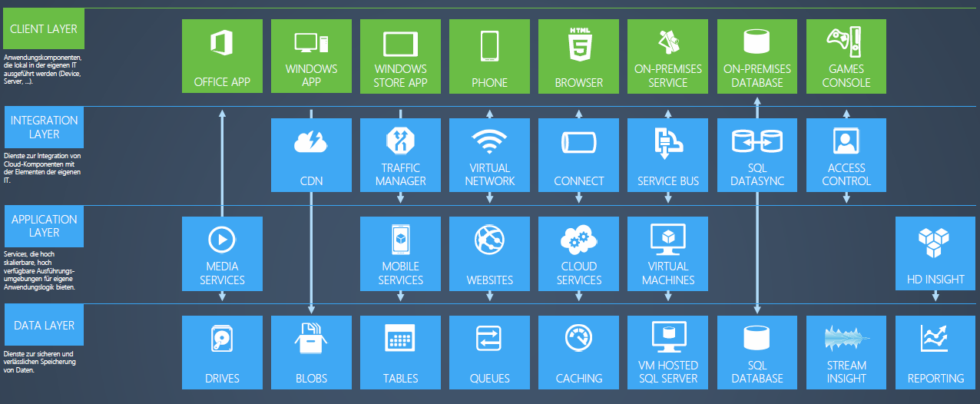
Azure Services
Grafik: Microsoft

Slide 3








Azure API Management
DEVELOPER PORTAL
APP DEVELOPERS
PROXY
BACKEND
SERVICES
APPS
PUBLISHER PORTAL
Hosted anywhere.
Developed using any technology.
API PIBLISHERS
Azure
API Management

Slide 4
In closing…
Azure API Management offers the following benefits
Easily create an API façade for the existing backend services
Quickly add new capabilities to the APIs, such as response caching and cross domain access
Package and publish APIs to developers and partners
Reliably protect published APIs from misuse and abuse
Engage developers with dynamically generated, interactive API documentation, samples, forum, and blog
Gain business and operational insights from analytics reports

Slide 5
What’s coming
Weekly updates
General Availability status in the fall
Net new features
Service management API
OAuth2
Mutual certificate authentication
Conditional policies
Custom policies
Hybrid proxy
Autoscale
…

Slide 6
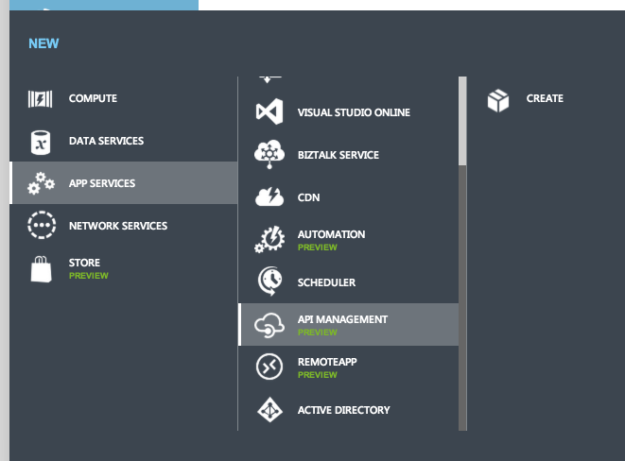
How to get started
Public preview started on May 12
50% off of list price
No bandwidth overage charges
Available to everyone on azure.com
Deployed to the following regions
US North Central
US West
US East
Europe North
Europe West
Asia Pacific East

Slide 7
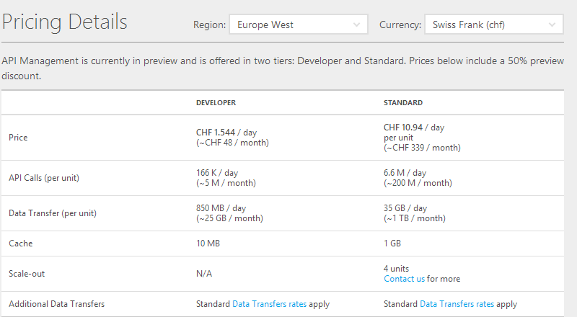
Pricing¹
¹ Prices are discounted 50% during Public Preview
SLA does not apply during Public Preview

