Slide 1
CDT Architecture 8:45–9:00
The CDT consists of the following components:
  Core
  UI
  Debug
  Launch
  Doc
  Refactoring

Slide 2
CDT Core
Cmodel/CDOM
  C/C++ AST
  Used the Outline View and “Reactoring”
Full blown C/C++ parser and Indexer
Binary parser
  Extracts symbol information from libraries, objects and archives
Project builder:
  Invokes external tools (e.g make) for building and
  Parses external tool output for problems and errors

Slide 3
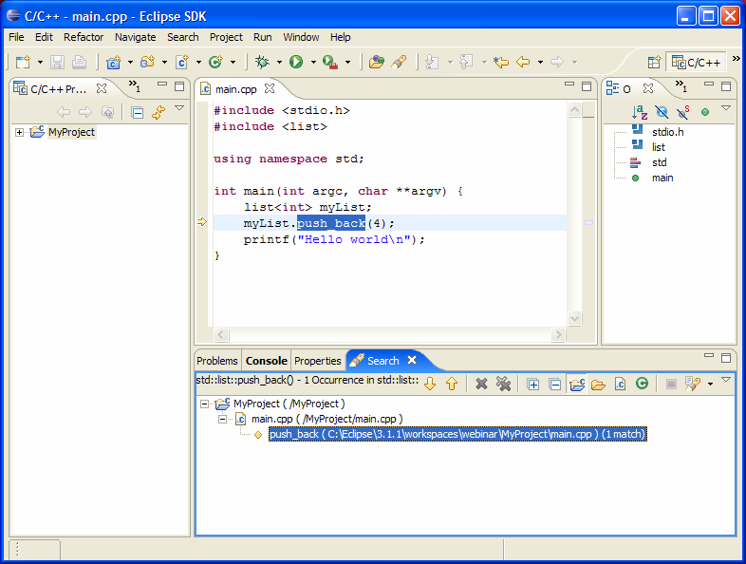
CDT UI
C/C++ Projects View
  C++-centric view of the project
C/C++ Editor
  syntax highlighting
  code assist,
  hover help
  include assistance
  Templates
C Outline View
C make view
Wizards for creating C and C++ projects
v
v
v

Slide 4
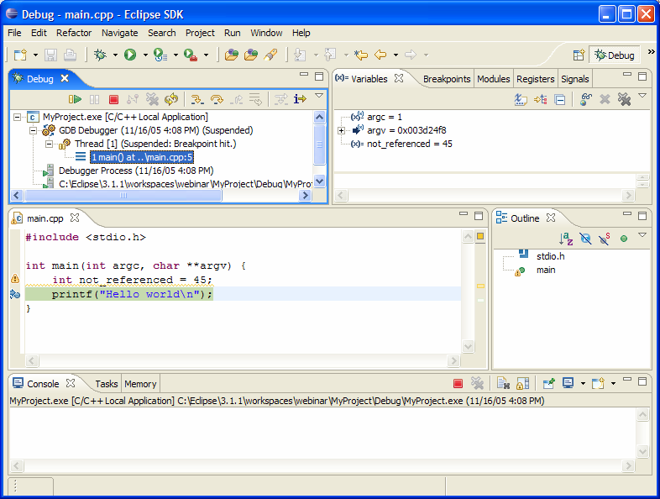
CDT Debug
Provides a C/C++ debug model which extends the debug model provided by the platform.
Provides a debugger interface (CDI) which is used to "talk" to the actual debugger.
Provides a default implementation for gdb

Slide 5
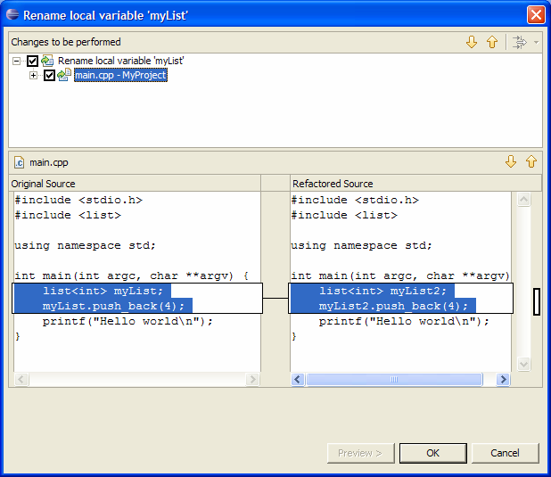
CDT Refactoring
Refactoring Support for the CDT
Extends the ltk Refactoring framework
Currently only rename refactoring

Slide 6
...and CDT Launch
  Which provides generic launch support for binaries

