Slide 1
Adding a New Language to the CDT
Jeff Overbey & Spiros Xanthos
University of Illinois at Urbana-Champaign • Software Architecture Group
Photran Committers • http://www.eclipse.org/photran

Slide 2
Welcome
Why we're talking about this:
  We are working on Photran, a CDT-based Fortran IDE
  By building on the CDT rather than the basic Eclipse platform, one can take advantage of:
    Outline view
    Make builder
    Makefile generator
    The gdb-based debugger
    Binary launcher, and
    Compiler error extraction facilities

Slide 3

Jeff Overbey
Jeff Overbey is a PhD student at the University of Illinois a Urbana-Champaign and a committer on Photran, an IDE and refactoring tool for Fortran. Photran recently changed from being a standalone Eclipse-based IDE to being a CDT add-in providing Fortran support. As part of this effort, he and the rest of the Photran team have been working closely with the developers of CDT to define a standard mechanism for adding additional languages to the CDT.

Slide 4

Spiros Xanthos
Spiros Xanthos is a PhD student at the University of Illinois at Urbana-Champaign. His research interests are mainly in the areas of Software Engineering and Systems. He is an Eclipse committer on Photran, a Fortran IDE and refactoring tool based on the CDT. As a member of the Photran team works closely with the developers of CDT to define a standard mechanism for adding additional languages to the CDT.

Slide 5
Introduction
What CDT is :
  A set of plug-ins that support C and C++ development
  With out-of-the-box support for gnu tools (gcc, g++, gdb, binutils)
  Platform for integrating other toolchains (compilers, debuggers, etc)
  Platform for adding other C/C++ tooling (Code analysis, documentation generation, unit testing)
History of CDT multi-language support :
  Started with Photran and PTP
  Other attempts within the Eclipse community (ldt)

Slide 6
We 'll cover
The CDT architecture
CDT changes for multi-language support
Implement an actual IDE for Eightbol
Managed Build System integration
Refactoring support
Current state and future directions

Slide 7
When we finish...
You should:
  Understand the architecture of the CDT
  Know what CDT components you can reuse
  Know how to extend the CDT components for a new language
  Know what need to add to create a full IDE
You shouldn't:
  Throw things to the presenters

Slide 8
Before We Start...
You will need:
  A laptop
  Eclipse >3.1
  Java 5
  Patience :)

Slide 9
Schedule
8:30–8:45 Welcome, introduction, overview
8:45–9:00 CDT overview, architecture
9:00–9:30 CDT changes for multi-language support
9:30–9:45 Break
9:45–11:15 Eightbol tutorial
11:15–11:45 Refactoring support
11:45–12:00 Discussion, Future directions

Slide 10
CDT Architecture 8:45–9:00
The CDT consists of the following components:
  Core
  UI
  Debug
  Launch
  Doc
  Refactoring

Slide 11
CDT Core
Cmodel/CDOM
  C/C++ AST
  Used the Outline View and “Reactoring”
Full blown C/C++ parser and Indexer
Binary parser
  Extracts symbol information from libraries, objects and archives
Project builder:
  Invokes external tools (e.g make) for building and
  Parses external tool output for problems and errors

Slide 12
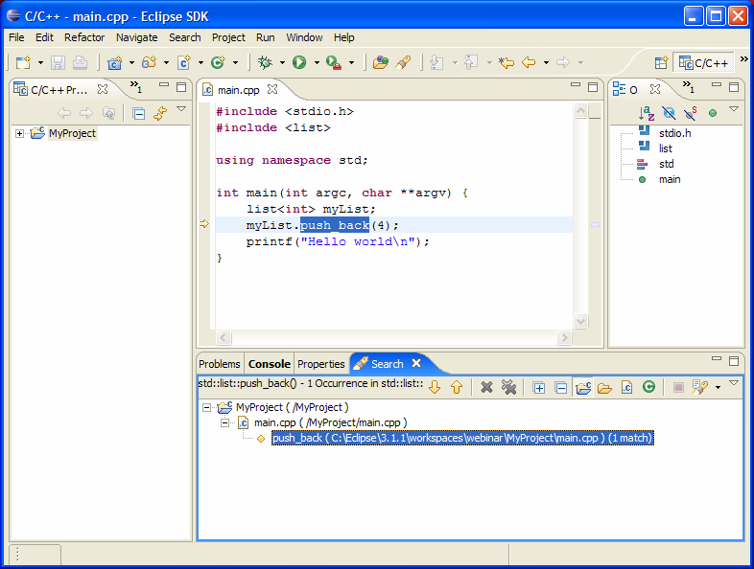
CDT UI
C/C++ Projects View
  C++-centric view of the project
C/C++ Editor
  syntax highlighting
  code assist,
  hover help
  include assistance
  Templates
C Outline View
C make view
Wizards for creating C and C++ projects
v
v
v

Slide 13
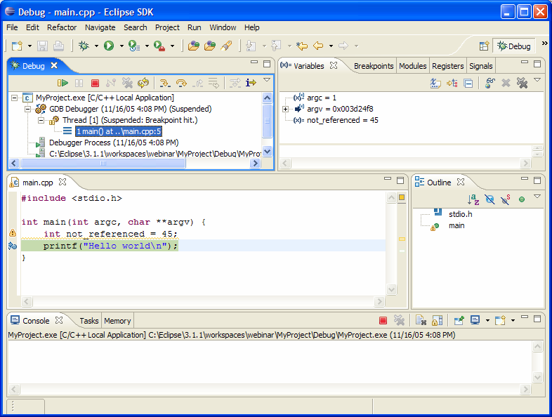
CDT Debug
Provides a C/C++ debug model which extends the debug model provided by the platform.
Provides a debugger interface (CDI) which is used to "talk" to the actual debugger.
Provides a default implementation for gdb

Slide 14
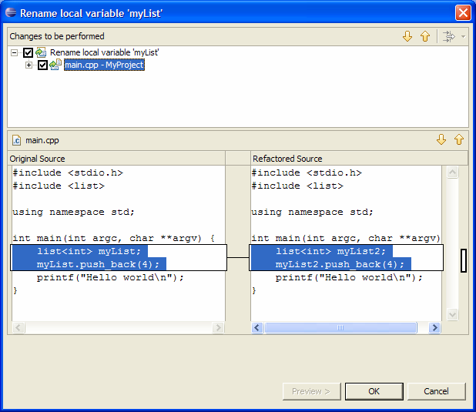
CDT Refactoring
Refactoring Support for the CDT
Extends the ltk Refactoring framework
Currently only rename refactoring

Slide 15
...and CDT Launch
  Which provides generic launch support for binaries

Slide 16
9:00–9:30
CDT Changes for Multi-language Support

Slide 17
Gee, This Is Convenient
Fortran programmers...
Use CVS
Use make
Compile to binaries
Debug using gdb

Slide 18
Gee, This Is Convenient
Fortran programmers...
Use CVS
Use make
Compile to binaries
Debug using gdb
CDT provides...
CVS synchronization
Make builder
Binary launcher
GUI for gdb

Slide 19
The Photran Heuristic
If your product development cycle involves cutting and pasting a quarter million lines of code every six months, there might be a better way to approach the problem.

Slide 20
What We Would Like
Language-Independent CDT
(make builder, gdb GUI, etc.)
C/C++ Support
(editor, etc.)
Fortran Support
(editor, etc.)

Slide 21
What We Actually Have
C/C++ CDT with Add’l Lang Suppt
(make builder, gdb GUI, etc.)
Fortran Support
(editor, etc.)

Slide 22
Basically...
If programs in a language are typically compiled with make and debugged with gdb, an IDE for that language can be created quickly by extending the CDT.
days or weeks for a basic IDE
(yes, really)

Slide 23
Part One
If programs in a language are typically compiled with make and debugged with gdb, an IDE for that language can be created quickly by extending the CDT.

Slide 24
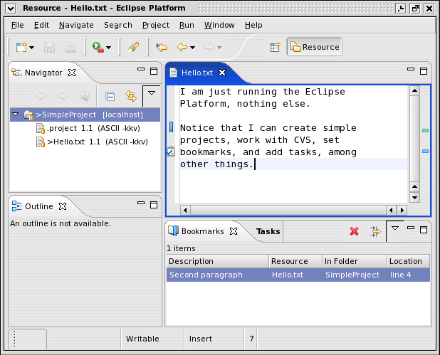
Eclipse vs. Eclipse+CDT
Eclipse provides...
Projects
Team/CVS
Frameworks
  editors
  debuggers
  etc.

Slide 25
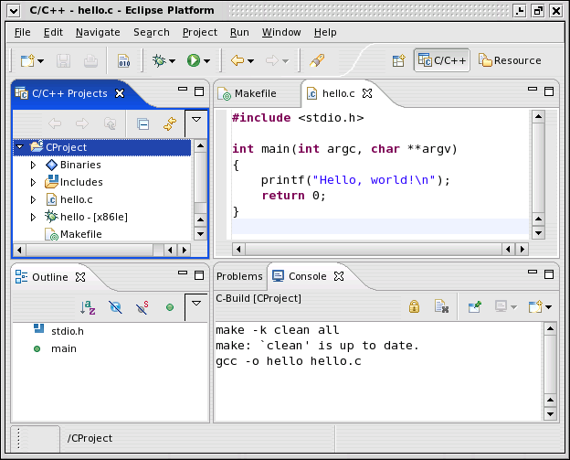
Eclipse vs. Eclipse+CDT
CDT provides...
(among other things)
Make builder
Binary launch
GUI for gdb

Slide 26
Eclipse vs. Eclipse+CDT
Eclipse provides...
Project support
Team support (CVS)
Frameworks
CDT provides...
Make builder
Binary launcher
GUI for gdb
Build on the CDT when programs in your language are typically compiled with make and debugged with gdb.

Slide 27
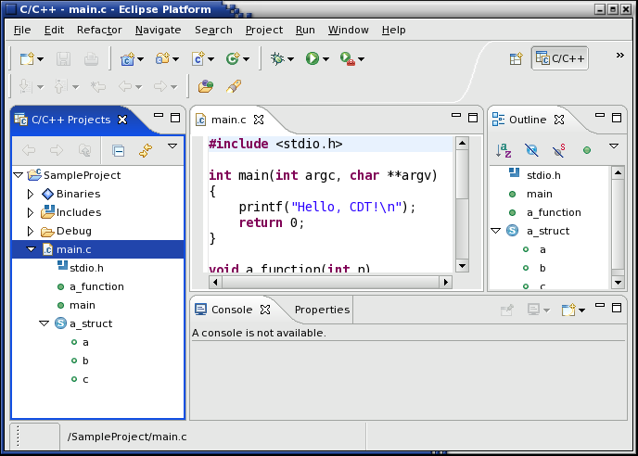
CDT Changes: User Interface

Slide 28
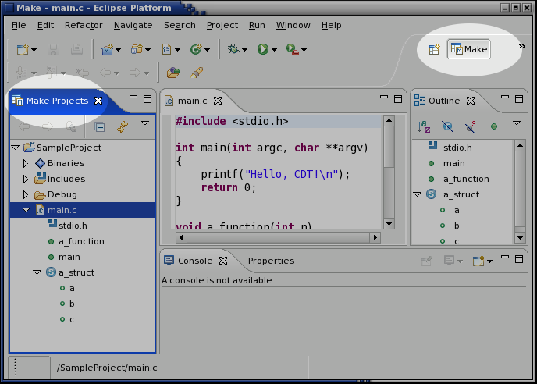
CDT Changes: User Interface

Slide 29
CDT Changes: Core
New extension point
  Plug new languages into the CDT

Slide 30
Part Two
If programs in a language are typically compiled with make and debugged with gdb, an IDE for that language can be created quickly by extending the CDT.

Slide 31
How to Extend the CDT (you'll be doing this in a few minutes...)
Create a “model builder”
  Produces Outline view for files in your language
Create an editor
  Nothing CDT-specific, except...
  Reuse the CDT Outline page
Plug into the new extension point
  List of content types (filename extensions)
  Model builder
  (more detailed descriptions follow)

Slide 32
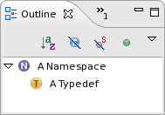
Step 1 of 3: Create a Model Builder
public class TrivialModelBuilder implements IModelBuilder
{
public Map parse(boolean quickParseMode) throws Exception
{
Map newElements = new Map();
// Create a namespace as a child of the translation unit
Namespace ns = new Namespace(translationUnit, “A Namespace”);
translationUnit.addChild(ns);
newElements.put(ns, ns.getElementInfo());
// Create a typedef as a child of the namespace
TypeDef td = new TypeDef(ns, “A Typedef”);
ns.addChild(td);
newElements.put(td, td.getElementInfo());
// No parse errors were encountered
translationUnit.getElementInfo().setIsStructureKnown(true);
return newElements;
}
}

Slide 33
Step 1.5 of 3: Support New Outline View Elements
public abstract class SampleElement extends SourceManipulation
implements ICElement, IParent, ISourceReference, IAdditionalLanguageElement
{
public SampleElement(Parent parent, String identifier)
{
super(parent, identifier, -1);
// To set position information within the file:
// setIdPos(offset, length);
// setPos(offset, length);
// setLines(startLine, endLine);
}
public Object getBaseImageDescriptor()
{
return MyPlugin.getImageDescriptor(“icons/sample.gif”);
}
}

Slide 34
Slide 2 of 3: Create an Editor
Nothing special (just a regular old Eclipse editor), except...
Reuse the CDT Outline page
  Reuse the CDT's document provider
  Set up syntax highlighting by overriding doSetInput
  Integrate the Outline page by overriding getAdapter
  Implement ISelectionChangedListener to “jump” to the correct location when the user clicks on elements in the Outline view
Allow the user to set breakpoints in your editor
  In the ctor, call setRulerContextMenuId(“#CEditorRulerContext”)

Slide 35
Step 3 of 3: Plug into the New Extension Point
Create a class that implements IAdditionalLanguage...
public interface IAdditionalLanguage
{
public String getName();
public Collection<String> getRegisteredContentTypeIds();
public IModelBuilder createModelBuilder(
TranslationUnit tu,
Map<ICElement, CElementInfo> newElements);
}
...and plug it into the CDT Core.
<extension point=”org.eclipse.cdt.core.AdditionalLanguages”>
<language class=”com.mycompany.XYZLanguage” />
</extension>

Slide 36
You May Also Want To
Create some “error parsers” (easy)
  An error parser scans the output of make for error messages from a particular compiler and displays them in the Problems view
Integrate into the Managed Build System
  Allows a makefile to be generated automatically

Slide 37
Things We Haven't Considered
  Indexer (not very good yet)
  Open Type dialog (still C/C++-specific)
  Browsing perspective (still C++-specific)
  IPathEntry hierarchy (huh?)
  CModelDeltaBuilder (huh?)
  AST integration (even if it's possible, sounds like a bad idea...)
  Search (still C/C++-specific)
  Refactoring UI (need to integrate with it or disable it)

Slide 38
9:30 - 9:45
Break

Slide 39
9:45–11:15
  Eightbol Tutorial

Slide 40
The Plan...
1. Learn the Eightbol language
2. Download and try out the Eightbol compiler
3. Build an entire IDE for Eightbol
Make sure you have these files (in eightbol.zip):
eightbol-site.pdf
eightbol-compiler-linux.tgz
eightbol-tutorial.pdf
starter-workspace.zip

Slide 41
11:15–11:45
Refactoring Support

Slide 42
Discussion / Future Directions 11:45 – 12:00

