Slide 1
BITSAT
CubeSat Bitcoin Mining

Slide 2
The Problem
Bitcoin mining using solar energy is subject to intermittent sunlight, disrupted by cloudy skies, night time, and the atmosphere
Launching satellites into space are expensive
Bitcoin mining is geography constrained, leading to centralization around certain locationsc

Slide 3
The Solution: CubeSat Bitcoin Mining!
There is potentially unlimited sunlight in space, meaning consistent, free energy for bitcoin mining
Bitcoin mining can offset the cost of a launch, potentially rendering it profitable
A BTC mining satellite can be launched from anywhere, decentralizing access to mining, and improving the security of the network

Slide 4
Constraints
Design a cubesat miner that can withstand the harshness of space
Materials must be lightweight and consume little energy, other than the bitcoin miner
Communications between the satellite and homebase

Slide 5
Initial Design
1U cubesat frame following Cubestat Design Principles handbook
Raspberry Pi Zero 2W for size, weight, low power draw
Cubeaxe for lightweight BTC asic
Lora for low cost long range radio communication between space and earth
Solar panels for energy
Battery back-up system

Slide 6
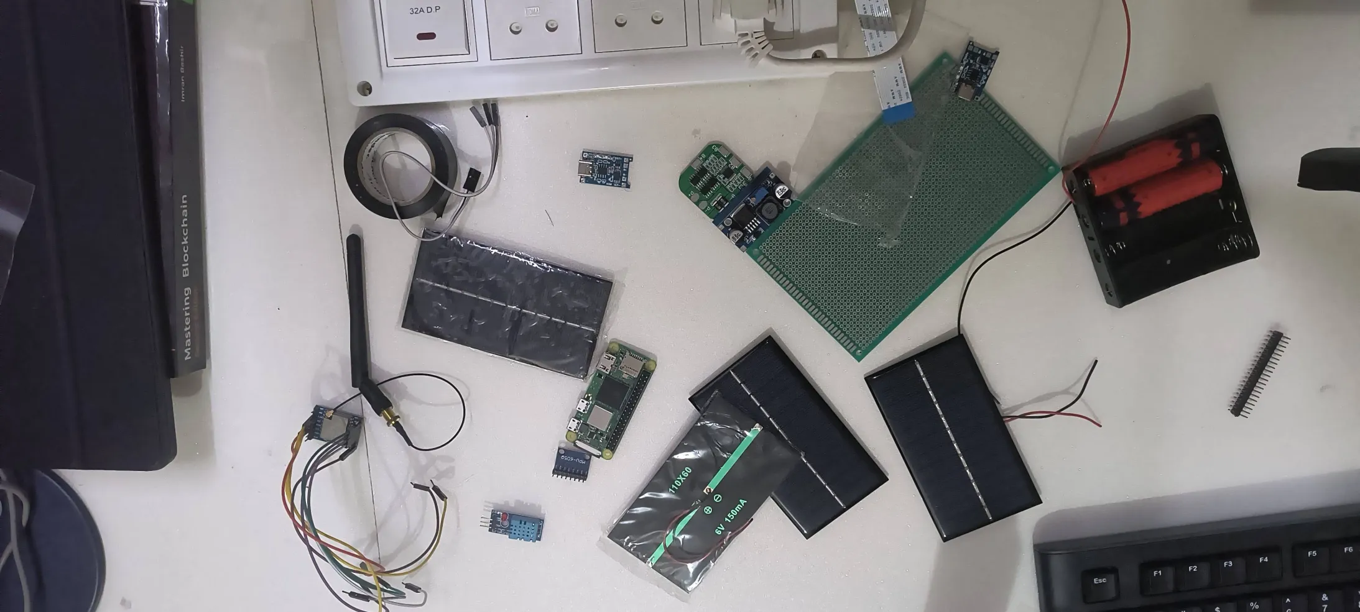

Slide 7
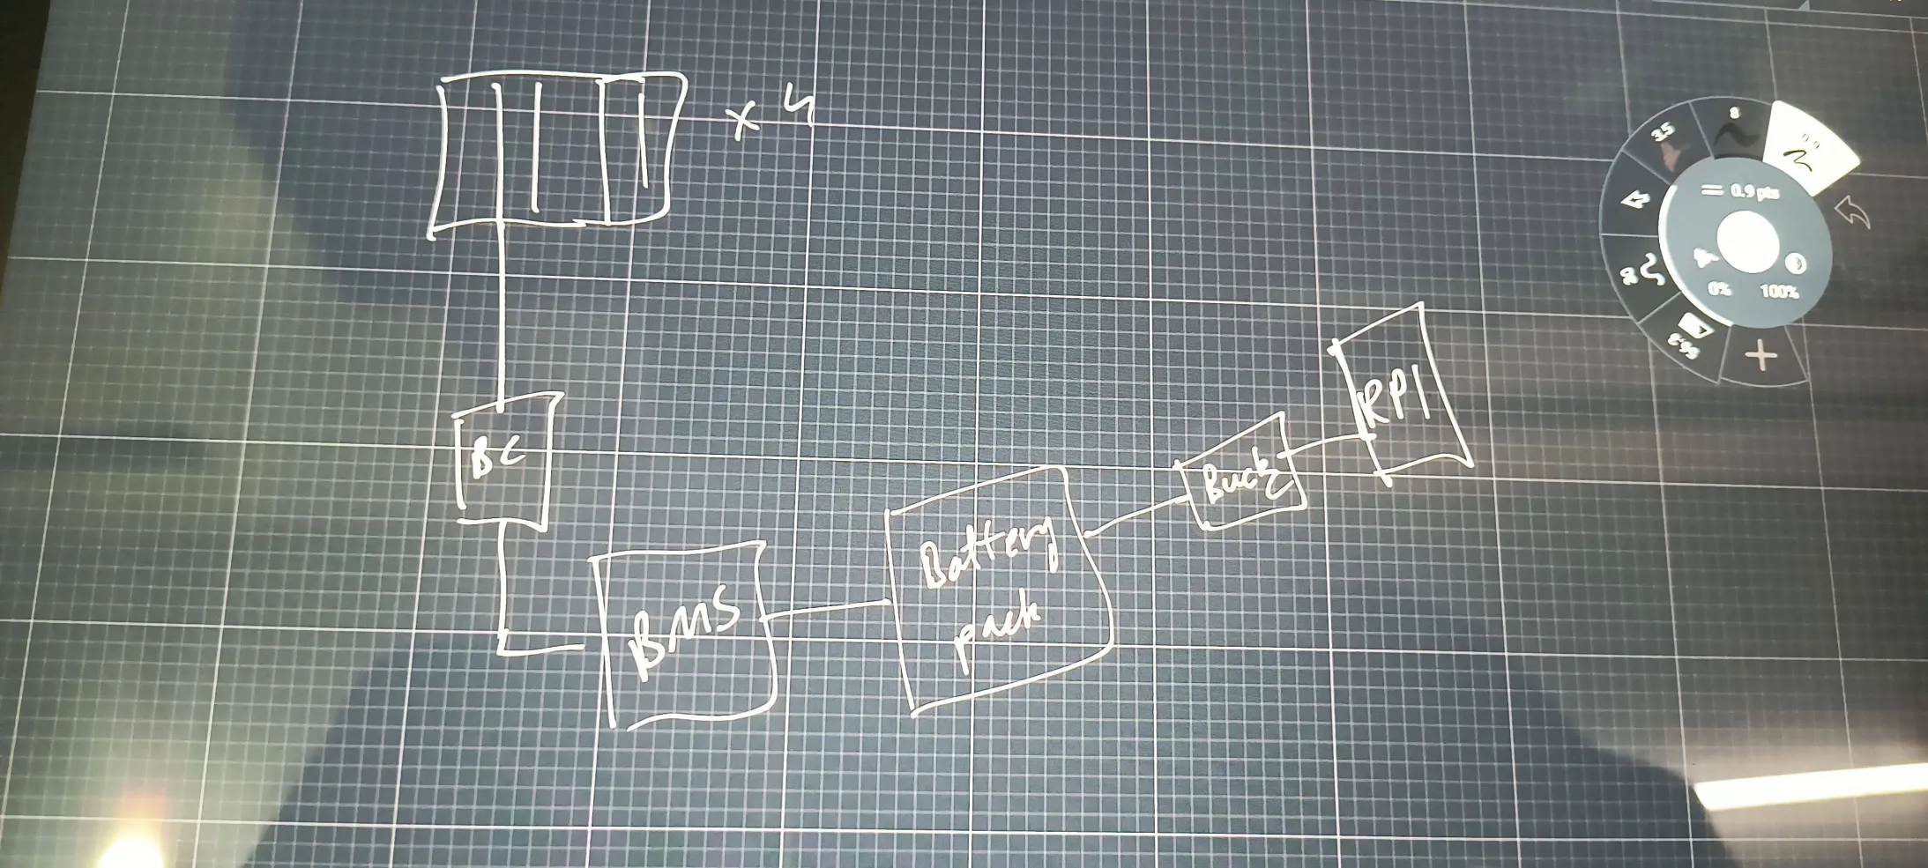

Slide 8
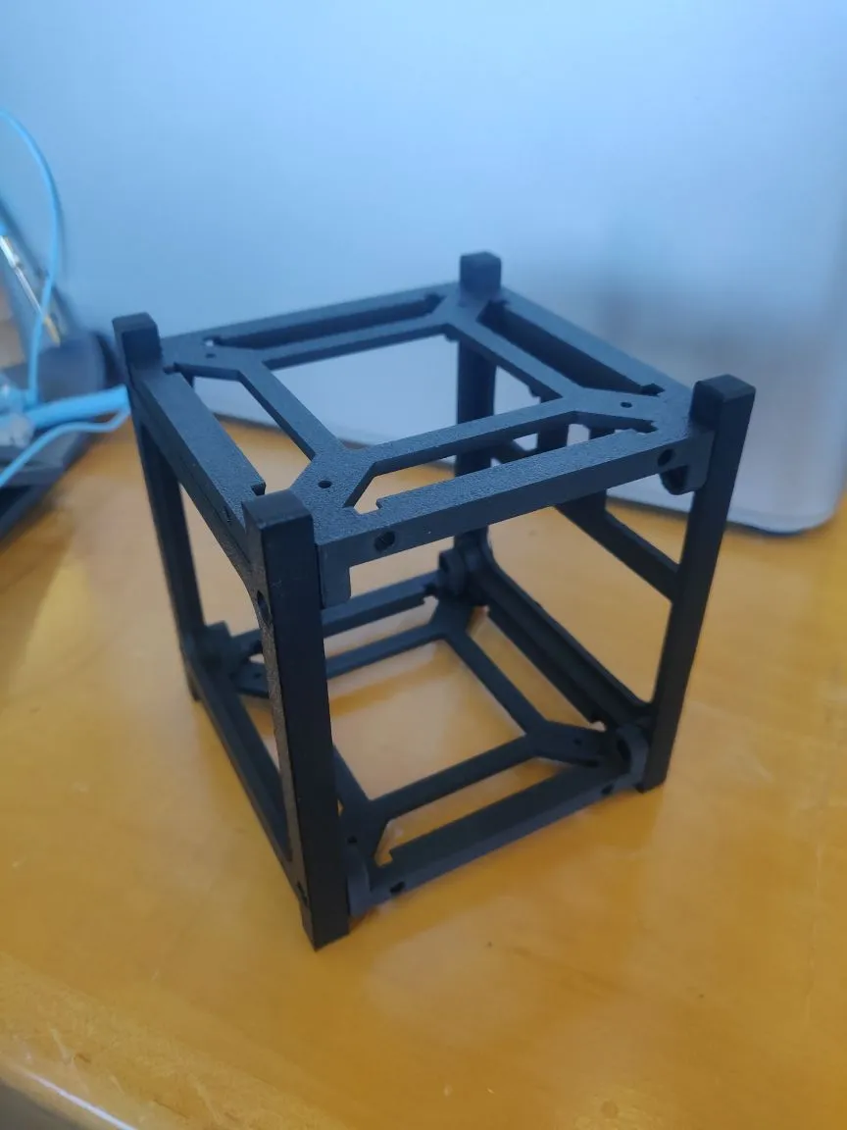

Slide 9
Demo

Slide 10
Impact
The BitSat lowers the cost of Satellite launches by mining Bitcoin
It improves the security of the network by de-tethering hashrate from geography, further decentralizing mining
Low cost and simple build means anyone can participate in Bitcoin mining

Slide 11
Future Plans
Design a space-ready 1U Cubesat chassis
Build a custom BitSat OS for tighter integration
Custom PCB design incorporating Lora, RPI Zero 2W, and BitAxe into one board

