Slide 1
AUTOSAR Integration Demo

Slide 2
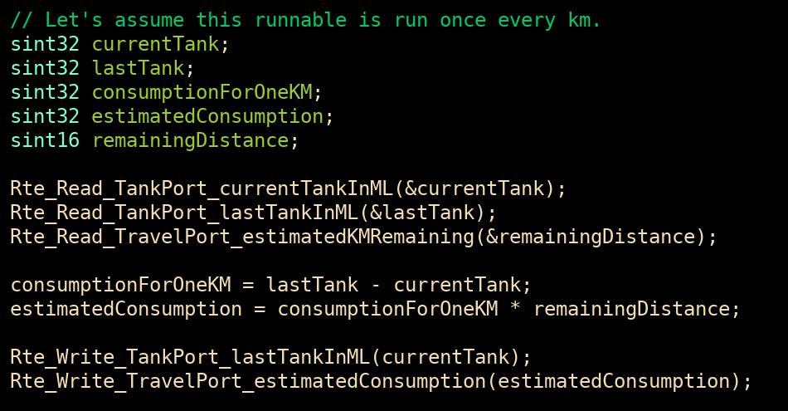
An autosar Example
Let’s consider a simple AUTOSAR application that computes an estimate of fuel economy and usage for a given trip:
Once per kilometer, the application calculates:
The current level of gas in the tank
The previous level of gas in the tank
The estimated remaining possible distance based on tank level
The estimated total consumption is computed
The estimated distance remaining without filling the tank is computed

Slide 3
AUTOSAR Classic Integration Overview
Vector DaVinci Developer Classic
Dassault Systèmes AUTOSAR Builder
…
App
Sources
.h / .c
AUTOSAR Authoring tool
ARXML
IDE
(Visual Studio, Eclipse…)
Comp DB
JSON
Note: Generation of Compilation database is optional. TrustInSoft’s integration tool can work without it
Live demo at https://github.com/TrustInSoft/demos/tree/main/autosar

Slide 4
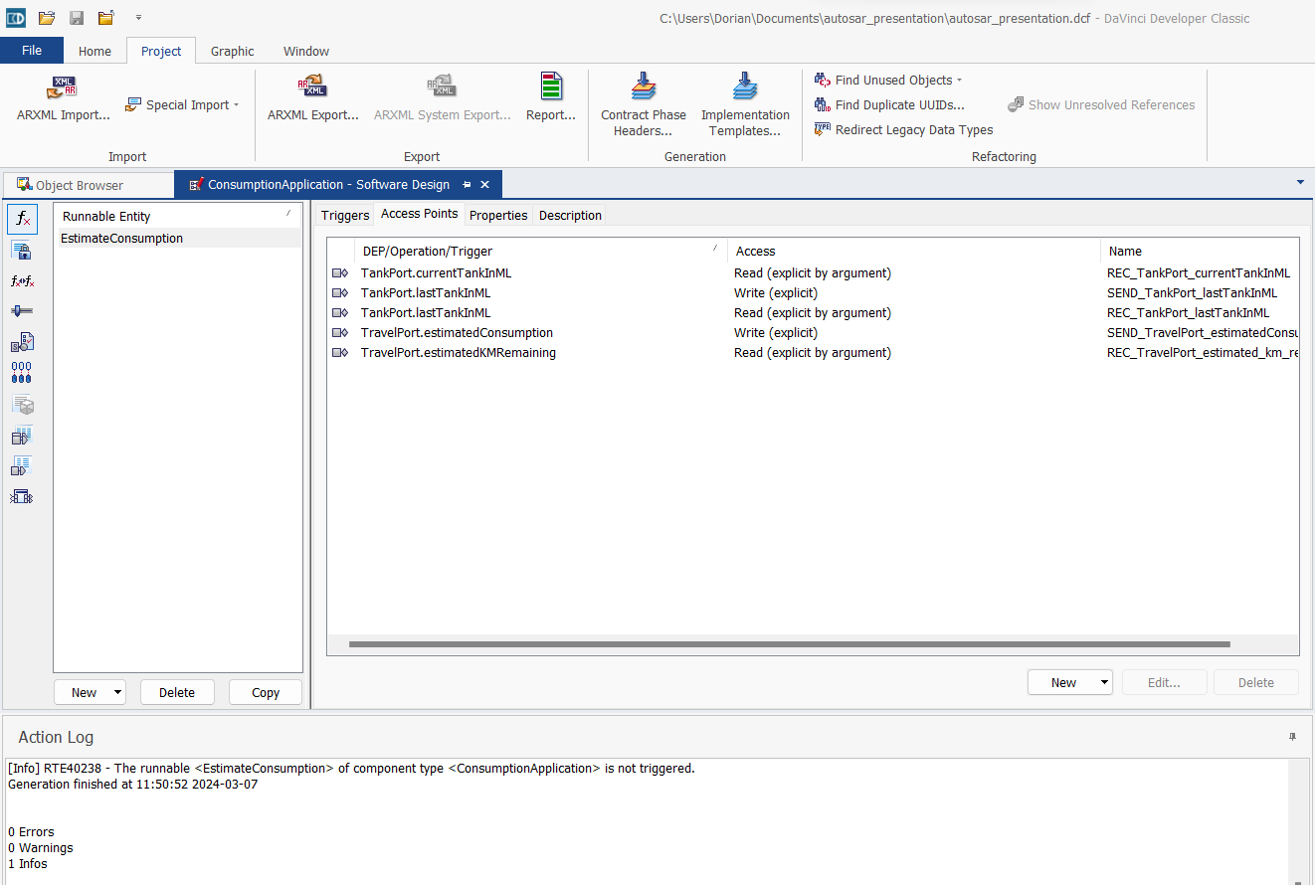
Write the code in DaVinci Developer Classic

Slide 5

AUTOSAR Classic Integration Overview
Vector DaVinci Developer Classic
Dassault Systèmes AUTOSAR Builder
App
Sources
.h / .c
Analysis Harness
AUTOSAR Authoring tool
Analysis config
ARXML
TrustInSoft Integration Tool
RTE
Mock
.c
IDE
(Visual Studio, Eclipse…)
Comp DB
JSON
Analysis Driver .c
Note: Generation of Compilation database is optional. TrustInSoft integration tool can work without it

Slide 6
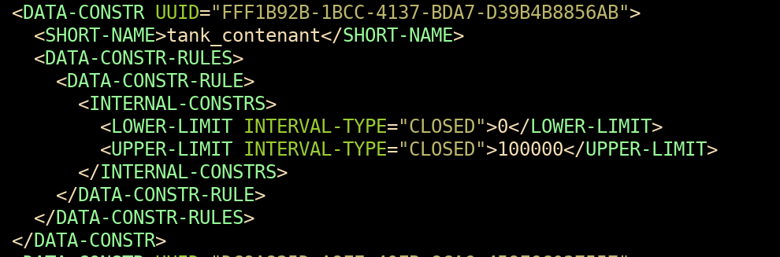
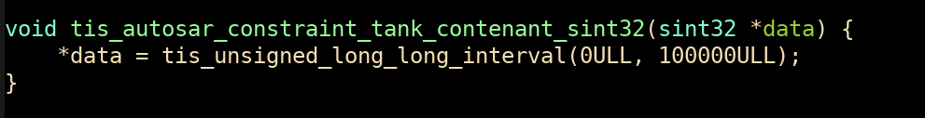
use ARXML Data to Generate stubs
tis-autosar \
--arxml ConsumptionApplication.arxml \
-o .trustinsoft
ConsumptionApplication.arxml
rte_mocks.c

Slide 7


AUTOSAR Classic Integration Overview
Vector DaVinci Developer Classic
Dassault Systèmes AUTOSAR Builder
…
App
Sources
.h / .c
Analysis Harness
AUTOSAR Authoring tool
Analysis config
TrustInSoft
Analyzer
Analysis report
ARXML
TrustInSoft Integration Tool
RTE
Mock
.c
RTE Mocks include generalized implementation of RTE API functions
Analysis Drivers include invocation of Runnables with generalized input parameters if any (Component Data Structure)
IDE
(Visual Studio, Eclipse…)
Comp DB
JSON
Analysis Driver .c
Note: Generation of Compilation database is optional. TrustInSoft integration tool can work without it
Live demo at https://github.com/TrustInSoft/demos/tree/main/autosar

Slide 8
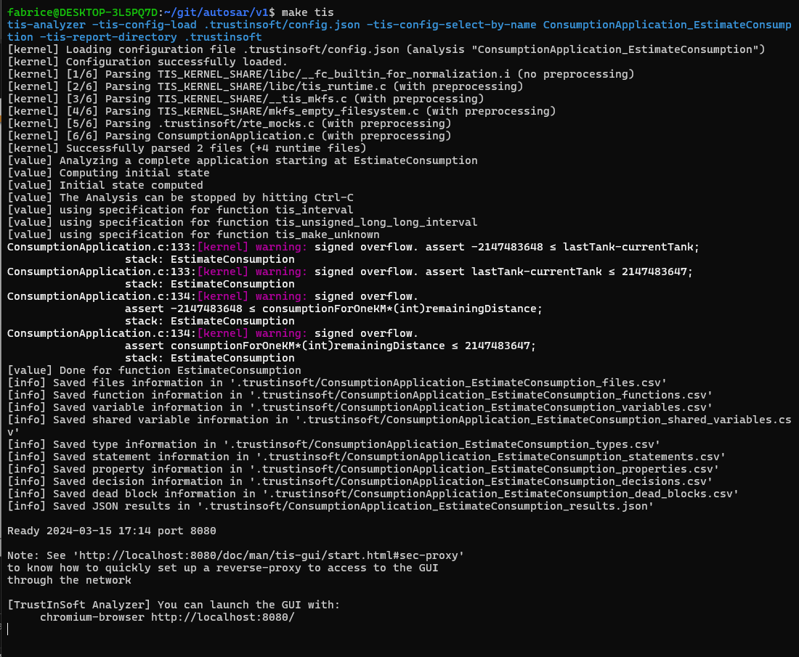
Let’s run TrustInsoft analyzer

Slide 9
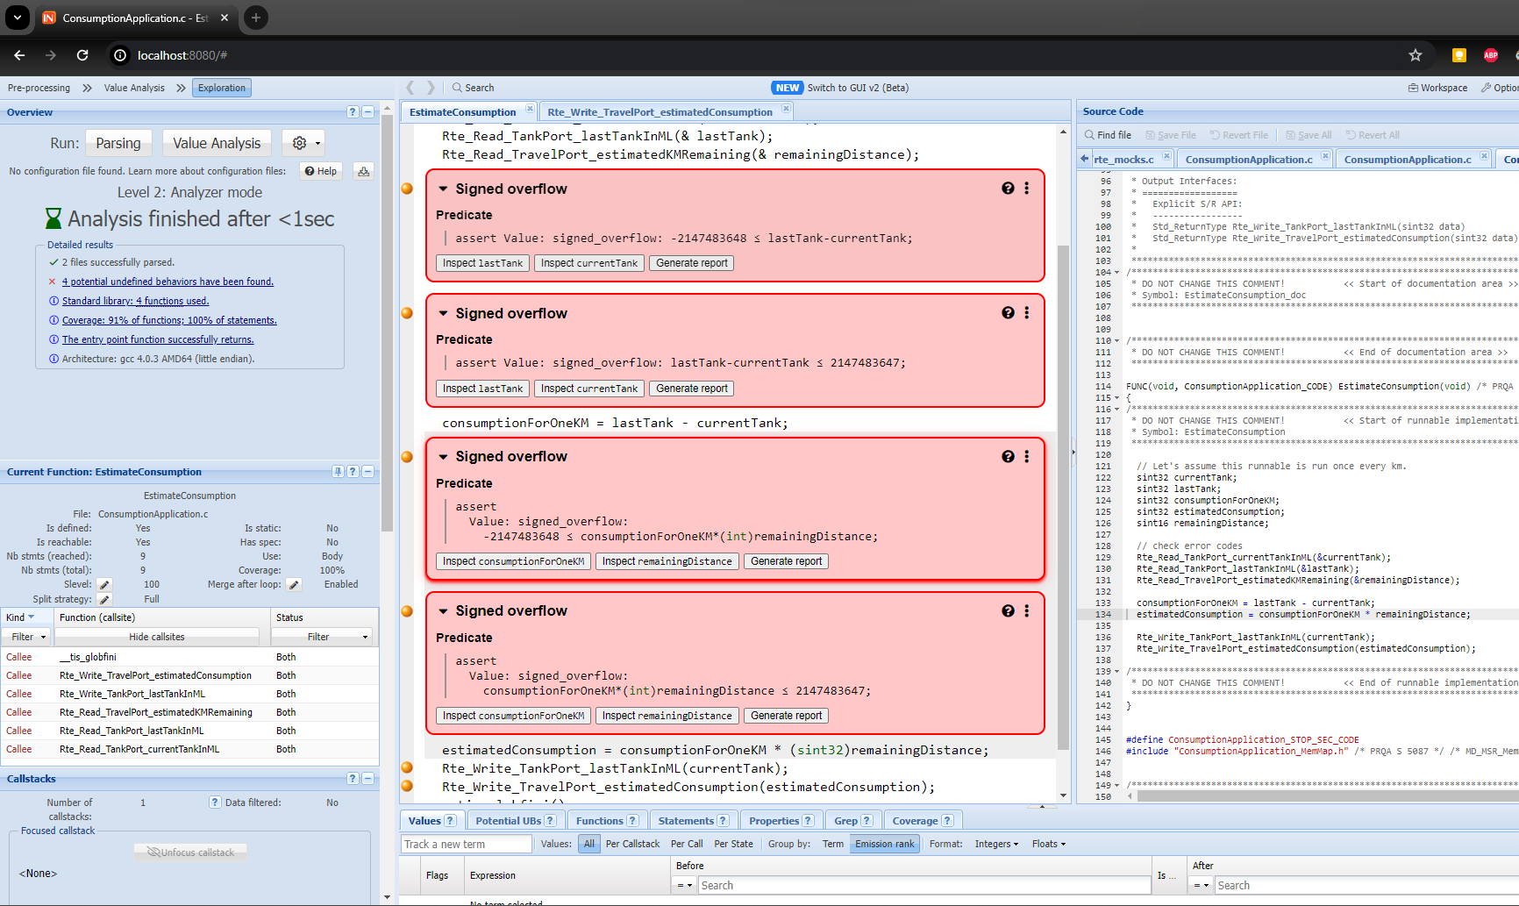
4 overflows
Because the error codes are not checked.

Slide 10
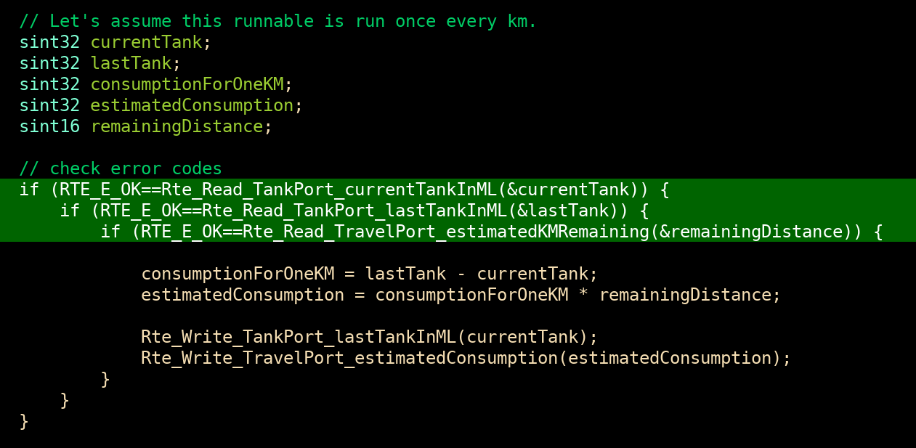
Check error codes
Check error codes when reading sensors:

Slide 11
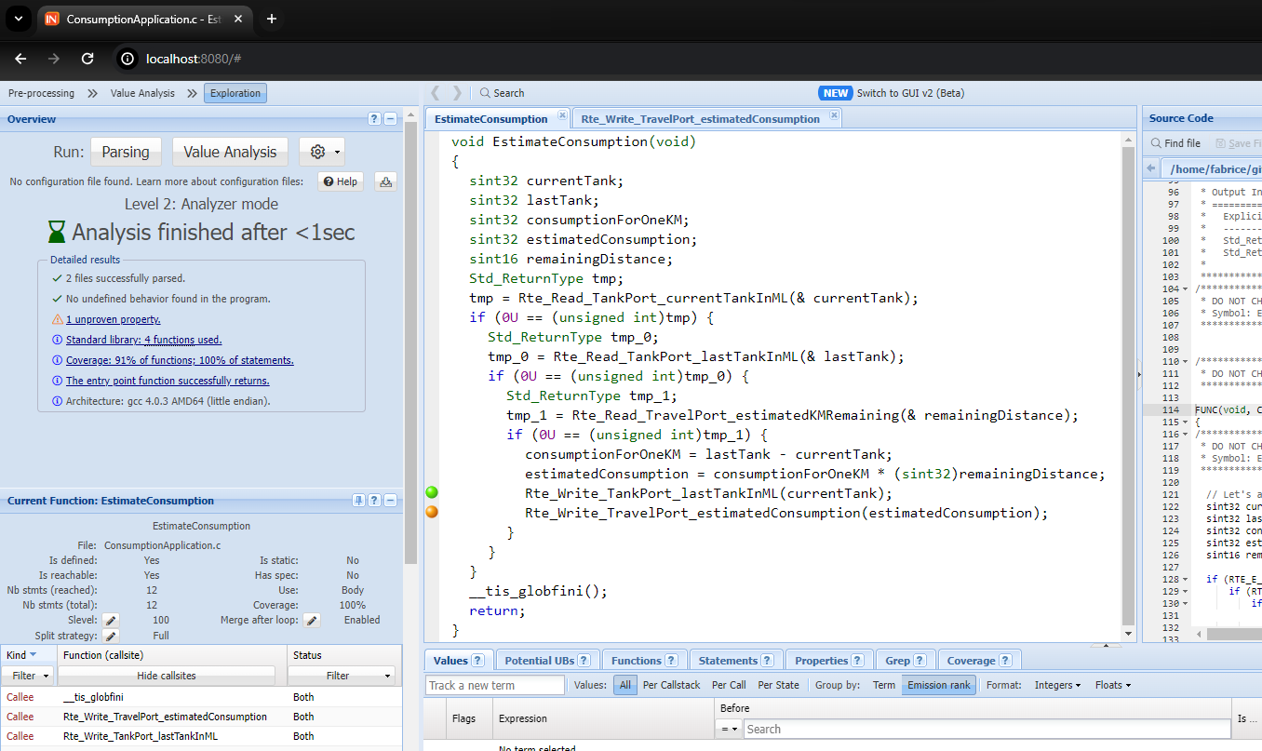
One Variable not in the right range
Not more overflows.
But when writing estimatedConsumption it might not be in the right range. In particular it can be negative when filling the tank.

Slide 12
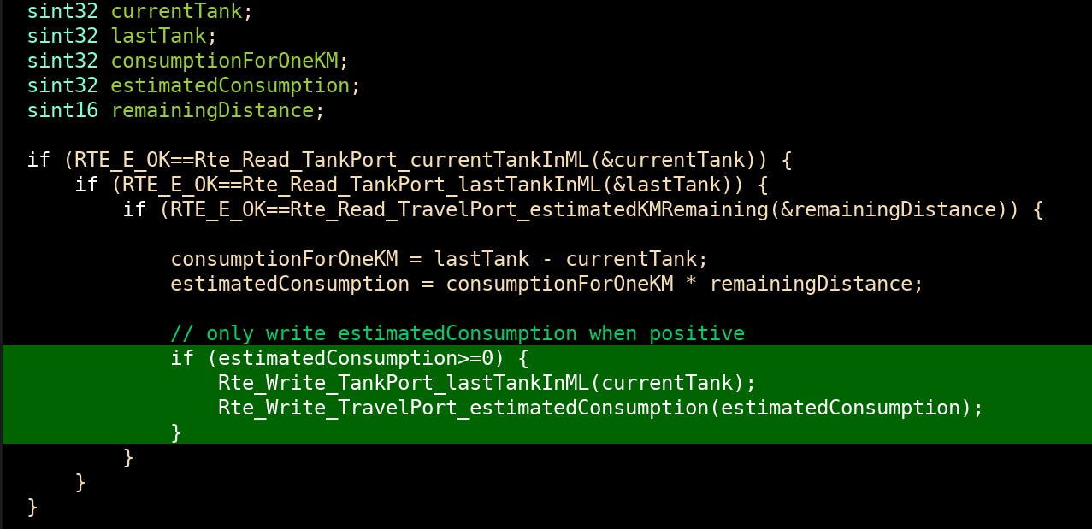
FIX the issue
Only write estimatedConsumption when it is positive :

Slide 13
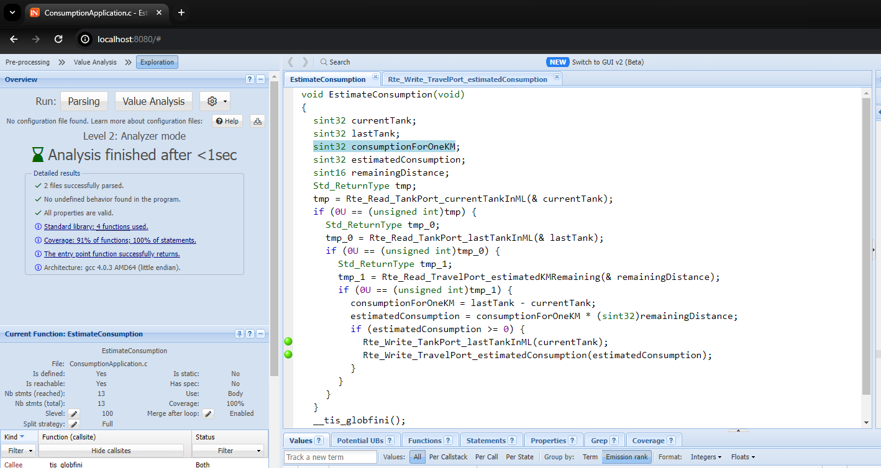
We now have A proven application

