Slide 1
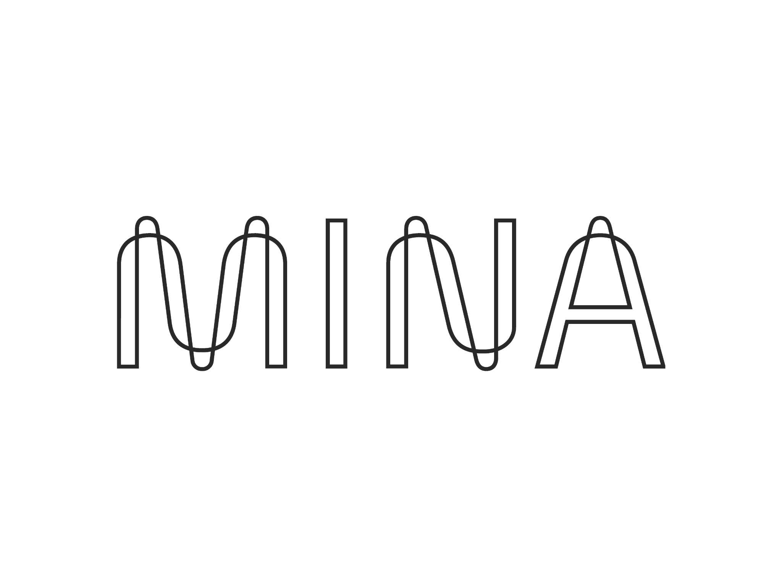
“the world’s lightest blockchain”
Attività Progettuale di Calcolatori Elettronici M Lorenzo Ziosi Prof. Andrea Bartolini Supervisors: Nicola Elia, Francesco Barchi

Slide 2
Agenda
Introduction to Mina
Introduction to zkApps
Problems
TicTacToe (Mina & EVM)
Performance comparison
Notes:
Agenda - Introduction to Mina - Introduction to zkApps - TicTacToe zkApp - Problems - Performance - Comparison with EVM
(cambiare anche i titoli nelle slides successive)

Slide 3
Introduction to Mina
Mina is an L1 blockchain based on zero-knowledge proofs (“ZKP”) with smart contracts written in TypeScript. It is the first cryptocurrency protocol with a succinct blockchain (22KB).
With Mina, the blockchain always remains a constant size–about 22KB (the size of a few tweets). It’s possible to verify the current consensus state of the protocol using this one recursive, 22KB zero-knowledge proof. This means participants can quickly sync and verify the current consensus state of the network.

Slide 4
Introduction to zkApps (1)
Mina’s zero-knowledge smart contracts are referred to as “zkApps”. zkApps provide powerful and unique characteristics such as unlimited off-chain execution, privacy for private data inputs that are never seen by the blockchain, the ability to write smart contracts in TypeScript, & more.
Because zkApps are based on zero-knowledge proofs (zk-SNARKs), a zkApp developer writes what is called a “circuit”. A circuit is the method from which a prover function and a corresponding verifier function are derived during the build process.

Slide 5
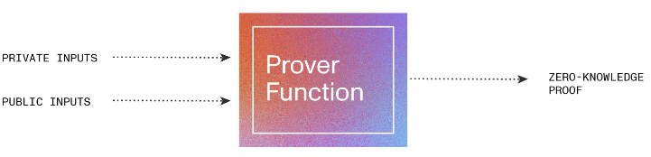
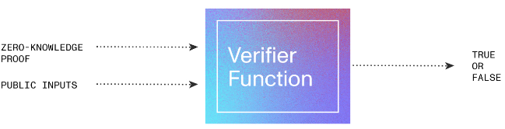
Introduction to zkApps (2)
The prover function is the function that executes a smart contract’s custom logic.
Both private inputs and public inputs represent data that must be provided to the prover function [...] Private inputs are not needed again after that point.
The verifier function is the function that validates whether a zero-knowledge proof successfully passes all the constraints defined in the prover function. This always runs quickly and efficiently irrespective of the prover function’s complexity.

Slide 6
Problems
Slow and not always available funding - transactions may remain in pending state indefinitely
Very large block time: 3 to 20 minutes per transaction
Continuous contract's state fetching - before the execution and after the creation of each block
Identical multiple transactions (due to a fast execution of the test script and the large block time) are rejected by the network
Transactions may remain in pending state indefinitely - solvable by manually incrementing the next transaction's nonce
Berkeley testnet gets regularly reset
…

Slide 7
TicTacToe (Mina)
Mina: https://github.com/o1-labs/zkapp-cli/tree/main/examples/tictactoe/ts/src
EVM: https://github.com/0xosas/tictactoe.sol/tree/master/contracts
zkApp written in TypeScript and tested on a local instance of the blockchain.
The main functions enable the start of a new game and the execution of a new player move from a particular player.
The final output of the function is a ZK-proof that will then be verified by the verifier nodes and thus inserted into the Blockchain. The computations for the function execution are carried out in the client node.
The test script has been modified to support the Berkeley testnet, which is the only network currently supporting zkApps.

Slide 8
TicTacToe (EVM)
Mina: https://github.com/o1-labs/zkapp-cli/tree/main/examples/tictactoe/ts/src
EVM: https://github.com/0xosas/tictactoe.sol/tree/master/contracts
Smart Contract written in Solidity.
The supported functions are nearly identical to Mina’s. Some differences occur in the state management.
A user transaction requires the execution of a contract’s function by each one of the network nodes; the execution implies the internal state change.
The test file has been built using the Truffle suite connected with the Binance Smart Chain testnet. This network is very performant thanks to its low block time equal to about 3s.

Slide 9
TicTacToe (comparison)
Mina: https://github.com/o1-labs/zkapp-cli/tree/main/examples/tictactoe/ts/src
EVM: https://github.com/0xosas/tictactoe.sol/tree/master/contracts
 | Mina | EVM
State | @state(Field) board = State<Field>(); @state(Bool) nextIsPlayer2 = State<Bool>(); @state(Bool) gameDone = State<Bool>(); @state(PublicKey) player1 = State<PublicKey>(); @state(PublicKey) player2 = State<PublicKey>(); | uint256 gameBoard = 0; address internal playerOne; address internal playerTwo;
New game | @method startGame(player1: PublicKey, player2: PublicKey) | function newGame() external isPlayer(msg.sender) returns (uint256)
New move | @method play(pubkey: PublicKey, signature: Signature, x: Field, y: Field) | function move(uint256 _move) isPlayer(msg.sender) isTurn(msg.sender) moveIsValid(_move) external returns (uint256)

Slide 10
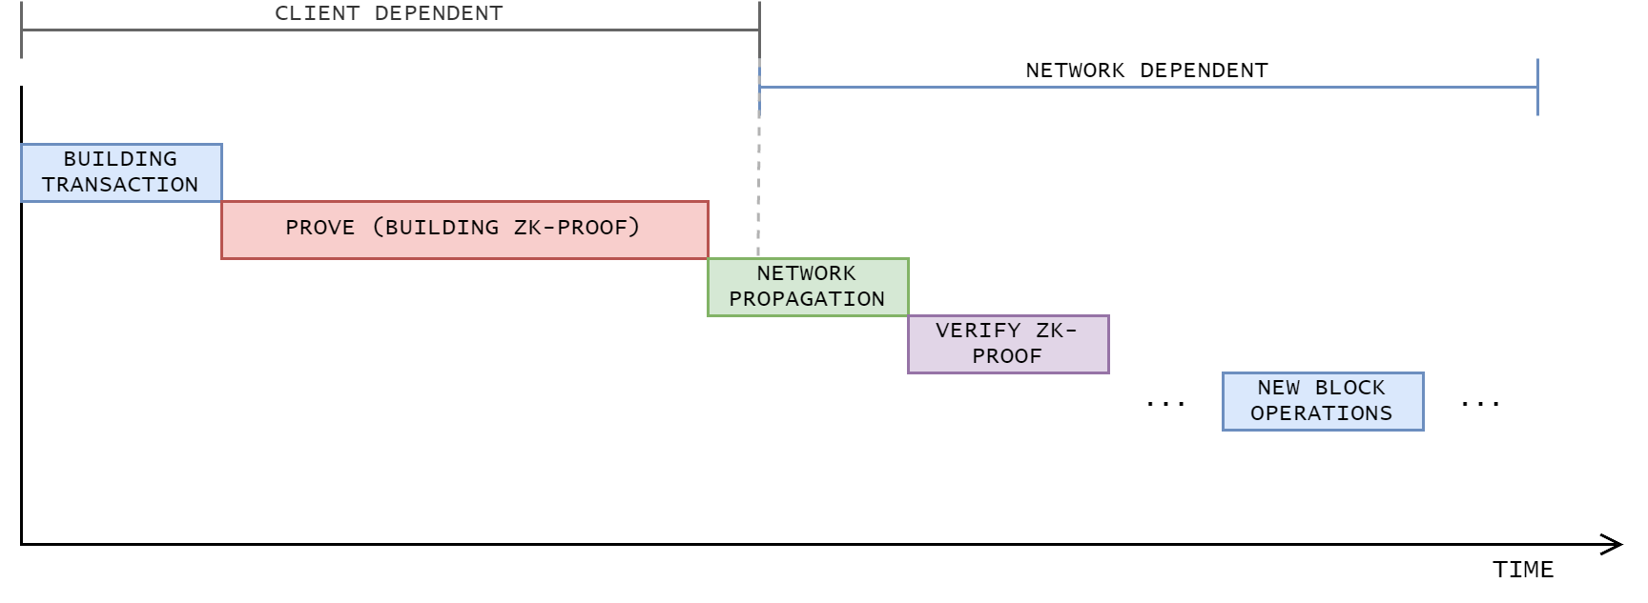
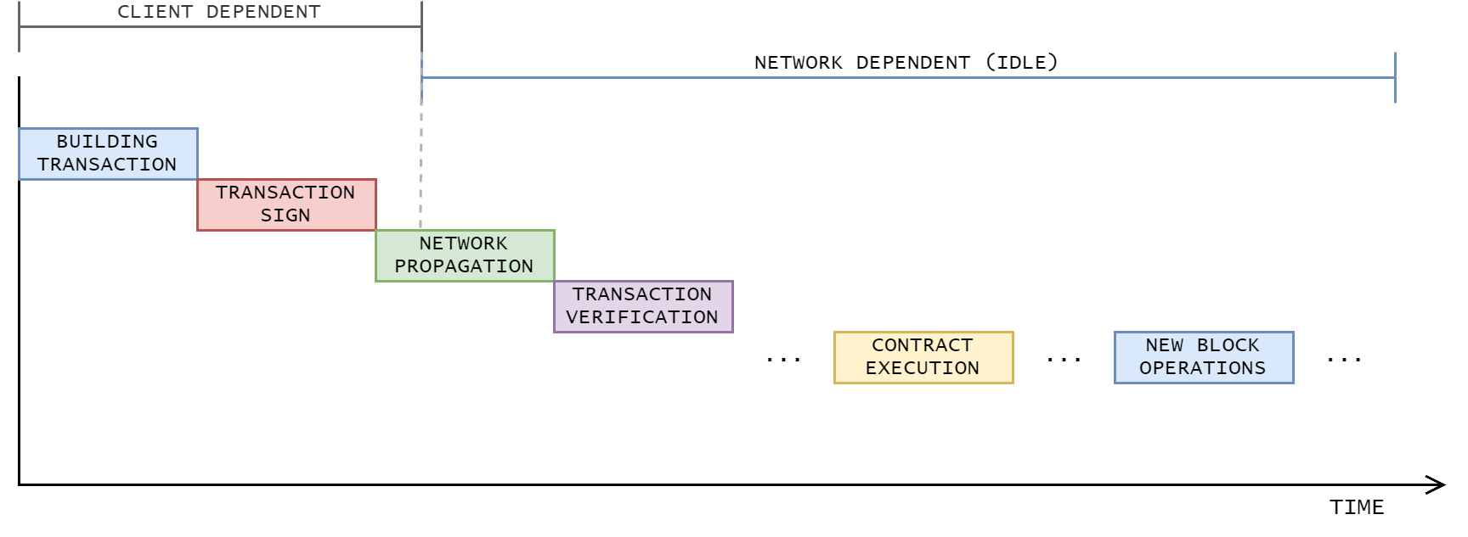
Performance comparison (1)
Mina
EVM
These charts show the chain of operations that each client makes on the two different blockchains.
Some time (referred to as “client dependent”) will be spent by the clients to actually make computations, while some time (referred to as “network dependent” or “idle”) will be spent waiting for the network to process and validate the transactions
The comparison takeaway is that while in Mina the most computing-intensive tasks are carried out by the client machine, EVM leaves the actual execution to the network nodes.

Slide 11
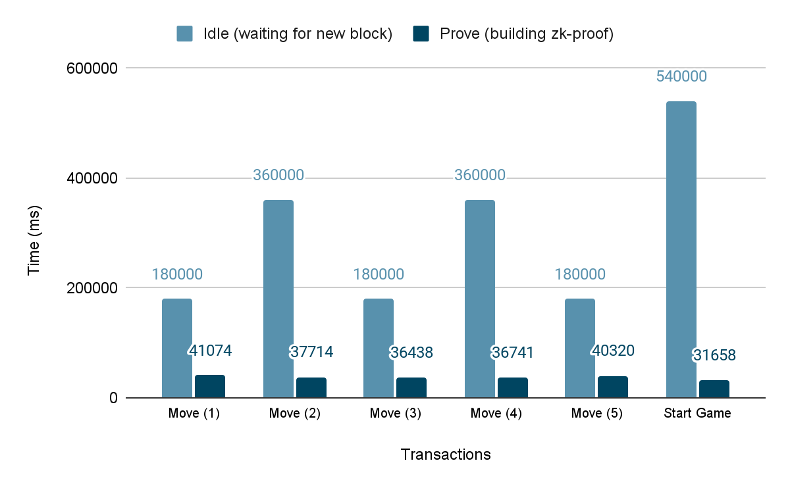
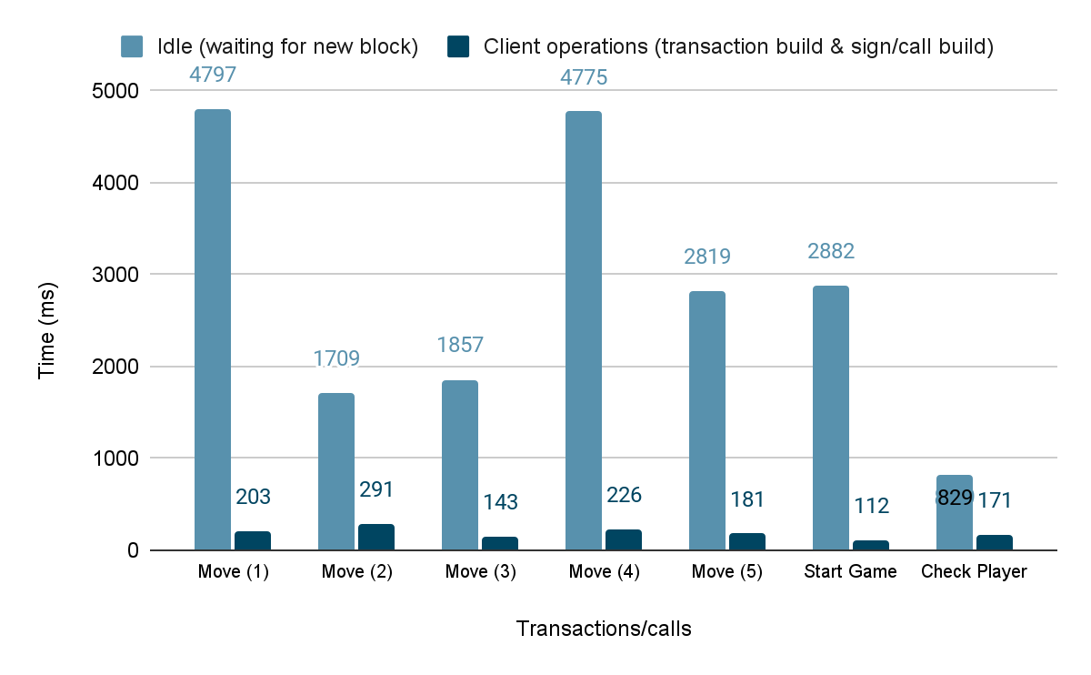
Performance comparison (2)
All the results are obtained on a HP 15-cx0997nl laptop, equipped with an Intel® Core™ i7-8750H (6 core, 2.2 to 4.1 GHz) and 16 GB DDR4-2666 SDRAM.
*Only the Prove function of client dependent operations has been indicated as it is the most computationally expensive.
*Check Player is a read-only call. Therefore, it does not imply the execution of a transaction, nor the creation of any block. In this case, the idle time represents the response time of the remote node.
Mina
EVM

