Slide 1








AWS Cloud(oscdev)
Region
ap-northeast-2a
ap-northeast-2b
ap-northeast-2c
ap-northeast-2d
ALB
EKS Cluster
max_size: 4
EKS Worker Group min_size: 2
desired_size: 2
Jira Node 0
Jira Node 1
EBS
EFS
RDS

Slide 2
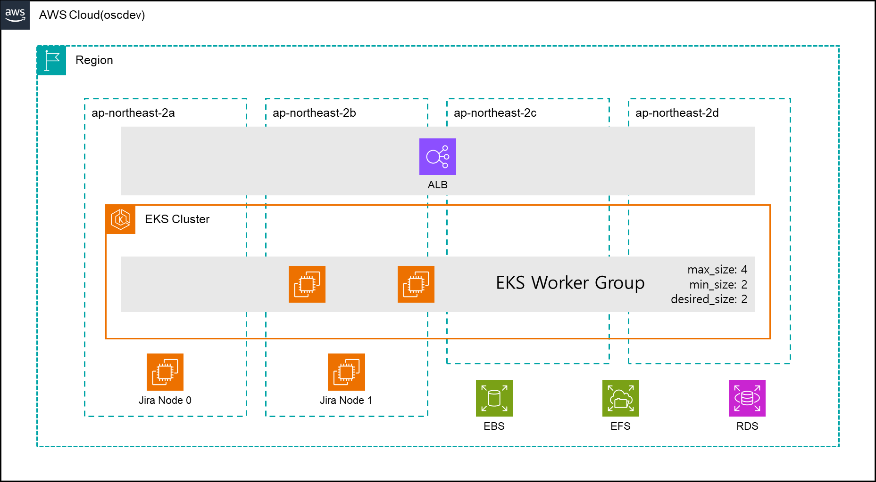

Slide 3

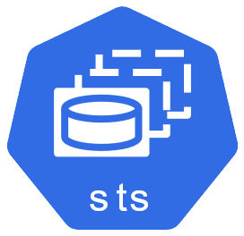













Namespace: atlassian
StatefulSet runs pods
Jira pods
values.yaml
base_resource
Users
Jira volumes
Deploy Jira Service
Database Secrets
jvm config, server config …
Jira Local Home
Jira Shared Home
Administrator

Slide 4
