Slide 1
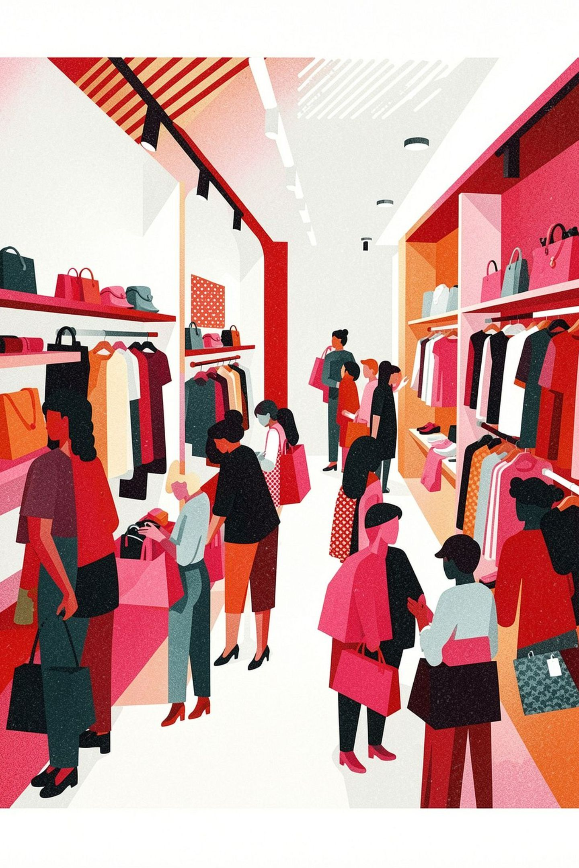
Customer Shopping Behavior Analysis
Uncovering insights from 3,900 transactions across product categories

Slide 2

The Dataset: 3,900 Transactions Analyzed
18 Data Dimensions
4 Product Categories
Customer demographics, purchase details, and shopping behavior captured across every transaction
Clothing, Accessories, Footwear, and Outerwear — the full retail spectrum
50 US Locations
Nationwide coverage with seasonal purchase patterns tracked across all regions

Slide 3
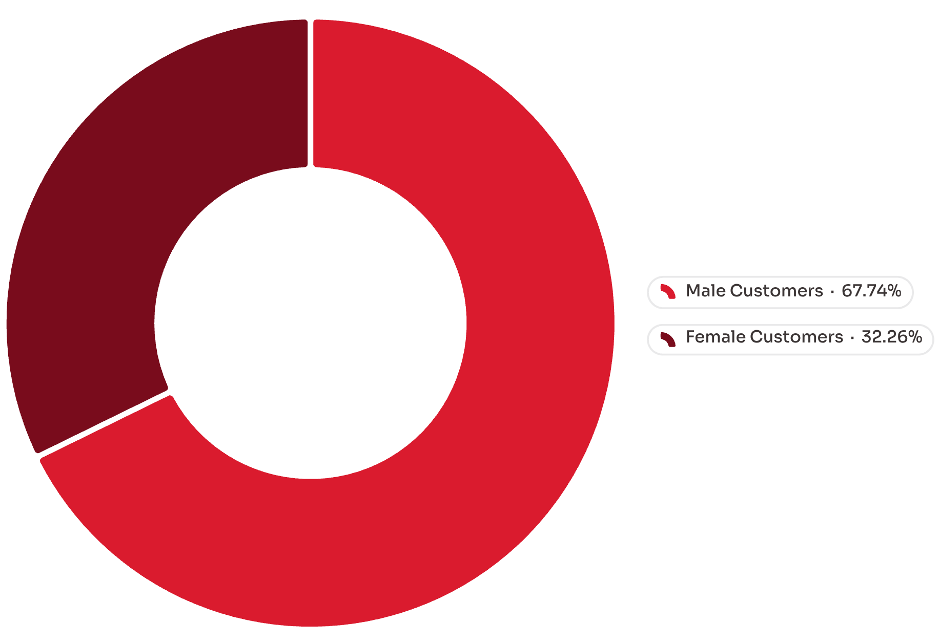
Revenue Split: Male Customers Drive 68% of Sales
Key Findings
Male customers: $157,890 total revenue
Female customers: $75,191 total revenue
Significant opportunity to expand female customer engagement and close the revenue gap

Slide 4
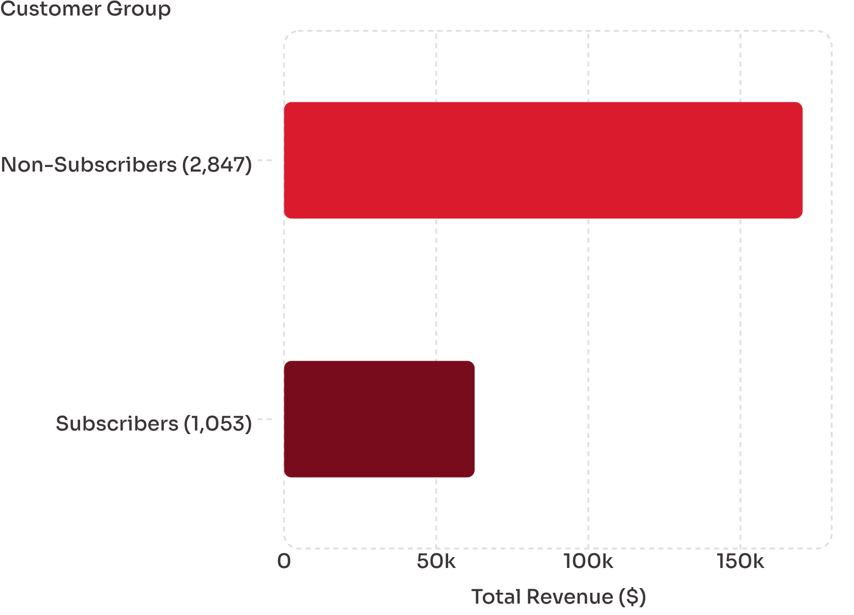

Subscription Paradox: 73% Non-Subscribers Generate More Revenue
The Subscription Problem
Despite being offered a dedicated loyalty program, subscribers account for just 27% of revenue while representing 27% of the customer base — a near-perfect mismatch signaling structural issues.
Subscription model is underperforming — needs strategic redesign to deliver real value.

Slide 5
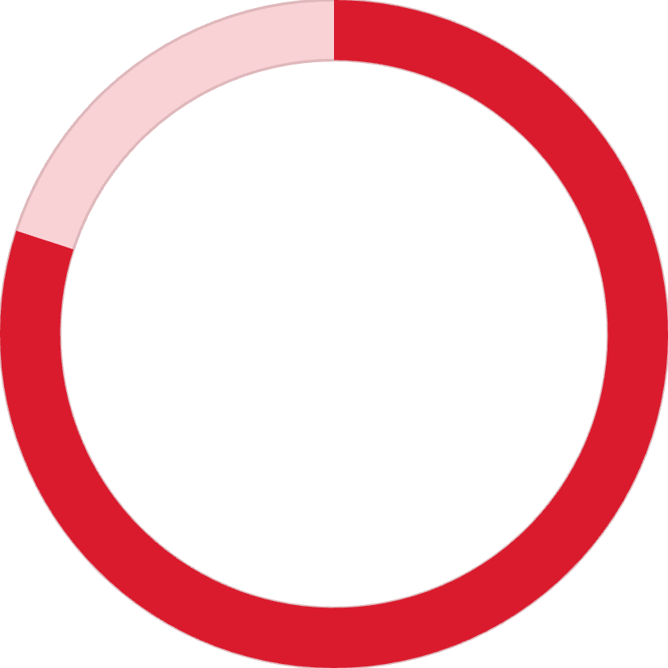
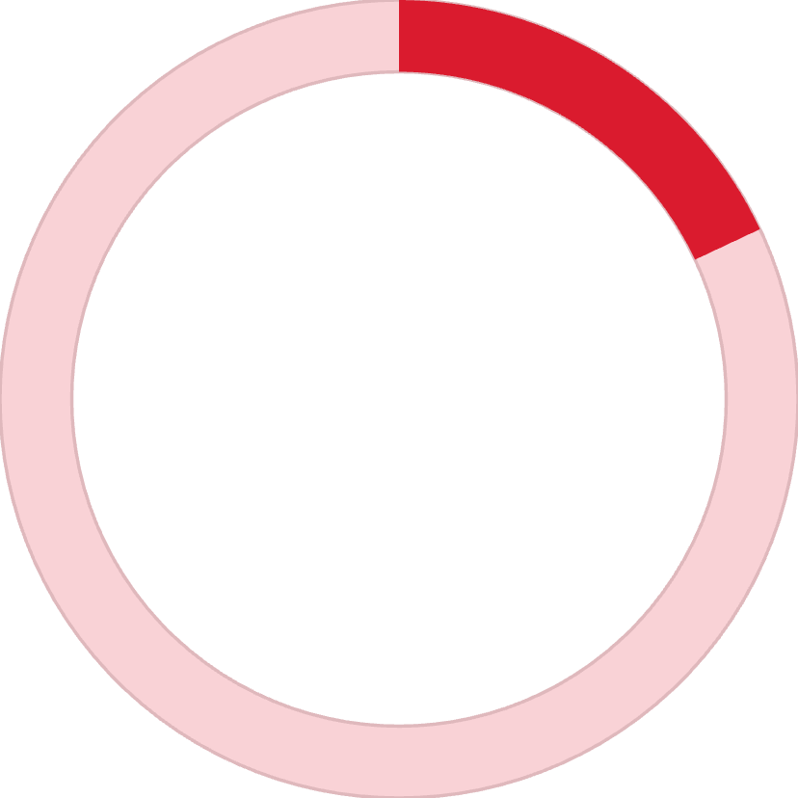

Customer Segments: 80% Are Loyal Repeat Buyers
80%
18%
2%
Loyal Customers
Returning Customers
New Customers
3,116 customers with 5+ purchases — the revenue backbone
701 customers with 2–4 purchases — strong growth potential
83 first-time buyers — acquisition pipeline needs investment
A highly retained base is a competitive asset — but the razor-thin 2% new customer rate signals acquisition risk over time.

Slide 6


Top Performers: Gloves Lead with 3.86★ Rating
🥇 Gloves — 3.86★
Category leader in quality perception, setting the benchmark for the entire product line
🥈 Sandals — 3.84★
Strong seasonal performer with consistently high customer satisfaction scores
🥉 Boots — 3.82★
Reliable footwear anchor outperforming the 3.75★ portfolio average

Slide 7
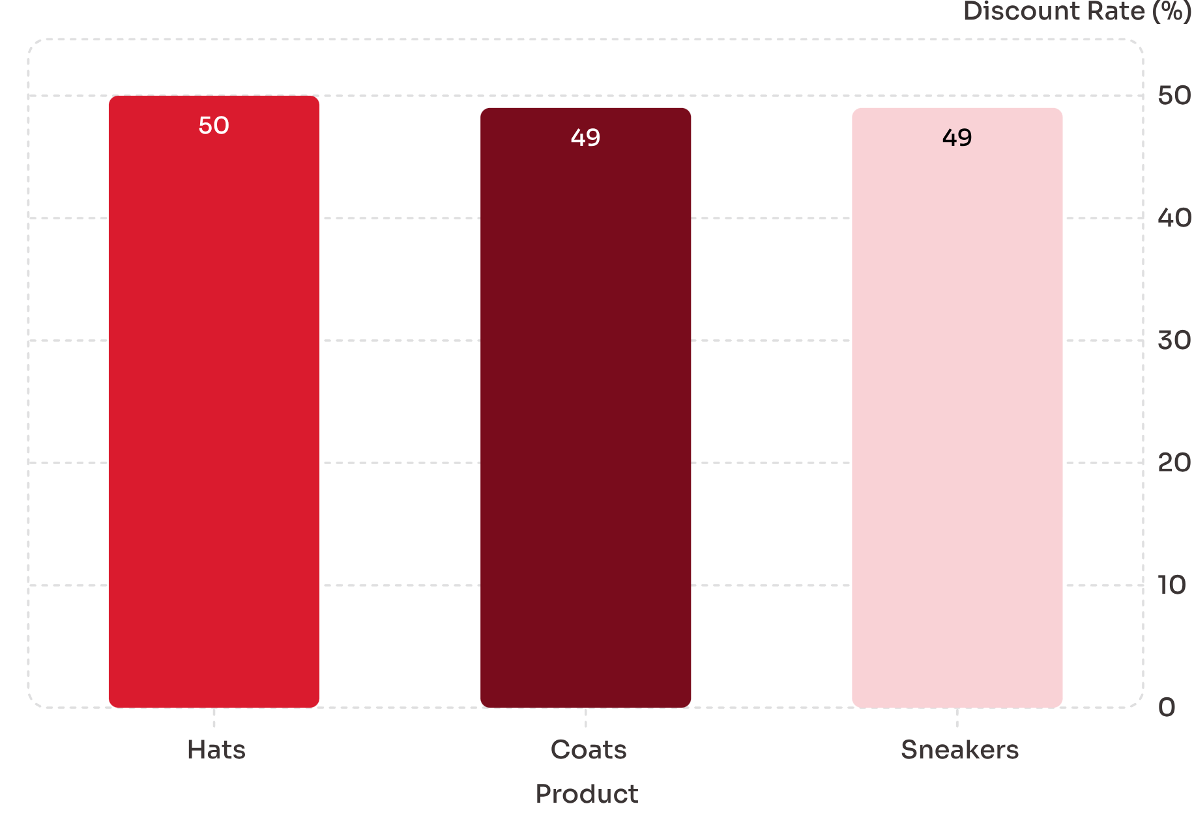
Discount Dependency: 50% of Hat Sales Require Discounts
Pricing Pressure Alert
Nearly half of all sales in these three categories depend on markdowns to close. This signals a value-perception gap — customers don't see full-price justification.
Indicates pricing pressure on these categories
Opportunity to improve margins through premium value positioning

Slide 8
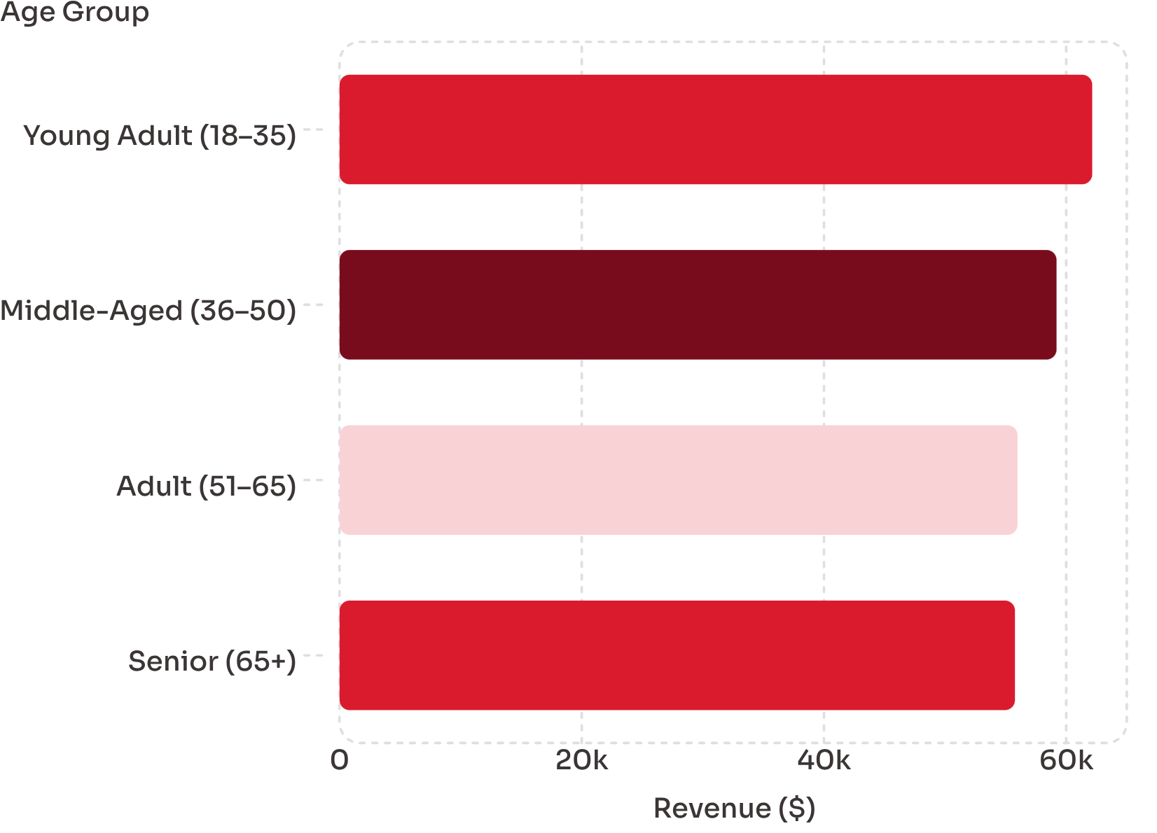
Young Adults Lead Revenue: $62,143 from the 18–35 Age Group
Balanced Yet Tiered
Revenue distribution is relatively even across age groups, but Young Adults hold a clear edge at 27% of total spend — making them the highest-priority segment for targeted growth.
Young Adult: $62,143 — 27% of total
Middle-Aged: $59,197 — 26% of total
Adult & Senior: ~24% each — stable, underserved segments

Slide 9

Shipping Preference: Express Slightly Outperforms Standard
🚀 Express Shipping
$60 average purchase amount
Customers opting for speed are also spending more — a premium behavior signal worth monetizing
📦 Standard Shipping
$58 average purchase amount
Reliable baseline but trailing express by a meaningful margin in basket value
Customers are willing to pay a premium for faster delivery — a lever that can be tied to higher-margin product promotions.

Slide 10
Strategic Recommendations
1
Expand Female Customer Acquisition
2
Redesign the Subscription Model
With male customers driving 68% of revenue, female segments represent the single largest untapped growth opportunity in the portfolio
Non-subscribers outperform subscribers in total revenue — the current program fails to incentivize high-value behavior and needs a structural overhaul
3
Break Discount Dependency
4
Activate the Young Adult Segment
Hats, Coats, and Sneakers each require discounts on ~50% of sales — invest in premium positioning and storytelling to justify full-price purchases
At 27% of total revenue, 18–35 year-olds are the top-spending cohort — targeted campaigns and product drops can accelerate their share further

