Slide 1

ANDROID STUDIO
Installation Process

Slide 2
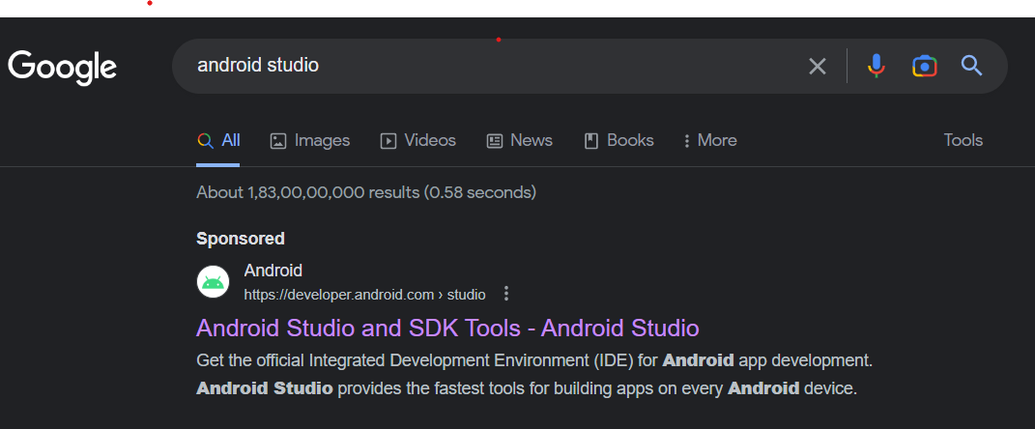
First Step-1
Search Android Studio and Click the below link

Slide 3
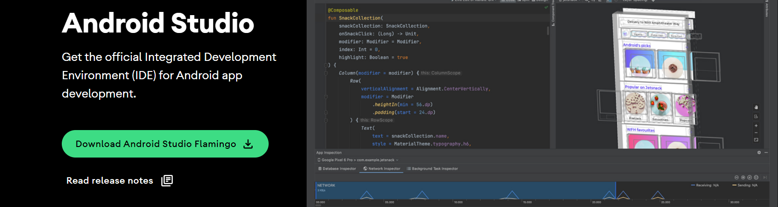
Second Step-2
Click below Button

Slide 4
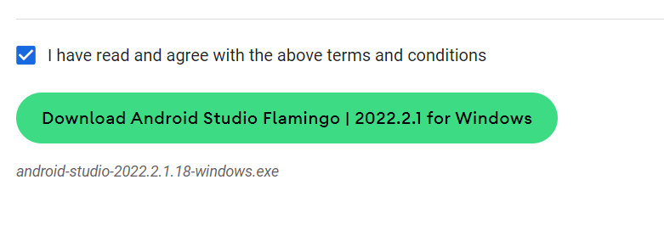
Step-4
Scroll the page
Accept the terms and conditions
Click download button

Slide 5
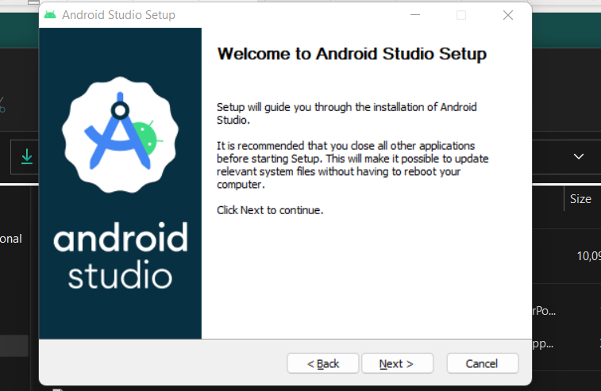
Step-5
Click downloaded android studio file
Next button

Slide 6
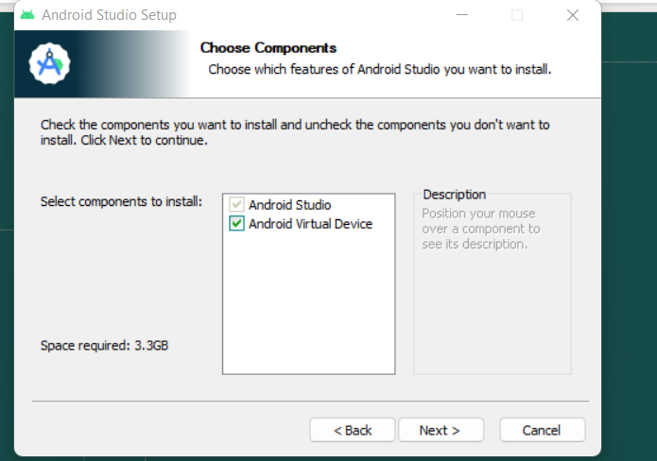
Step-6
Click Next button

Slide 7
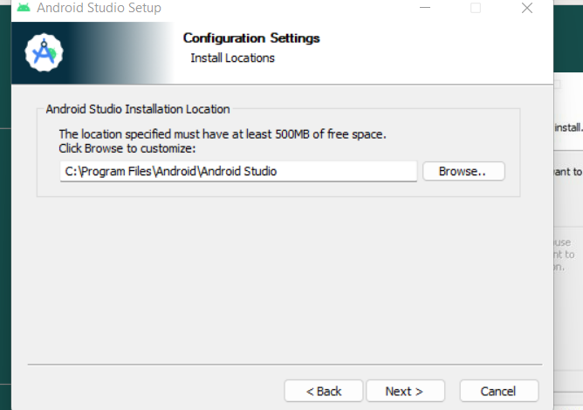
Step-7
Click Next

Slide 8
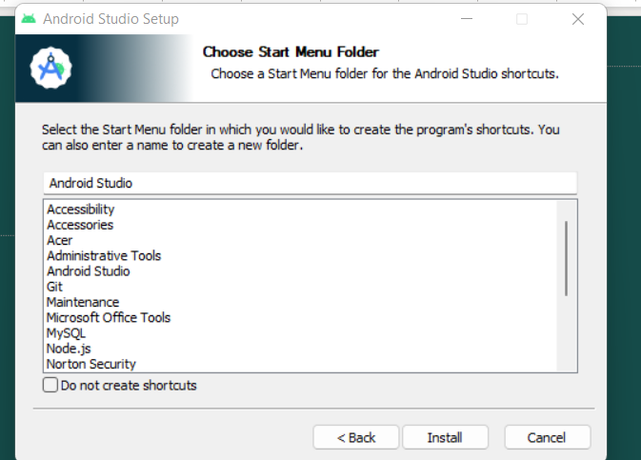
Step-8
Click Install button
Once done click again NEXT and FINISH buttons

Slide 9
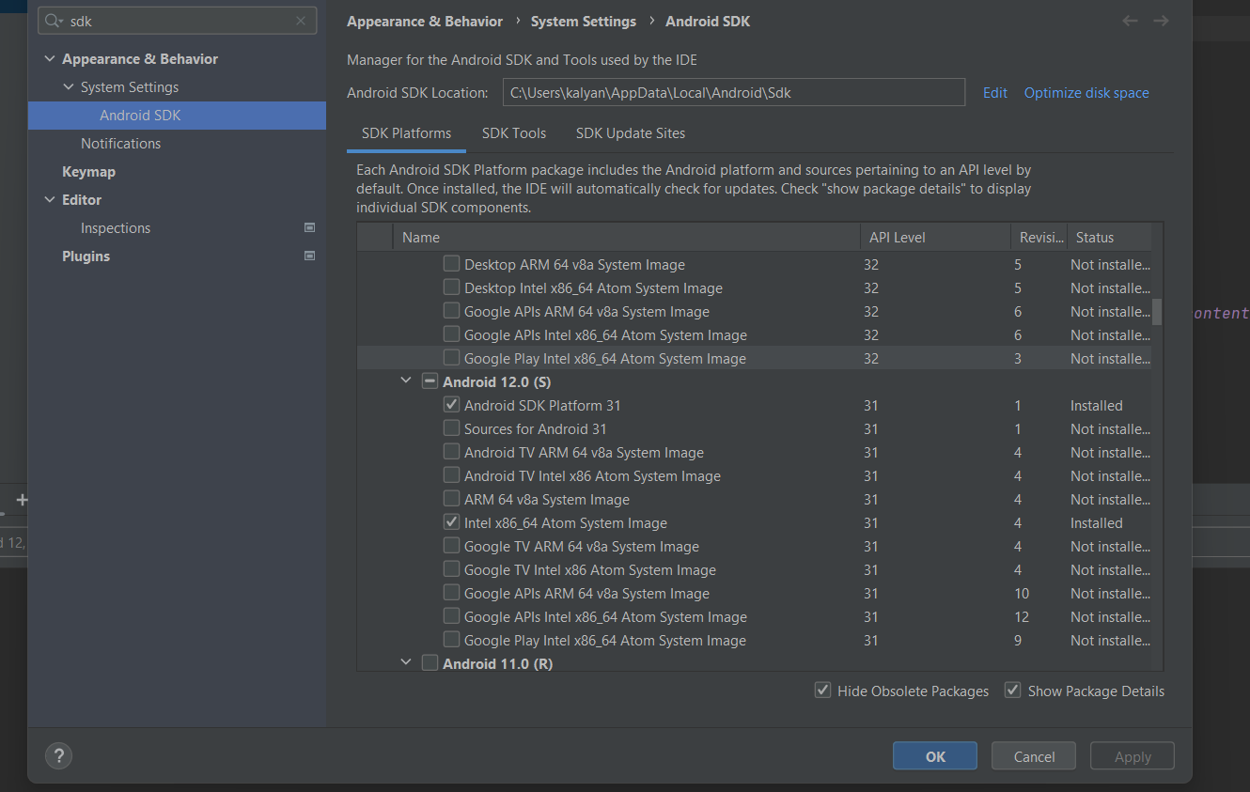
Step-9
We need android studio SDK setup for working with react native.
Open your android studio.
Open file button and select setting and search ANDROID SDK.
After select the below right side in show package details.
Scroll the SDK Platform and search ANDROID 12.0 (S) and Enable below.
Android SDK Platform 31 ,Intel x86_64 Atom System Image

Slide 10
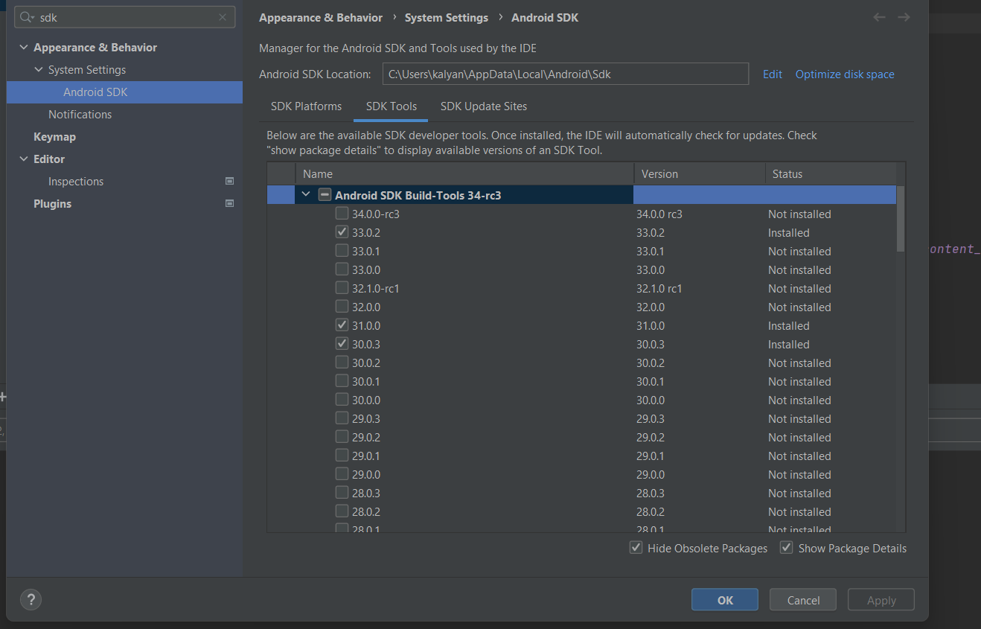
Step-10
Go to SDK Tools
After Select Show packages Details
Select 31.0.0 and click OK
Accept confirm changes
It will download some files and click FINISH

Slide 11
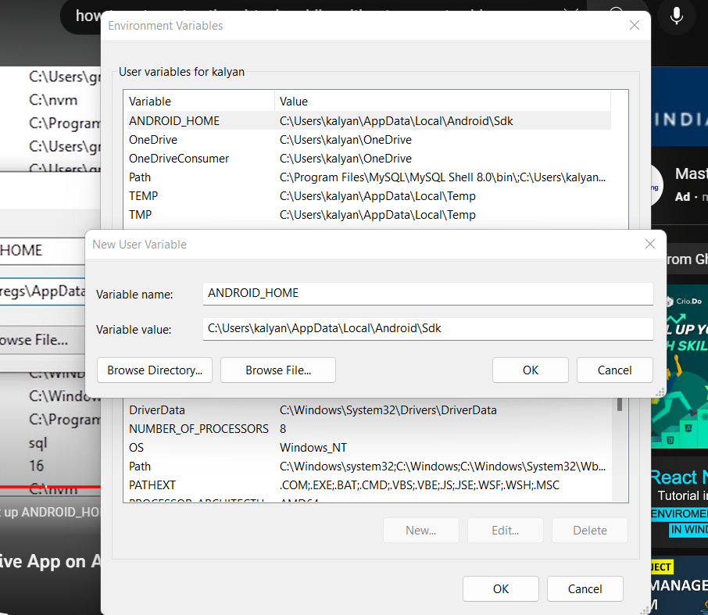
Step-11
We need to setup ANDROID_HOME_SDK_PATH environment.
Copy path of SDK and search environmental variables and click NEW button.
Varaible_Name: ANDROID_HOME Value: copied path paste here and click ok.
If you wanna check path set or not .go to power shell and run this command
Get-ChildItem –path Env:\ and we can see our variable_Name

Slide 12
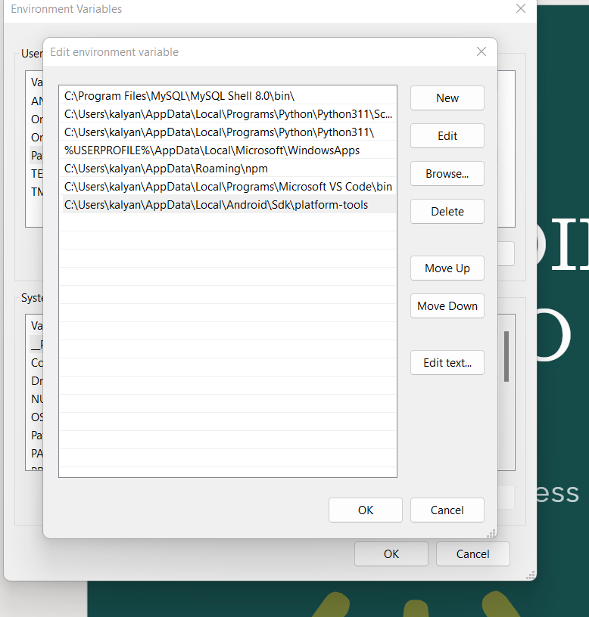
Step-12
Again we need setup . Go to that SDK folder in platform-tools and copy that path.
Open environment variables and select path and click edit .
After click new button and paste copied path and clear everything.

Slide 13
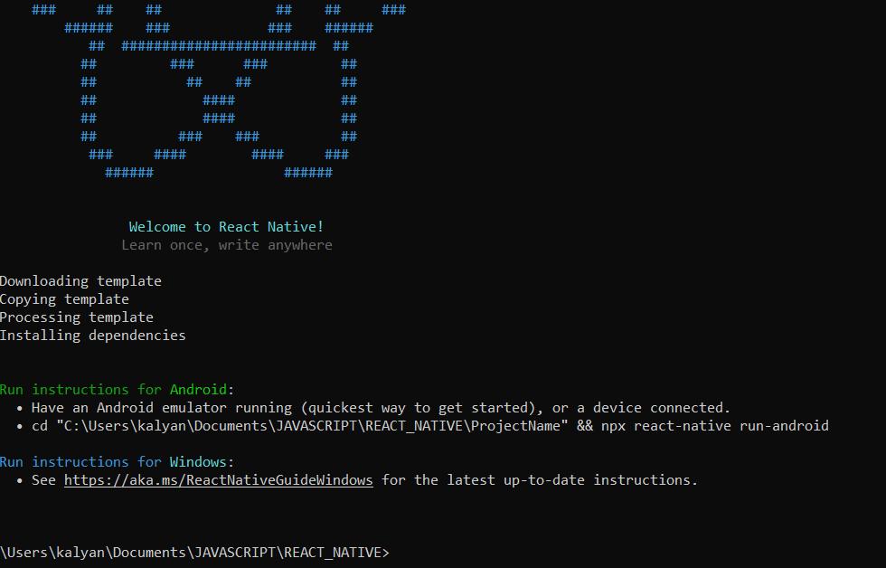
Import files
We need to install react-native packages 1.npm install –g react-native-cli 2.npm install –g react-native
Create project app react-native init project1 (or) npx react-native init project1
Go to that project1 app and enter dir. will show what it created.
Send this code to vs code code .

Slide 14
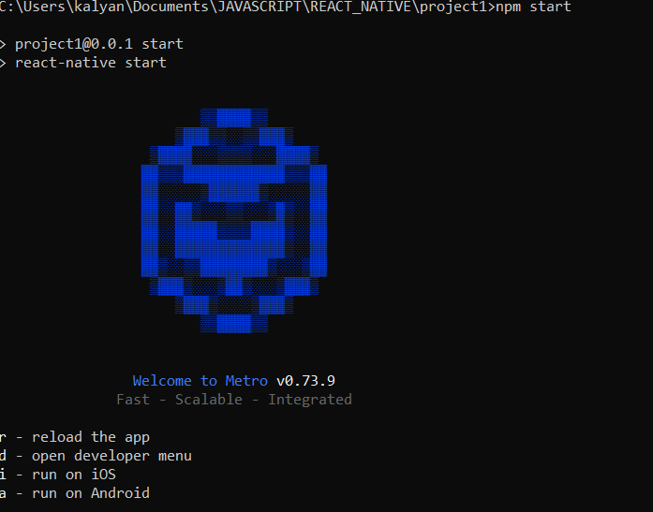
npm start

Slide 15
Step-15
Run this command in vscode terminal npm run android

Slide 16
Step-16

Slide 17
Step-17

Slide 18
Step-18

Slide 19
Step-19

Slide 20
Step-20

Slide 21
Step-21

Slide 22
Step-22

Slide 23
Step-23

Slide 24
Step-24

Slide 25
Step-25

