Slide 1
Light Dependent Resistors (LDR)
R. Becker
2022-09-22

Slide 2
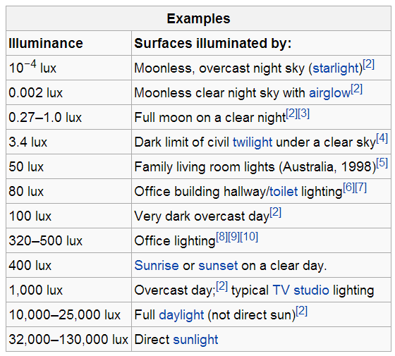
Illuminance
10⁰
10²
10³
10⁴
10⁵
http://en.wikipedia.org/wiki/Lux

Slide 3
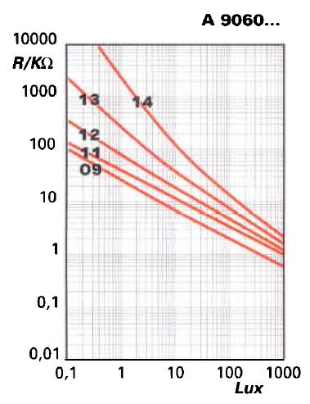
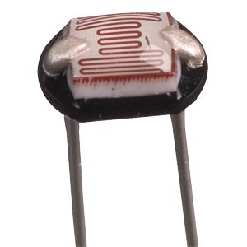
Fritzing: LDR A 9060(-09?)
Source: PerkinElmer

Slide 4
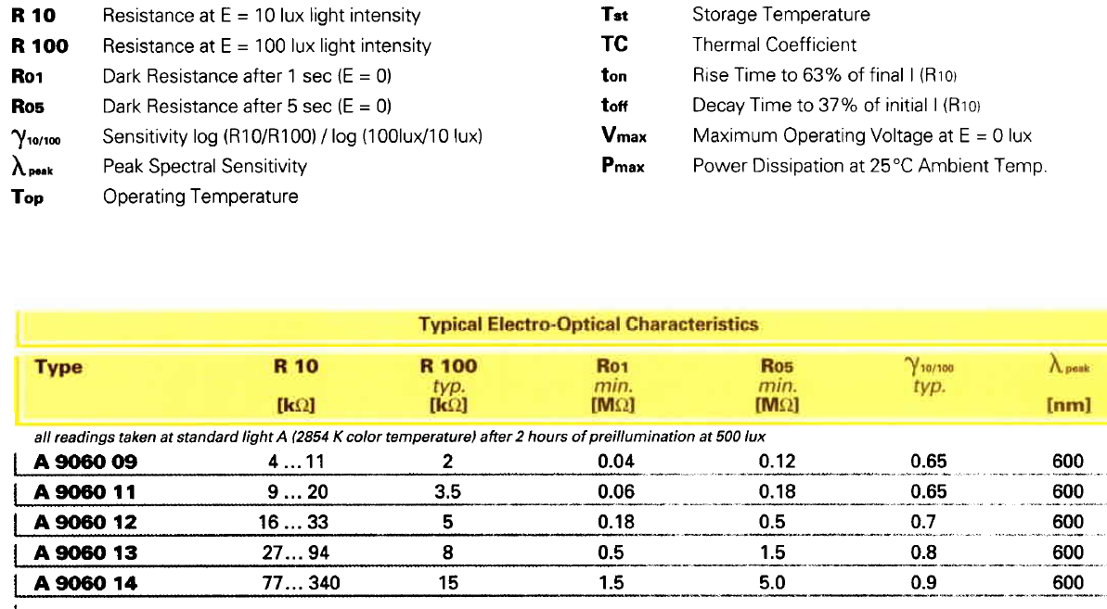
Fritzing: LDR A 9060(-09?)
Source: PerkinElmer

Slide 5
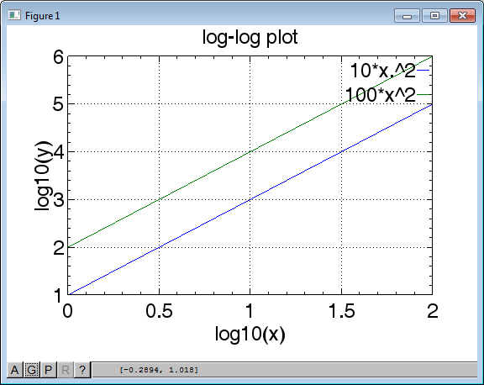
log-log Plot
x = [1:100]
y1 = 10 * x.^2
y2 = 100 * x.^2
plot(log10(x),log10(y))

Slide 6
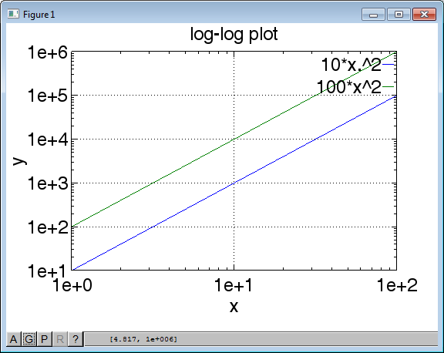
log-log Plot
x = [1:100]
y1 = 10 * x.^2
y2 = 100 * x.^2
loglog(x,y)

Slide 7
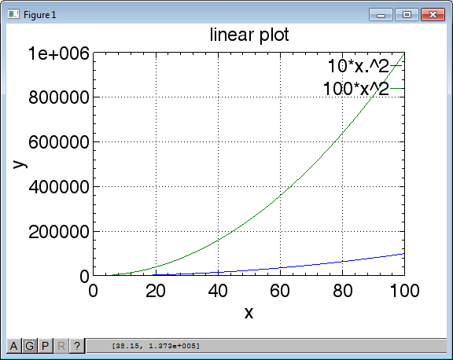
Linear Plot
x = [1:100]
y1 = 10 * x.^2
y2 = 100 * x.^2
loglog(x,y)

Slide 8
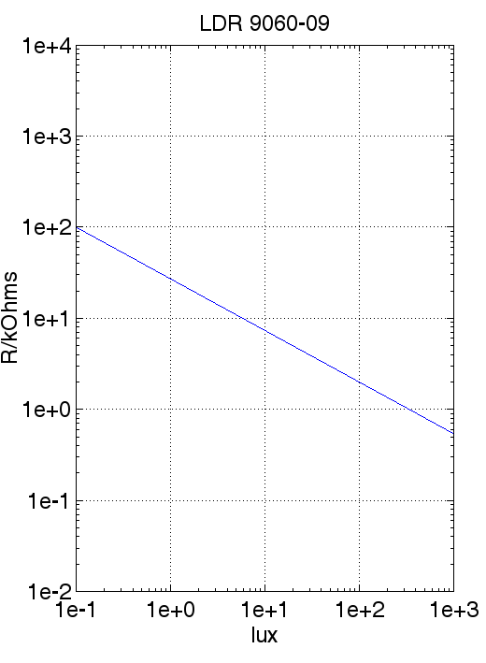
Fritzing: LDR A 9060(-09?)
R = 2.71e4 * x^(-0.57)
Source: PerkinElmer

Slide 9
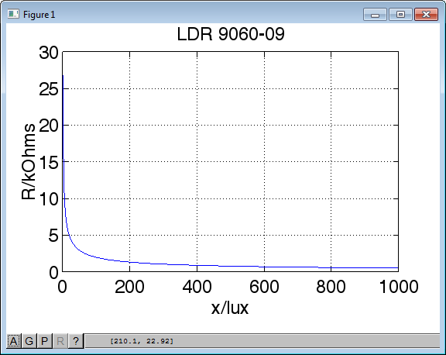
Sensitivity!

