Slide 1
Concurrent data structures using RCU
Rolfe Bozier
19-Oct-2014

Slide 2
Agenda
Wait-free data structures
How does the RCU mechanism work?
A hash table with wait-free readers
Conclusion
References

Slide 3
RCU – Read-Copy-Update
What is RCU?
A synchronisation method that can often be used in place of a traditional reader-write lock
Used to protect data structures that are written and read at the same time
Extremely low overhead for readers – wait-free
Readers cannot block writers
Multiple writes are serialised
What are the drawbacks then?
Multiple versions of the data structure can be present at any one time
Concurrent readers can see different [valid] versions
Some memory overhead in keeping older versions of the structure around (for a period)
RCU has been used in the Linux kernel for over 10 years
RCU requires 2 pieces of functionality:
Publish-subscribe mechanism
Grace periods

Slide 4
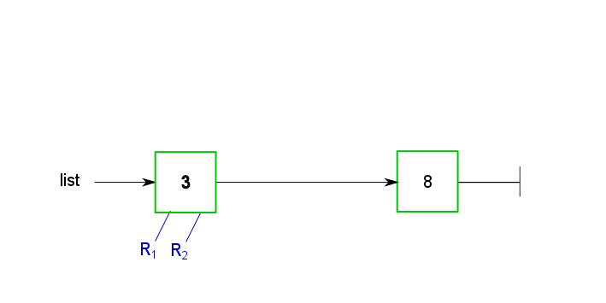
Publish-subscribe
Consider the following stages in adding an element to a shared linked list
There are two readers, currently at the first node

Slide 5
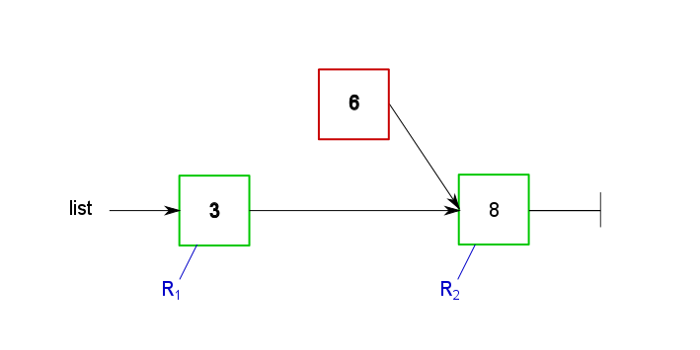
Publish-subscribe
We create a new node and set its next pointer to the correct destination
No reader can see the new node yet
Meanwhile, the second reader has moved to the last node

Slide 6
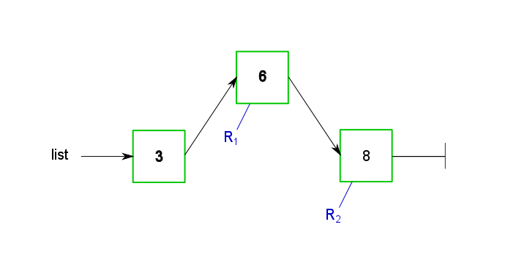
Publish-subscribe
Finally, we atomically update the previous nodes next pointer to include the new node
The first reader follows the pointer to the new node (and then finally to the last node)

Slide 7
Publish-subscribe
OK, this seems pretty simple, but…
Don’t forget about compiler and CPU re-ordering of instructions!
Writer
prev = …
p = malloc(sizeof(node));
p->value = 6;
p->next = prev->next;
rcu_assign_pointer(prev, p);
Reader
list_for_each_entry_rcu(p, head, next)
{
do_something_with(p->value);
}
Add a write barrier before setting prev->next
Add a read barrier for each step through the list

Slide 8
Publish-subscribe
Different readers can see different views of the list at the “same time”
Reader 1 saw: 3, 6, 8
Reader 2 saw: 3, 8
Publish semantics:
Writer updates the data structure atomically
Writer uses memory barriers to prevent store re-ordering
Subscribe semantics
Readers are prepared for things to change on the fly
Readers use memory barriers to prevent load re-ordering

Slide 9
Grace periods
Deleting an item from an RCU list is not quite so straightforward…
Remember that readers can be looking at any node in the list while we are deleting
… including the node we want to remove!
To allow for this, we preserve the existing data for a grace period, to allow readers to complete
After the grace period has expired, we can delete the old node
Obviously we need something a bit more rigorous than a “timeout”

Slide 10
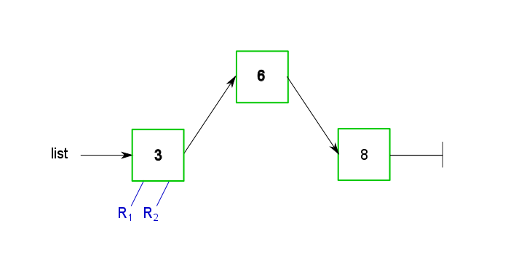
Grace periods
Consider the following stages in deleting an element in a shared linked list

Slide 11
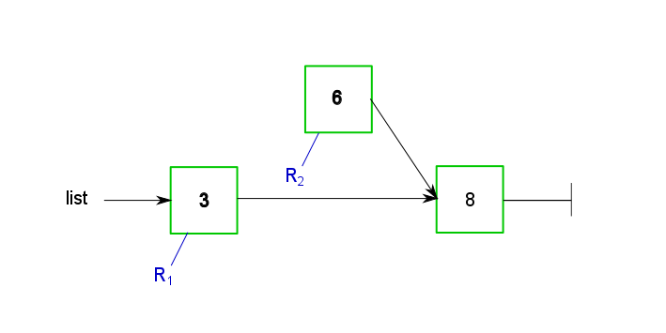
Grace periods
The next pointer in the previous node is updated to bypass the target node
But before this, reader 2 has traversed to the target node

Slide 12
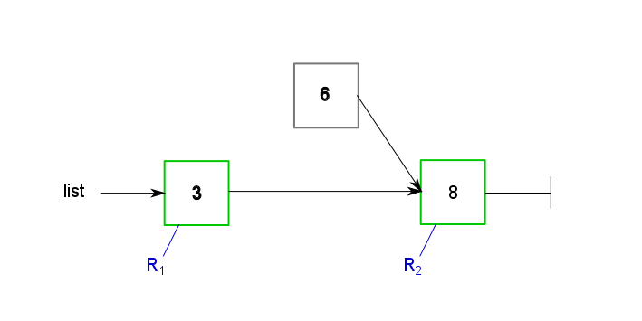
Grace periods
The writer waits for a “grace period”
After the grace period has expired, there can be no readers still referencing the target node
Reader 2 has moved to the final node

Slide 13
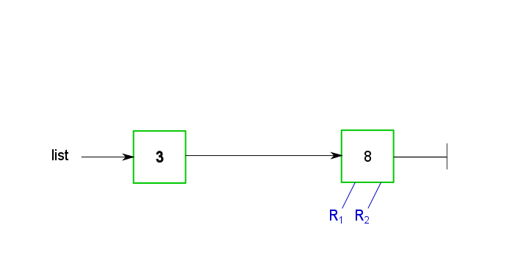
Grace periods
The target node is freed
Meanwhile the first reader traverses the list to the final node

Slide 14
Grace periods
Different readers can see different views of the list at the “same time”
Reader 1 saw: 3, 8
Reader 2 saw: 3, 6, 8
The grace period allows the writer to safely perform garbage collection of the deleted node
This needs to be long enough for all readers to no longer reference the deleted data
It should not be so long as to hold up the writer or cause excess memory usage
If we want to update a node, we generally can’t do this atomically (unless the data is atomic)
Read the node to be replaced
Copy it to a new node with the modified values
Update the list atomically to use the replacement node

Slide 15
Grace periods
In the Linux kernel, grace periods are managed as follows:
Readers enclose their operations in rcu_read_lock() and rcu_read_unlock() “functions” - in the simple case they do nothing
Code must not block between these two functions
The write thread schedules itself to run on each CPU in turn
At the end, it is guaranteed that no reader is still holding on to a deleted node
The node can be freed
Obviously something different needs to be done for userspace implementations of RCU
There are now a number of userspace libraries that can manage RCU operations in various ways, e.g.
A global 64-bit grace period counter that can be atomically incremented, plus
Per-thread grace period counter references to indicate where the reader is
See the references for more information

Slide 16
An RCU Hash Table
Consider the example of an RCU Hash Table
In open hashing, collisions are resolved by adding a linked list to the bucket
We can see that RCU lets us add, modify and delete entries to a hash table, including the bucket lists
But what about resizing?
We can resize a hash table without blocking readers with the following conditions:
The table grows or shrinks by a factor of two
Bucket lists can be imprecise – they can contain extra entries (from different hash values)

Slide 17
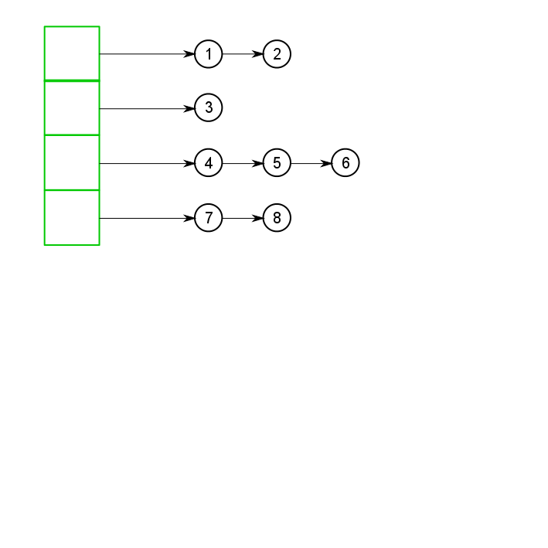
An RCU Hash Table
Consider a hash table with 4 buckets
We want to shrink it to size 2

Slide 18
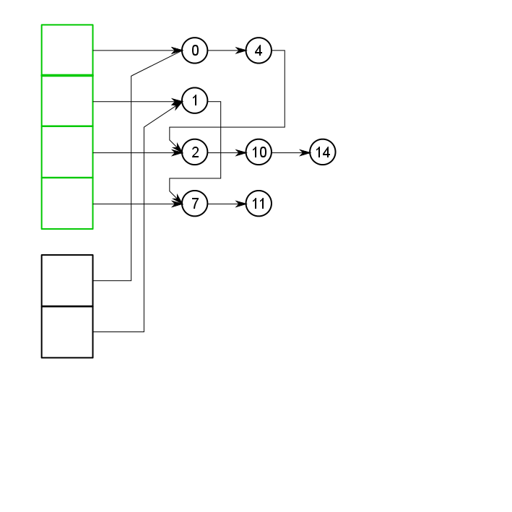
An RCU Hash Table
Create the new bucket array
Chain the bucket lists according to their new hash value

Slide 19
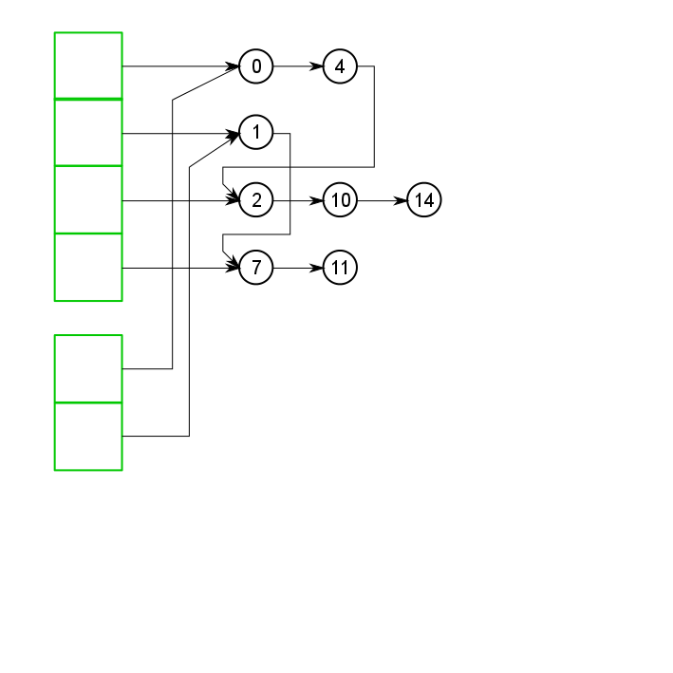
An RCU Hash Table
Publish the new table and wait for readers

Slide 20
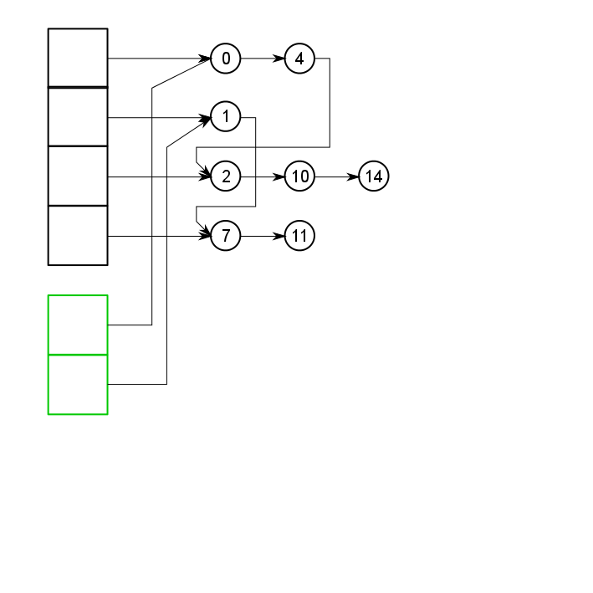
An RCU Hash Table
The old bucket array can now be freed

Slide 21
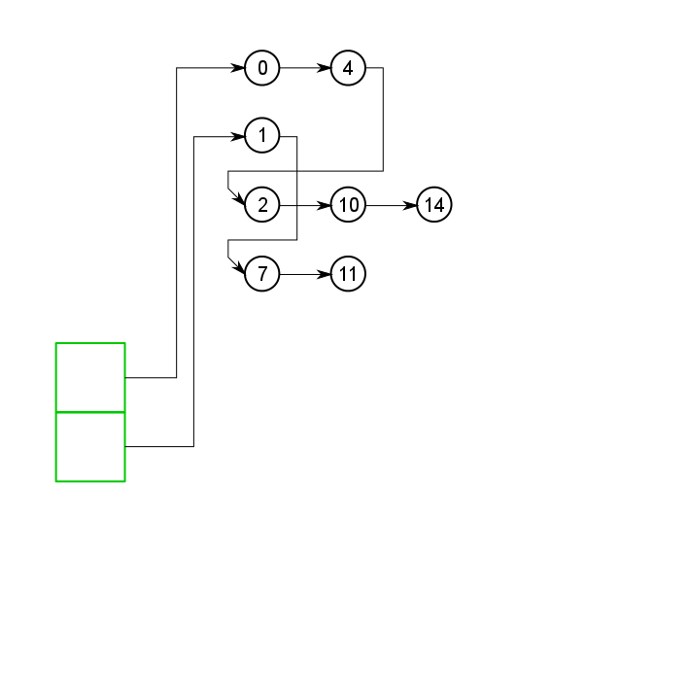
An RCU Hash Table
The final version
Growing is essentially the reverse process
It is a bit more involved due to the need to unzip the bucket lists and wait for readers for each step

Slide 22
Conclusion
RCU is a synchronisation mechanism for managing data structures with wait-free readers
Most suitable where reads >> writes
The data structure semantics may need some adjustment (e.g. imprecise bucket lists)
It has been used in Linux kernels for over 10 years
To implement, you need a few things
Atomic operations
Memory barriers
A suitable grace period mechanism

Slide 23
References
What is RCU, Fundamentally? [3 parts]
http://lwn.net/Articles/262464/
http://lwn.net/Articles/263130/
http://lwn.net/Articles/264090/
“User-Level Implementations of Read-Copy Update”
https://www.efficios.com/pub/rcu/urcu-main.pdf
https://www.efficios.com/pub/rcu/urcu-supp.pdf
Resizable, Scalable, Concurrent Hash Tables via Relativistic Programming
http://www.usenix.org/events/atc11/tech/final_files/Triplett.pdf
http://works.bepress.com/jonathan_walpole/12/

