Slide 1
What the heck is a Raspberry Pi?
Rolfe Bozier
10-Dec-2014

Slide 2
Agenda
Background
Hardware
Getting started
What can you do with it?
Some demos
Giveaway!

Slide 3
Overview
Credit-card sized computer
Created to promote basic computer science in schools, inspired by Acorn BBC Micro (c. 1981)
Low cost ($20-35)
Designed by Eben Upton, a Broadcom employee
Managed by Raspberry Pi Foundation - not for profit
First released Feb 2012
Extremely popular (current sales of 3.8 million in < 3 years)

Slide 4
Hardware
Broadcom BCM2835 SoC
ARM1176 700MHz 32-bit CPU
VideoCore iV GPU
256-512MB RAM
Optional 10/100 ethernet port
1-4 USB 2.0 ports
SD / microSD slot
HDMI and/or composite video out
Analogue audio out, HDMI out, I2S in/out
GPIO pins including: UART, I2S, I2C, SPI, power
MIPI camera connector

Slide 5
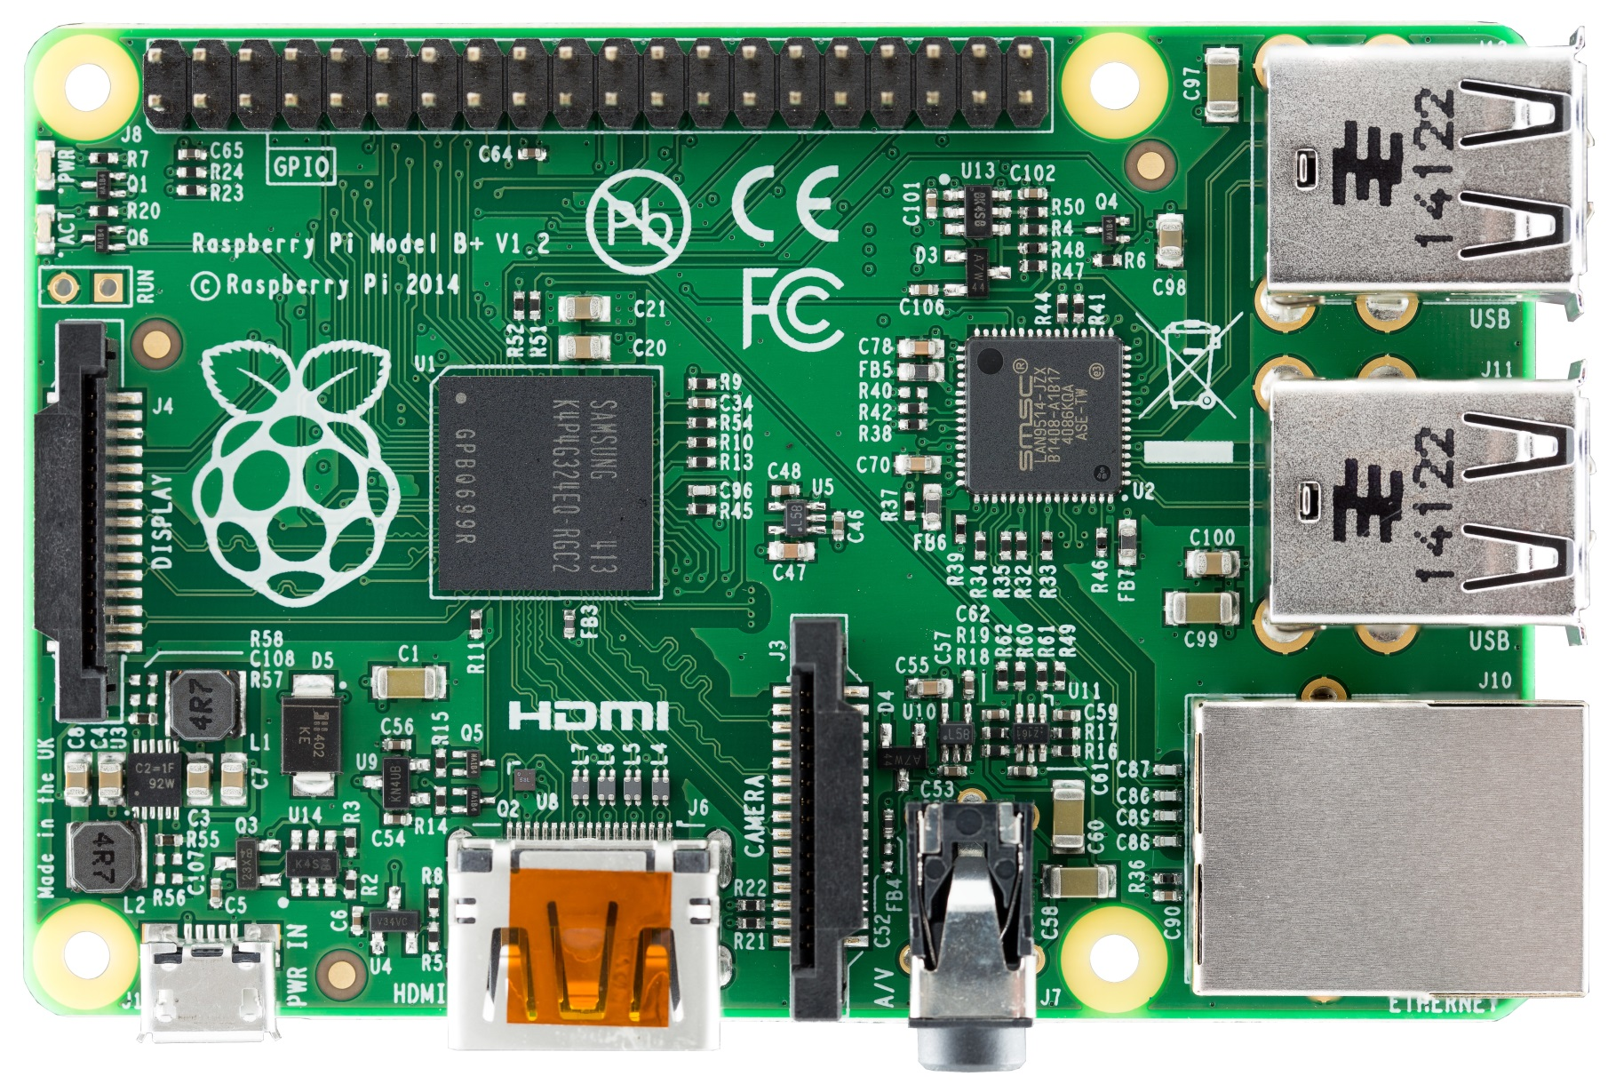
Hardware

Slide 6
Hardware
Comparison
CPU ~ 300MHz Pentium II (1997-99 vintage)
GPU ~ 2001 XBox
Models
Model A+ - 256MB RAM, 1 USB, 200mA - $23
Model B+ - 512MB RAM, 4 USB, 1 10.100 ethernet, 600mA, more GPIO - $38
Model A - obsolete version of A
Model B - obsolete version of B
Compute module - less dedicated I/O, more GPIO, SO-DIMM format

Slide 7
What does it run?
Linux:
Raspbian (Debian), Pidora (Fedora), Arch, Gentoo, openSUSE
Other OSs:
RISC OS, FreeBSD, NetBSD, Plan 9, Inferno
Application-specific:
OpenWrt, Xbian, XBMC, Instant WebKiosk
Not Windows ☹
Applications:
Mathematica, Minecraft
Linux development tools
gcc compiler (C, C++)
Python, perl
Scratch
of course you can download and install many more

Slide 8
Getting started
What you typically need:
USB keyboard + mouse
Monitor with HDMI video in
5V power supply via micro USB
Network connection (ethernet or wifi dongle)
micro SD card with bootable OS (or install image)
Typical install image is "NOOBS"
contains install images for Arch, Pidora (Fedora), Raspbian (Debian), XBMC
you can choose which image[s] to install
Takes around 20 minutes
System runs entirely from the SD card

Slide 9
Installation process
Initial install process
insert SD card and apply power
choose install OS[s]
reboot
set up some initial config (keyboard, hostname, locale, sshd server etc.)
reboot
You’re done
There are a huge number of resources on the Internet to get you started

Slide 10
Now what?
What can you do with it?
Learn some Linux sysadmin
Use it as a low-power network server (e.g. DHCP, DNS, NTP, print server, ...)
Run a dedicated application on it (e.g. kiosk, XBMC media centre, security camera)
Use it as an experimental Linux platform
Home automation
Programmable camera
Hook it up to some hardware to make it more widely accessible
Christmas light controller
Robot controller
Add extra HAT boards on to it
Build a radio-astronomy interferometer

Slide 11
Fingers crossed…
Demos
Sensor network receiver
Smart still / video camera
Software-defined radio receiver

