Slide 1
Implementing foreign language support
Rolfe Bozier
5-Aug-2015

Slide 2
Agenda
A bit of background
What is internationalisation (I18N)?
Supporting foreign languages
Encoding
Translation
Presentation

Slide 3
Background
Goal: provide an application for use in other countries
Standalone software that is sold or distributed in another environment
Shared systems (“cloud”) that are used in multiple places
Deployment has two phases:
Internationalisation (“I18n”)
Localisation (“L10n”)
As software developers, we are mainly concerned about i18n

Slide 4
What are the issues?
Language (content, collation, fonts, writing direction, …)
Time-zone, currency
Number/date/time formatting
Identification issues (name/address/phone/titles/etc.)
Cultural issues
Paper size
Public holidays
Units of measure
Map coordinate systems
Regulatory issues (e.g. encryption, data retention)
… many more
Notes:
Assumptions about names, how to address people, do you live in a city or have a zip code?
Unlucky logo
SA map origin

Slide 5
What are the issues?
Language (content, collation, fonts, writing direction, …)
Time-zone, currency
Number/date/time formatting
Identification issues (name/address/phone/titles/etc.)
Cultural issues
Paper size
Public holidays
Units of measure
Map coordinate systems
Regulatory issues (e.g. encryption, data retention)
… many more
Notes:
Today’s talk

Slide 6
Language issues
Three key aspects:
Defining and preserving the representation of data (encoding)
Conversion of text into the local language (translation)
Representation of translated text (fonts and UI)
Notes:
Today’s talk

Slide 7
Defining and preserving the representation of data (encoding)
Notes:
Authentication involves comparing the encrypted passwords

Slide 8
Text encoding
How do you store this text:
Привіт, я не росіянин.
… so that it doesn’t come out like this:
??????, ? ?? ????????
This is not a trivial problem.

Slide 9
A brief history of text encodings
1960s-1980s – 7-bit ASCII
Great for English and maybe one or two other languages
95 printable characters out of a possible 128
But at least every agreed on what characters were encoded as
Well, mostly

Slide 10
A brief history of text encodings
1990s – Let’s use the 8th bit for more characters – ISO-8859
Encoding | Purpose
iso-8859-1 (“latin-1”) | Western European languages
iso-8859-2 (“latin-2”) | Central European languages
iso-8859-3 (“latin-3”) | Southern European languages
iso-8859-4 (“latin-4”) | Northern European languages
iso-8859-5 | Cyrillic characters
iso-8859-6 | Arabic characters
iso-8859-7 | Modern Greek
iso-8859-8 | Modern Hebrew
iso-8859-9 (“latin-5”) | Like -1 but with Icelandic replaced with Turkish
iso-8859-10 (“latin-6”) | Like -4, but with better support for Nordic languages
iso-8859-11 | Thai
iso-8859-13 (“latin-7”) | Like -4 and -10, but with better support for Baltic languages
iso-8859-14 (“latin-8”) | Celtic languages
iso-8859-15 (“latin-9”) | Like -1, but with more useful symbols
iso-8859-16 (“latin-10”) | Better south-eastern European language support
Notes:
What’s wrong with this?

Slide 11
A brief history of text encodings
Several problems with this…
It only covers mostly European languages
What about languages with more than around 200 characters?
What about other symbols that might be useful?
What if you want to mix characters from multiple encodings?
How do you know which encoding is being used?

Slide 12
A brief history of text encodings
Meanwhile, on the other side of the world…
Asian languages need many more characters
Around 2,000 for Japanese
Up to 40,000 for Chinese
Various encodings were developed
Encoding | Data size | Purpose
Big5 | Double-byte | Traditional Chinese (Taiwan, Hong Kong, Macau)
GBnnnnn | Variable | Chinese (official)
Shift JIS | Variable (1-2 bytes) | Japanese (not well standardised)
EUC-JP | Variable | Japanese
EUC-CN | Variable | Chinese
EUC-KR | Variable | Korean
EUC-TW | Variable | Taiwan

Slide 13
A brief history of text encodings
1990s-present - Unicode to the rescue!
A modern, international standard for character definition and encoding
Identifies characters by abstract code points
Aims to cover all possible language encoding requirements
around 120,000 characters
around 129 modern/historic scripts
even scripts such as: Egyptian hieroglyphs, Linear A, Braille, Cherokee, Runic
private spaces: Klingon, Tengwar, Ferengi, ...
Also supports
combining characters
ligatures
emoticons
direction changing
mathematical and graphical symbols

Slide 14
A brief history of text encodings
1990s-present - Unicode to the rescue!
Space for around 1 million code points (entries)
All the characters you’ll need are in the first 2¹⁶ entries
Also known as the Basic Multilingual Plane (BMP)
Defines several encodings that can be used:
UTF-8 (variable-length, 1-4 x 8-bit bytes)
UTF-16 (variable-length 1-2 x 16-bit entities)
UTF-32 (fixed-length 32-bit entities)

Slide 15
A brief history of text encodings
1990s-present - Unicode to the rescue!
Space for around 1 million code points (entries)
All the characters you’ll need are in the first 2¹⁶ entries
Also known as the Basic Multilingual Plan (BMP)
Defines several encodings that can be used:
UTF-8 (variable-length, 1-4 x 8-bit bytes)
UTF-16 (variable-length 1-2 x 16-bit entities)
UTF-32 (fixed-length 32-bit entities)
HINT: choose this one!

Slide 16
A brief history of text encodings
Several problems with this…
It only covers European languages ✓
What about languages with more than around 200 characters? ✓
What about other symbols that might be useful? ✓
What if you want to mix characters from multiple encodings? ✓
How do you know which encoding is being used?
Only this problem remains…

Slide 17
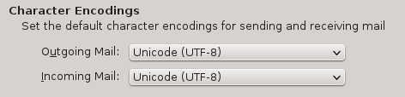
Which encoding is being used?
You generally can’t tell just by looking at the text
You need to make your choice and enforce it everywhere
When you have the opportunity to specify what encoding is being used, then take it!
Database:
CREATE DATABASE db_name CHARACTER SET utf8 …
Web pages:
<meta http-equiv=”Content-Type” content=”text/html; charset=utf-8” />
Email:
Notes:
J smiley
Bad web pages
Windows text documents in UTF-16 on Linux

Slide 18
Implementation issues
“Just use UTF-8 everywhere”
Don’t convert between encodings unless you really know the source encoding
C functions:
Don’t use strlen(), strchr(), strcmp()
If you think you need to use them, ask yourself why…
Do use strcoll()
Maybe use mb*() functions
Maybe use wc* functions

Slide 19
Conversion of text into the local language (translation)
Notes:
Authentication involves comparing the encrypted passwords

Slide 20
Extracting text to be translated
It is going to be painful
Don’t just have message identifiers in your code
At least have the English text as a comment nearby
Automate wherever possible
You’re going to have to re-write some of your text / code…

Slide 21
Extracting text to be translated
printf() and ordering of the replacements
printf
(
”You need to specify the correct %s mode for %s paper\n”,
mode_str,
paper_name
);
What if these words should be in a different order?

Slide 22
Extracting text to be translated
Word construction
printf
(
”%d page%s printed\n”,
n,
n == 1 ? ”” : ”s”
);
That only works for English…

Slide 23
Extracting text to be translated
Short phrases or jargon
printf
(
”file: %s\n”,
result
);
Should the translator treat “file” as a noun, verb, adjective, or what?

Slide 24
Testing text translation
If it’s not continually tested, it will break
Mishandling of encoding can result in bad output
Some text is always missed out
You won’t find out until late in the process… too late
You need a way to verify translation during development…

Slide 25
Testing text translation
If it’s not continually tested, it will break
Mishandling of encoding can result in bad output
Some text is always missed out
You won’t find out until late in the process… too late
You need a way to verify translation during development…
Automatic translation to “jive”
Amusing, somewhat readable, doesn’t test non-7-bit data
Not for demonstrations in the southern US states
Please enter a valid printer name
“Please enta' some valid printa' dojigger. What it is, Mama. Right On!”

Slide 26
Testing text translation
If it’s not continually tested, it will break
Mishandling of encoding can result in bad output
Some text is always missed out
You won’t find out until late in the process… too late
You need a way to verify translation during development…
Custom character set
Solves most of the above issues
Printer is not known
“Ṗṝȉńŧëṝ ȉṧ ṋṏŧ ḵńṏẅń”

Slide 27
Actual text translation
Send your message files to a professional translation agency
Preferably one with experience in technical translation
They should be capable of raising issues with ambiguity or jargon
Not the receptionist or a friend…
Double-check the translation with someone else
Maybe a customer or an employee

Slide 28
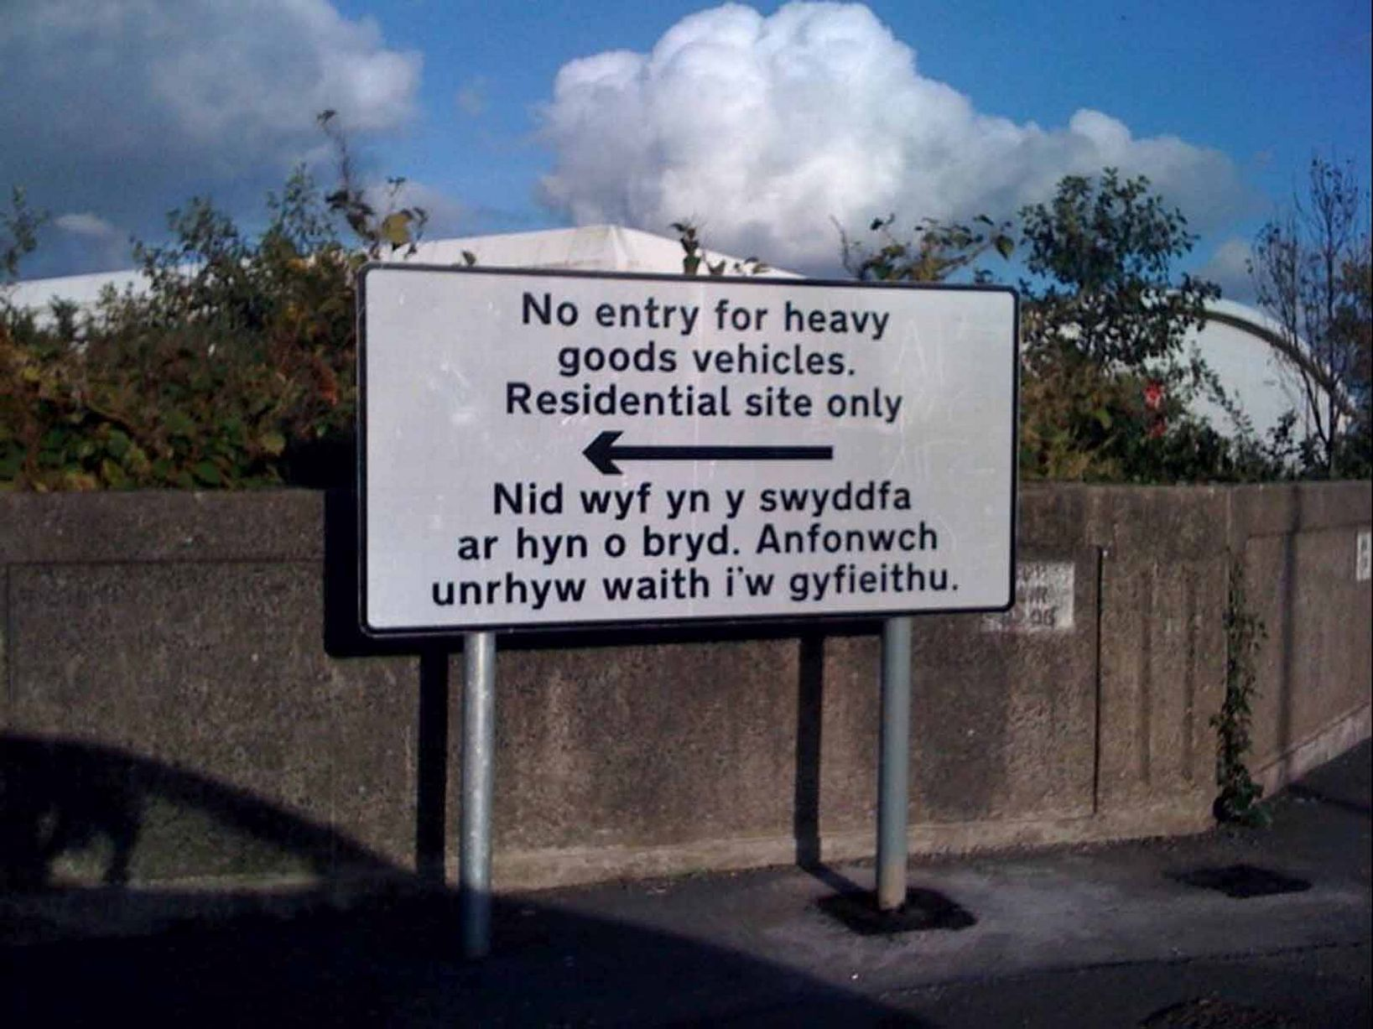
What could possibly go wrong?

Slide 29
What could possibly go wrong?
“I am not in the office at the moment. Send any work to be translated”

Slide 30
Representation of translated text (fonts and UI)

Slide 31
Presentation issues
Obviously you need the right fonts available
Usually this is managed at the user’s end
Be aware that the translated text may not be a drop-in replacement for the English version

Slide 32
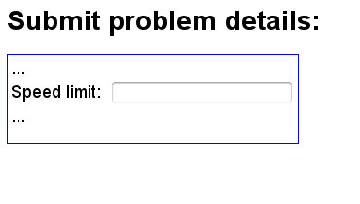
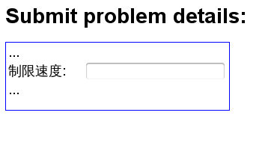
Presentation issues
Obviously you need the right fonts available
Usually this is managed at the user’s end
Be aware that the translated text may not be a drop-in replacement for the English version
For example:

Slide 33
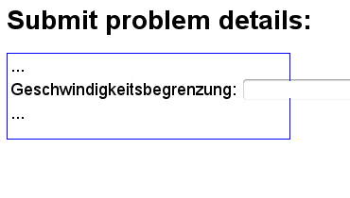
Presentation issues
Obviously you need the right fonts available
Usually this is managed at the user’s end
Be aware that the translated text may not be a drop-in replacement for the English version
For example:

Slide 34
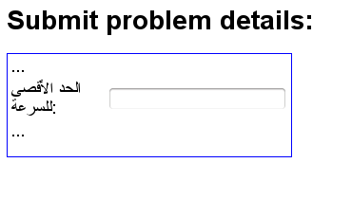
Presentation issues
Obviously you need the right fonts available
Usually this is managed at the user’s end
Be aware that the translated text may not be a drop-in replacement for the English version
For example:

Slide 35
Recap
Language (content, collation, fonts, writing direction, …)
Time-zone, currency
Number/date/time formatting
Identification issues (name/address/phone/titles/etc.)
Cultural issues
Paper size
Public holidays
Units of measure
Map coordinate systems
Regulatory issues (e.g. encryption, data retention)
… many more
We didn’t even consider these other issues…

Slide 36
Take away messages
You will need to identify and overcome your preconceptions
You need to be disciplined in your development processes
You will need outside help
By the time you find your mistakes, it could be too late…

