Slide 1
gRPC
gRPC Remote Procedure Call
Recursive Acronym
Nagy Roland

Slide 2
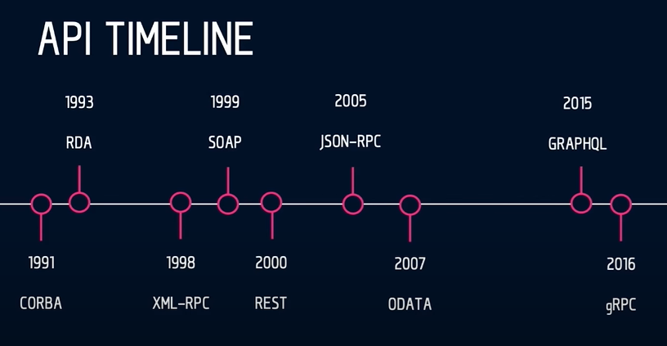
Notes:
COBRA (Common object request broker architecture)
RDA (remote database access)
XML-RPC
-Régi http
-Sima xml-hez képest annyi xml tag-et tartalmaz, hogy 4x annyi byte egy üzenet
SOAP (Simple Object Access Protocol)
App layer protokols -> (((SMTP…))), http főleg, de MQ is pl
classic
<soap:Envelope xmlns:soap="http://www.w3.org/2003/05/soap-envelope" xmlns:m="http://www.example.org">
<soap:Header>
</soap:Header>
<soap:Body>
<m:GetStockPrice>
<m:StockName>T</m:StockName>
</m:GetStockPrice>
</soap:Body>
</soap:Envelope>
JSON-RPC
-mint az XML-RPC csak json encoded
ODATA (open data protocol)
-http restful (OData is a way to create RESTful web services)
-json/atom
https://www.odata.org/getting-started/basic-tutorial/

Slide 3
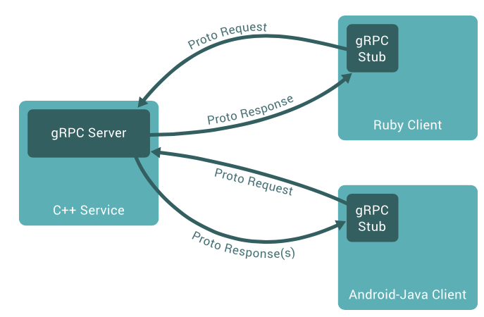
What is GRPC
High performance remote procedure call (RPC) framework
Open source made by google in 2015, publicized V1.0 in 2016
Uses HTTP/2
Uses Protocol Buffers (protobuf)
Cross platform

Slide 4
Common usages
Connecting microservices
Connect mobile device to backend
Used by Square, Netflix, CoreOS, Docker, CockroachDB, Cisco, Juniper Networks and many other organizations and individuals.

Slide 5
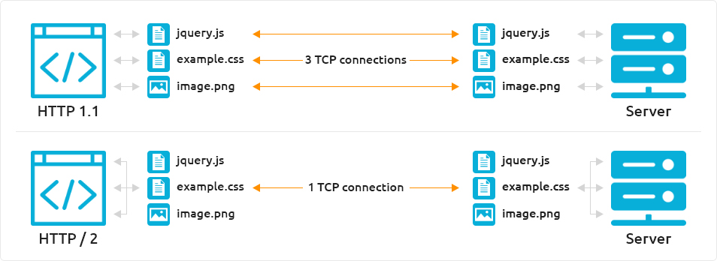
HTTP/2
HTTP/2 is binary
HTTP/2 is fully multiplexed
HTTP/2 uses the same connection
HTTP/2 has header compression
HTTP/2 allows servers to push
Notes:
HTTP/2 is binary instead of textual like HTTP1.x – this makes it transfer and parsing of data over HTTP/2 inherently more machine-friendly, thus faster, more efficient and less error prone.
HTTP/2 is fully multiplexed allowing multiple files and requests to be transferred at the same time, as opposed to HTTP1.x which only accepted one single request / connection at a time.
HTTP/2 uses the same connection for transferring different files and requests, avoiding the heavy operation of opening a new connection for every file which needs to be transferred between a client and a server.
HTTP/2 has header compression built-in which is another way of removing several of the overheads associated with HTTP1.x having to retrieve several different resources from the same or multiple web servers.
HTTP/2 allows servers to push required resources proactively rather than waiting for the client browser to request files when it thinks it need them.
Chrome has max 6 connection/host and 10 overall

Slide 6
Four type of communication
Unary RPC
Server streaming RPC
Client streaming RPC
Bidirectional streaming RPC
Notes:
Unary RPC: this is the simplest form of RPC. In this case, the client sends a request message to the server and receives a response.
Server streaming RPC: in this scenario, the client sends a request message to the server and receives a sequence of responses.
Client streaming RPC: this is the case where the client sends a sequence of messages and receives a single response from the server.
Bidirectional streaming RPC: in this case, the client and the server exchange messages in both directions.

Slide 7
ProtoBUF3 Struct
syntax = "proto3";
package foo;
enum order {
desc = 0;
asc = 1;
}
message SearchRequest { string query = 1; int32 page_number = 2; int32 result_per_page = 3;
order order = 100; }
message SearchResponse {…}
service SearchService {
rpc search(SearchRequest) returns (SearchResponse);
}

Slide 8
Supported languages
C/C++
C#
Dart
GO
JAVA
Kotlin
Node.js
Objective-C
PHP
Python
Ruby

Slide 9
Code generating
Use:
protoc -I=$SRC_DIR --java_out=$DST_DIR $SRC_DIR/addressbook.proto
Or protobuf-maven-plugin maven plugin
https://developers.google.com/protocol-buffers
https://github.com/protocolbuffers/protobuf/releases

Slide 10
Browser???
Google and Improbable worked on this
impossible, as there is simply no browser API with enough fine-grained control over the requests
raw HTTP/2 frames are inaccessible in browsers

Slide 11
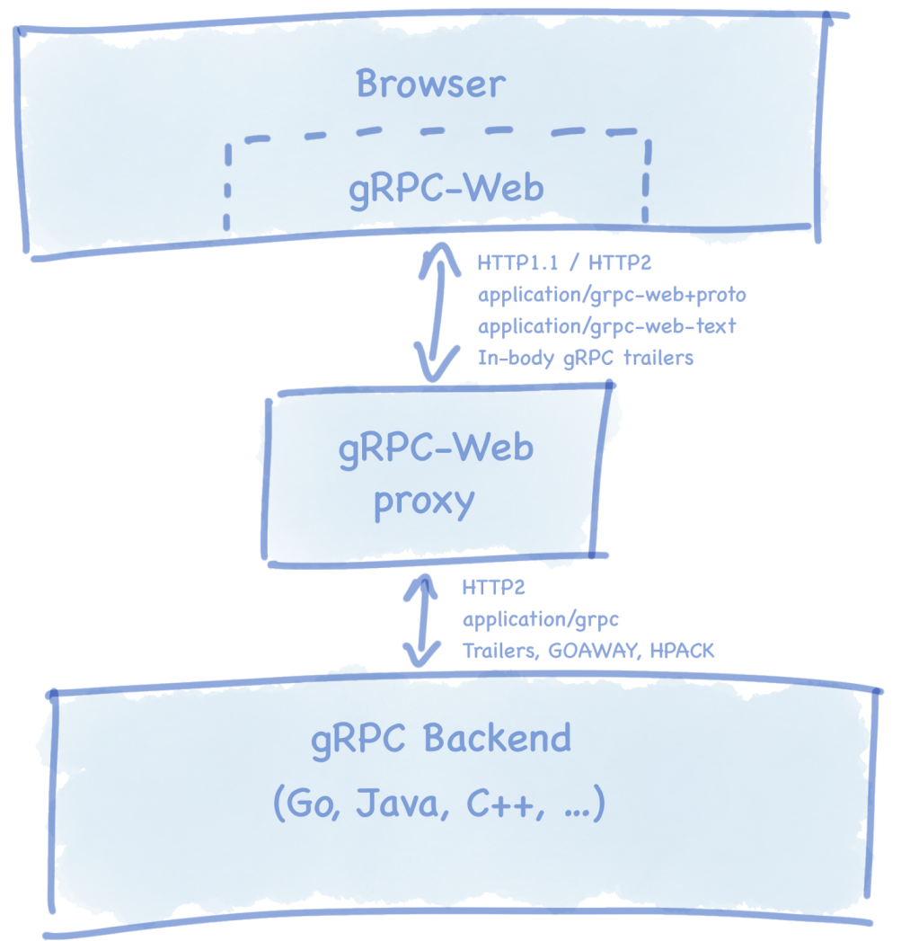
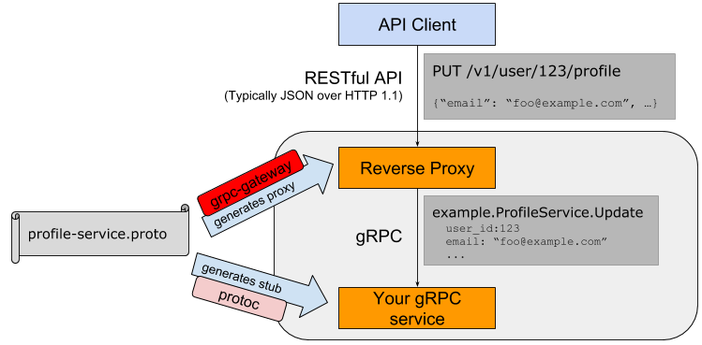
Browser???
https://grpc.io/blog/state-of-grpc-web/
https://github.com/grpc/grpc-web/blob/master/doc/roadmap.md
Notes:
Recent talks between the two projects have agreed on promoting the Google client and Envoy proxy as preferred solutions for new users.
Roadmap:
In-process Proxies on roadmap to eliminate the need of Envoy proxy
TypeScript support

Slide 12
Rest | gRPC
Resource based (GET /products/42) | Action based (getProduct(product))
Text based | Binary Based
HTTP/1.1 – higher latency | HTTP/2 – Lower latency
Request/Response only | Client, Server, Bidirectional streaming support
Code generating using OpenAPI/Swagger | Code generation out of the box
Browser – backend can communicate | Browser – backend need an additional proxy layer

Slide 13
links
https://grpc.io/docs/what-is-grpc/introduction/
https://github.com/uw-labs/bloomrpc
https://devopedia.org/grpc
https://github.com/roliiii/grpc-learning
https://github.com/roliiii/pontsystems-homework

Slide 14
THX

