Slide 1


Slide 2
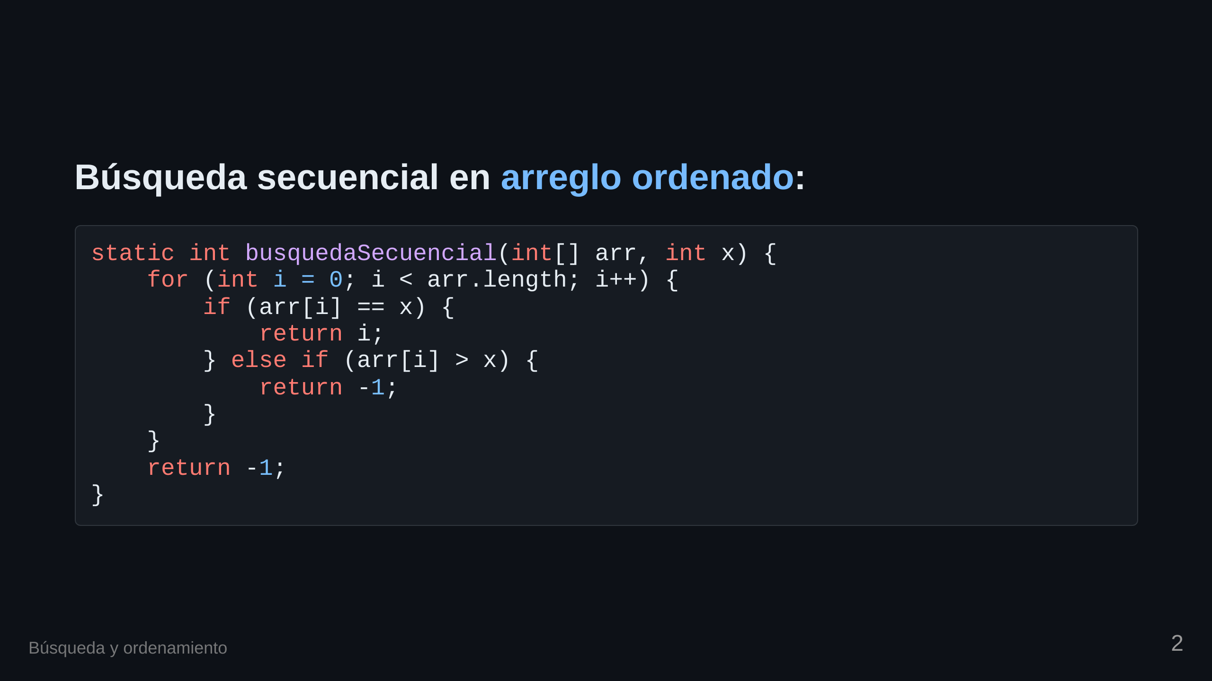

Slide 3
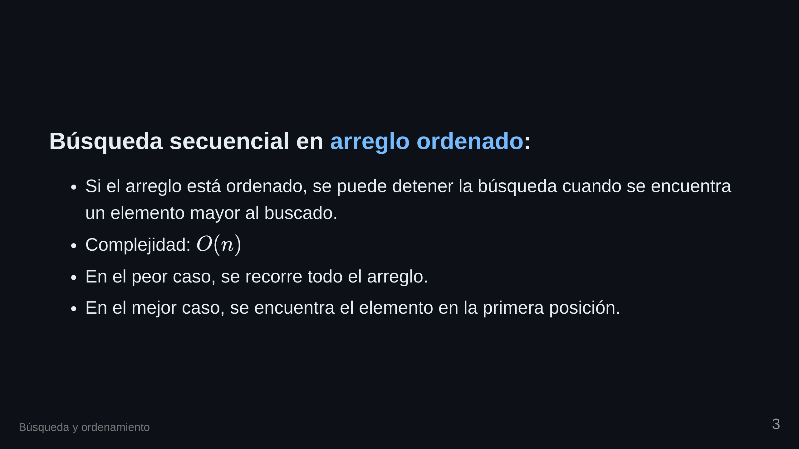

Slide 4


Slide 5
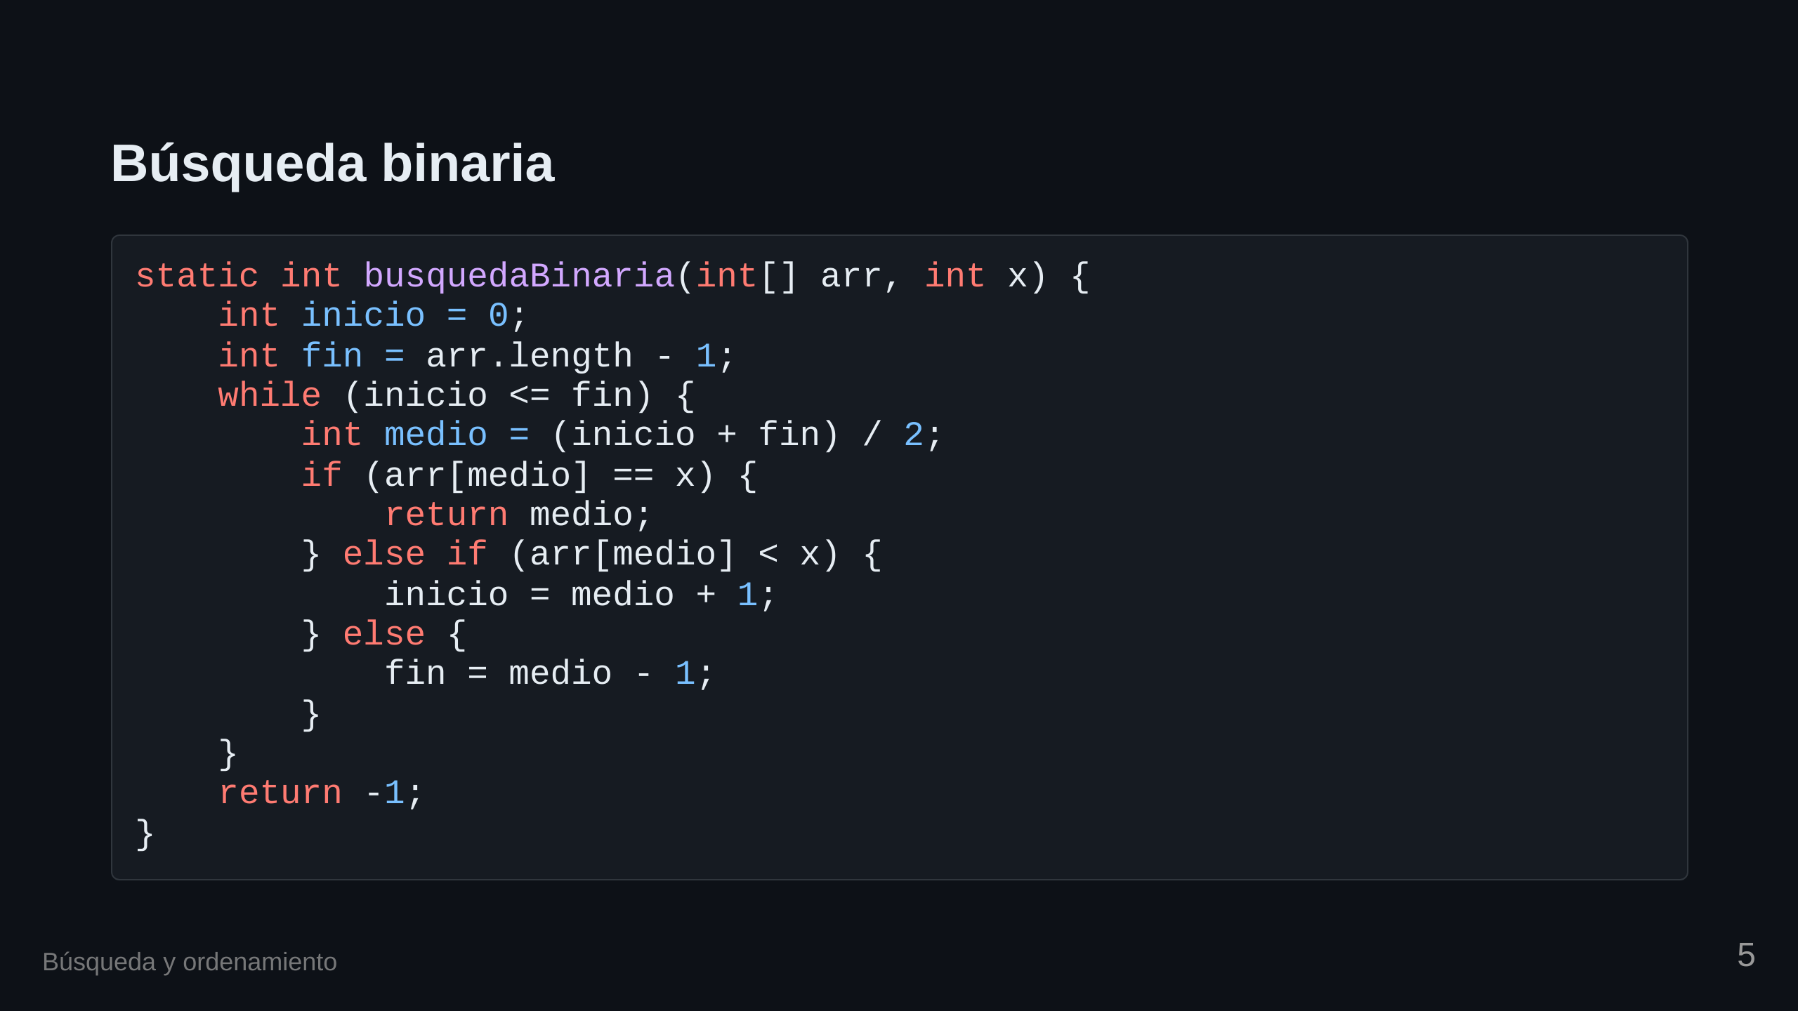

Slide 6
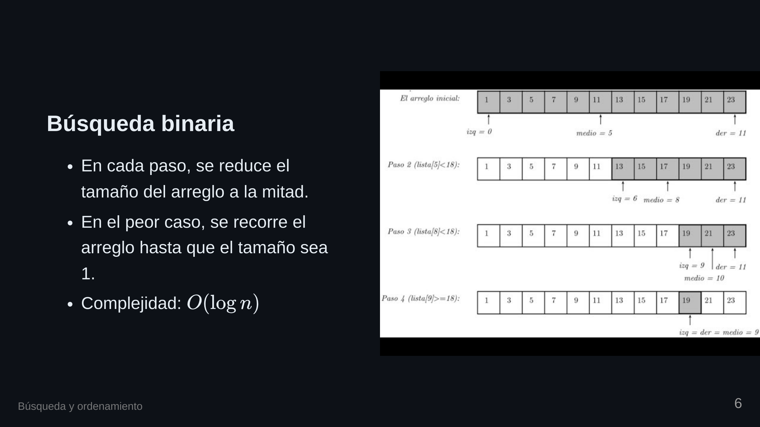

Slide 7


Slide 8
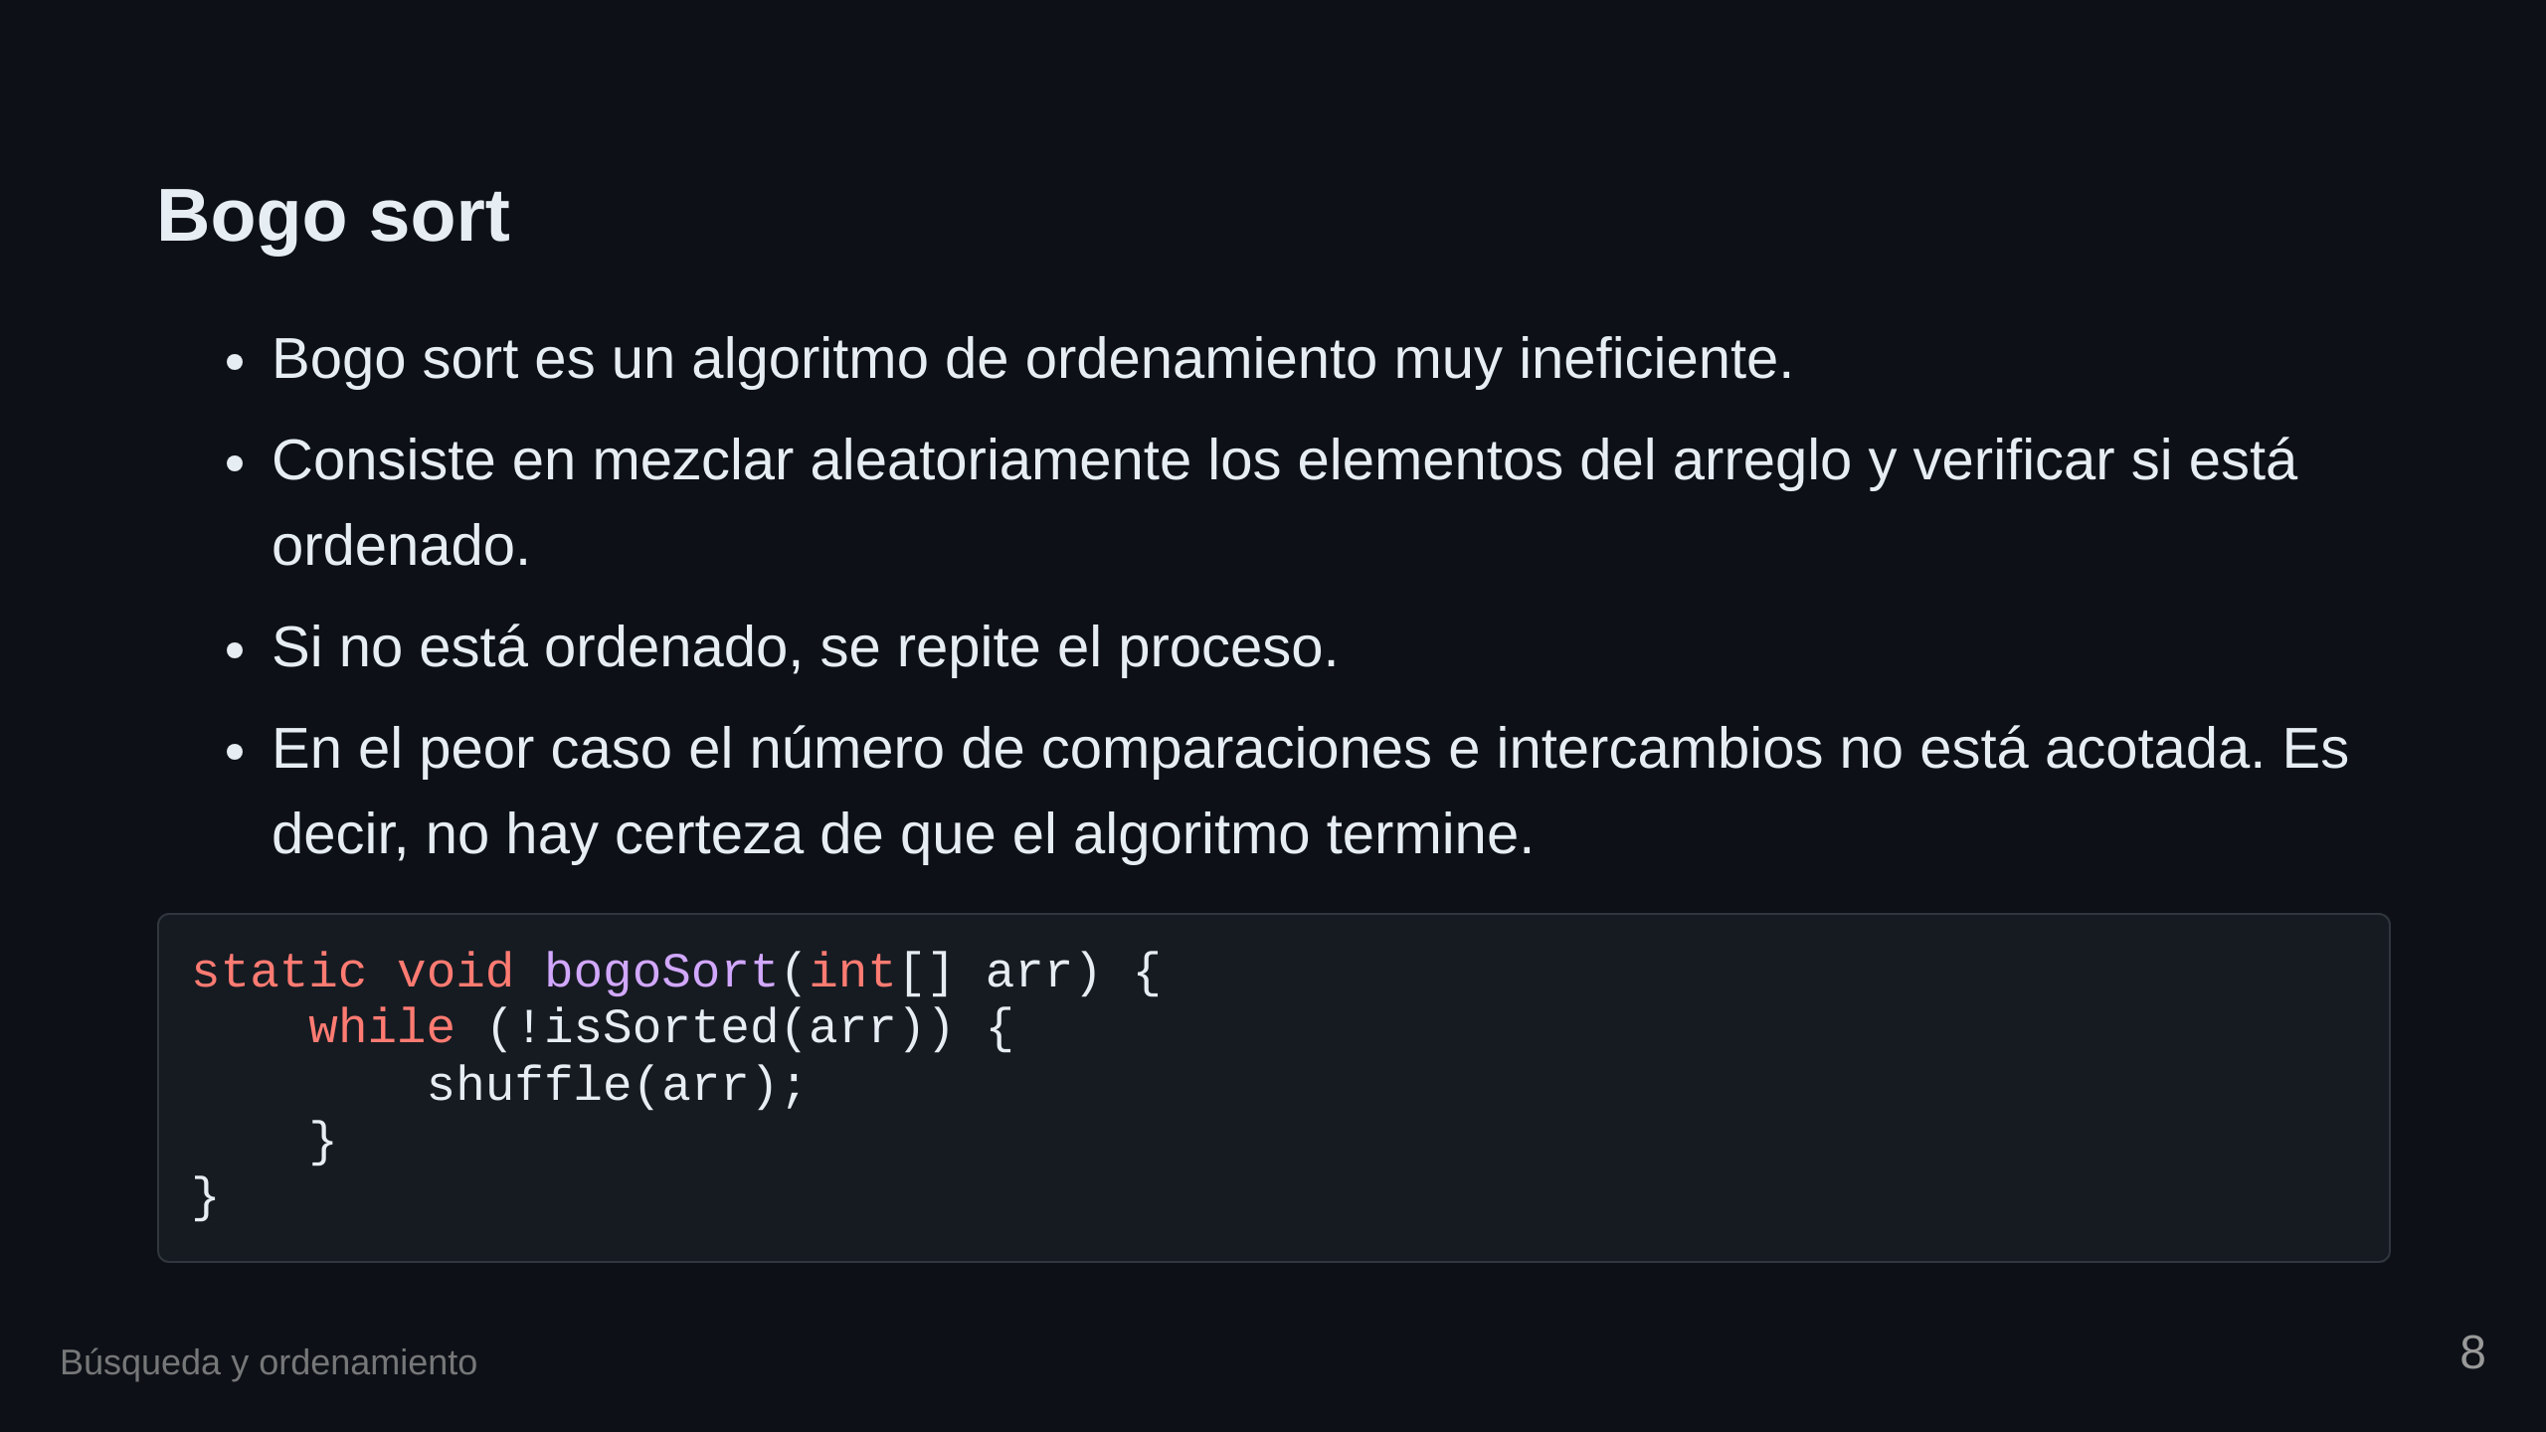

Slide 9
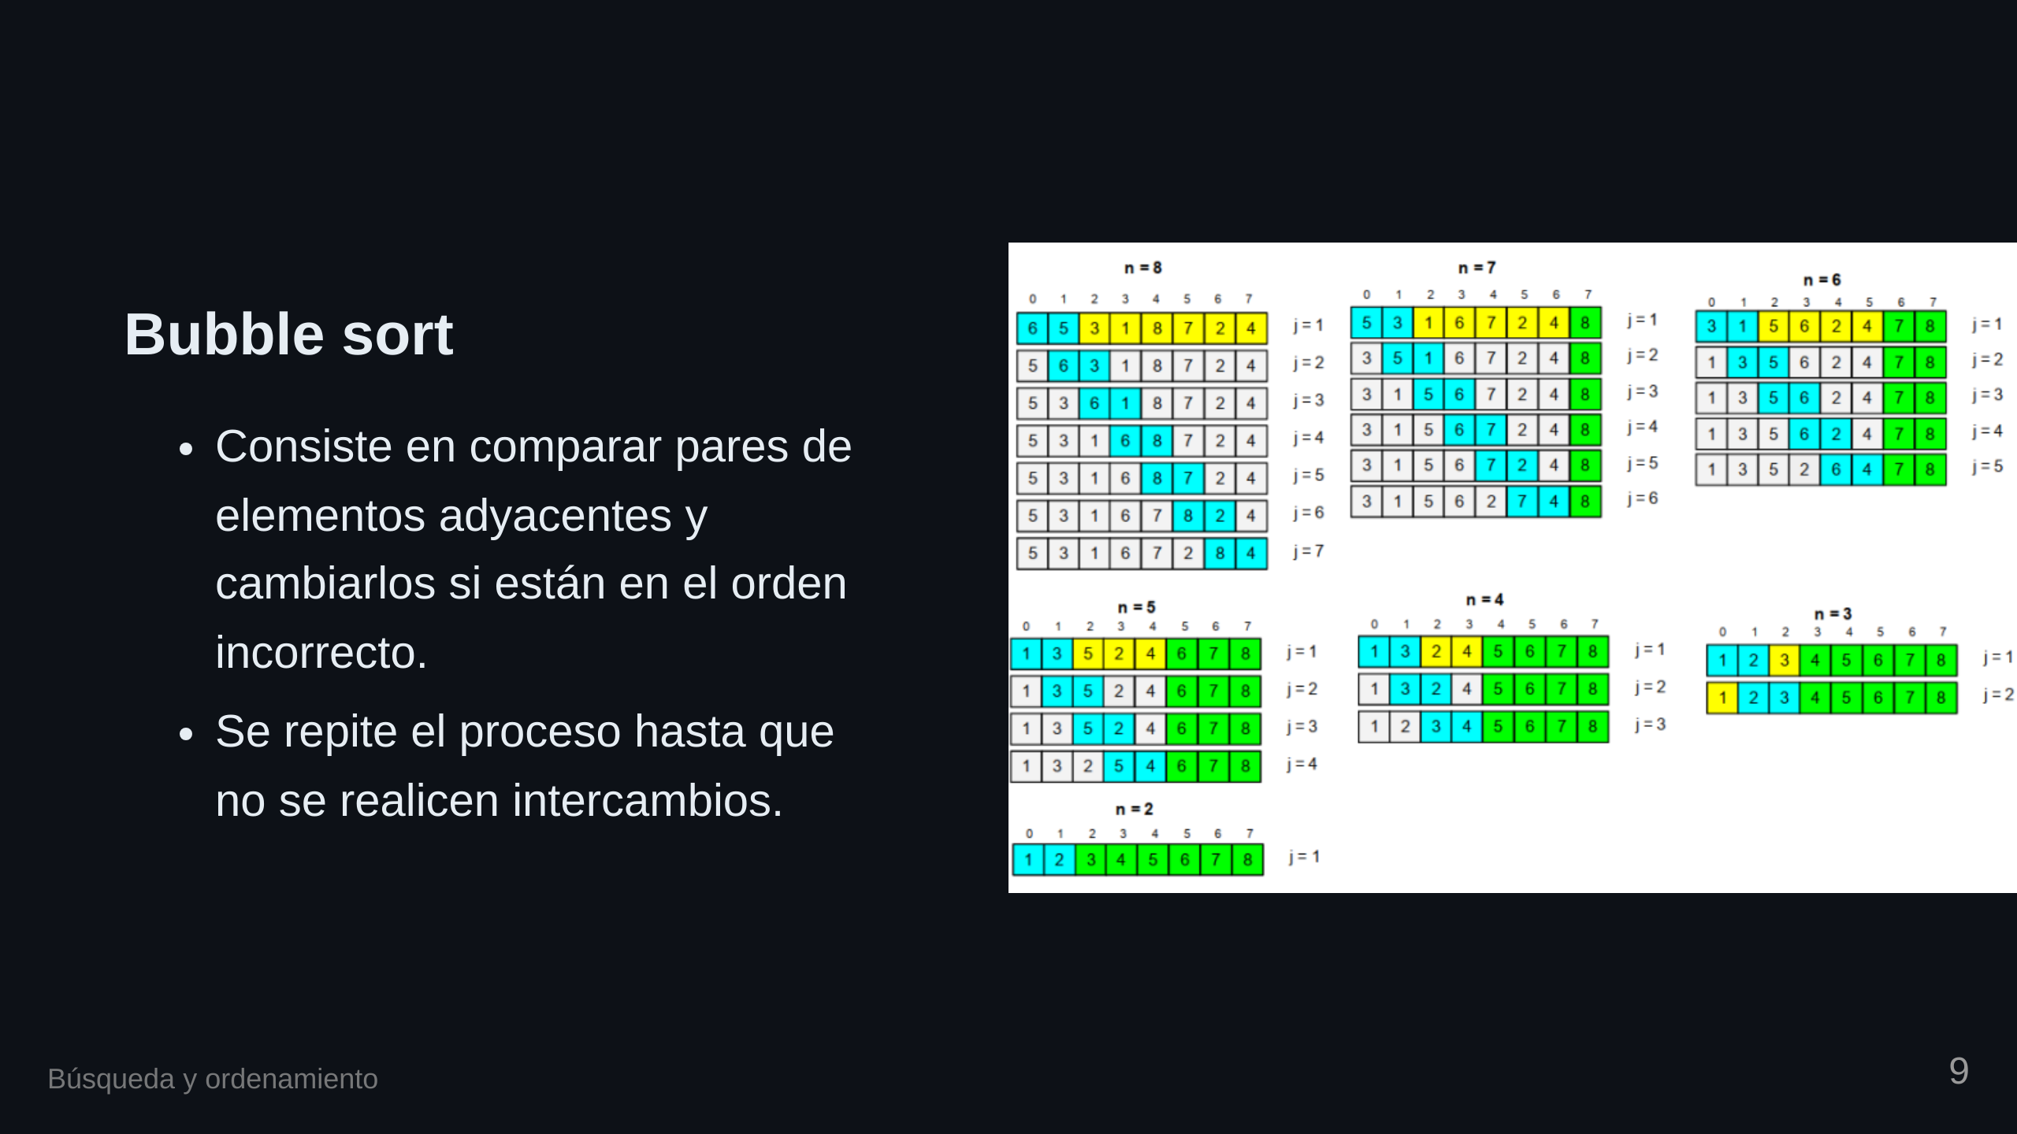

Slide 10

Notes:
transition: fade

Slide 11


Slide 12


Slide 13

Notes:
transition: slide

Slide 14
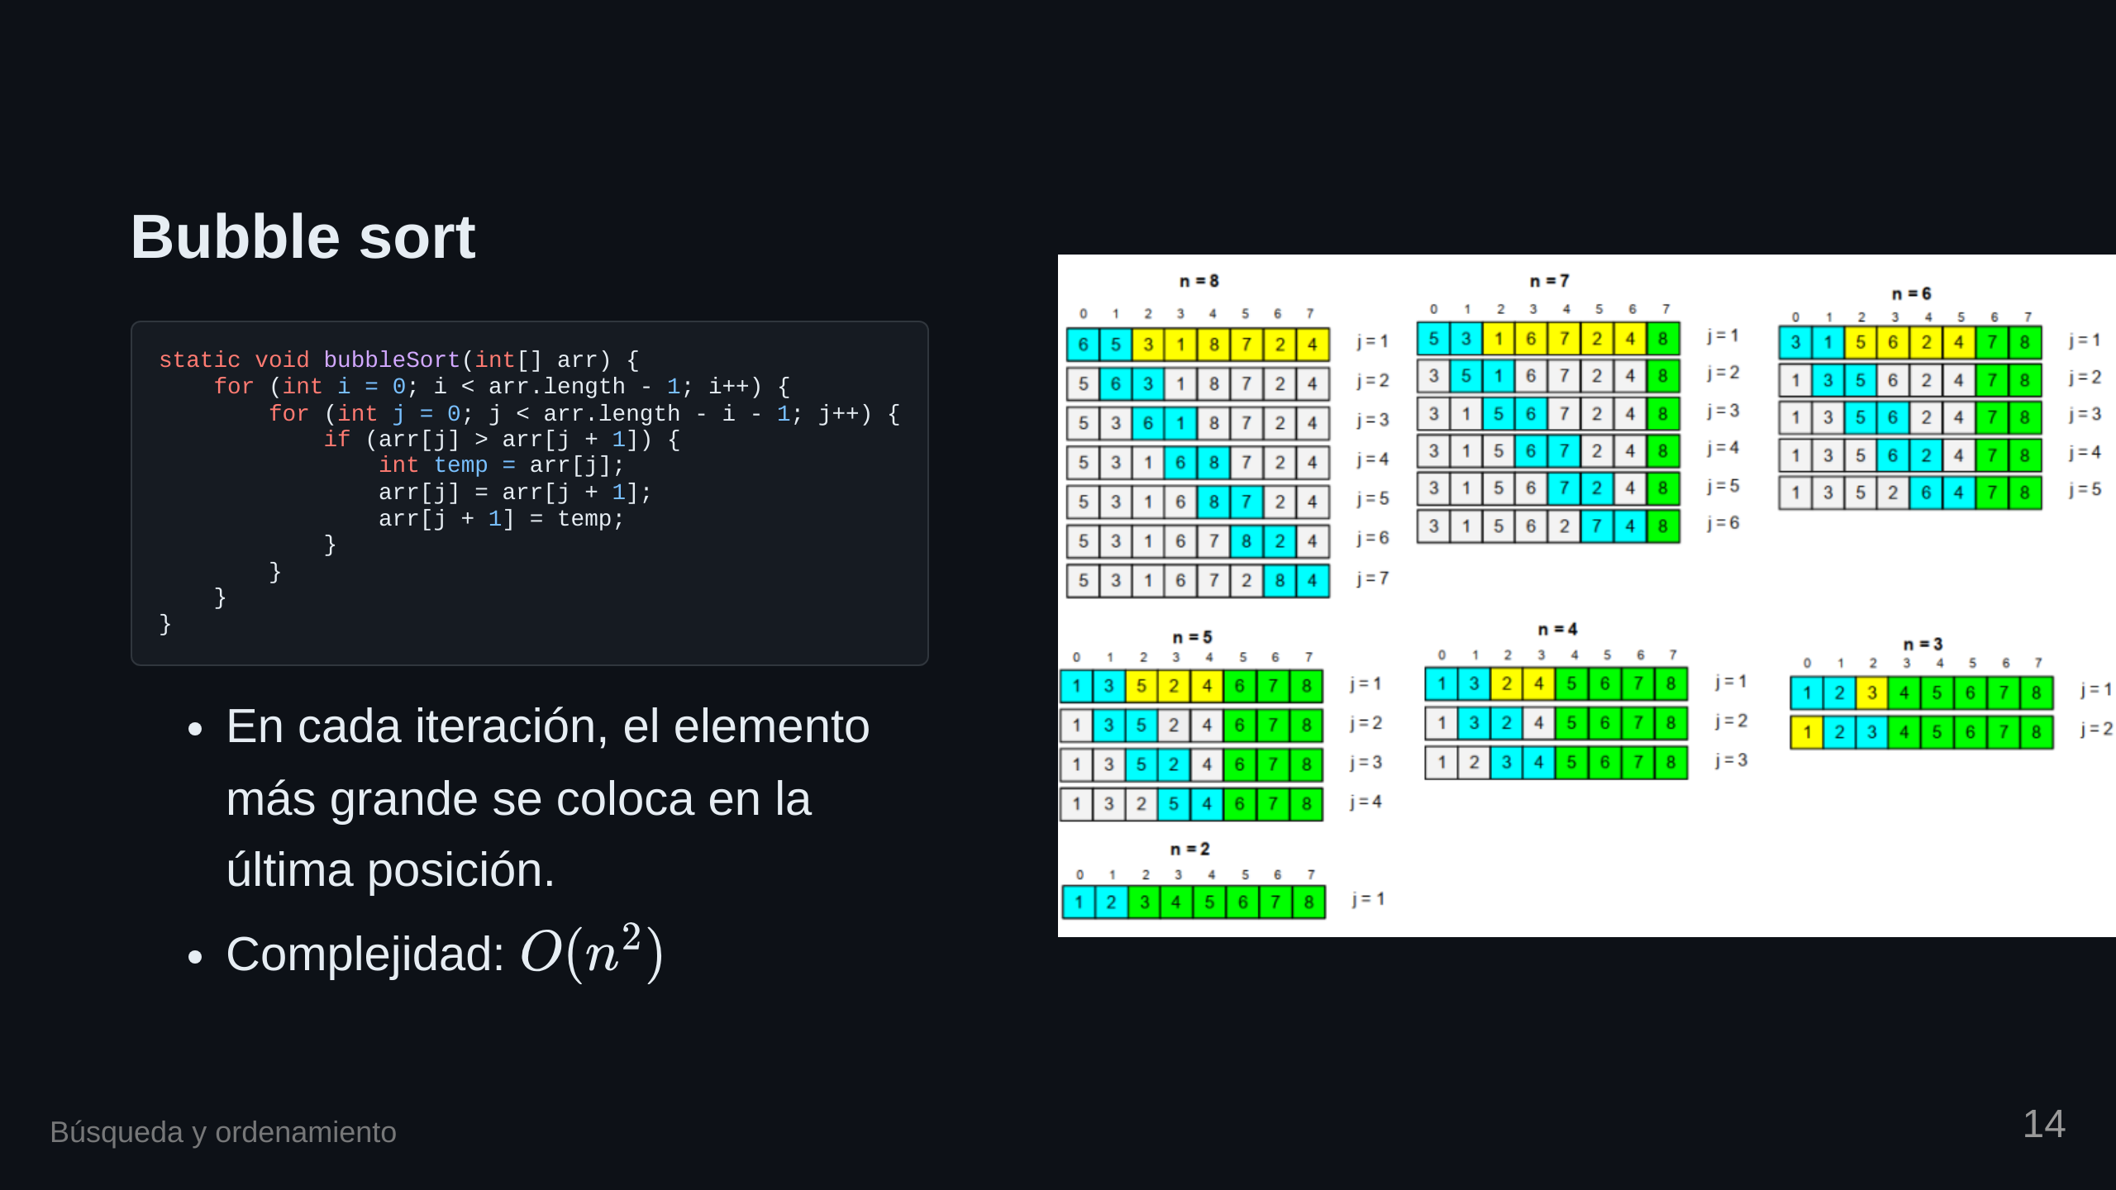

Slide 15
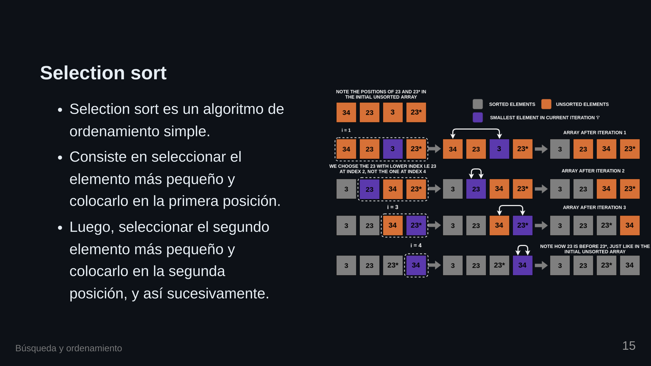

Slide 16

Notes:
transition: fade

Slide 17


Slide 18


Slide 19

Notes:
transition: slide

Slide 20
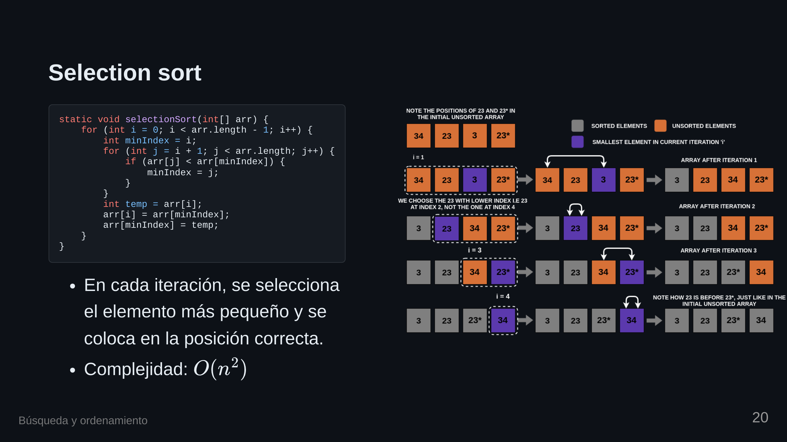

Slide 21
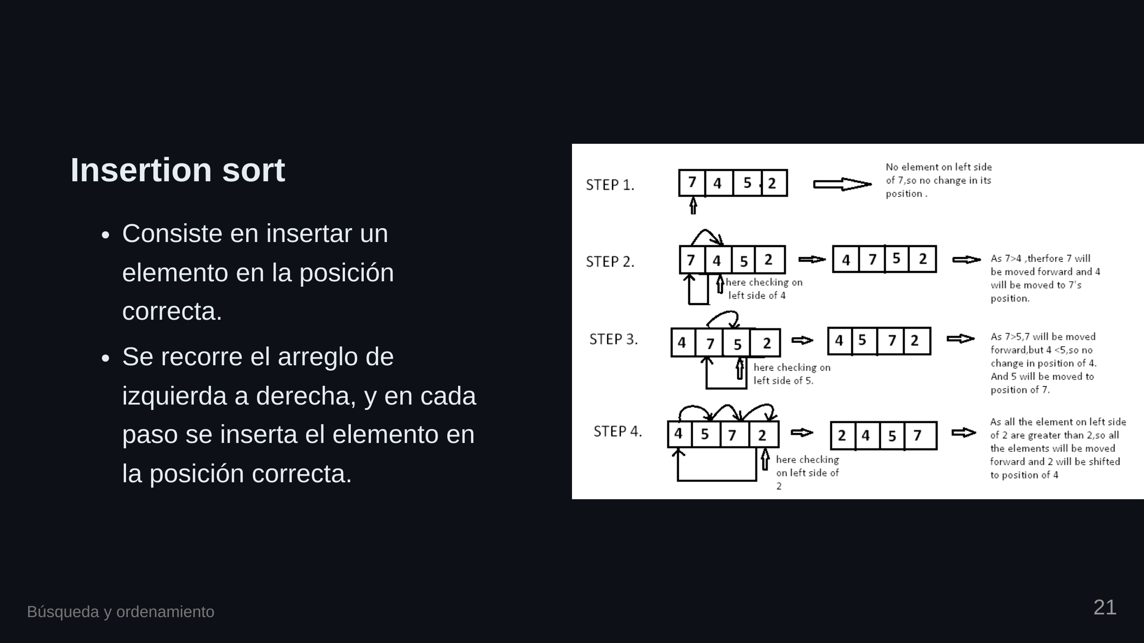

Slide 22

Notes:
transition: fade

Slide 23


Slide 24

Notes:
transition: slide

Slide 25
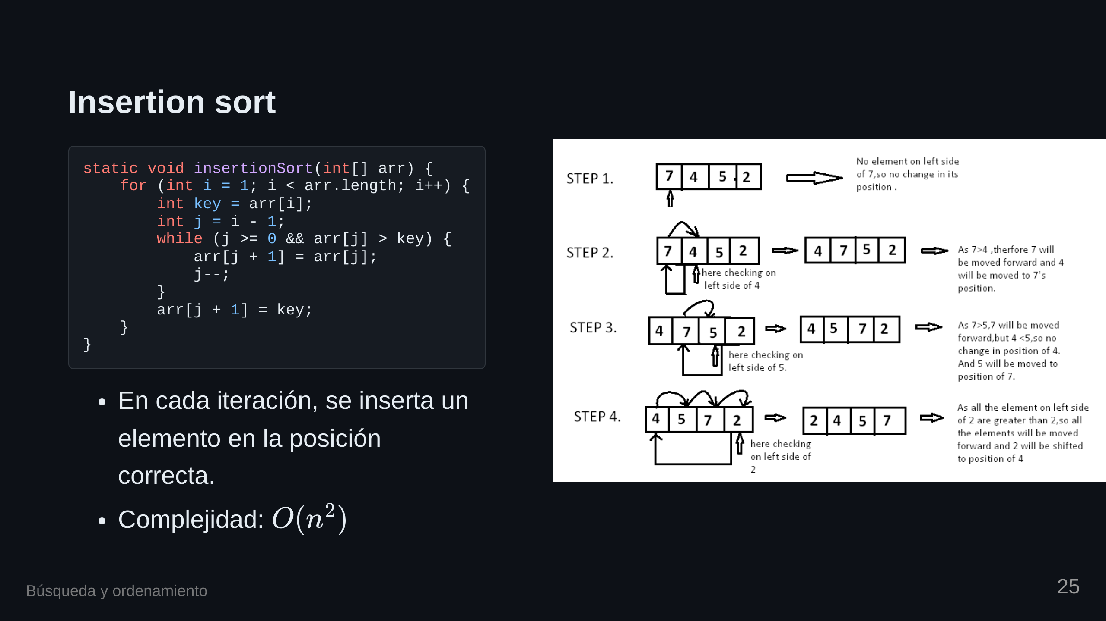

Slide 26


