Slide 1
draft-ietf-roll-mopex-cap
- Rahul, Pascal, Michael
IETF106, Singapore

Slide 2
Capabilities(CAP)
What is it?
  RPL nodes could signal their capabilities
How is it different from MOP & DIO Config Option?
  MOP & Config Option is strictly root-controlled
  CAP could be sent by 6LN/6LR/root
  CAP can emit more rich information
  CAPs may be more dynamic than MOP/Config

Slide 3
Design Goals
Any node could generate it
An option that could be sent in any message
Capabilities could change at runtime
Could be explicitly queried
CAPs could flow upstream or downstream
Work with existing Modes of operation

Slide 4
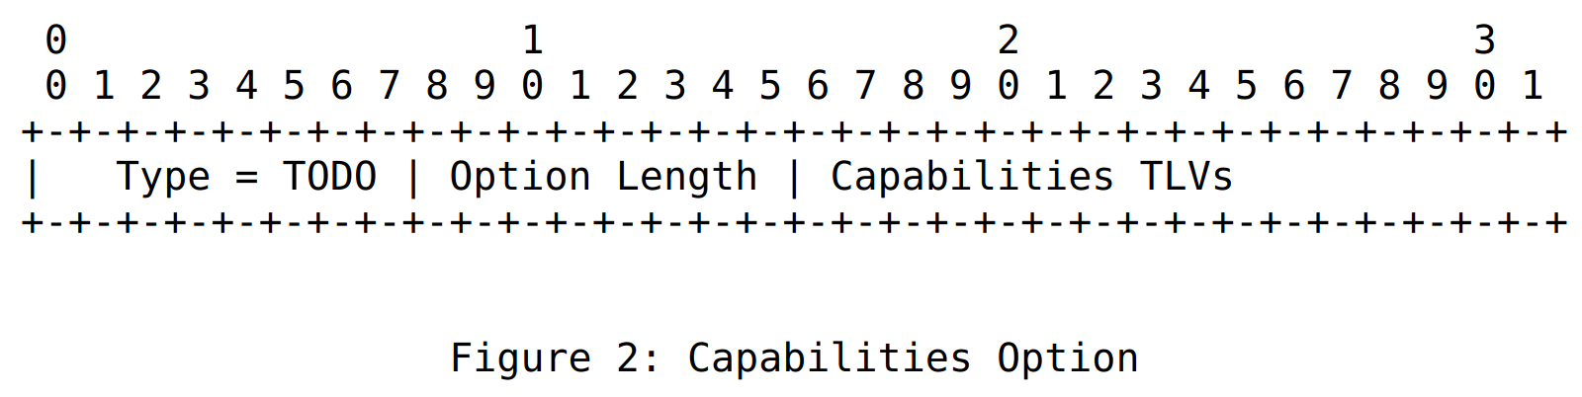
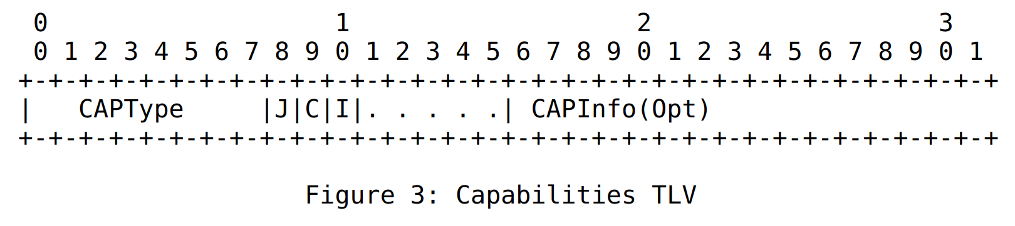
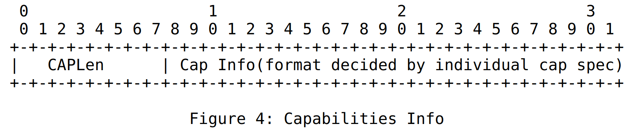
How it looks?
CAPs are not just bits.
They can carry associated data optionally.
Join as leaf
if CAP
not understood
CAP Info
present
Copy CAP
Downstream
if not understood?
Optional

Slide 5
Handling CAP unaware nodes
MOPex to rescue
CAPs to be used only with MOPex
MOP=0-6 has equivalent MOPex=0-6
  If CAPs are needed use MOPex even for existing modes

Slide 6
CAPs signalling
CAPs need to be carried in DIO
  Since, they could influence parent selection
It should be possible to query node’s capability in the future
  New <TODO> message to query capability
CAPs itself are carried as options
  Thus could be carried in DIO/DAO or the new message

Slide 7
What can we use it for now?
Projected routes
  Root needs to know whether nodes along the projected segments are capable to install projected routes.
6LoRH (RFC 8138)
  Nodes need to signal whether they are 8138 capable
    Root could use 6LoRH only when all nodes in the network support 8138

Slide 8
MOPex where we are?
MOPex value calculation changed
  Final MOPex is directly carried in the new option
New logic is,
  If MOP=7, use MOPex option
  Discard DIO if MOPex not present
  MOPex could still carry 0-6 values
    This could be used to indicate existing MOPs with CAPs

Slide 9
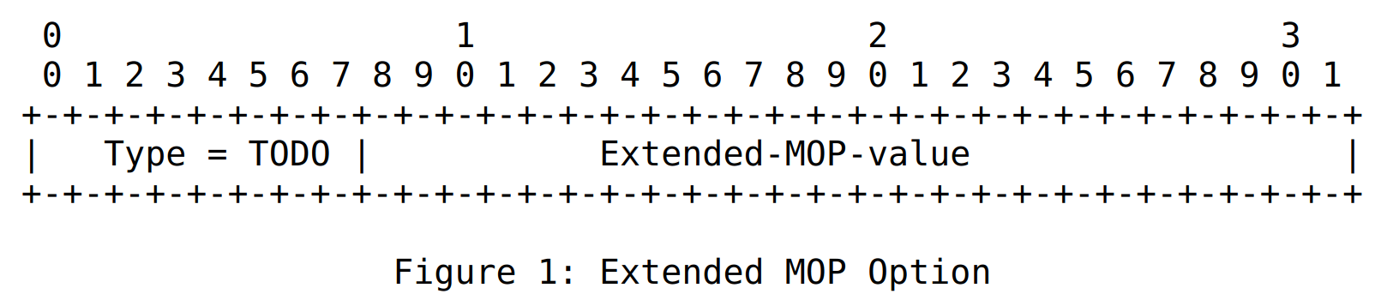
Two Questions
MOPex has 24-bits currently
  Limit 16-bits for MOPex?
    Anyways CAPs should reduce use of new MOPs
  Reserve 8 bits for future use
Split the two topics? MOPex and CAP

Slide 10
ACK
Interims really helped!
What next?
  Set of considerations for defining CAPs
  One more major update is due
  Shall we update P-DAO to use this?

