Slide 1
ROLL Interim Meeting - 23 Sept 2019
Webex Information to join:
-----------------------------------------------------------------------------------------
ROLL Interim Meeting - 23 Sept 2019
Hosted by ROLL WG
Monday, Sep 23, 2019 9:00 am | 2 hours | (UTC-05:00) Eastern Time (US & Canada)
Meeting number: 649 726 882
Password: 44TgnsSv
https://ietf.webex.com/ietf/j.php?MTID=m597b185680335e4ca5f03c3a78ae662f
Join by phone
1-650-479-3208 Call-in toll number (US/Canada)
Access code: 649 726 882
-------------------------------------------------------------------------------------------------------
Etherpad: https://etherpad.tools.ietf.org/p/roll-interim-virtualmeeting-20190923
---------------------------------------------------------------------------------------------------------
Materials: https://github.com/roll-wg/ROLL-Interim-Meeting

Slide 2
ROLL Interim September 2019
Discussion Topics
MOPex syntax
Capabilities (CAP)
  CAP handshake
  handling CAP-unaware RPL nodes
CAP Use-cases
  Turnon-8138
  P-DAO
Eliding CAP/MOPex/CfgOption

Slide 3
MOPex syntax
Final MOP calculation
  Keep base MOP as is
  If MOP=7, then use MOPex value as is
    If MOP=7 and MOPex < 7 ... we allow it?
  Simple to implement and easy to understand

Slide 4
MOPex, where to keep?
Opt1: Using Config Option
  8 bits extn possible (8b resv field available)
  Eliding MOPex with Config Option possible
  MOP is instance config and not DODAG config. Thus not logical place.
Opt2: New RPL Control Option
  Allows extending beyond 8 bits
  Eliding criteria can be same a Config Option

Slide 5
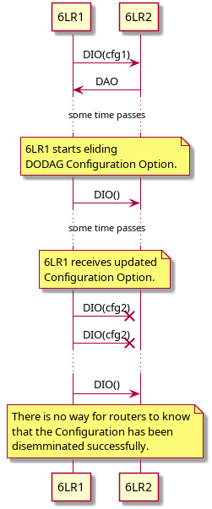
Problem eliding Options
Scenario where eliding may result in inconsistent config

Slide 6
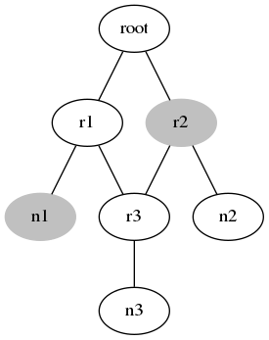
Capabilities (CAP)
Carrying CAP in DIO/DAO
CAP-unaware 6LR
Eliding CAP
Reference Network -->
Gray nodes are CAP-unaware.
n2 is CAP-aware but connected to CAP-unaware 6LR.

Slide 7
Defining CAP
Shall we use same bits for both direction?
  Certain CAPs are only indicated from nodes to root
  Certain CAPs may be bidirectional

Slide 8
CAP use-case (turnon-8138)
Root signals enable-8138 using ‘T’ flag in DIO Config Option
But before doing that, Root needs to know if all the devices are 8137 capable
  Thus the need for nodes to advertise capability
Only need to be sent in DAO

Slide 9
CAP use-case (P-DAO)
Pascal’s list of requirements
  Express support for exposing siblings
  Signal supported OFs
  Express support for storing P-DAO
  Express route capacity
    Approx num of routes that can be installed
    Current utilization
    Expected target utilization
    Overload bit that means do not use me for now
  Same for non-storing P-DAO
    Avg num of hops per route e.g., 5.
    Plus: Max num of hops in route

Slide 10
That’s all!

