Slide 1

ROLL Interim Meeting
14 Oct 2019

Slide 2
ROLL Interim Meeting - 14 Oct 2019
Hosted by ROLL WG
------------------------------------------------------------------------------------------------------------------------
Webex Details:
Monday, Oct 14, 2019 8:45 am | 2 hours 15 minutes | (UTC-05:00) Eastern Time (US & Canada)
Meeting number: 319 527 168
Password: pxT5tCu6
https://ietf.webex.com/ietf/j.php?MTID=mbf22e8e09dfa7a79eccc8646e17153ec
Join by phone
1-650-479-3208 Call-in toll number (US/Canada)
Access code: 319 527 168
--------------------------------------------------------------------------------------------------------------------
Etherpad: https://etherpad.ietf.org/p/roll-interim-virtual-meeting-20191014
------------------------------------------------------------------------------------------------------------------
Agenda:
0) Agenda Bashing
1) Note Well https://www.ietf.org/about/note-well/
2) Discuss about: draft-ietf-roll-mopex-cap-00 Mode of Operation extension and Capabilities
- Configuration Option Structure
- Cap unaware 6LR
- Capabilities Option structure and semantics
4) AOB

Slide 3
Note Well
This is a reminder of IETF policies in effect on various topics such as patents or code of conduct. It is only meant to point you in the right direction. Exceptions may apply. The IETF's patent policy and the definition of an IETF "contribution" and "participation" are set forth in BCP 79; please read it carefully.
As a reminder:
By participating in the IETF, you agree to follow IETF processes and policies.
If you are aware that any IETF contribution is covered by patents or patent applications that are owned or controlled by you or your sponsor, you must disclose that fact, or not participate in the discussion.
As a participant in or attendee to any IETF activity you acknowledge that written, audio, video, and photographic records of meetings may be made public.
Personal information that you provide to IETF will be handled in accordance with the IETF Privacy Statement.
As a participant or attendee, you agree to work respectfully with other participants; please contact the ombudsteam (https://www.ietf.org/contact/ombudsteam/) if you have questions or concerns about this.
Definitive information is in the documents listed below and other IETF BCPs. For advice, please talk to WG chairs or ADs:
BCP 9 (Internet Standards Process)
BCP 25 (Working Group processes)
BCP 25 (Anti-Harassment Procedures)
BCP 54 (Code of Conduct)
BCP 78 (Copyright)
BCP 79 (Patents, Participation)
https://www.ietf.org/privacy-policy/ (Privacy Policy)
Source: https://www.ietf.org/about/note-well/

Slide 4
ROLL Interim - 14th Oct 2019
Discussion Points:
1. Configuration Option Structure
2. Cap unaware 6LR
3. Capabilities Option structure and semantics

Slide 5
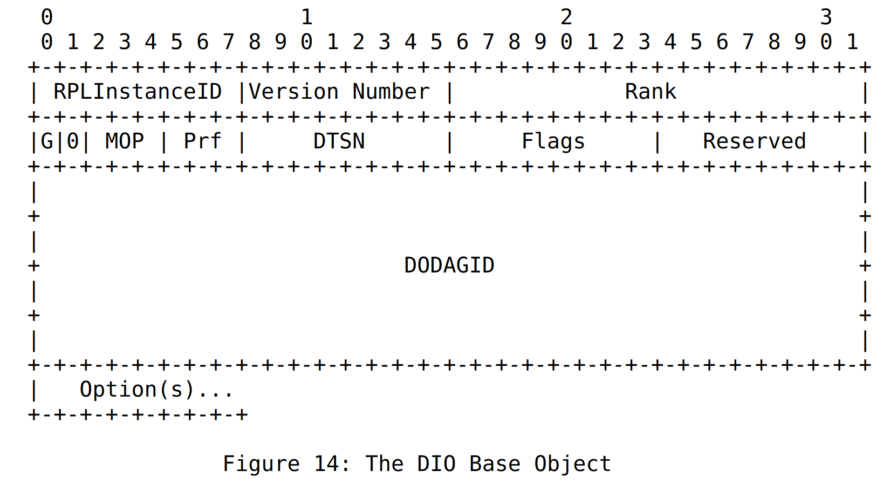
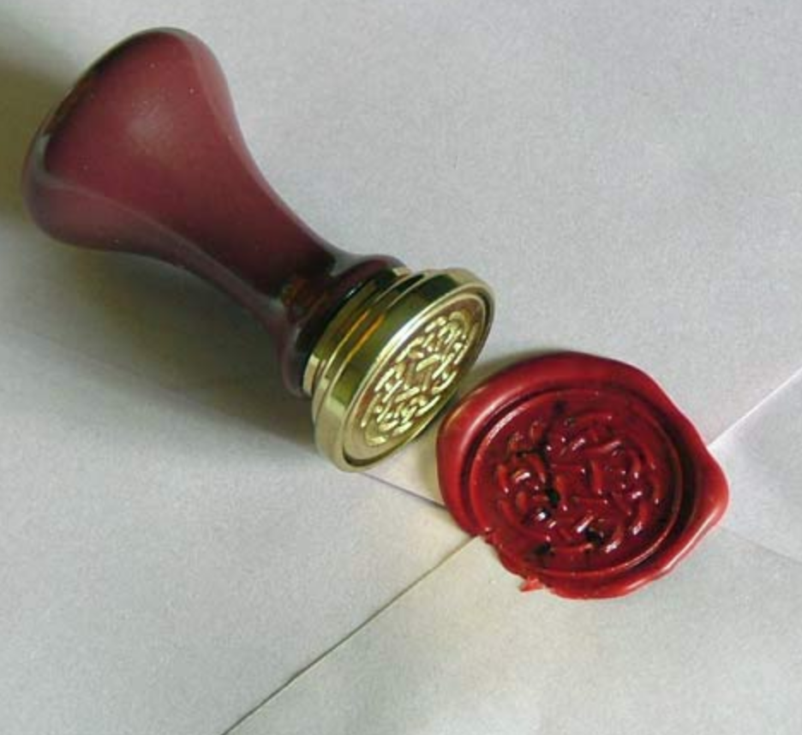
Configuration Option freshness
How to elide?
  Use counter in Reserved low-4b
  Lollipop counter
    Using just 4b might be an issue?
  Which doc should this go in?
What should this counter be called?
  SET (Static info Eliding counTer)
  Wanted to call it SEAL but could not think of an appropriate full-form

Slide 6
SET counter applicability
Elide what?
  Configuration Option
  Future { Cap Option, MOPex }
  What else?
    Prefix Information Option and other options which rarely change
It is not a problem if different nodes elide different options
  Since a query will still reveal the complete set of info regardless of what is elided
Only the root is allowed to change the counter

Slide 7
Capability Option syntax
Current draft considers CAPs as sequence of bits, but we are moving towards TLV format
CAP bits
  Join as router/leaf if cap not understood
  Copy to children
    Why do we need such flag? Individual cap spec should define whether the node should copy or not.
  CAP Info (optional), provides ext info for the CAP

Slide 8
Capability option syntax
0 1 2 3
0 1 2 3 4 5 6 7 8 9 0 1 2 3 4 5 6 7 8 9 0 1 2 3 4 5 6 7 8 9 0 1
+-+-+-+-+-+-+-+-+-+-+-+-+-+-+-+-+-+-+-+-+-+-+-+-+-+-+-+-+-+-+-+-+
| Type = TODO | CAP TLVs..
+-+-+-+-+-+-+-+-+-+-+-+-+-+-+-+-+-+-+-+-+-+-+-+-+-+-+-+-+-+-+-+-+
0 1 2 3
0 1 2 3 4 5 6 7 8 9 0 1 2 3 4 5 6 7 8 9 0 1 2 3 4 5 6 7 8 9 0 1
+-+-+-+-+-+-+-+-+-+-+-+-+-+-+-+-+-+-+-+-+-+-+-+-+-+-+-+-+-+-+-+-+
| CAPType |J|C|I|. . . . .| CAPInfo(Opt)
+-+-+-+-+-+-+-+-+-+-+-+-+-+-+-+-+-+-+-+-+-+-+-+-+-+-+-+-+-+-+-+-+
J = Join only as leaf if CAP not understood
C = Copy cap to children
I = Cap Info present
0 1 2 3
0 1 2 3 4 5 6 7 8 9 0 1 2 3 4 5 6 7 8 9 0 1 2 3 4 5 6 7 8 9 0 1
+-+-+-+-+-+-+-+-+-+-+-+-+-+-+-+-+-+-+-+-+-+-+-+-+-+-+-+-+-+-+-+-+
| CAPLen | Cap Info(format decided by individual cap spec)
+-+-+-+-+-+-+-+-+-+-+-+-+-+-+-+-+-+-+-+-+-+-+-+-+-+-+-+-+-+-+-+-+
Optional, present
only if I-bit set

Slide 9
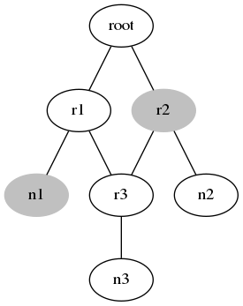
CAP unaware nodes
CAP unaware node would strip-off the CAP option
Thus a mandatory CAP may be ignored
How to handle it?
  Should we let CAP be used with only newer MOPs?

Slide 10
Other Points
Where to carry capabilities?
  Last time we discussed using new messages!
  Shall we allow the node to proactively update the capability set?
  If caps are used for parent selection, then it will result in additional messaging post parent selection.

