Slide 1
Controlling Secure Network Enrollment
in RPL Networks
draft-ietf-roll-enrollment-priority-04
Rahul Arvind Jadhav <rahul.ietf@gmail.com>
Pascal Thubert <pthubert@cisco.com>
Huimin She <hushe@cisco.com>
Michael Richardson mcr+ietf@sandelman.ca
post-IETF111 Virtual Interim, August 31 2021

Slide 2
The Story So Far
Behaviour assumed in RFC9032
Document Adopted March 2020
Merged with draft-hushe-roll-dodag-metric after virtual interim meeting January 2021.
Version -04 posted with merged document
Reviews and Discussion Summer 2021

Slide 3
RFC9032 – Enhanced Beacon
Priority of Join Proxy
(< is better)
Protocol Definition
1 2 3
0 1 2 3 4 5 6 7 8 9 0 1 2 3 4 5 6 7 8 9 0 1 2 3 4 5 6 7 8 9 0 1
+-+-+-+-+-+-+-+-+-+-+-+-+-+-+-+-+-+-+-+-+-+-+-+-+-+-+-+-+-+-+-+-+
| 2 |R|P| res | proxy prio | rank priority |
+-+-+-+-+-+-+-+-+-+-------------+-------------+-----------------+
| PAN priority | |
+---------------+ +
| Join Proxy Interface ID |
+ (present if P=1) +
| |
+ +-+-+-+-+-+-+-+-+-+-+-+-+-+-+-+-+-+-+-+-+-+-+-+-+
| | |
+-+-+-+-+-+-+-+-+ +
| network ID |
+ variable length, up to 16 bytes +
~ ~
+ +
| |
+ +-+-+-+-+-+-+-+-+-+-+-+-+-+-+-+-+-+-+-+-+-+-+-+-+
| |
+-+-+-+-+-+-+-+-+
Rank is locally known
Unclear how it is
configured, could be added
to RFC9031 (CoJP)
Calculated from DODAGID
Included if L2 addr != L3 addr

Slide 4













JRC
Enhanced
Beacon
Samples
Enhanced
Beacons
DAG Root
11
12
13
0x22
22
23
24
25
31
32
33
34
35
41
42
43
44
45
46
0x72
0x7f
0x52
base diagram
from PThubert
51
52
53

Slide 5
“The Minimum Enrollment Priority”
0 1 2 3
0 1 2 3 4 5 6 7 8 9 0 1 2 3 4 5 6 7 8 9 0 1 2 3 4 5 6 7 8 9 0 1
+-+-+-+-+-+-+-+-+-+-+-+-+-+-+-+-+-+-+-+-+-+-+-+-+-+-+-+-+-+-+-+-+
| Type |Opt Length = 3 | exp | DODAG_Size |
+-+-+-+-+-+-+-+-+-+-+-+-+-+-+-+-+-+-+-+-+-+-+-+-+-+-+-+-+-+-+-+-+
|R| min priority|
+-+-+-+-+-+-+-+-+

Slide 6
Issues from Review
Trickle timer means that DIOs are not sent if there is no topology change.
  So would changes to min priority be considered a change?
  The DODAG size field could change quite often, particularly during network formation, how should it be dealt with?
If updated min priority does not reset Trickle Timer, then this option needs to go into some new flooded control.
  What are the desired properties of this new control, and what other things should go into it?

Slide 7

Discussion!
draft-ietf-roll-enrollment-priority-04
Auxiliary Slides Follow

Slide 8
JRC
Example
enrollment
priority
Enhanced
Beacons
DAG Root
0x10
0x10
0x10
DIOs
0x22
11
0x21
12
13
0x22
0x23
0x42
22
23
24
25
0x62
0x32
0x64
31
32
33
34
35
0x7f
0x42
41
42
43
44
45
46
0x72
0x7f
0x52
base diagram
from PThubert
51
52
53

Slide 9


JRC
With
impaired
node (24)
Enhanced
Beacons
DAG Root
0x10
0x10
0x10
DIOs
Does not
support
this option
0x22
11
0x21
12
13
0x22
0x23
0x42
22
23
24
25
0x62
0x32
implied 0x40
0x64
31
32
33
34
0x42
35
0x42
0x7f
0x42
41
42
43
44
45
46
0x72
0x7f
0x52
0x51
0x53
51
52
53

Slide 10
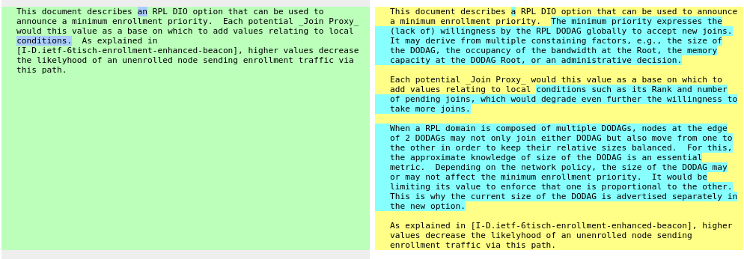
version -04

