Slide 1
Controlling Secure Network Enrollment
in RPL Networks
draft-ietf-roll-enrollment-priority-04
Rahul Arvind Jadhav <rahul.ietf@gmail.com>
Pascal Thubert <pthubert@cisco.com>
Huimin She <hushe@cisco.com>
Michael Richardson mcr+ietf@sandelman.ca
IETF110, March 2021

Slide 2
Status of Document
Adopted March 2020
Merged with draft-hushe-roll-dodag-metric after virtual interim meeting January 2021.
Version -04 posted with merged document

Slide 3
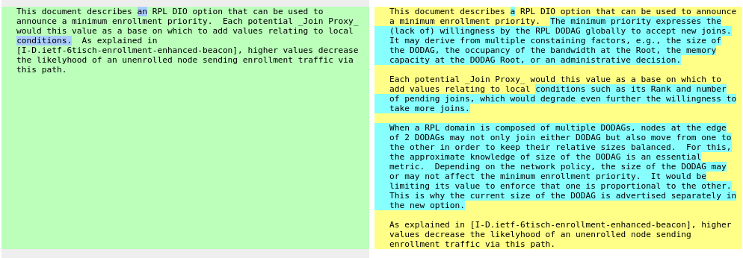
version -04

Slide 4
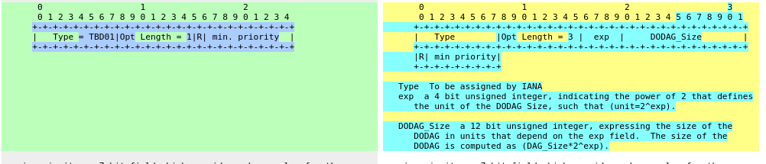
Version -04 changes 2

Slide 5

Questions?
draft-ietf-roll-enrollment-priority-04

Slide 6




JRC
Example
enrollment
priority
Enhanced
Beacons
DAG Root
0x10
0x10
0x10
DIOs
0x22
11
0x21
12
13
0x22
0x23
0x42
22
23
24
25
0x62
0x32
0x64
31
32
33
34
35
0x7f
0x42
41
42
43
44
45
46
0x72
0x7f
0x52
base diagram
from PThubert
51
52
53

Slide 7
JRC
With
impaired
node (24)
Enhanced
Beacons
DAG Root
0x10
0x10
0x10
DIOs
Does not
support
this option
0x22
11
0x21
12
13
0x22
0x23
0x42
22
23
24
25
0x62
0x32
implied 0x40
0x64
31
32
33
34
0x42
35
0x42
0x7f
0x42
41
42
43
44
45
46
0x72
0x7f
0x52
0x51
0x53
51
52
53

