Slide 1
draft-ietf-roll-efficient-npdao
- Updates

Slide 2
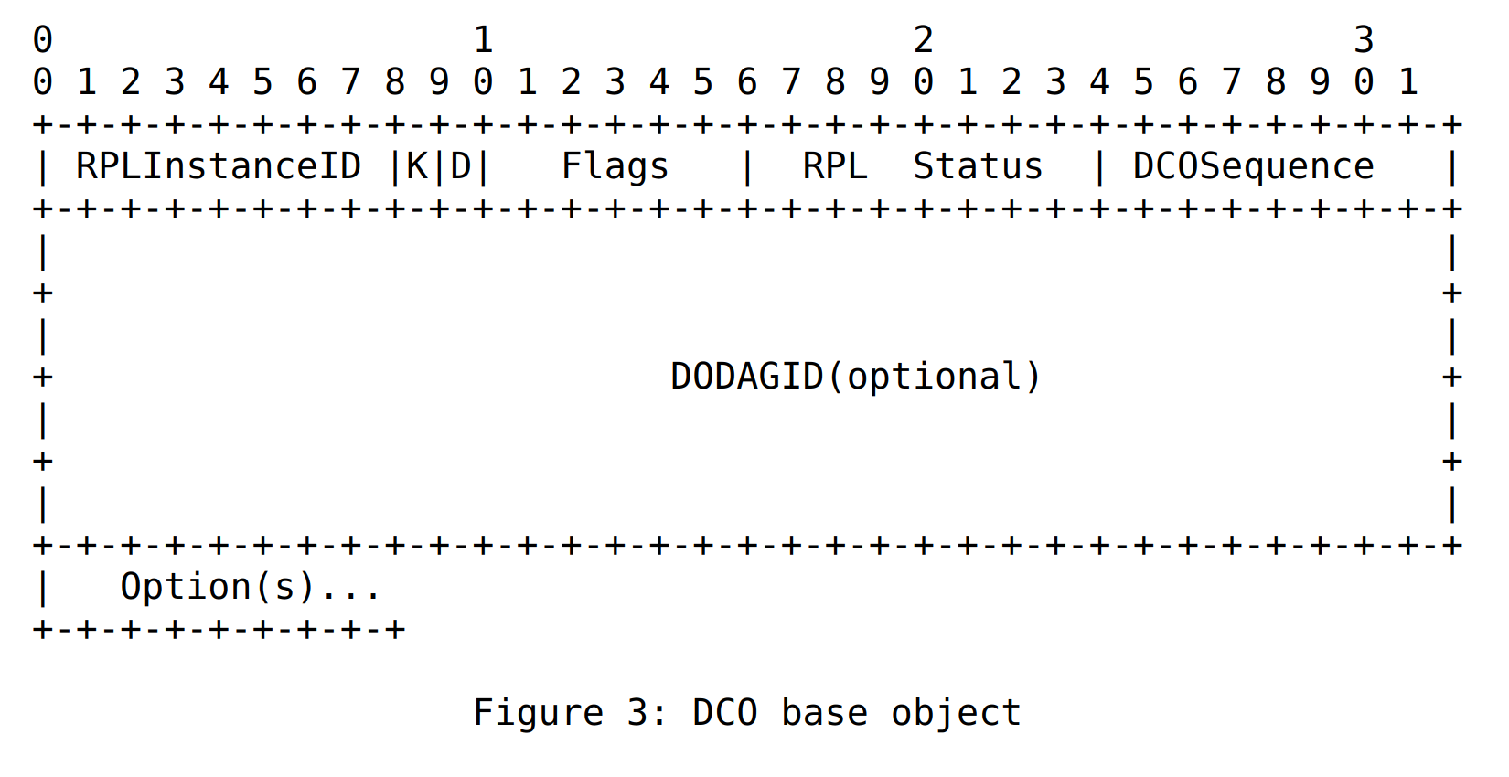
Updates
DCO to carry the reason why it was generated
  DCO base object modified to carry “RPL Status”
  The status values are updated in unaware draft.

Slide 3
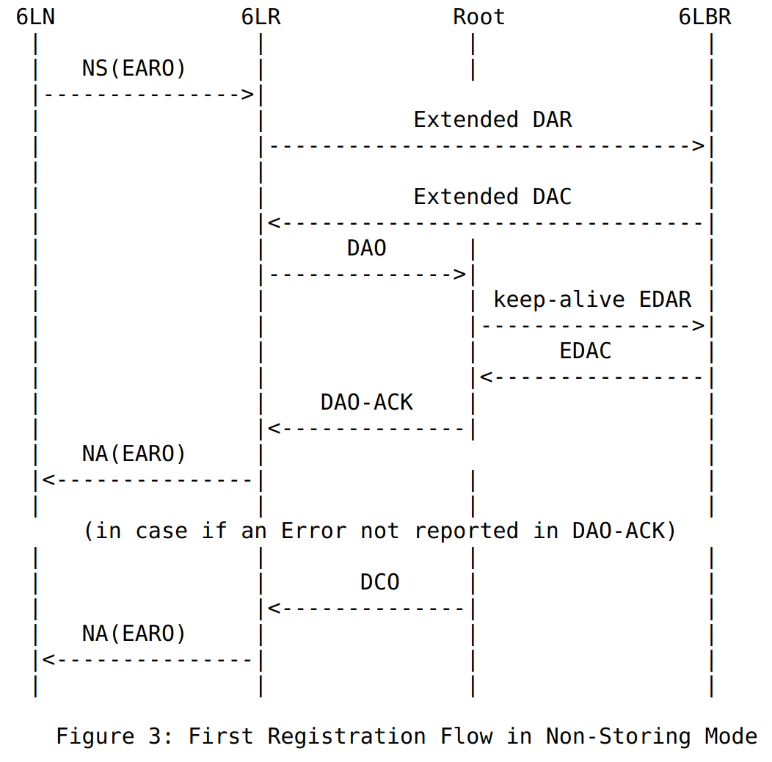
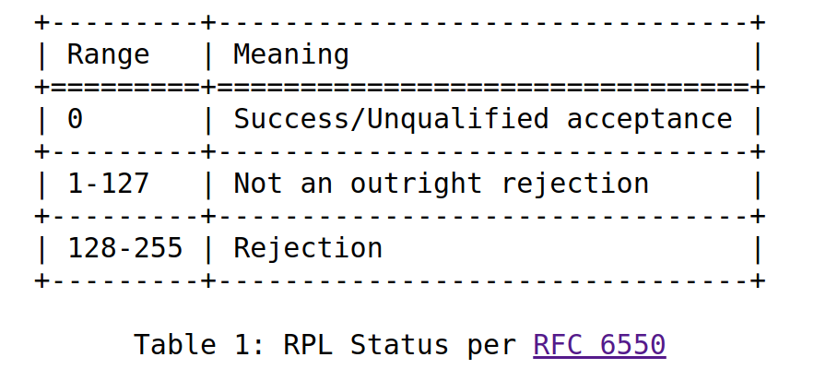
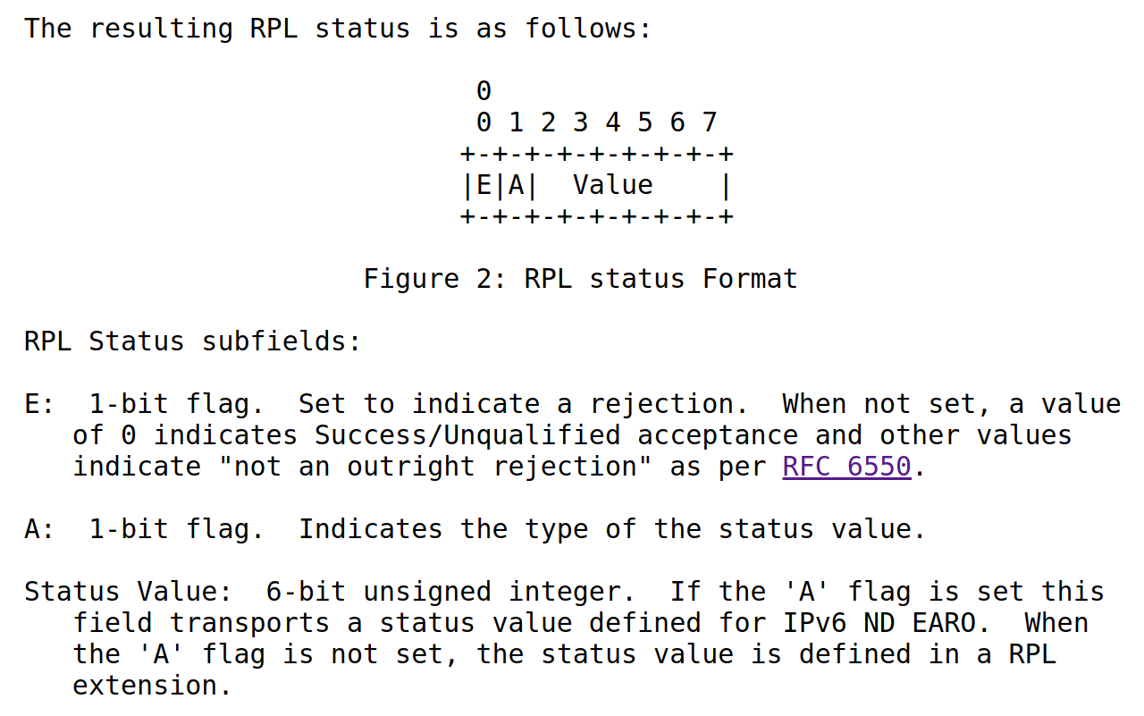
Unaware-leaves impact

Slide 4
Next?
An Update to fix the value of Status

