Slide 1
draft-ietf-roll-rpl-observations
- ROLL Working Group
IETF 106, Singapore

Slide 2
What is this about?
Aim is to stabilize-fix-clarify RFC 6550
RFC 6550 observations over period of time
  Implementation observations
  Clarify unclear/complex mechanisms in 6550
  Extracts from mailing list discussions
Draft keeps record of all the observations

Slide 3
Parent Switching
DTSN
  Destination Advertisement Trigger Sequence Number
  Sent in DIO by a parent to trigger DAO from child nodes
Scenario: Node D switches to parent C
Very easy to handle in non-storing MOP
  Only root can increment DTSN

Slide 4
Parent Switching – Storing MOP
Storing MOP, not so easy!
Two strategies possible
  Increment DTSN
    Node D increment DTSN and reset DIO trickle
    Child nodes of D also reset DIO trickle when they see their preferred parent
    Thus the whole sub-DODAG rooted at D has resetted their trickle timer.
    Too bad for control overhead
  Send aggregated DAO on behalf of sub-DODAG
    Multiple targets with multiple Transit Info options
    Single DAO may not fit all targets
      Splitting across DAOs not an easy thing to handle

Slide 5
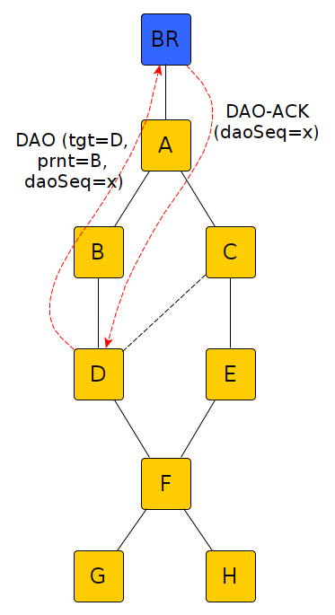
DAO-ACK handling
DAO-ACK helps node to ascertain that end to end path is established
  Indication to start application traffic
Non-storing MOP
  DAO sender knows whether root has rcvd the DAO based on DAO-ACK

Slide 6
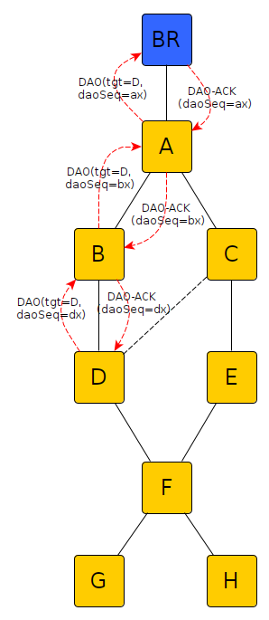
DAO-ACK, Storing MOP
DAO-ACK sent hop-by-hop
  Upstream node sending +ve DAO-ACK accepts responsibility to deliver DAO upstream
Issue
  Node B responds with DAO-ACK instantly
    DAO-ACK cannot be used as an indication to start app-traffic
  What happens if DAO-ACK with -ve status is responded somewhere up?
    How to inform downstream peer that DAO-ACK failed somewhere upstream?

Slide 7
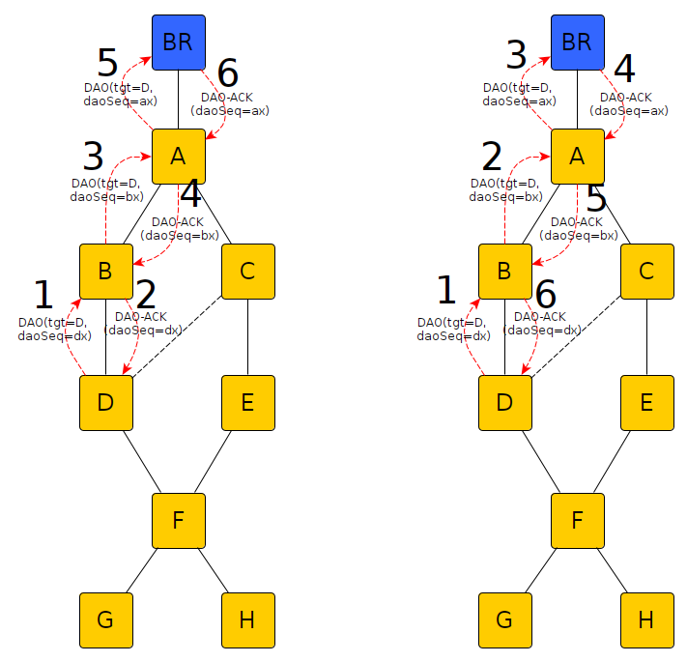
Another DAO-ACK interpretation
Respond with DAO-ACK only when the peer upstream has ACKed
Works well for app-traffic start indication
Problems
  Routing table needs additional state, thus costly
  Implementations using different schemes can’t interoperate

Slide 8
Design goals for DAO-ACK
Status=0 as an indication that path is established
No explicit state should be required on intermediate 6LRs for DAO-ACKing
DAO-ACK aggregation

Slide 9
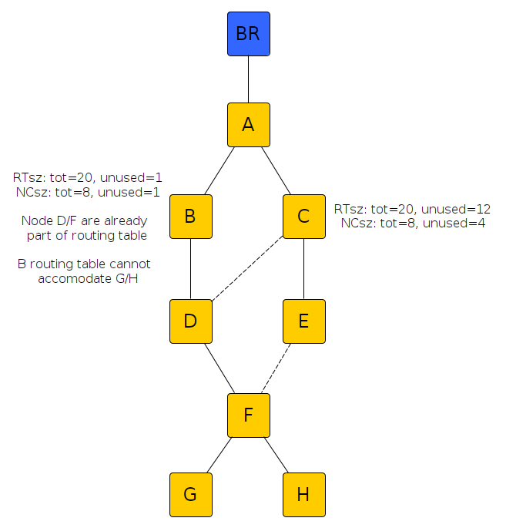
Signaling Resource Contraints
Handling resource constraints at multihop
Need new OCPs to take into account
  Routing table size
  Neighbor cache size
Enrollment priority
  Step in that direction
  But needs to be usable at multiple hops

Slide 10
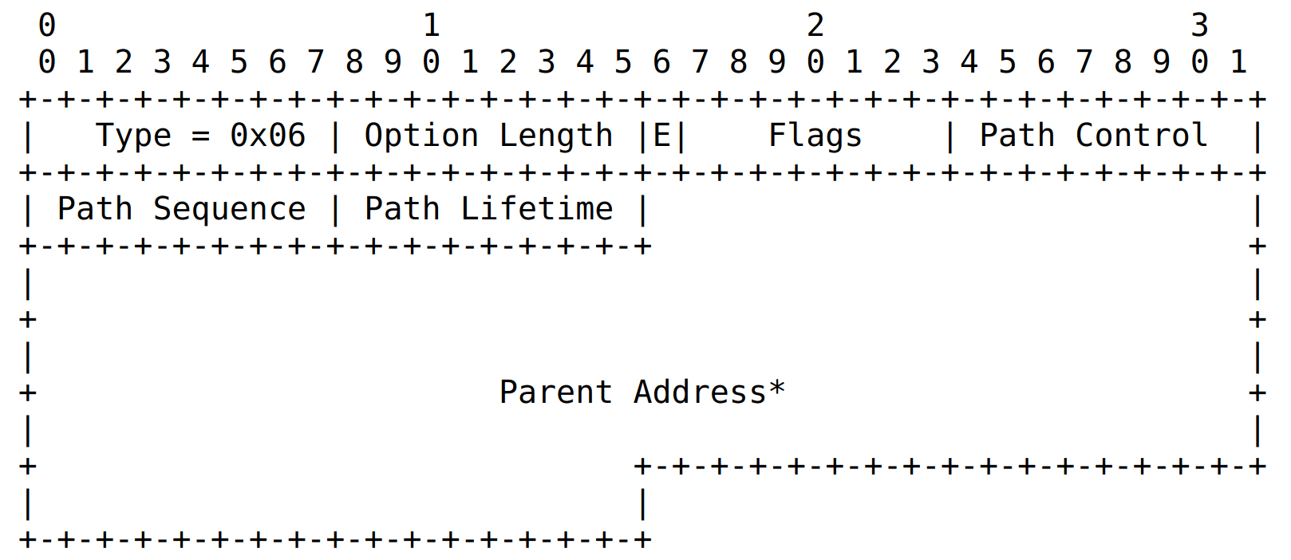
Transit Information Option
TIO design goal
  Map one or more transit info to one or more targets
  Provide syntax for aggregating common transit information
But contains elements which mostly varies on per target
  E (External):Not a transit info; applies to target
  E.g. PathSequence and PathLifetime
  Making it difficult to aggregate efficiently
TIO is optional as per 6550
  How should a 6LR/root deal with this?
    Non-storing mode, parent address is needed
    Can 6LR assume Path lifetime of 0xff if TIO not present?

Slide 11
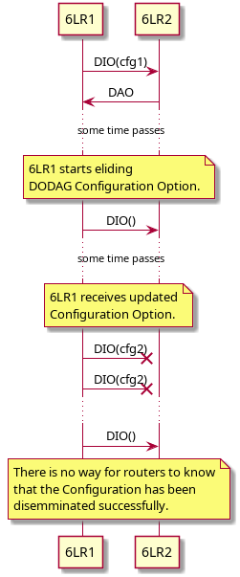
Eliding Options
RFC 6550 allows eliding config option
  But does not give details
  In its current state, eliding may not work under certain conditions
We need
  Eliding to work for Config Option and other static options which rarely change
  Should be extensible for new options in the future

Slide 12
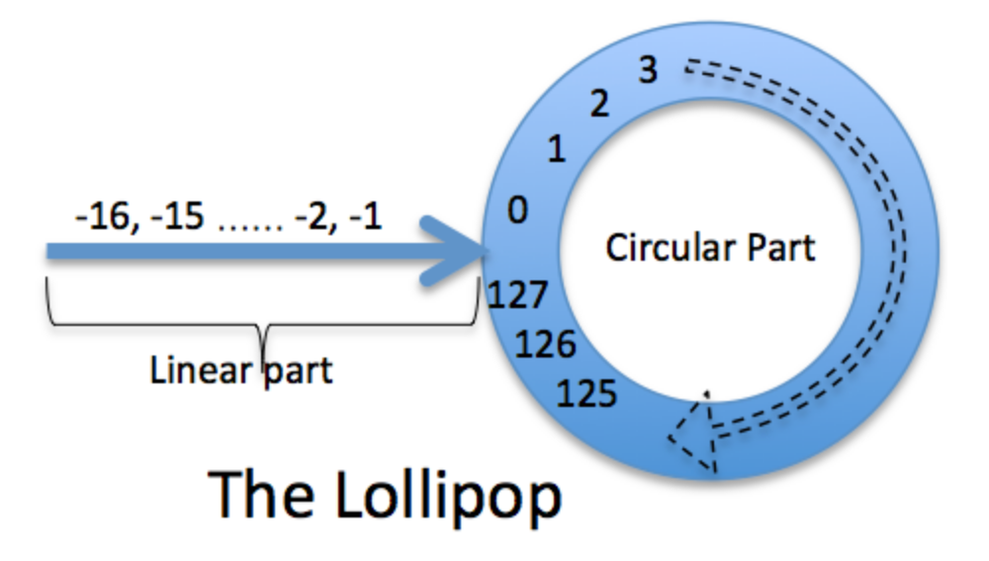
RPL Persistent state
RPL uses lollipop counters
  For most of the sequence counters
  Handling conditions when the node reboots in linear part still requires use of persistent storage
Inference
  Lollipop counters reduce the use of persistent storage in circular part but does not fully eliminate the need for it.
Sequence Win = 16 (Def RFC6550)

Slide 13
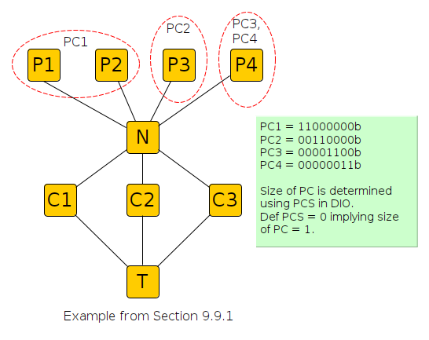
Path Control bits
What is it?
  Enables multiple downwards routes
  Can advertise pref for paths
Value of Path Control
  Provides multi-path routing capability
  Allows traffic load-balancing within a DODAG

Slide 14
Path Control Bits
Not an easy mechanism to implement
  Impacts Memory and Program size
  But might be useful in the context of 6tisch/RAW!
No implementation we know is compliant with the use of Path Control Bits
  Section 9.9 Point 9 says, “A node MUST NOT unicast a DAO msg that has no active bits in the Path Control field set”.
  By default, even with one parent at-least a single PC bit must be set
    Default PCS is 0, which means PCS+1 bit in TIO-PC is in use
  No implementation handles path-control bits even though 6550 mandates it

Slide 15
Miscellaneous
Mandating support for reception of aggregated targets
It is possible that DAO-ACK may not be sent even in case the ‘K’ flag (indicating ACK needed) is set.
  Why is DAO-ACK sending a SHOULD in 6550 even if K flag is set?
Multi-DODAG/Multi-Instance
  Should the routing table be reset when switching from one DODAG to another in the same instance?
  Best practices when handling multi-instance/multi-DODAG
Why is Transit Information Option optional?
Is it better to have an RPL-lite with very specific features?
  No Path Control
  Support for handling of aggregated targets

Slide 16
Overall Status
Point | Status | Remarks
DTSN handling in storing MOP | No update | BCP needed
DAO-ACK | No update | Some work is initiated. Prototype + draft (Rabi?)
Capability & MOPex | draft-ietf-roll-mopex-cap | Draft in-progress
Eliding static info | draft-thubert-roll-eliding-dio-information | Draft in-progress
Miscellaneous | No update | Aggregated Targets handling, TIO vs Target bits
Lollipop Counters | Get WG consensus | Linear part needs to be backed in persistent storage
Resource constraints | No update

Slide 17
Other points still uncovered
Multi-Sink/BR practices
Multicast Operation
Partial dependency on ND
  Prefix Info sent in DIO
  But Context Table and other global configuration uses ND

