Slide 1
Sales & Discount Analysis – October vs November 2024
Fashion industry insights

Slide 2
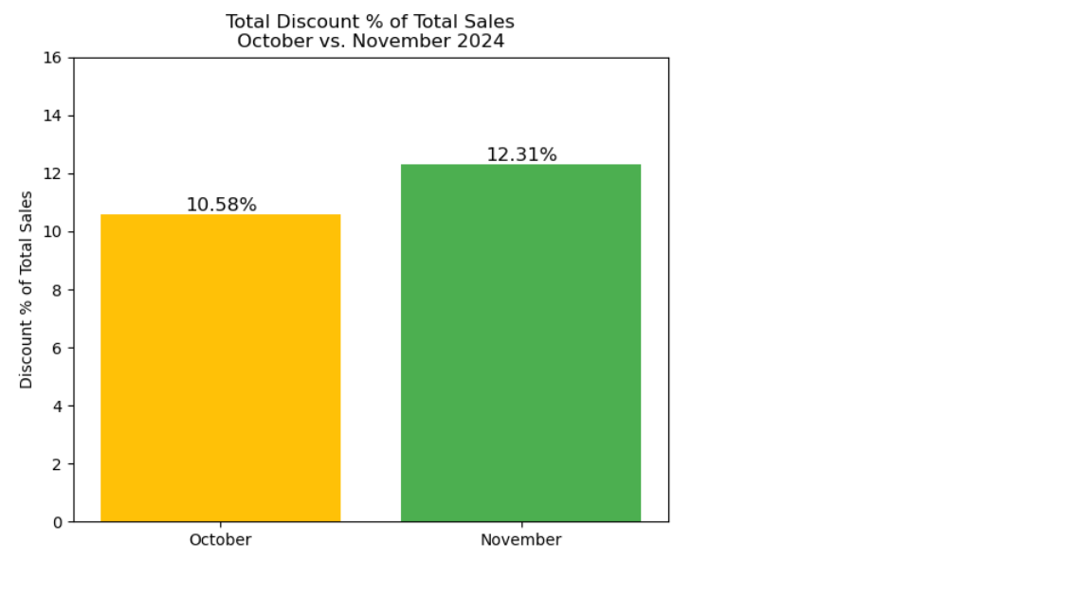
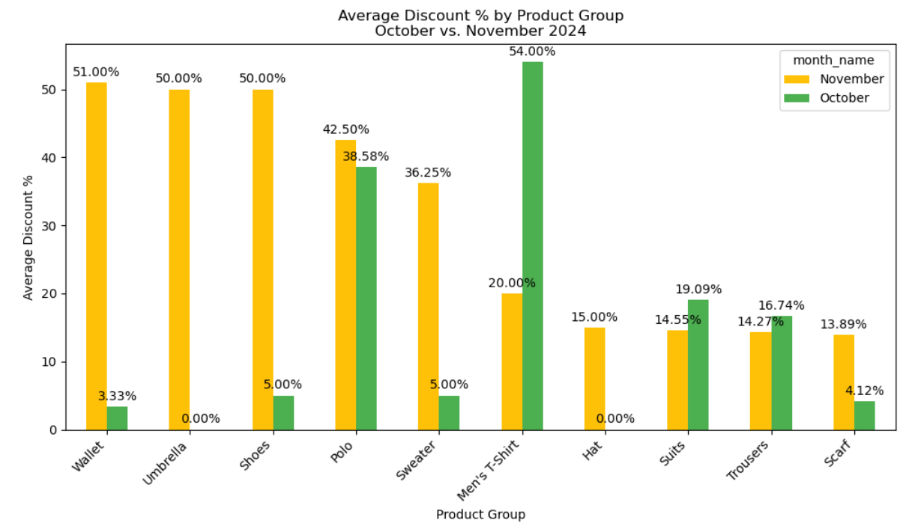
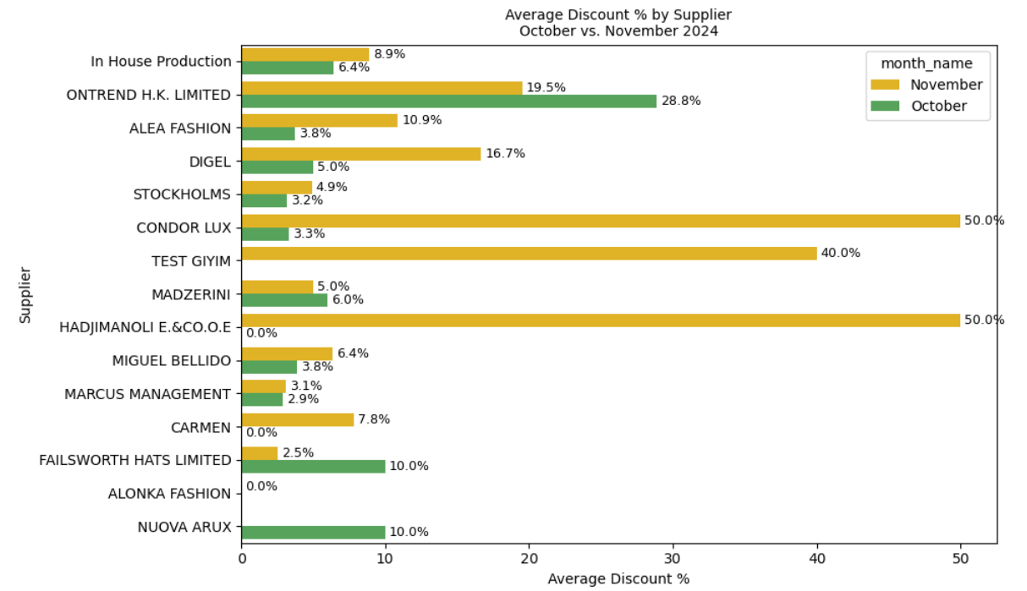
Discounts Overview
The average discountshare of total sales increased from 10.58% in October to 12.31% in November, indicating stronger promotional activity toward season-end.
By product group, discounts ranged widely – from just 3.33% on Wallets in October to over 51% on Umbrellas in November. For Men’s T-Shirt, the average discount dropped from 54% in October to 20% in November.
Among Suppliers, average discount in November went as high as 50% for CONDOR LUX and TEST GIYIM, compared to much lower levels in October. For example, ONTREND H.K. LIMITED increased its average discount from 19.5% to 28.8%.

Slide 3
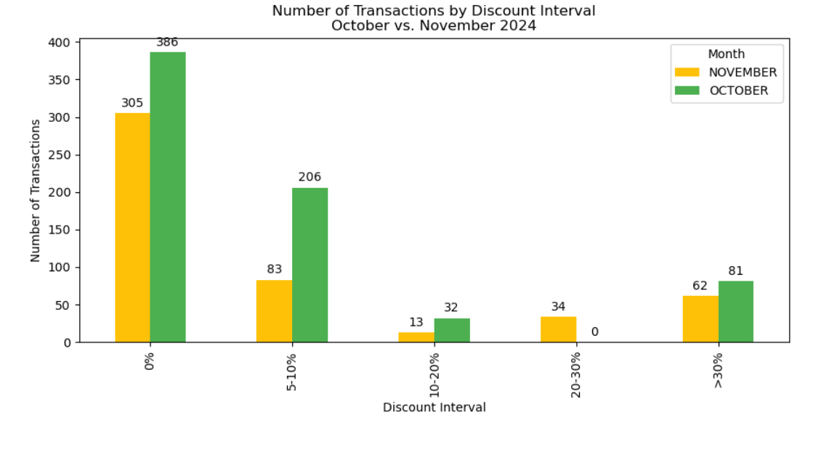
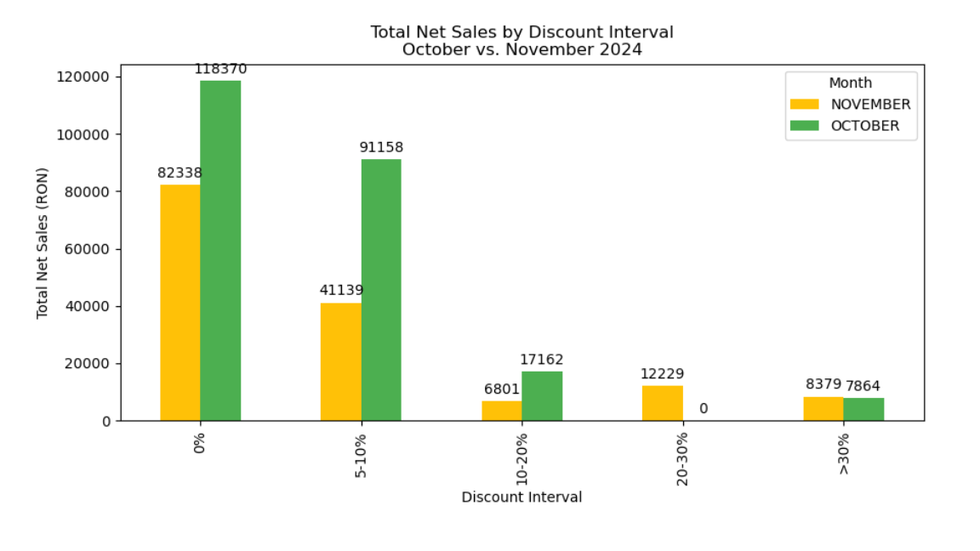
Discount Performance Impact
In November, most transactions (386) still took place with 0% discount, similar to October (305 transactions).
However, transactions in the 5-10% discount range surged to 206 in November, compared to only 83 in October.
Net sales without any discount reached 118,370 RON in November, up from 82,338 RON in October.
Net sales in the 5-10% discount interval doubled, growing from 41,053 RON in October to 91,158 RON in November.

Slide 4
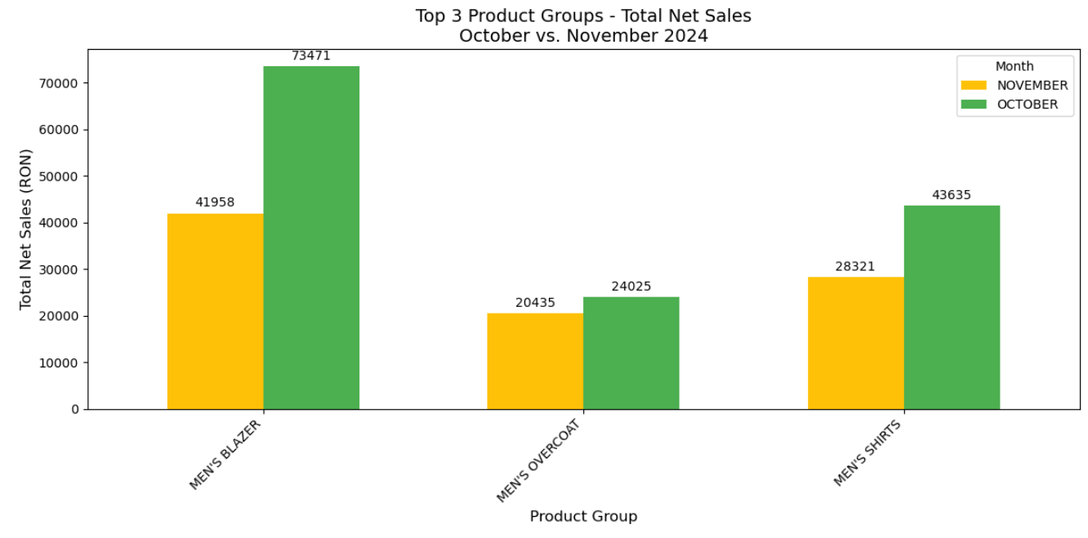
Best Sellers
Men’s Shirt increased by +54% in November, reaching 43,635 RON, while Men’s Blazer declined by -42.9% to 41,958 RON.
Men’s Overcoat grew slightly from 20,435 RON to 24,025 RON (+17.6%).
Altogether, the top 3 product groups generated over 109,618 RON in net sales during November.

Slide 5
Conclusion & Recommendations
Moderate discounts (5-10%) helped boost sales volumes, especially in November.
High discounts (over 30-50%) were mostly applied to specific items or lower-volume products, without significant impact on total revenue.
Men’s Shirt showed strong responsiveness to promotions and could remain a key target for future campaigns.
For December, a more precise discount strategy could help preserve margins while maintaining sales momentum.

