Slide 1
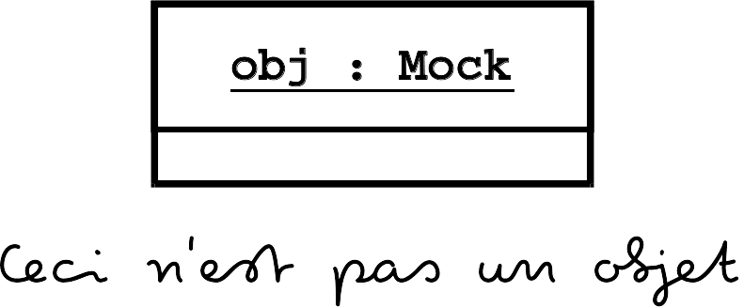
Trompeloeil cheat sheet for implementing mock
functions and placing expectations on them.
Mock implement member functions.
non-const member function
MAKE_MOCKn(name, sig{, spec})
const member function
MAKE_CONST_MOCKn(name, sig{, spec})
Place expectations. Matching expectations are searched from youngest to oldest. Everything is illegal by default.
Anonymous local object
std::unique_ptr<expectation>
REQUIRE_CALL(obj, func(params))
NAMED_REQUIRE_CALL(obj, func(params))
ALLOW_CALL(obj, func(params))
NAMED_ALLOW_CALL(obj, func(params))
FORBID_CALL(obj, func(params))
NAMED_FORBID_CALL(obj, func(params))
Refine expectations.
When to match
Impose an ordering relation between expectations by using
sequence objects
.IN_SEQUENCE(s...)
.TIMES(min, max = min)
Define how many times an expectation must match. Default is 1.
Conveniency arguments are AT_MOST(x) and AT_LEAST(x)
Local objects are const copies
Parameters are _1 .. _15
Local objects are non-const references
.WITH(condition)
when to match
.LR_WITH(condition)
.SIDE_EFFECT(statement)
What to
do when
matching
.LR_SIDE_EFFECT(statement)
.RETURN(expression)
.LR_RETURN(expression)
.THROW(expression)
.LR_THROW(expression)

Slide 2
Trompeloeil cheat sheet for matchers and
object life time management.
Matchers. Substitute for values in parameter list of expectations.
Any type allowing op
Disambiguated type
_
any value
value | == | mark
value | != | mark
value | < | mark
value | <= | mark
value | > | mark
value | >= | mark
match regular expression /mark/
ANY(type)
eq(mark)
eq<type>(mark)
ne(mark)
ne<type>(mark)
lt(mark)
lt<type>(mark)
le(mark)
le<type>(mark)
gt(mark)
gt<type>(mark)
ge(mark)
ge<type>(mark)
re(mark, ...)
re<type>(mark, ...)
Use operator* to dereference pointers. E.g. *ne(mark) means parameter is pointer (like) and *parameter != mark
Use operator! to negate matchers. E.g. !re(mark) means not matching regular expression /mark/
Object life time management
auto obj = new deathwatched<my_mock_type>(params);
*obj destruction only allowed when explicitly required. Inherits from my_mock_type
Anonymous local object
REQUIRE_DESTRUCTION(*obj)
std::unique_ptr<expectation>
NAMED_REQUIRE_DESTRUCTION(*obj)
When to match
Impose an ordering relation between expectations by using
sequence objects
.IN_SEQUENCE(s...)

