Slide 1


Koopman Operator Spectrum and Dynamic Model
of Chaotic System
混沌系统的动力学模式与Koopman算符谱
北京邮电大学 理学院
2019.5.18
姓名：张聪
研究方向：非线性动力学与复杂系统
导师：兰岳恒

Slide 2

Koopman Operator Spectrum and Dynamic Model of Chaotic System
Most of the systems in reality are often difficult to approximate with more accurate dynamic equations due to their complex principles, and only a large number of experimental observations can be used to obtain system characteristic data. We hope to find a universal data analysis method to extract the dynamic model of the dynamic system through the characteristic data of the system.

Slide 3
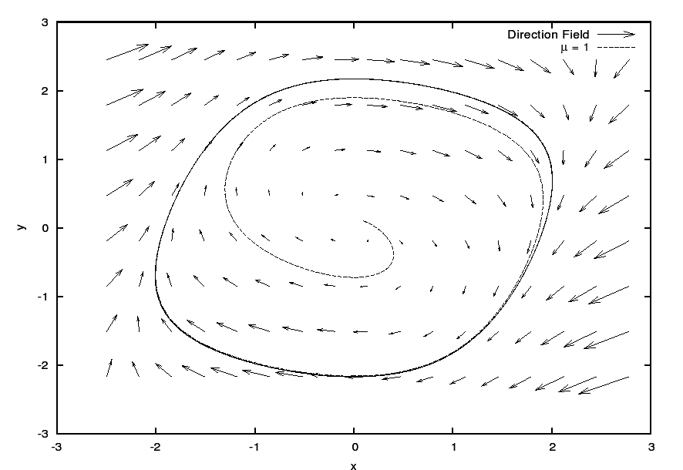
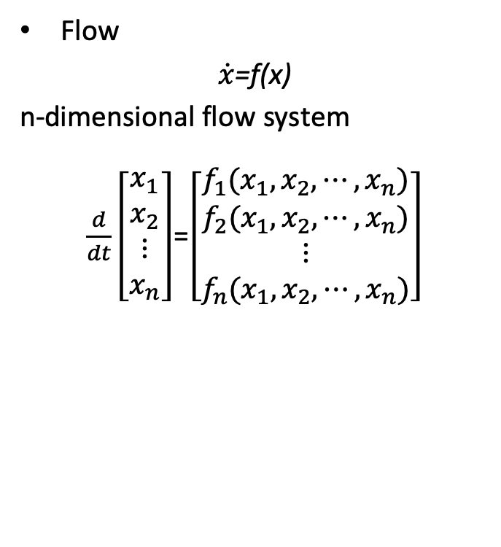
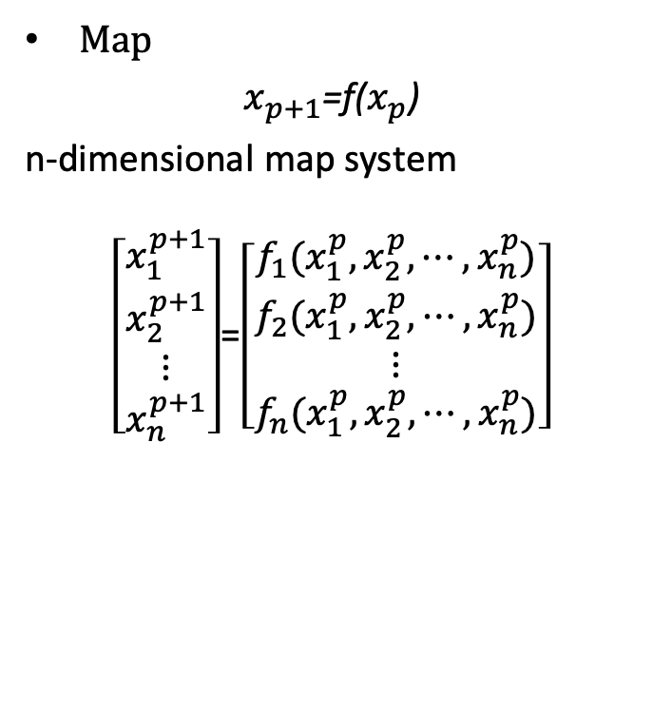
Dynamic System
Flow
$\dot{x}$=f(x)
n-dimensional flow system
$\frac{d}{dt}\left[\begin{matrix}\begin{matrix}x_{1} \\ x_{2}\end{matrix} \\ ⋮ \\ x_{n}\end{matrix}\right]$=$\left[\begin{matrix}\begin{matrix}f_{1}(x_{1},x_{2},⋯,x_{n}) \\ f_{2}(x_{1},x_{2},⋯,x_{n})\end{matrix} \\ ⋮ \\ f_{n}(x_{1},x_{2},⋯,x_{n})\end{matrix}\right]$
Map
$x_{p+1}$=f($x_{p}$)
n-dimensional map system
$\left[\begin{matrix}\begin{matrix}x_{1}^{p+1} \\ x_{2}^{p+1}\end{matrix} \\ ⋮ \\ x_{n}^{p+1}\end{matrix}\right]$=$\left[\begin{matrix}\begin{matrix}f_{1}(x_{1}^{p},x_{2}^{p},⋯,x_{n}^{p}) \\ f_{2}(x_{1}^{p},x_{2}^{p},⋯,x_{n}^{p})\end{matrix} \\ ⋮ \\ f_{n}(x_{1}^{p},x_{2}^{p},⋯,x_{n}^{p})\end{matrix}\right]$

Slide 4
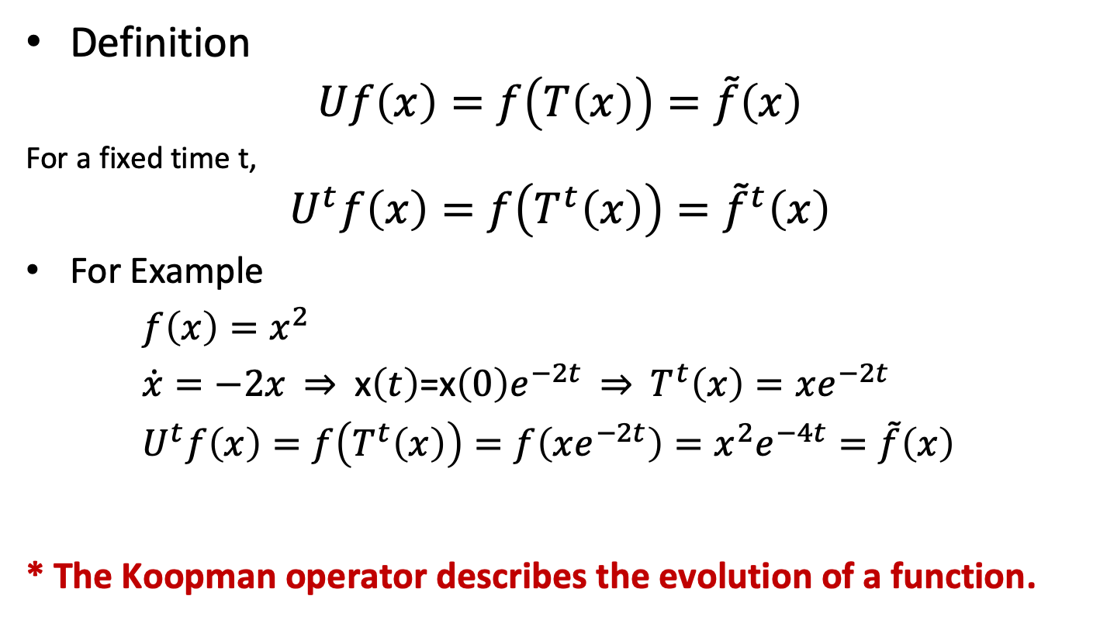
Koopman Operator
Definition
$$Uf\left(x\right)=f\left(T\left(x\right)\right)=\tilde{f}\left(x\right)$$
For a fixed time t,
$$U^{t}f\left(x\right)=f\left(T^{t}\left(x\right)\right)={\tilde{f}}^{t}\left(x\right)$$
For Example
$f\left(x\right)=x^{2}$
$\dot{x}=−2x \text{⇒} \text{x}\left(t\right)\text{=}\text{x}\left(0\right)e^{−2t} \text{⇒} T^{t}\left(x\right)=xe^{−2t}$
$U^{t}f\left(x\right)=f\left(T^{t}\left(x\right)\right)=f\left(xe^{−2t}\right)=x^{2}e^{−4t}=\tilde{f}\left(x\right)$
* The Koopman operator describes the evolution of a function.

Slide 5
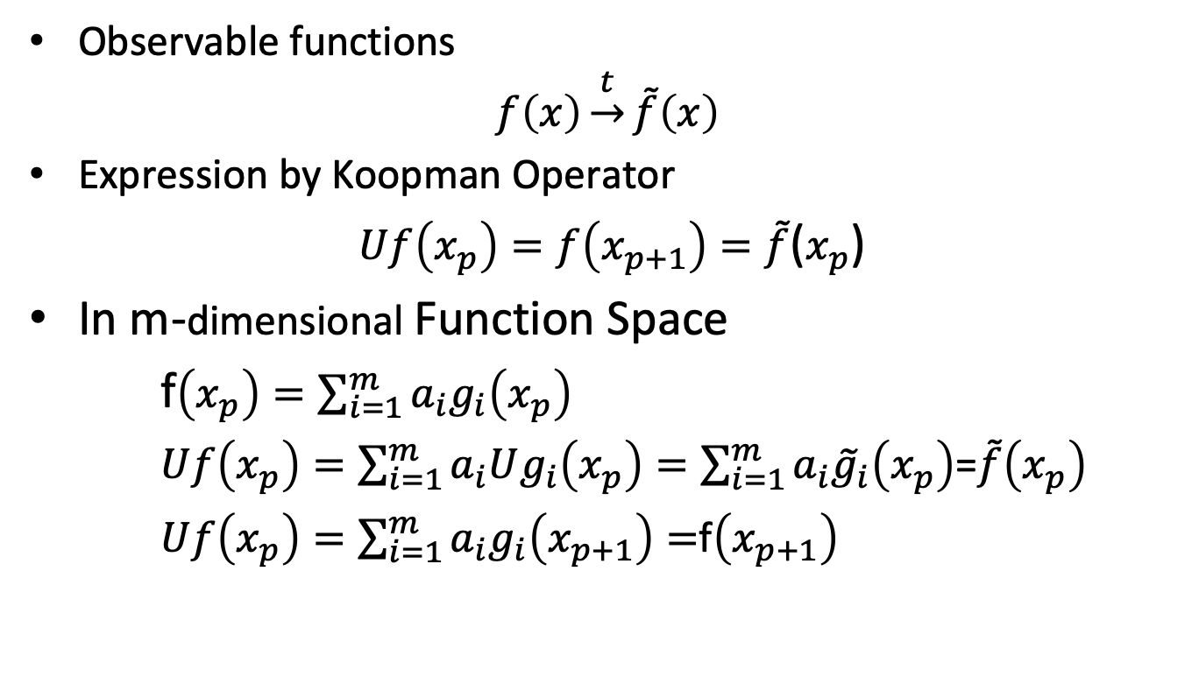
Koopman Operator in Function Space
Observable functions
$$f\left(x\right)\underset{→}{t}\tilde{f}\left(x\right)$$
Expression by Koopman Operator
$Uf\left(x_{p}\right)=f\left(x_{p+1}\right)=\tilde{f}$($x_{p}$)
In m-dimensional Function Space
f$\left(x_{p}\right)=\sum_{i=1}^{m}{a_{i}g_{i}\left(x_{p}\right)}$
$Uf\left(x_{p}\right)=\sum_{i=1}^{m}{a_{i}Ug_{i}\left(x_{p}\right)}=\sum_{i=1}^{m}{a_{i}{\tilde{g}}_{i}\left(x_{p}\right)}$=$\tilde{f}\left(x_{p}\right)$
$Uf\left(x_{p}\right)=\sum_{i=1}^{m}{a_{i}g_{i}\left(x_{p+1}\right)}=$f$\left(x_{p+1}\right)$

Slide 6
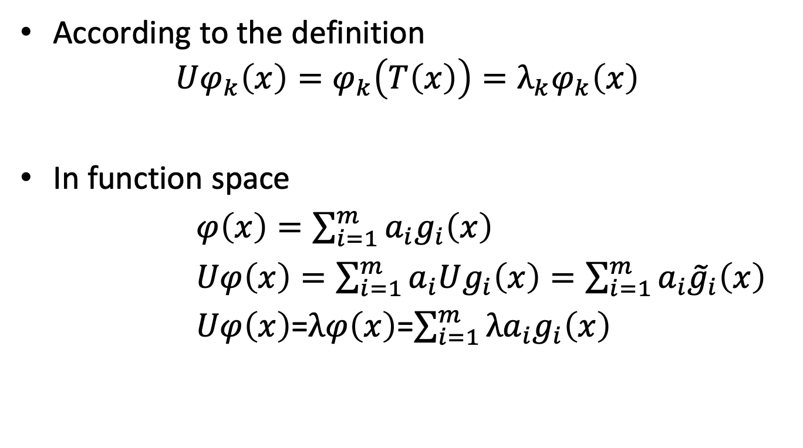
Eigenvalues and Eigenfunctions of Koopman Operator
According to the definition
$$Uφ_{k}\left(x\right)=φ_{k}\left(T\left(x\right)\right)=λ_{k}φ_{k}\left(x\right)$$
In function space
$φ\left(x\right)=\sum_{i=1}^{m}{a_{i}g_{i}\left(x\right)}$
$Uφ\left(x\right)=\sum_{i=1}^{m}{a_{i}Ug_{i}\left(x\right)}=\sum_{i=1}^{m}{a_{i}{\tilde{g}}_{i}\left(x\right)}$
$Uφ\left(x\right)$=$λφ\left(x\right)$=$\sum_{i=1}^{m}{{λa}_{i}g_{i}\left(x\right)}$

Slide 7
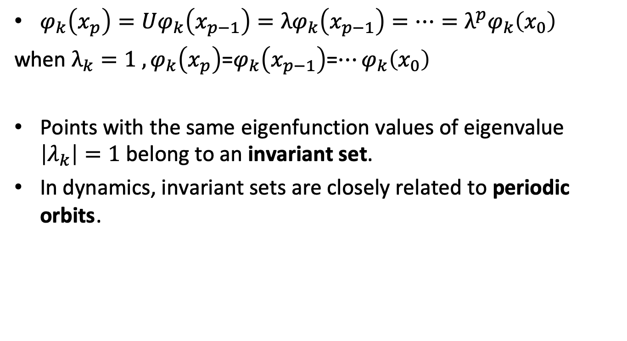
Eigenvalues and Eigenfunctions of Koopman Operator
$φ_{k}\left(x_{p}\right)=Uφ_{k}\left(x_{p−1}\right)=λφ_{k}\left(x_{p−1}\right)=…=λ^{p}φ_{k}\left(x_{0}\right)$
when $λ_{k}=1 , φ_{k}\left(x_{p}\right)$=$φ_{k}\left(x_{p−1}\right)$=$…φ_{k}\left(x_{0}\right)$
Points with the same eigenfunction values of eigenvalue $\left|λ_{k}\right|=1$ belong to an invariant set.
In dynamics, invariant sets are closely related to periodic orbits.

Slide 8
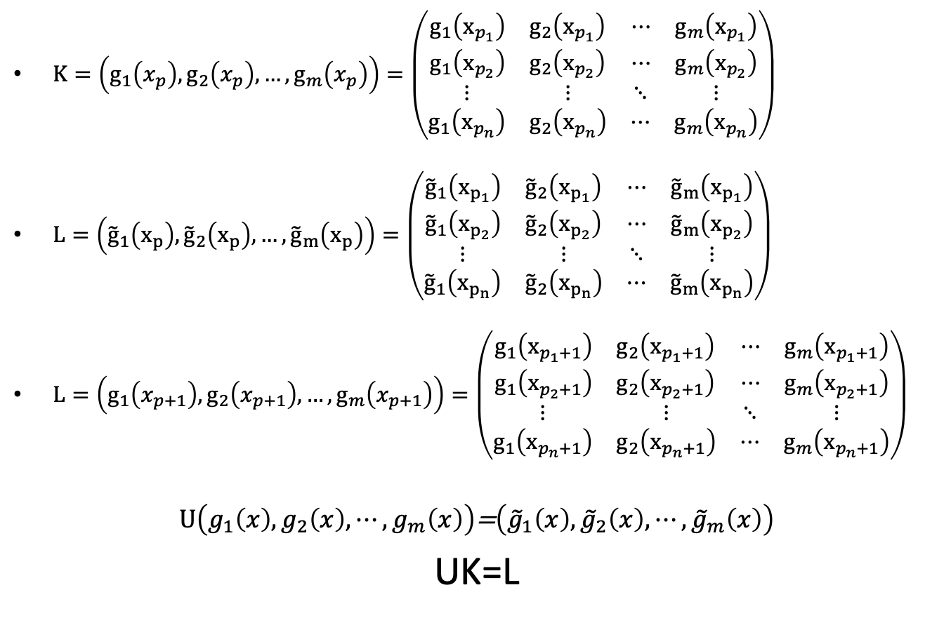
Eigenvalues and Eigenfunctions of Koopman Operator
$K=\left(g_{1}\left(x_{p}\right),g_{2}\left(x_{p}\right),…,g_{m}\left(x_{p}\right)\right)=\left(\begin{matrix}\begin{matrix}g_{1}\left(x_{p_{1}}\right) & g_{2}\left(x_{p_{1}}\right) \\ g_{1}\left(x_{p_{2}}\right) & g_{2}\left(x_{p_{2}}\right)\end{matrix} & \begin{matrix}⋯ & g_{m}\left(x_{p_{1}}\right) \\ ⋯ & g_{m}\left(x_{p_{2}}\right)\end{matrix} \\ \begin{matrix}⋮ & ⋮ \\ g_{1}\left(x_{p_{n}}\right) & g_{2}\left(x_{p_{n}}\right)\end{matrix} & \begin{matrix}⋱ & ⋮ \\ ⋯ & g_{m}\left(x_{p_{n}}\right)\end{matrix}\end{matrix}\right)$
$L=\left({\tilde{g}}_{1}\left(x_{p}\right),{\tilde{g}}_{2}\left(x_{p}\right),…,{\tilde{g}}_{m}\left(x_{p}\right)\right)=\left(\begin{matrix}\begin{matrix}{\tilde{g}}_{1}\left(x_{p_{1}}\right) & {\tilde{g}}_{2}\left(x_{p_{1}}\right) \\ {\tilde{g}}_{1}\left(x_{p_{2}}\right) & {\tilde{g}}_{2}\left(x_{p_{2}}\right)\end{matrix} & \begin{matrix}⋯ & {\tilde{g}}_{m}\left(x_{p_{1}}\right) \\ ⋯ & {\tilde{g}}_{m}\left(x_{p_{2}}\right)\end{matrix} \\ \begin{matrix}⋮ & ⋮ \\ {\tilde{g}}_{1}\left(x_{p_{n}}\right) & {\tilde{g}}_{2}\left(x_{p_{n}}\right)\end{matrix} & \begin{matrix}⋱ & ⋮ \\ ⋯ & {\tilde{g}}_{m}\left(x_{p_{n}}\right)\end{matrix}\end{matrix}\right)$
$L=\left(g_{1}\left(x_{p+1}\right),g_{2}\left(x_{p+1}\right),…,g_{m}\left(x_{p+1}\right)\right)=\left(\begin{matrix}\begin{matrix}g_{1}\left(x_{p_{1}+1}\right) & g_{2}\left(x_{p_{1}+1}\right) \\ g_{1}\left(x_{p_{2}+1}\right) & g_{2}\left(x_{p_{2}+1}\right)\end{matrix} & \begin{matrix}⋯ & g_{m}\left(x_{p_{1}+1}\right) \\ ⋯ & g_{m}\left(x_{p_{2}+1}\right)\end{matrix} \\ \begin{matrix}⋮ & ⋮ \\ g_{1}\left(x_{p_{n}+1}\right) & g_{2}\left(x_{p_{n}+1}\right)\end{matrix} & \begin{matrix}⋱ & ⋮ \\ ⋯ & g_{m}\left(x_{p_{n}+1}\right)\end{matrix}\end{matrix}\right)$
$U\left(g_{1}\left(x\right),g_{2}\left(x\right),⋯,g_{m}\left(x\right)\right)$=$\left({\tilde{g}}_{1}\left(x\right),{\tilde{g}}_{2}\left(x\right),⋯,{\tilde{g}}_{m}\left(x\right)\right)$
UK=L

Slide 9
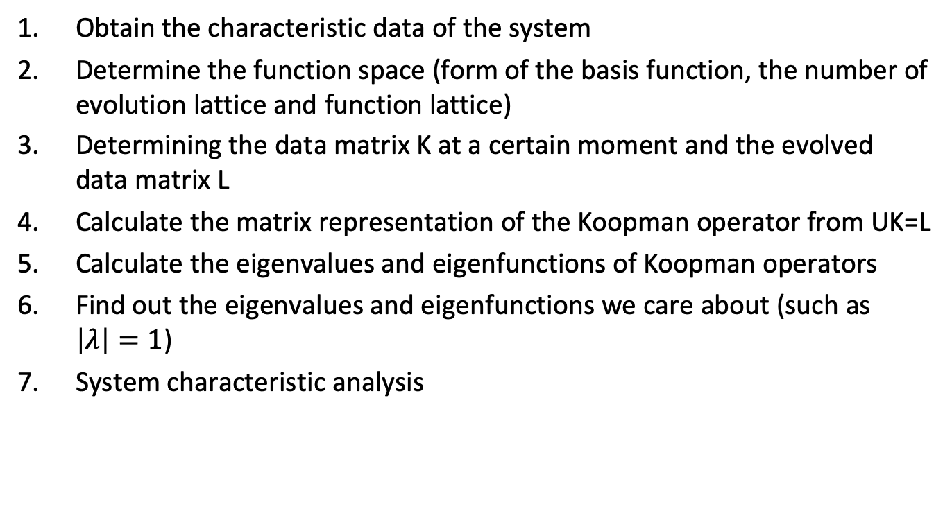
Koopman Analysis
Obtain the characteristic data of the system
Determine the function space (form of the basis function, the number of evolution lattice and function lattice)
Determining the data matrix K at a certain moment and the evolved data matrix L
Calculate the matrix representation of the Koopman operator from UK=L
Calculate the eigenvalues and eigenfunctions of Koopman operators
Find out the eigenvalues and eigenfunctions we care about (such as $\left|λ\right|=1$)
System characteristic analysis

Slide 10
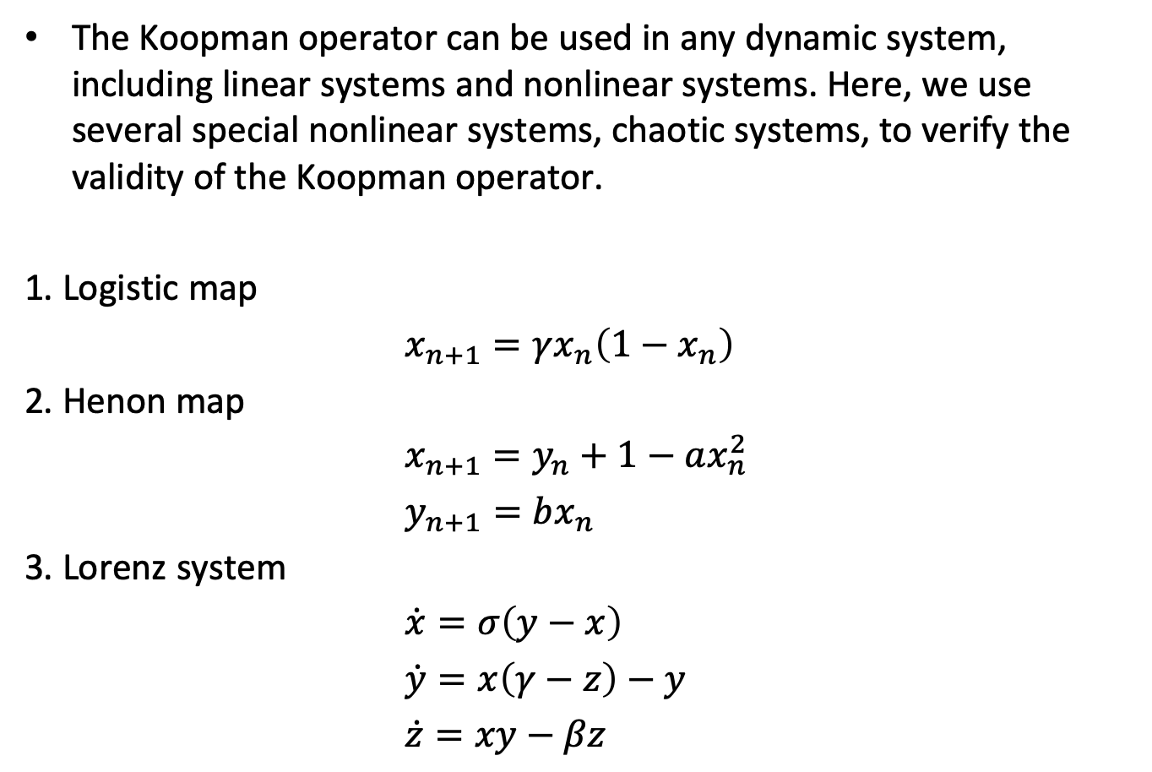
Chaotic System
The Koopman operator can be used in any dynamic system, including linear systems and nonlinear systems. Here, we use several special nonlinear systems, chaotic systems, to verify the validity of the Koopman operator.
1. Logistic map
$x_{n+1}=γx_{n}\left(1−x_{n}\right)$
2. Henon map
$x_{n+1}=y_{n}+1−ax_{n}^{2}$
$y_{n+1}=bx_{n}$
3. Lorenz system
$\dot{x}=σ\left(y−x\right)$
$\dot{y}=x\left(γ−z\right)−y$
$\dot{z}=xy−βz$

Slide 11
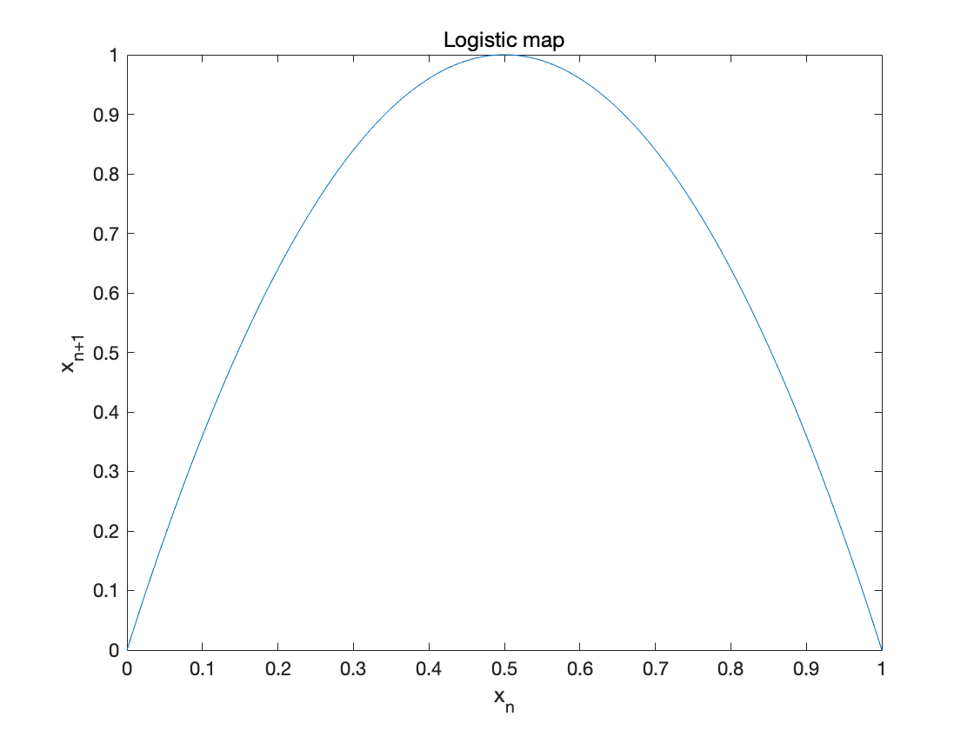
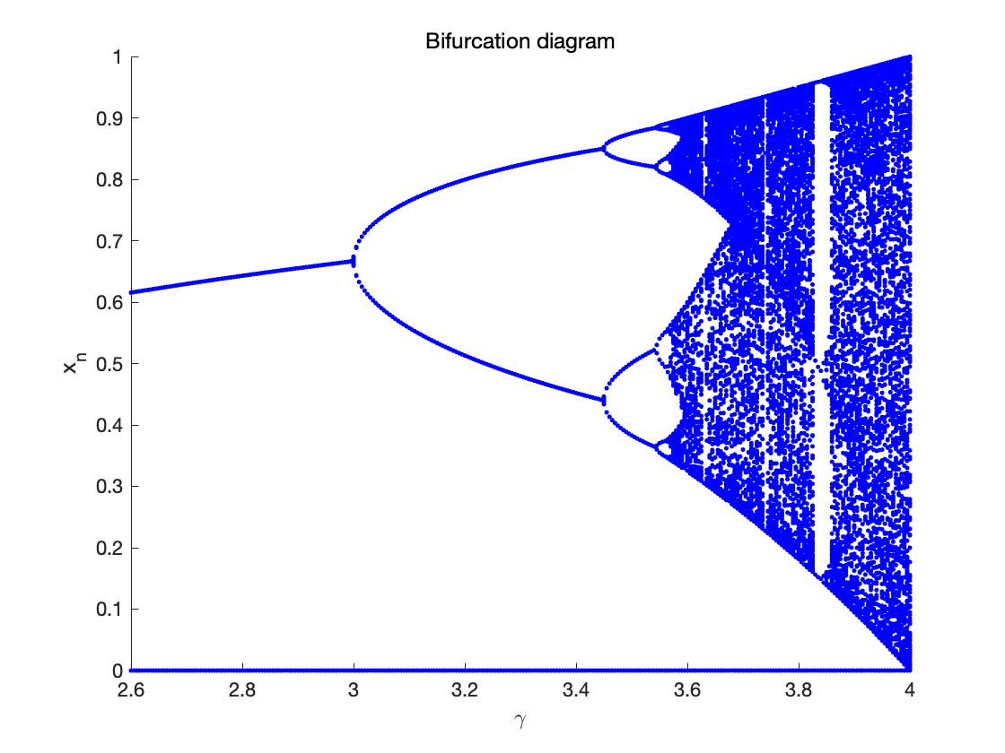
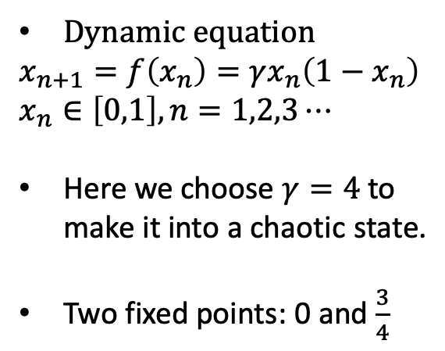
Logistic Map
Dynamic equation
$$x_{n+1}=f\left(x_{n}\right)=γx_{n}\left(1−x_{n}\right)$$
$$x_{n}∈\left[0,1\right],n=1,2,3⋯$$
Here we choose $γ=4$ to make it into a chaotic state.
Two fixed points: 0 and $\frac{3}{4}$

Slide 12
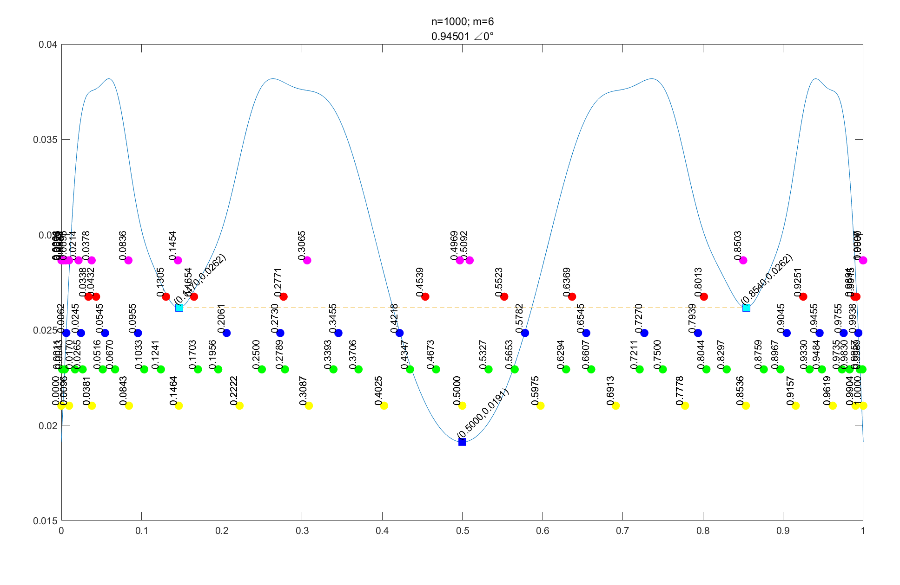
Koopman eigenfunctions of Logistic Map
The extreme points of Koopman's eigenfunction agree well with the "boundary point". The boundary point reflects the symbolic dynamics of the Logistic map. The division of symbolic dynamics can predict the long-term behavior of the system.

Slide 13
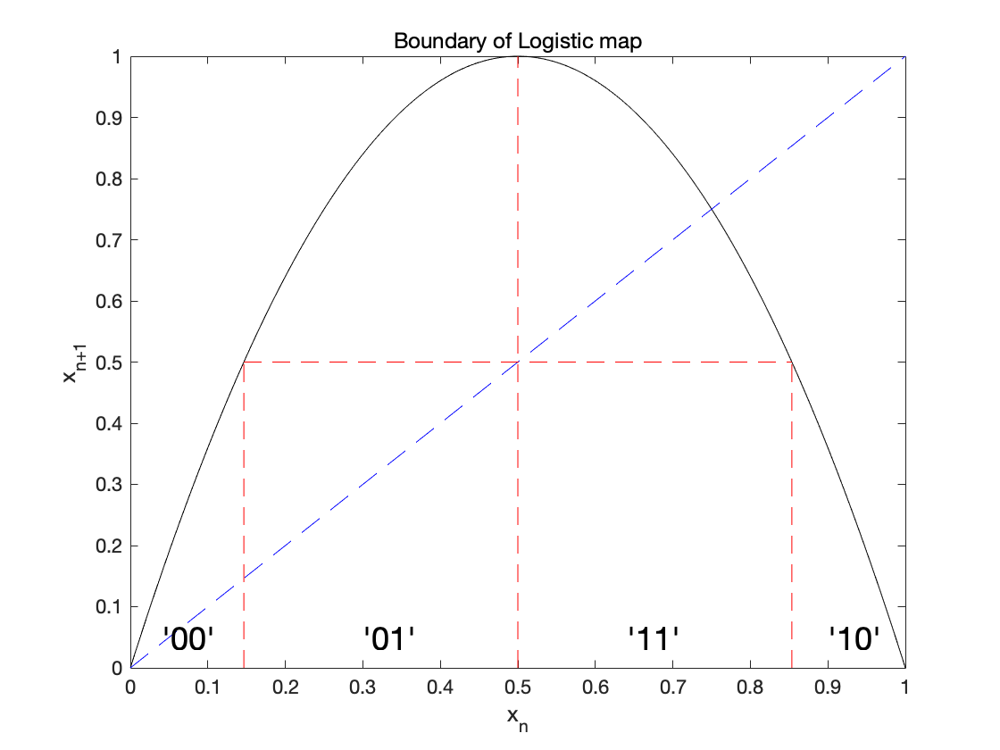
Symbolic dynamics
Any point in the phase space can be described by a sequence of symbolic dynamics.

Slide 14
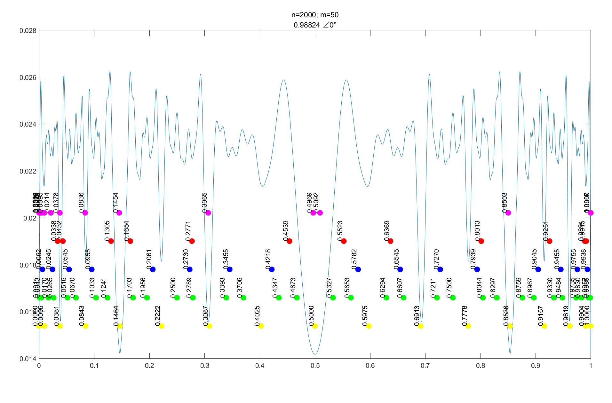
Koopman eigenfunctions of Logistic Map
The extreme points of Koopman's eigenfunction agree well with the "boundary point". The boundary point reflects the symbolic dynamics of the Logistic map. The division of symbolic dynamics can predict the long-term behavior of the system.

Slide 15
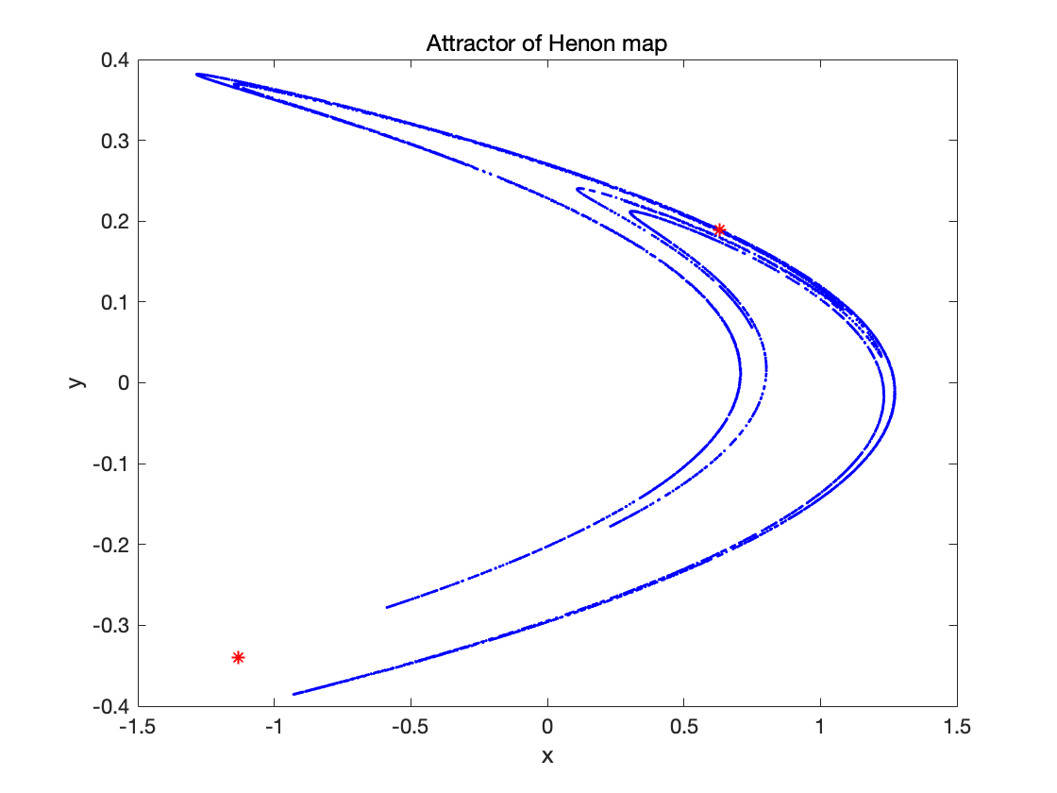
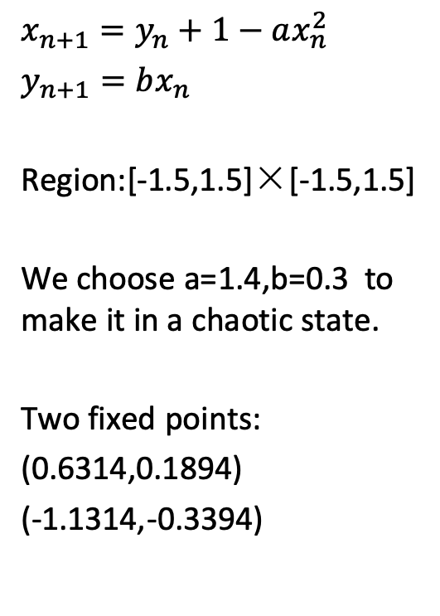
Henon map
$$x_{n+1}=y_{n}+1−ax_{n}^{2}$$
$y_{n+1}=bx_{n}$
Region:[-1.5,1.5]×[-1.5,1.5]
We choose a=1.4,b=0.3 to make it in a chaotic state.
Two fixed points:
(0.6314,0.1894)
(-1.1314,-0.3394)

Slide 16
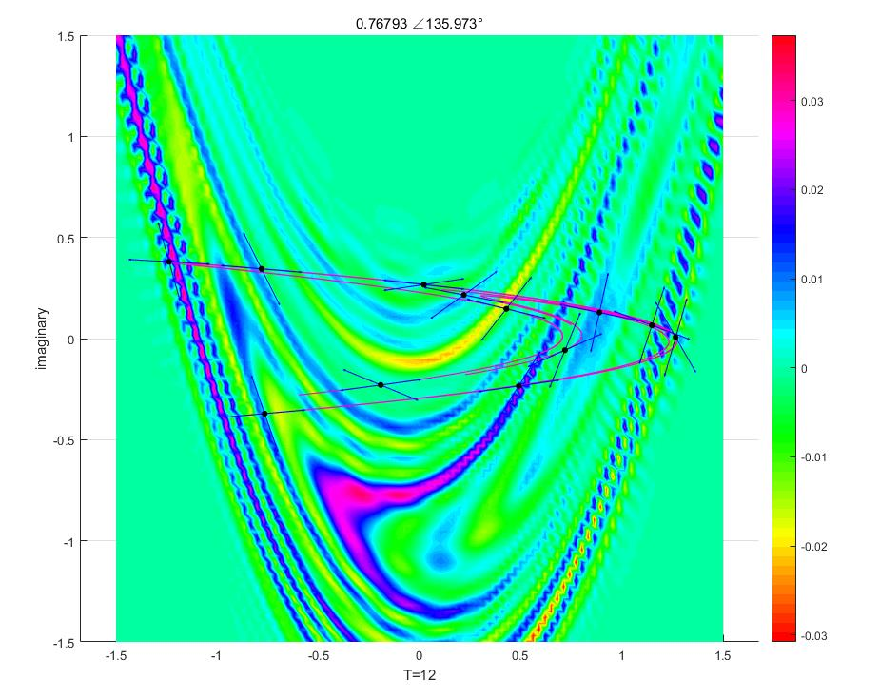
Koopman eigenfunctions of Henon Map
The eigenfunction of the Koopman operator agrees with the unstable manifold of the Henon map. The linearization direction of the periodic point (one stable, one unstable) coincides with the shape of the attractor and the flow of the eigenfunction.

Slide 17
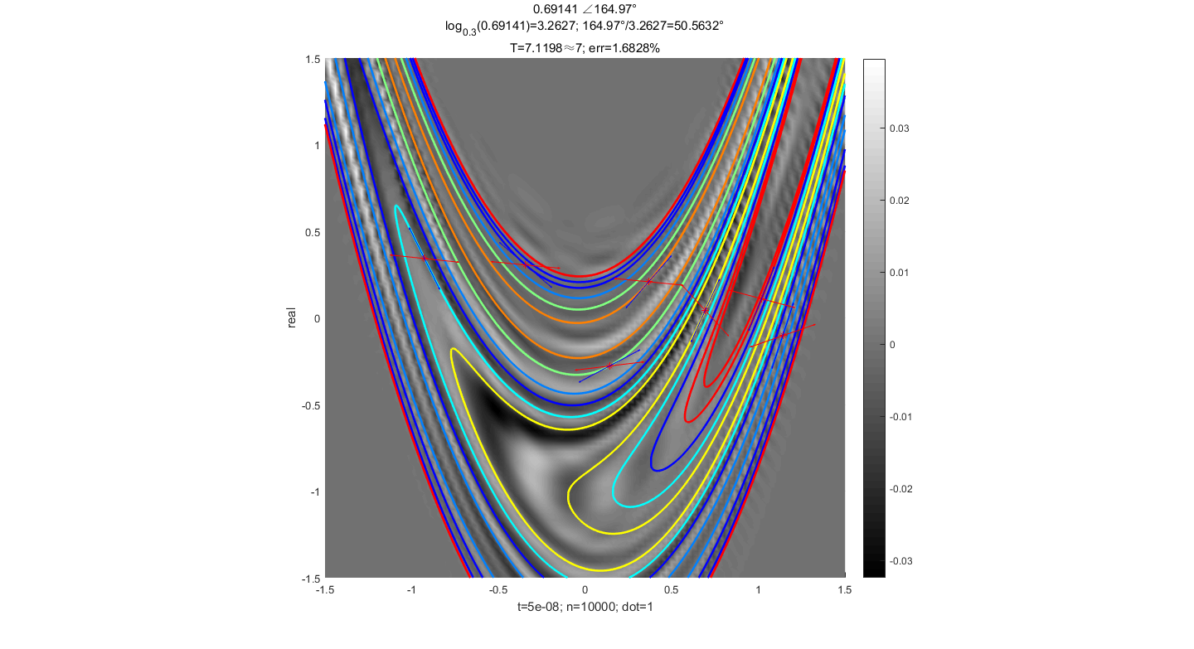
Koopman eigenfunctions of Logistic Map
The eigenfunction of the Koopman operator agrees with the unstable manifold of the Henon map. The linearization direction of the periodic point (one stable, one unstable) coincides with the shape of the attractor and the flow of the eigenfunction.

Slide 18
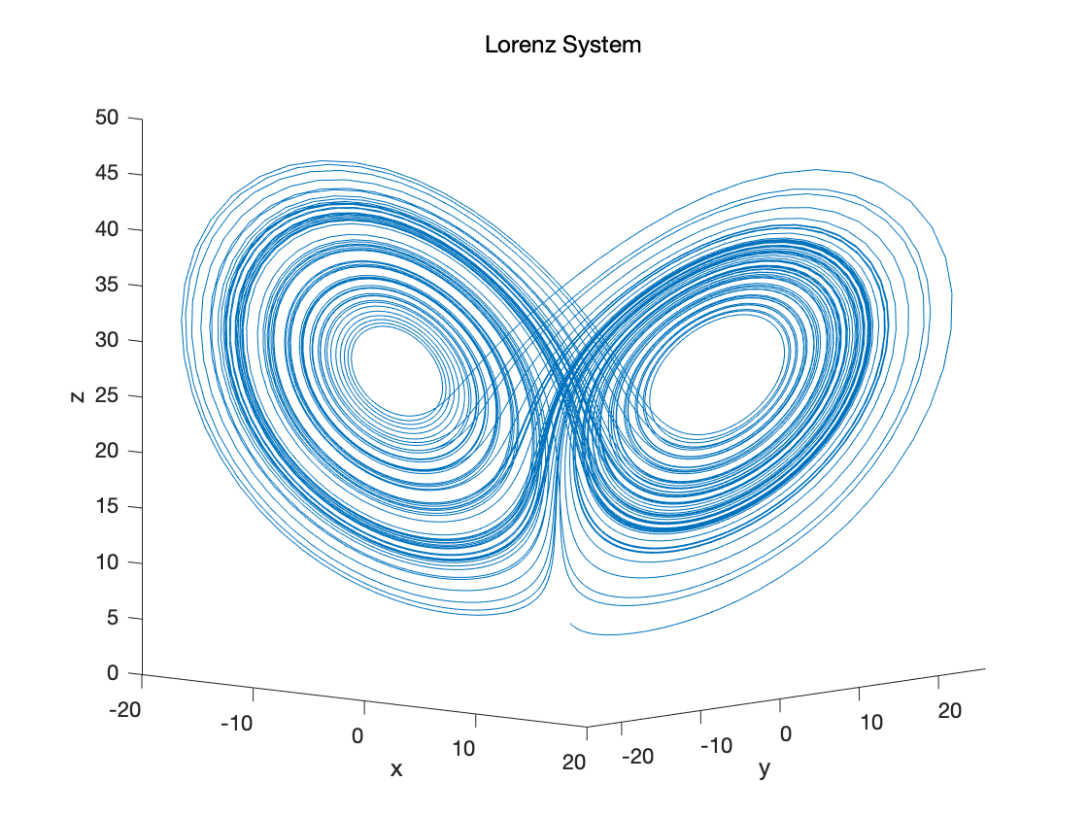
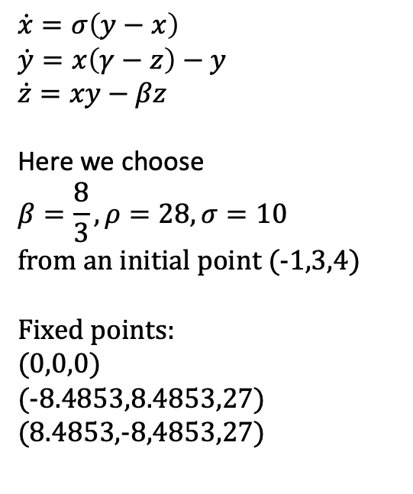
Lorenz System
$$\dot{x}=σ\left(y−x\right)$$
$$\dot{y}=x\left(γ−z\right)−y$$
$$\dot{z}=xy−βz$$
Here we choose
$$β=\frac{8}{3},ρ=28,σ=10$$
from an initial point (-1,3,4)
Fixed points:
(0,0,0)
(-8.4853,8.4853,27)
(8.4853,-8,4853,27)

Slide 19
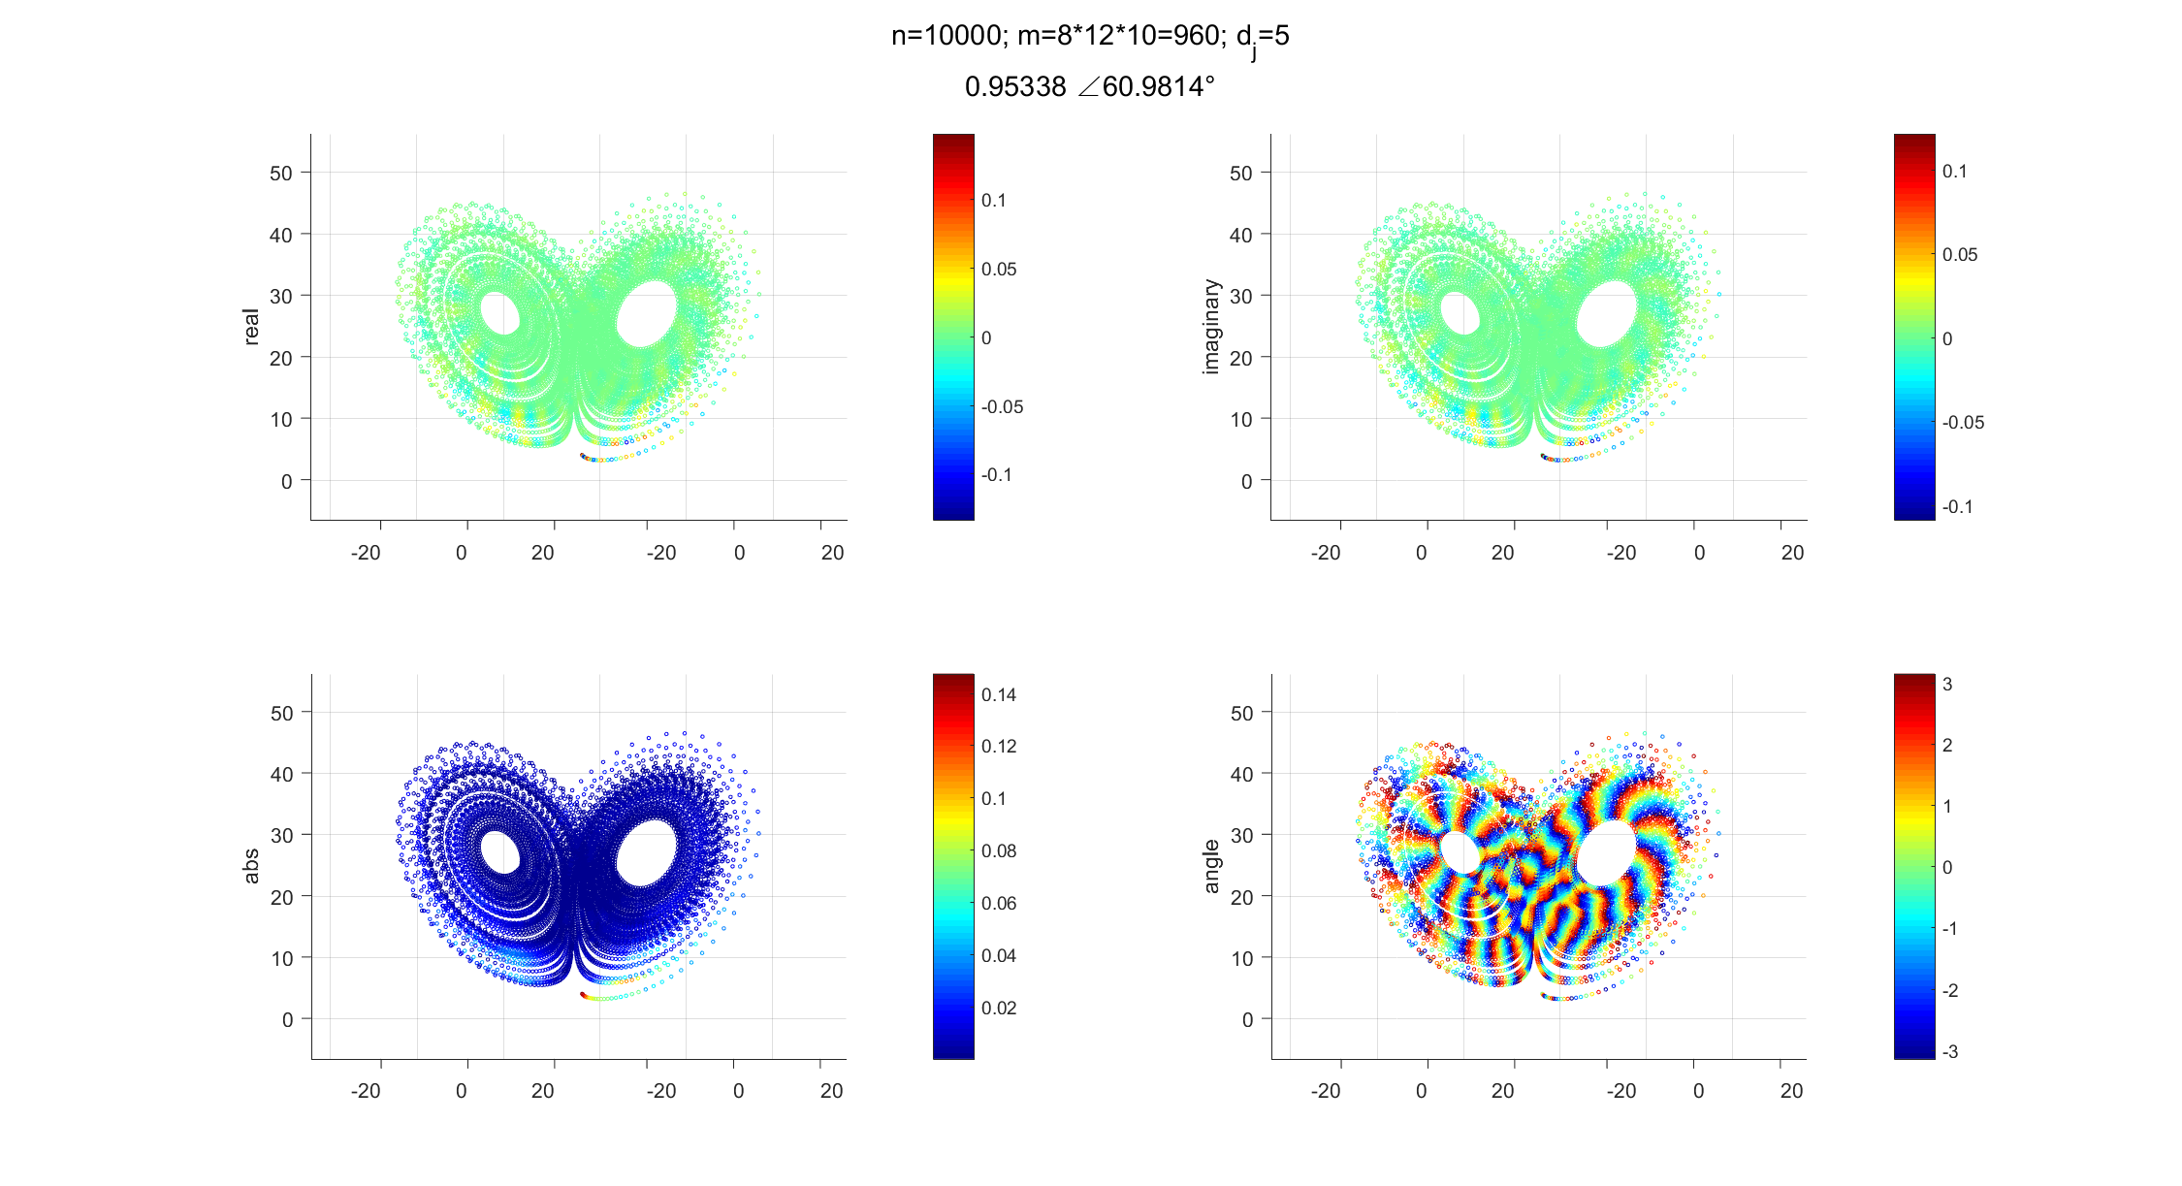
Koopman eigenfunctions of Lorenz System

Slide 20
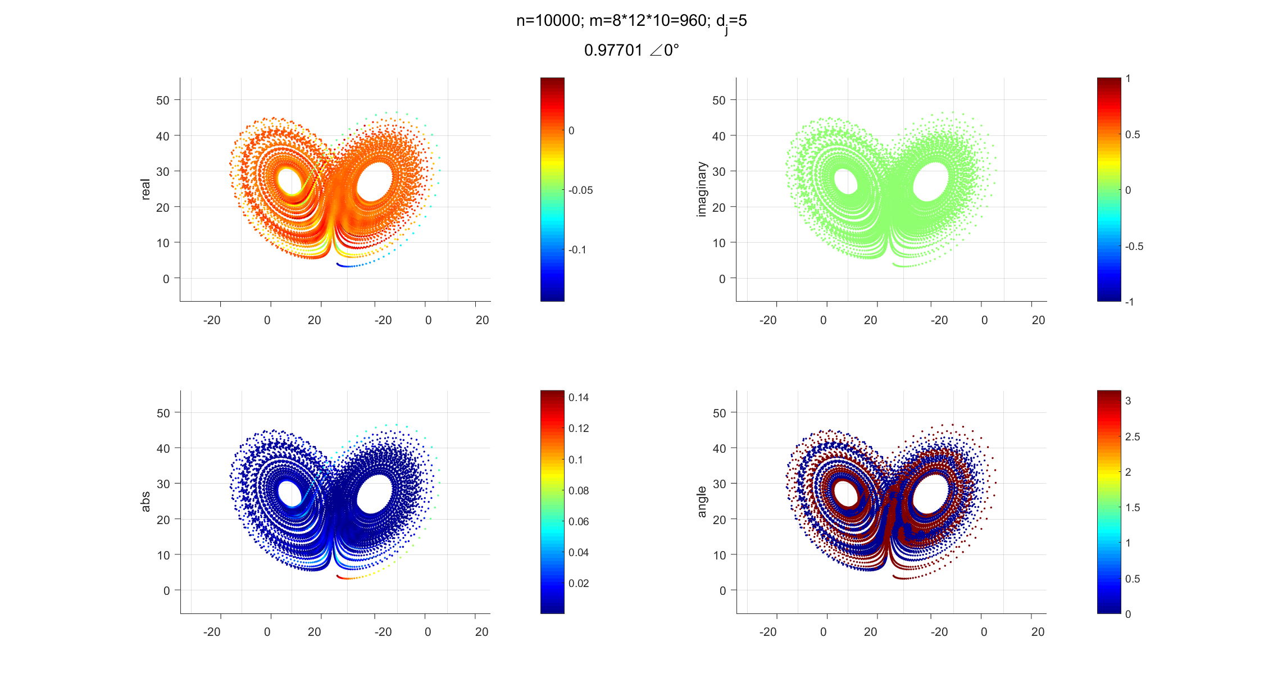
Koopman eigenfunctions of Lorenz System

Slide 21
Summary
The Koopman operator provides an effective mathematical tool, which acts on a certain function and describes the evolution of the function.
If the evolution of the system’s characteristic data is regarded as the evolution of the function, we can use the Koopman operator to analyze the evolution characteristics of the system, further extract the key characteristics, and predict the long-term behavior of the system to a certain extent.
Points with the same eigenfunction value belong to an invariant set.In dynamics, invariant sets are closely related to periodic orbits.
The extreme points of Koopman's eigenfunction agree well with the "boundary point". The boundary point reflects the symbolic dynamics of the Logistic map. The division of symbolic dynamics can predict the long-term behavior of the system.
Suitable for any dynamic system.

Slide 22
Thanks for your attention.
北京邮电大学 理学院
张聪
非线性动力学与复杂系统
zhangcongbupt@bupt.edu.cn

