Slide 1
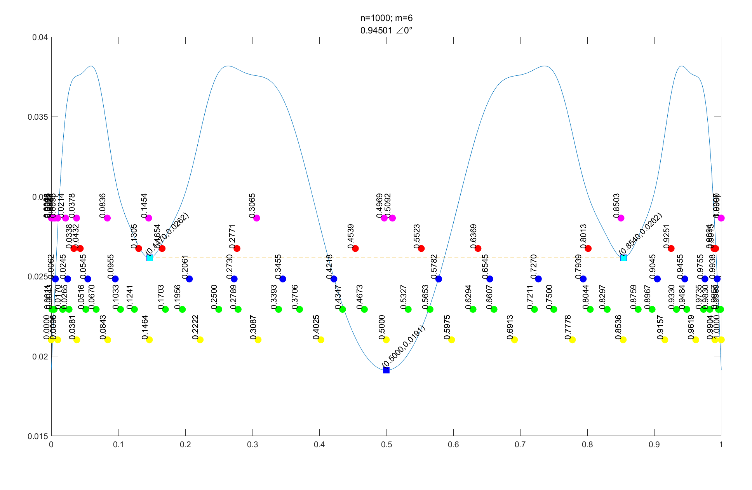

Koopman eigenfunctions of Logistic Map
The extreme points of Koopman's eigenfunction agree well with the "boundary point". The boundary point reflects the symbolic dynamics of the Logistic map. The division of symbolic dynamics can predict the long-term behavior of the system.

Slide 2
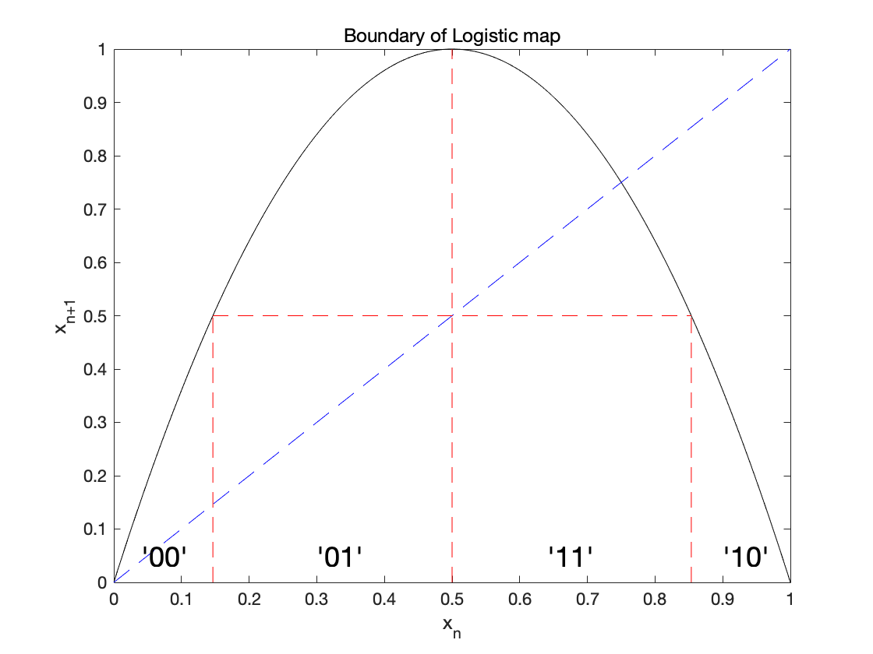
Symbolic dynamics
Any point in the phase space can be described by a sequence of symbolic dynamics.

Slide 3
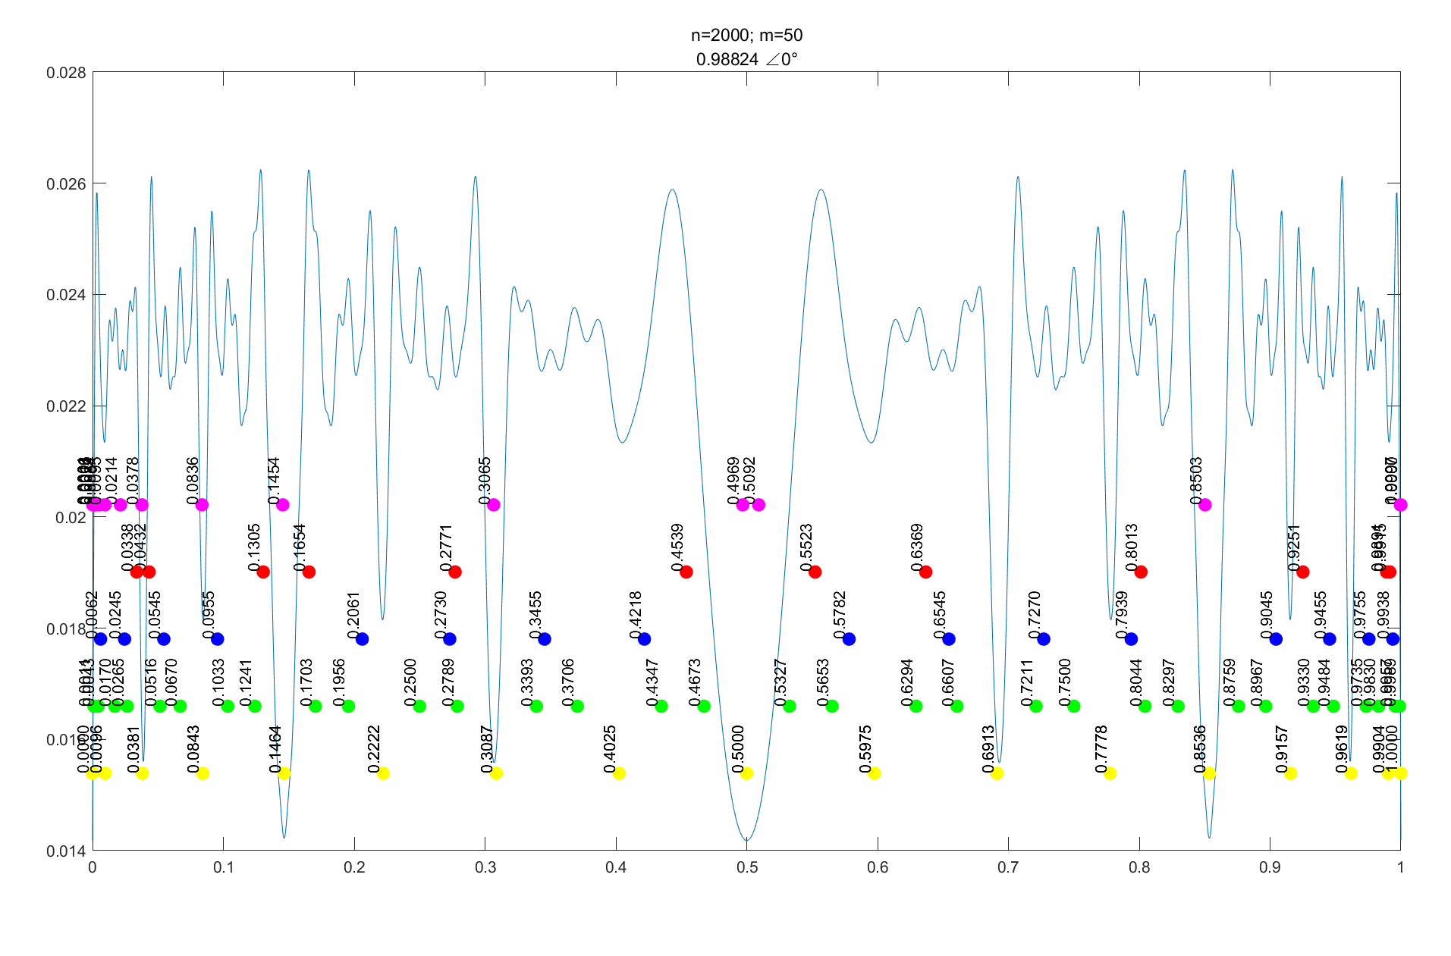
Koopman eigenfunctions of Logistic Map
The extreme points of Koopman's eigenfunction agree well with the "boundary point". The boundary point reflects the symbolic dynamics of the Logistic map. The division of symbolic dynamics can predict the long-term behavior of the system.

Slide 4
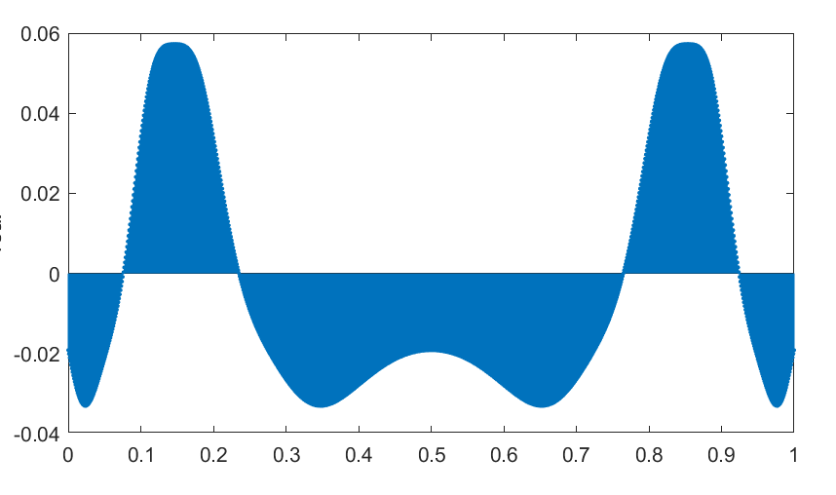
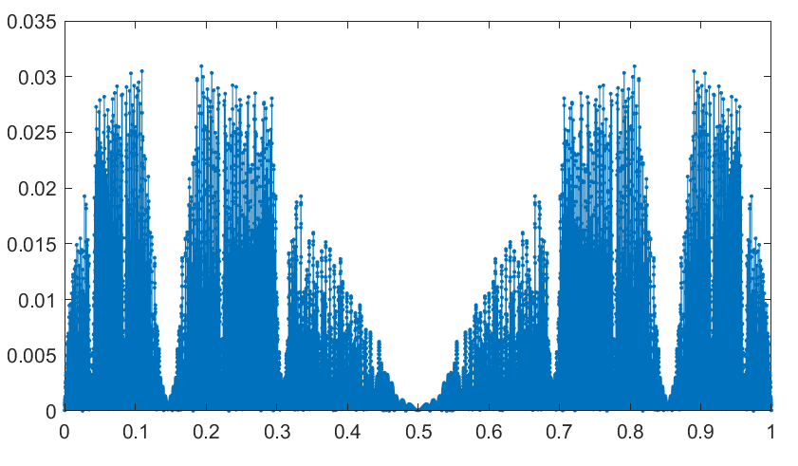
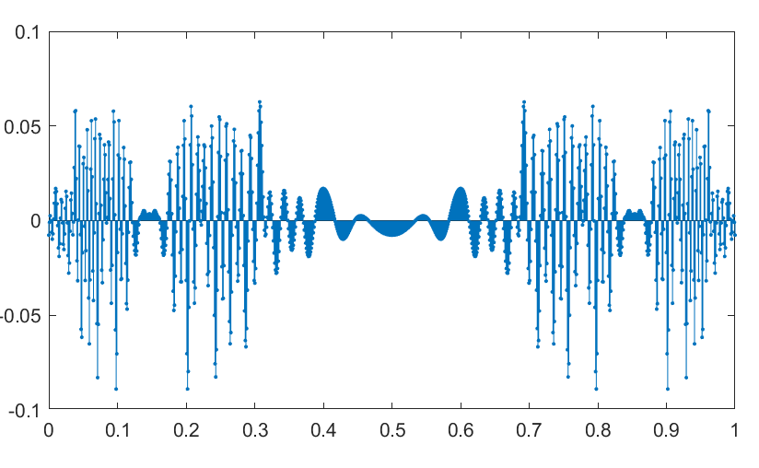
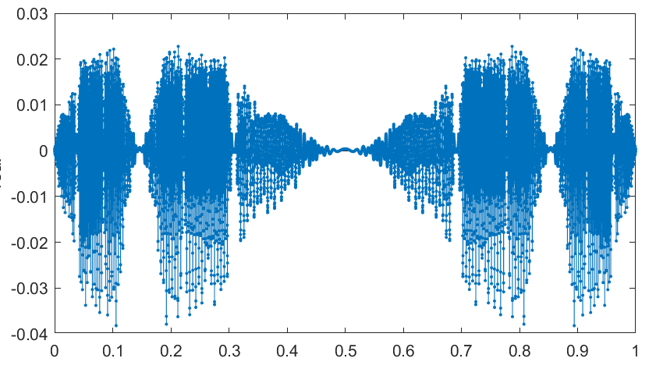
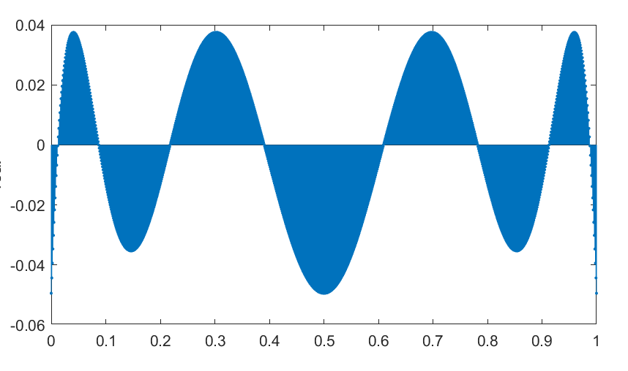
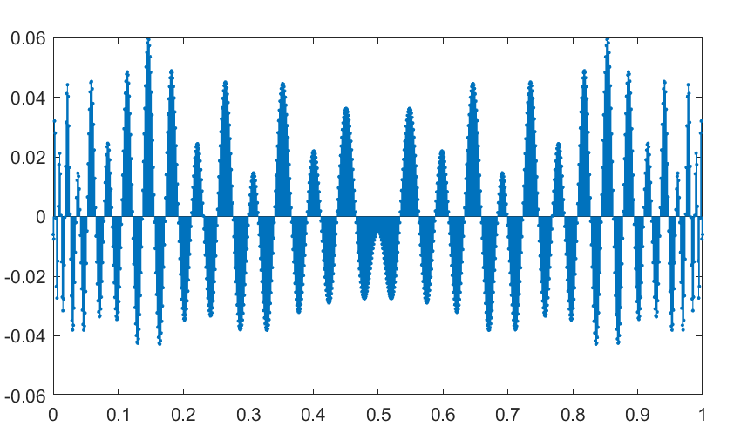
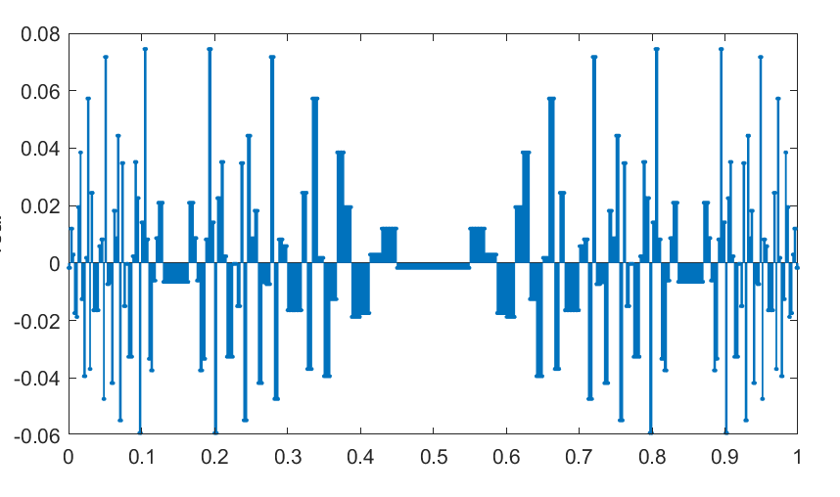
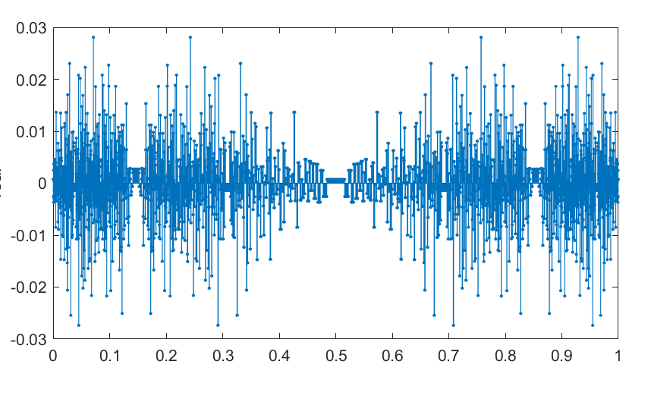

Koopman Operator is Effective, but…
The eigenfunction depends on
n: number of points (phase space dimension)
m: number of basis functions (function space demension)
g$\left(x\right)$: base function (Form, Number, and other parametres)
(Form:Gauss、Fourier、Rectangle、Legendre)
λ: eigenvector (absolute value, real/imaginary)
So we get a lot of eigenfunctions…

Slide 5
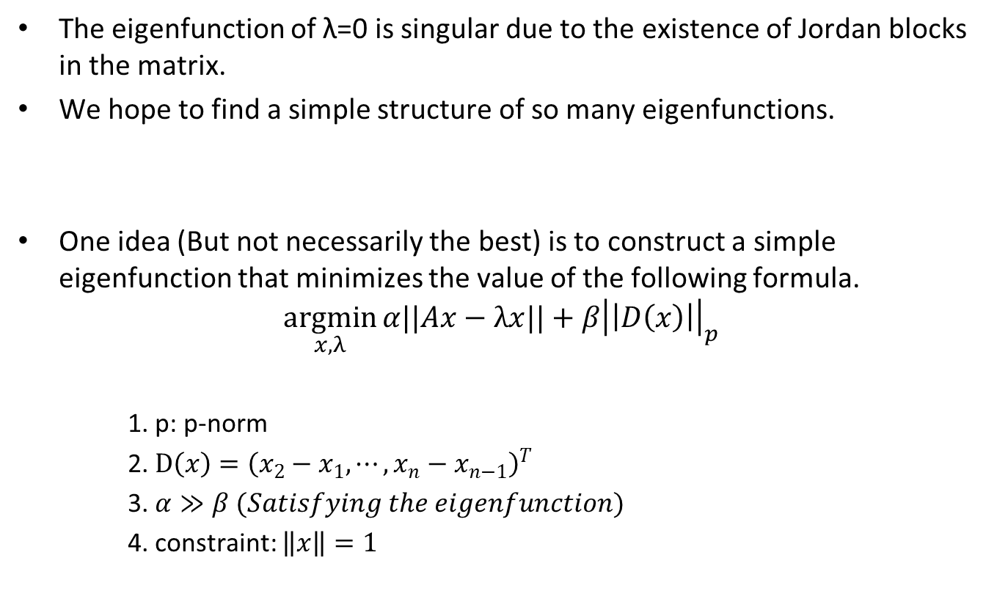
Find the simple structure of eigenfunction
The eigenfunction of λ=0 is singular due to the existence of Jordan blocks in the matrix.
We hope to find a simple structure of so many eigenfunctions.
One idea (But not necessarily the best) is to construct a simple eigenfunction that minimizes the value of the following formula.
$$\underset{x,λ}{argmin}{α||Ax−λx||}+β{\left|\left|D\left(x\right)\right|\right|}_{p}$$
1. p: p-norm
2. $D\left(x\right)={\left(x_{2}−x_{1},⋯,x_{n}−x_{n−1}\right)}^{T}$
3. $α≫β (Satisfying the eigenfunction)$
4. constraint: $\left\|x\right\|=1$

Slide 6
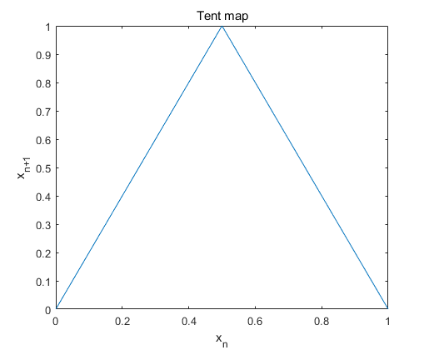
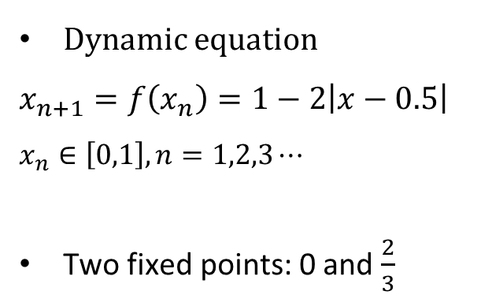
Tent Map
Dynamic equation
$$x_{n+1}=f\left(x_{n}\right)=1−2\left|x−0.5\right|$$
$$x_{n}∈\left[0,1\right],n=1,2,3⋯$$
Two fixed points: 0 and $\frac{2}{3}$

Slide 7
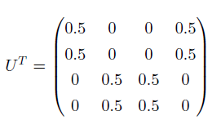
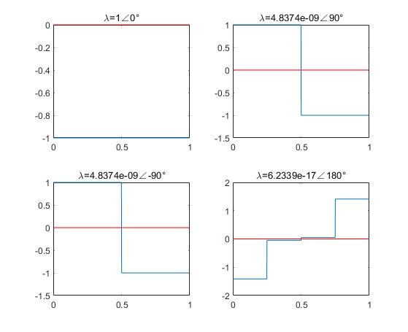

Eigenfunctions of Tent map
$U^{T}$, Tent map, Rectangle basis function, m=4

Slide 8
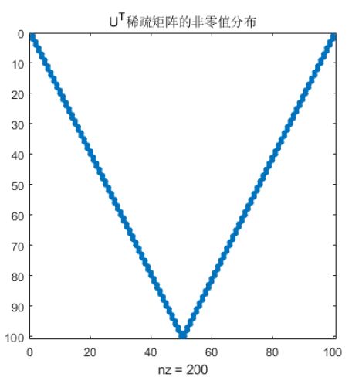
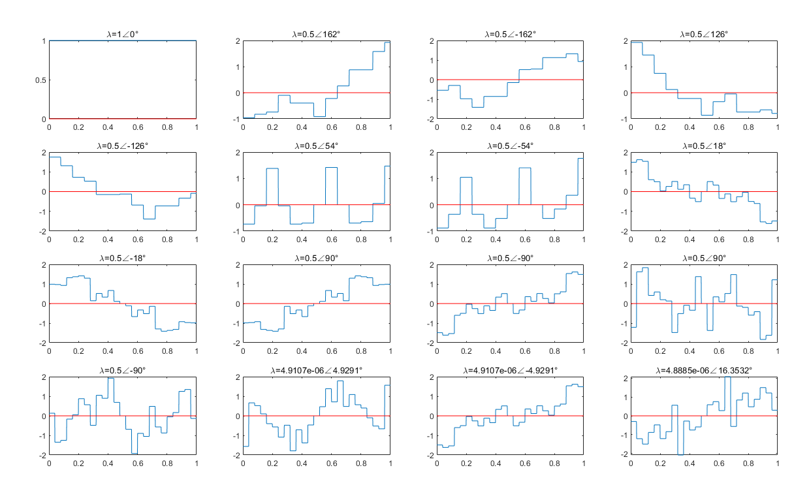

Eigenfunctions of Tent map (top 16)
$U^{T}$, Tent map, Rectangle basis function, m=100

Slide 9
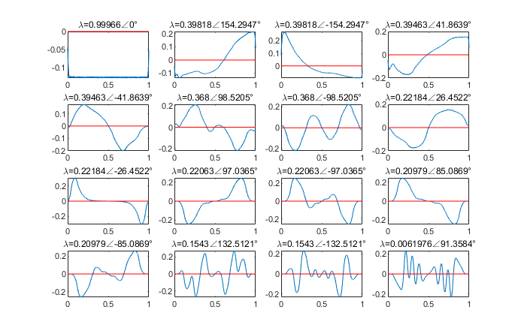

Eigenfunctions of Tent map (top 16)
$U^{T}$, Tent map, Gauss basis function, m=100

Slide 10
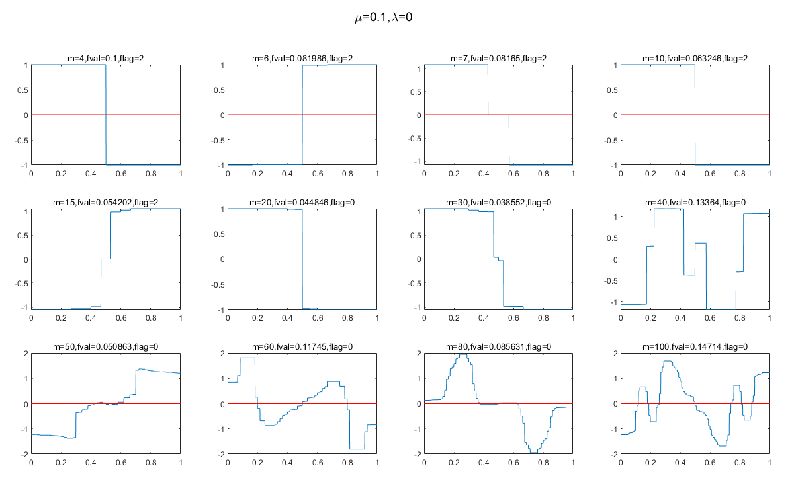

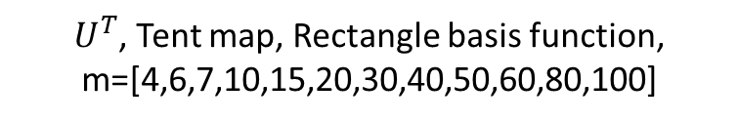
Iterative minimum (Interior point algorithm)
$$\underset{x,λ}{argmin}{α||Ax−λx||}+β{\left|\left|D\left(x\right)\right|\right|}_{p}$$
$U^{T}$, Tent map, Rectangle basis function, m=[4,6,7,10,15,20,30,40,50,60,80,100]
Cannot jump out of local minimum.

Slide 11
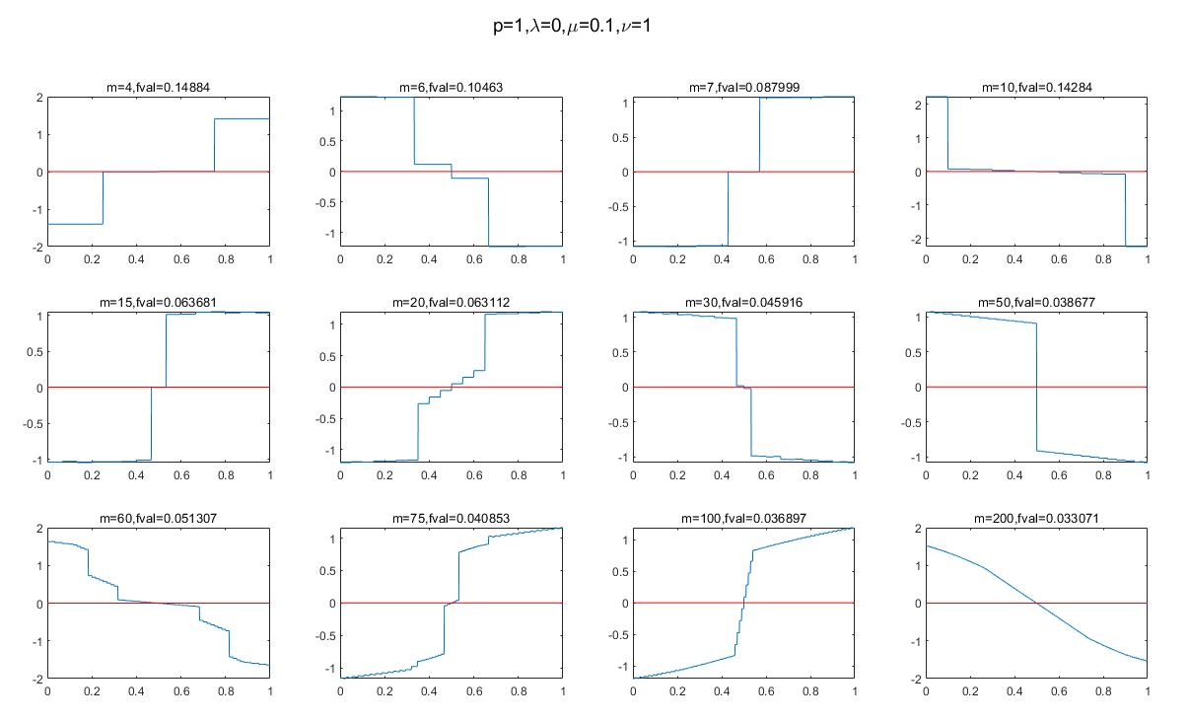

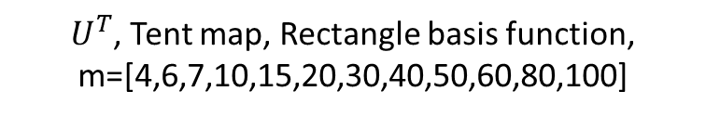

SVG (Stochastic gradient descent)
$$\underset{x,λ}{argmin}{α||Ax−λx||}+β{\left|\left|D\left(x\right)\right|\right|}_{p}+γ\left(\left\|x\right\|−1\right)$$
$U^{T}$, Tent map, Rectangle basis function, m=[4,6,7,10,15,20,30,40,50,60,80,100]

Slide 12
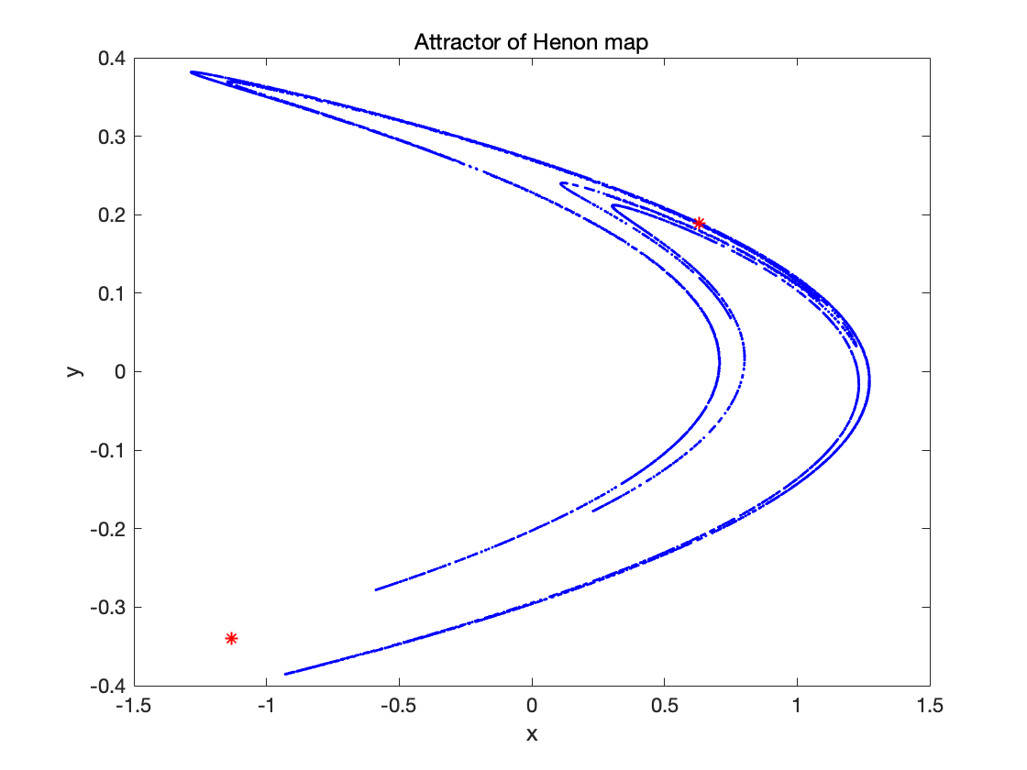
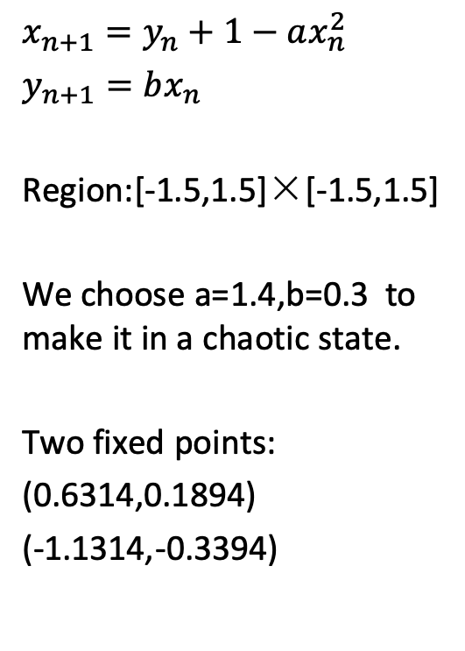
Henon map
$$x_{n+1}=y_{n}+1−ax_{n}^{2}$$
$y_{n+1}=bx_{n}$
Region:[-1.5,1.5]×[-1.5,1.5]
We choose a=1.4,b=0.3 to make it in a chaotic state.
Two fixed points:
(0.6314,0.1894)
(-1.1314,-0.3394)

Slide 13
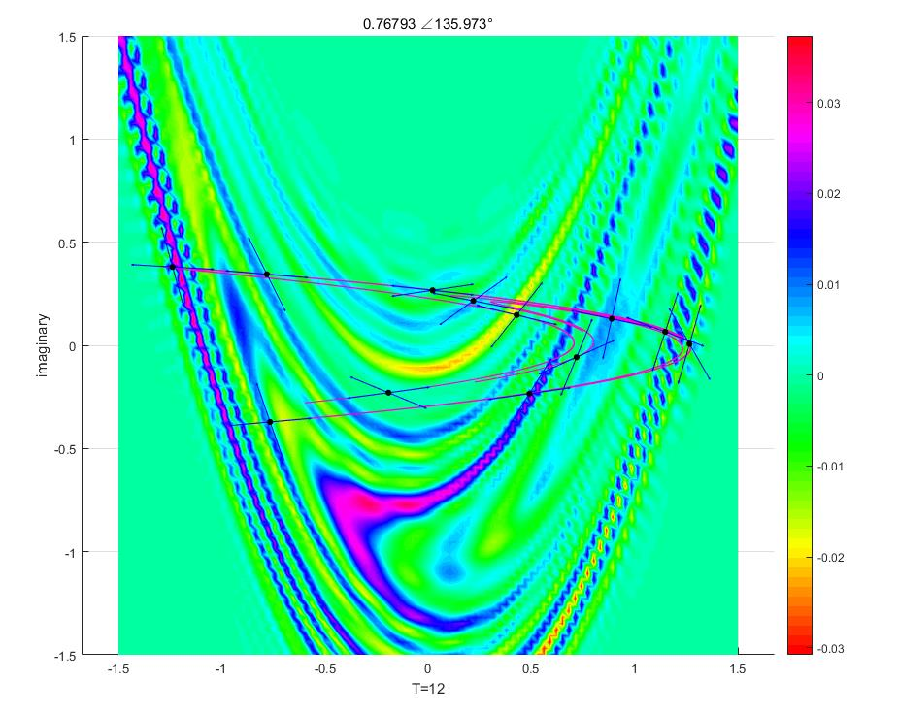
Koopman eigenfunctions of Henon Map
The eigenfunction of the Koopman operator agrees with the unstable manifold of the Henon map. The linearization direction of the periodic point (one stable, one unstable) coincides with the shape of the attractor and the flow of the eigenfunction.

Slide 14
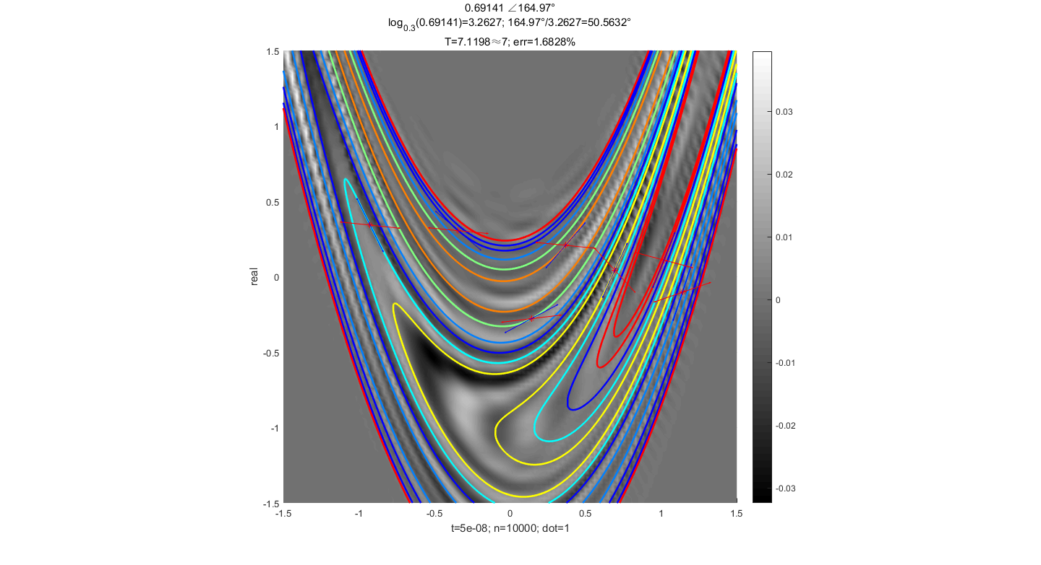
Koopman eigenfunctions of Logistic Map
The eigenfunction of the Koopman operator agrees with the unstable manifold of the Henon map. The linearization direction of the periodic point (one stable, one unstable) coincides with the shape of the attractor and the flow of the eigenfunction.

Slide 15
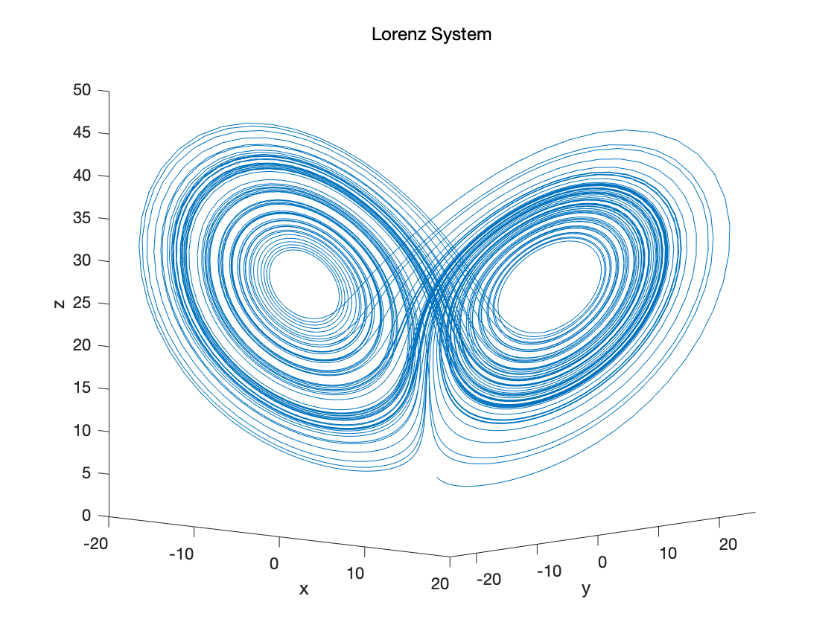
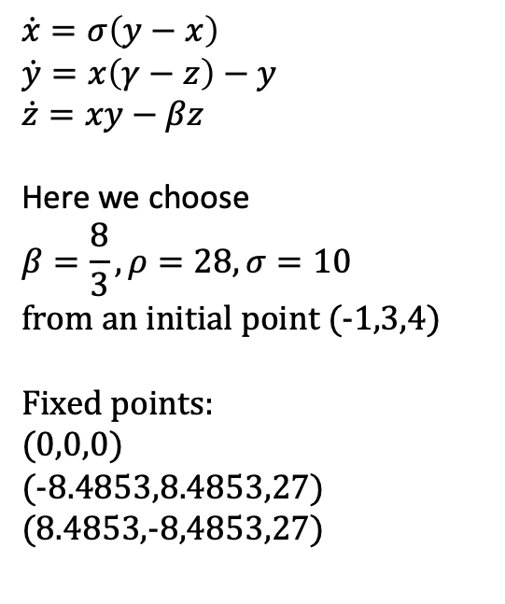
Lorenz System
$$\dot{x}=σ\left(y−x\right)$$
$$\dot{y}=x\left(γ−z\right)−y$$
$$\dot{z}=xy−βz$$
Here we choose
$$β=\frac{8}{3},ρ=28,σ=10$$
from an initial point (-1,3,4)
Fixed points:
(0,0,0)
(-8.4853,8.4853,27)
(8.4853,-8,4853,27)

Slide 16
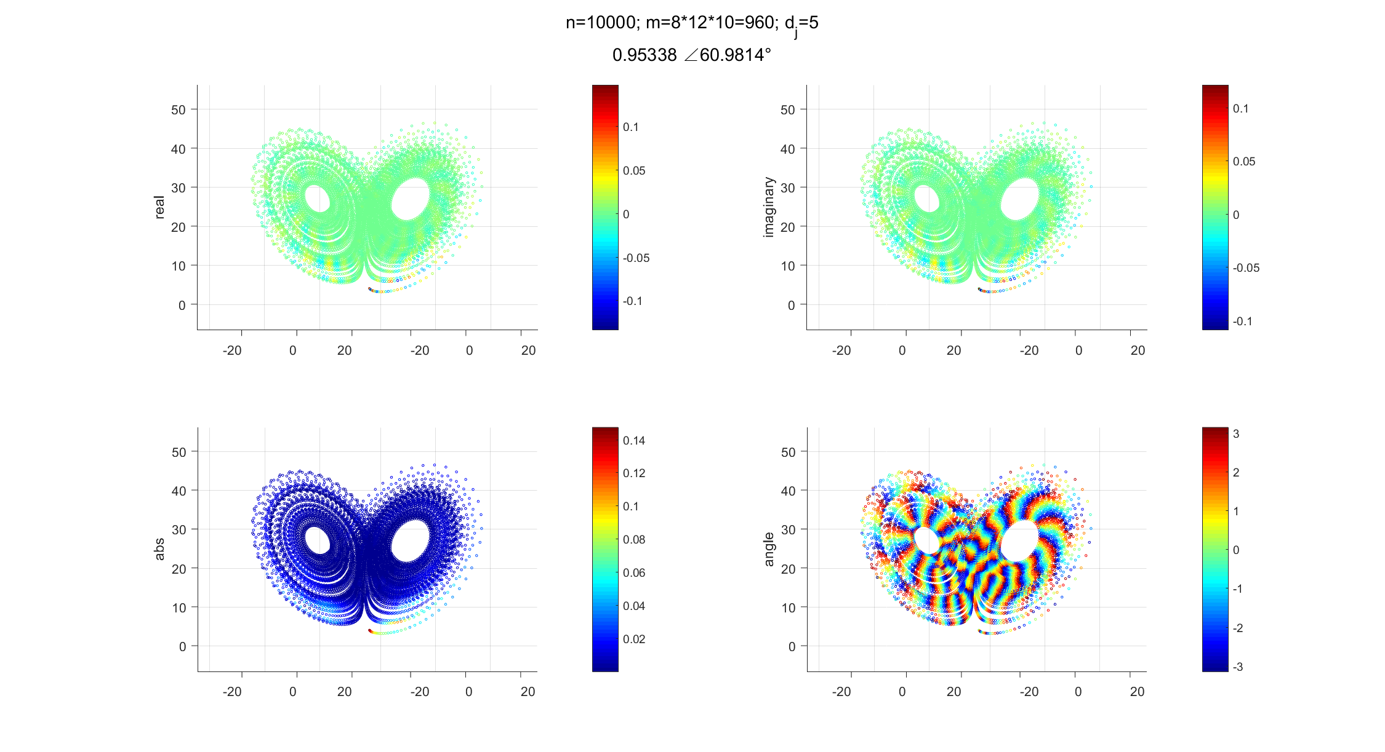
Koopman eigenfunctions of Lorenz System

Slide 17
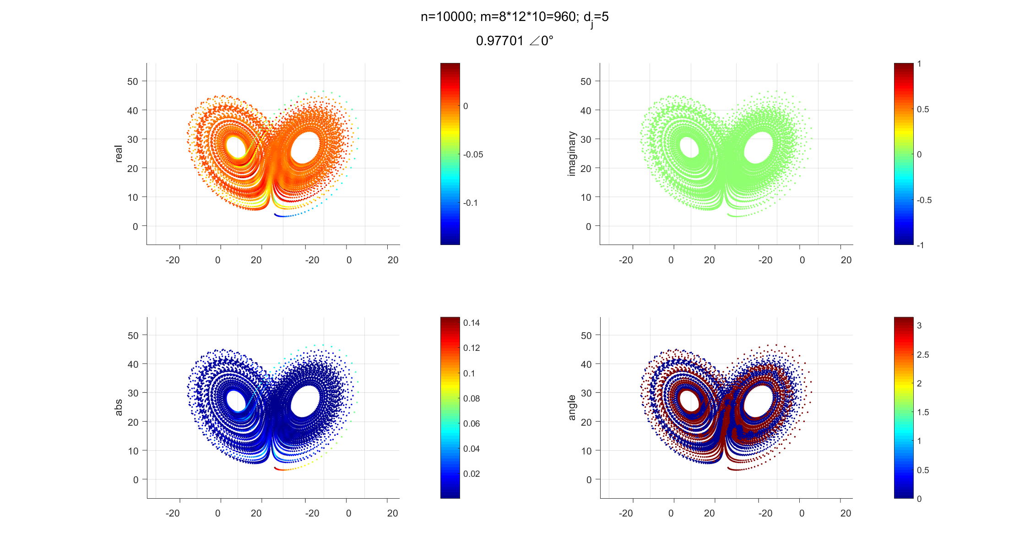
Koopman eigenfunctions of Lorenz System

