Slide 1
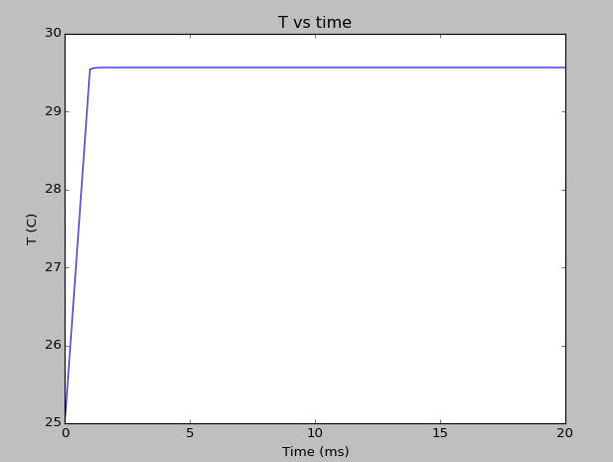
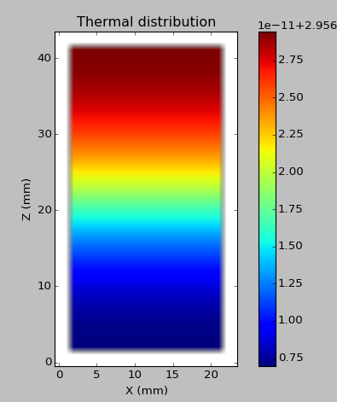
I = 50 mA V = 2.5 V,
heating turned of after 1 ms
Z (10x um)
X (10x um)

Slide 2
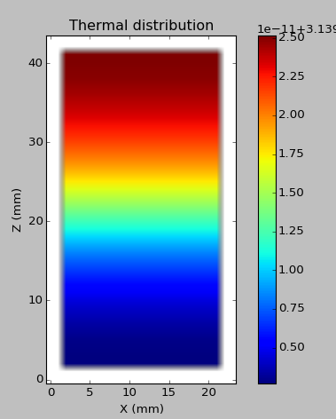
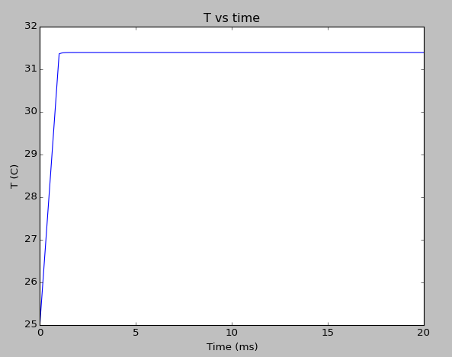
I = 70 mA V = 2.5 V,
heating turned of after 1 ms
Z (10x um)
X (10x um)

Slide 3
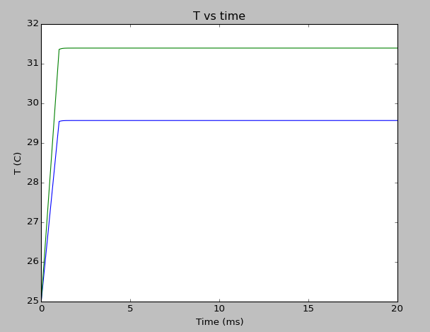
I = 70 mA V = 2.5 V,
heating turned of after 1 ms
I = 50 mA V = 2.5 V,
heating turned of after 1 ms

Slide 4
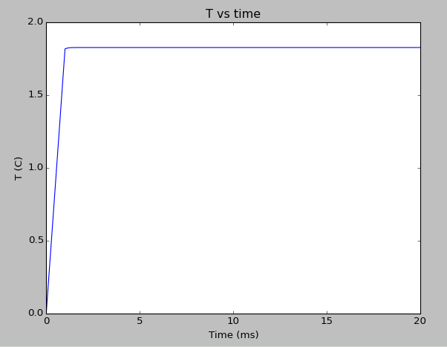
Temperature difference of I=70mA and I=50 mA vs time
Saturates at 1.83 C

