Slide 1
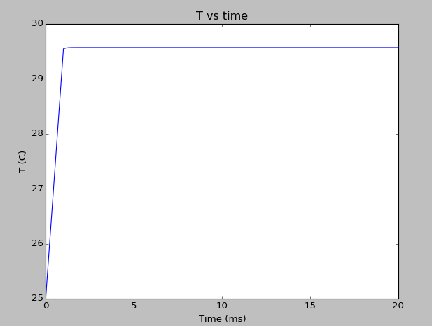
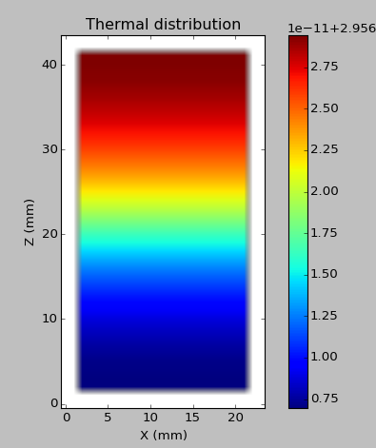
I = 50 mA V = 2.5 V,
heating turned of after 1 ms
Z (10x um)
X (10x um)

Slide 2
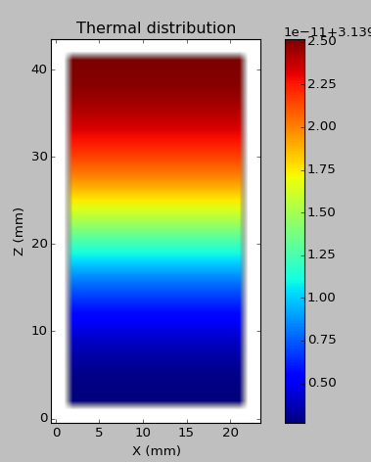
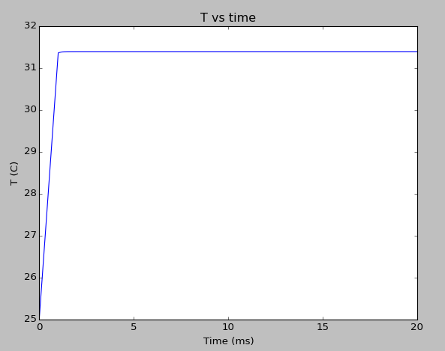
I = 70 mA V = 2.5 V,
heating turned of after 1 ms
Z (10x um)
X (10x um)

Slide 3
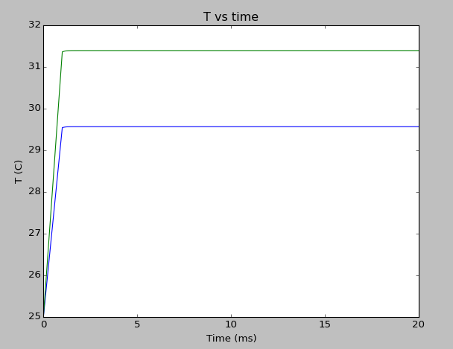
I = 70 mA V = 2.5 V,
heating turned of after 1 ms
I = 50 mA V = 2.5 V,
heating turned of after 1 ms

Slide 4
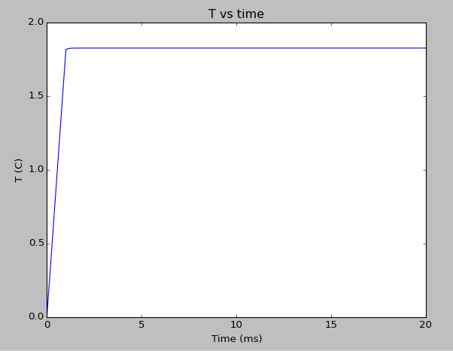
Temperature difference of I=70mA and I=50 mA vs time
Saturates at 1.83 C

Slide 5
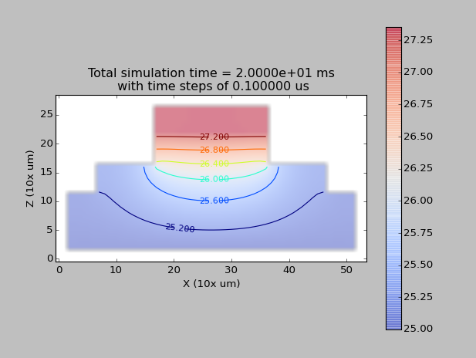
Ilow = 0 mA, Ihigh = 16mA
LED
Lead Frame
IMS

Slide 6
L = 30
a = int(20)
b = a
c = 40
voxel_L = 10*1e-6 * 100 # 10 um to cm
voxel_volume_cm3 = voxel_L**3.0 # cm3
I = 16e-3 # amp
V = 2.5 # volt
C_joul_per_gram = 0.33 # J g-1°C -1
rho_GaAs = 5.317 # g/cm^3
print rho_GaAs
rho_c = C_joul_per_gram*rho_GaAs # joul/cm^3/C
Q = I * V/voxel_volume_cm3 # Joul/s
print 'Q = %.4e J/cm3/s' % (Q,)
heat_fraction = 1
heat_source = Q/(rho_GaAs * C_joul_per_gram) * heat_fraction
D_val = 3.1e-5 # m^2/s
A0 = 20
x_star = float(a)/1000.0
y_star = x_star
boundary_temp = 25
mfactor = 1
model1 = mm.MKModel(model_id= 1, model_size=(10,50,50), D = 1.2e-5, initial_condition = 25) # IMS-PCB Alu
model2 = mm.MKModel(model_id= 2, model_size=(5, 40, 40), D = 3.4e-7, initial_condition = 25) # Lead Frame
model3 = mm.MKModel(model_id= 3, model_size=(10, 20, 20), D = 3.1e-5, initial_condition = 25) # GaAs P-N junction semiconductor
model4 = mm.MKModel(model_id= 4, model_size=(10, 20, 20), D = 3.1e-5, initial_condition = 25) # GaAs P-N junction semiconductor
main_system = mm.MKMultiMaterialSystem(base_model = model1, delta_pos=voxel_L, delta_time= 1e-8, time_step_scaling = 1,\
padding=(3, 0.2, 0.2))
main_system.addModel(model2, onTopOfObject=model1)
main_system.addModel(model3, onTopOfObject=model2, placement_position=(0,0,0))

Slide 7
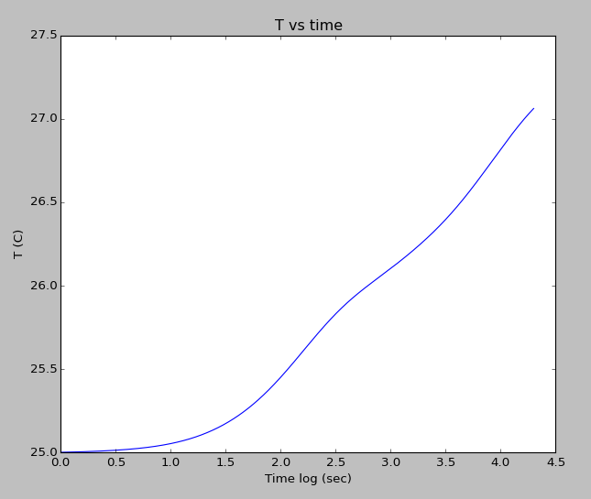
LED temperature

Slide 8
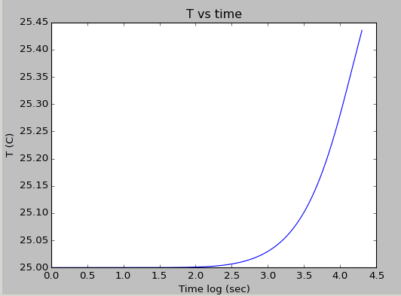
Lead Frame Temperature

Slide 9
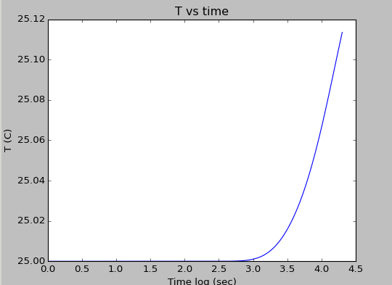
IMS temperature

Slide 10
Plastic Material Thermal Diffusivity DataPlasticSpecific Heat(J/kg*K)Specific Heat(J/g*K)Thermal Conductivity(W/m*K)Density(g/cm^3)Thermal Diffusivity(mm^2/s)Thermal Diffusivity(in^2/hr)ABS 1468 1.47 0.18 1.02 0.120.67PC/ABS 1300 1.30 0.23 1.18 0.150.84PA 1700 1.70 0.26 1.15 0.130.74POM 1500 1.50 0.23 1.41 0.110.61PS 1300 1.30 0.15 1.05 0.110.61PC 1200 1.20 0.21 1.19 0.150.82PEEK 1340 1.34 0.25 1.30 0.140.80PBT 1750 1.75 0.25 1.43 0.100.56PVC 1005 1.01 0.21 1.45 0.140.80PPS 1800 1.80 0.16 0.89 0.100.56PE 1200 1.20 0.12 0.93 0.110.60PMMA 1450 1.45 0.18 1.22 0.100.57PET 1275 1.28 0.28 1.35 0.160.89PEI 2000 2.00 0.22 1.31 0.080.47

Slide 11
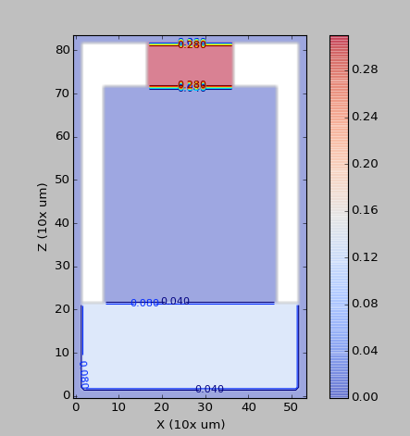

Slide 12
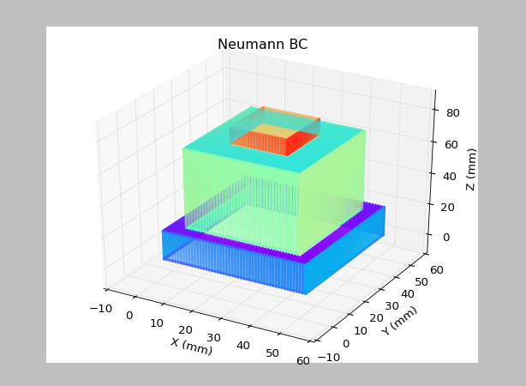

Slide 13
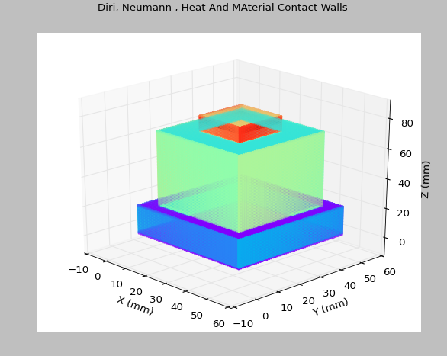

Slide 14
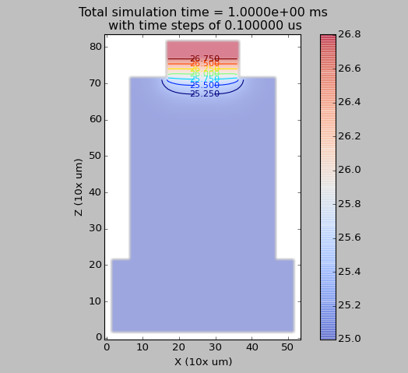

Slide 15
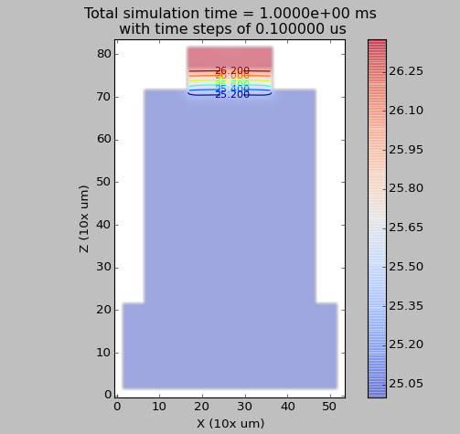

Slide 16
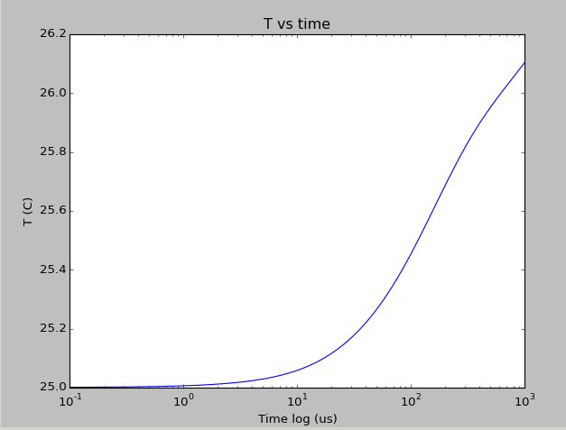
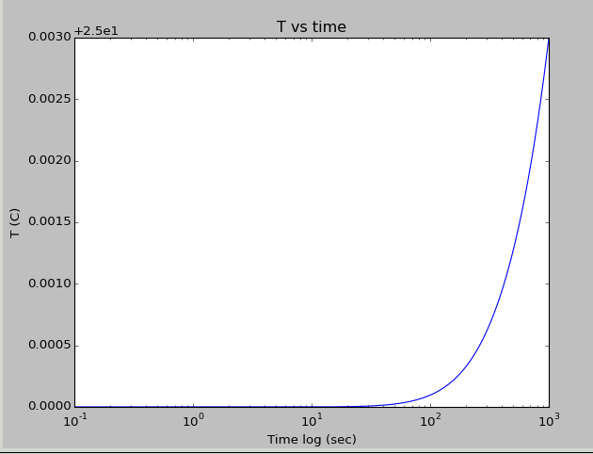
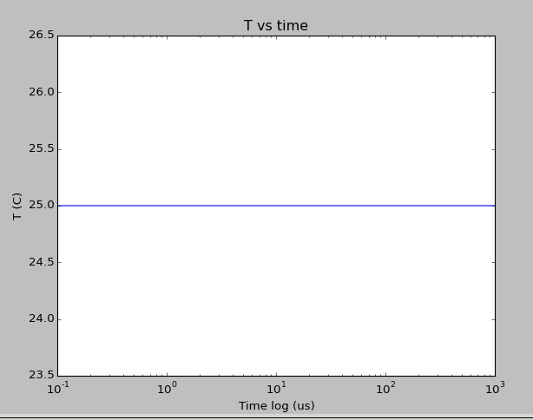
LED
LF
IMS

Slide 17
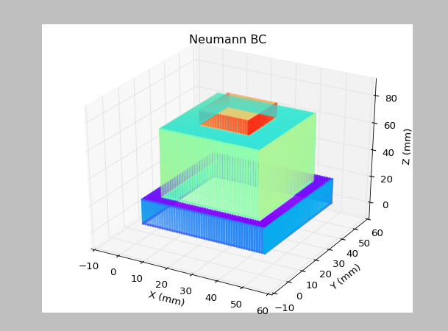

Slide 18
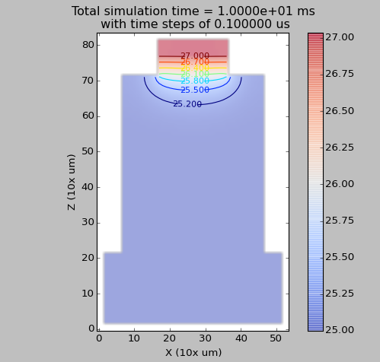

Slide 19
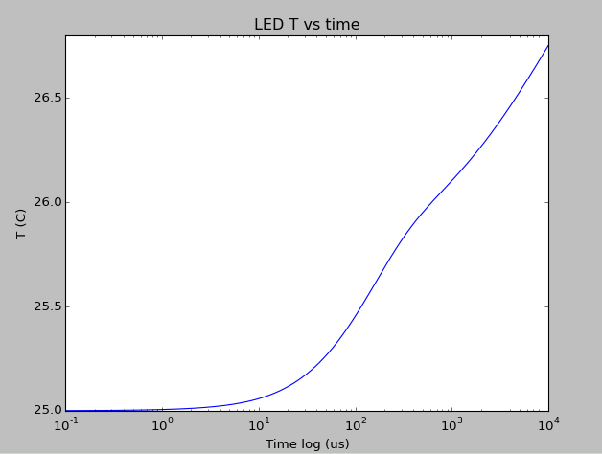
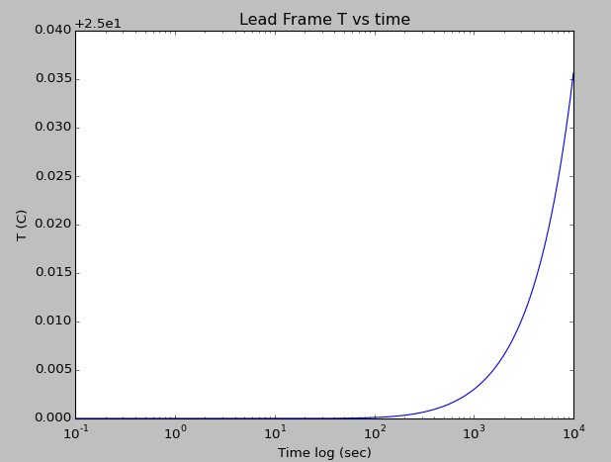

Slide 20
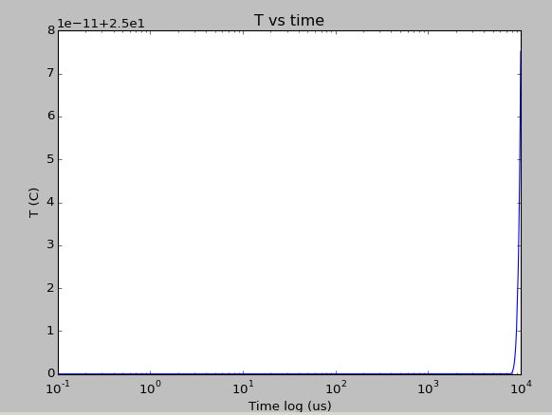

Slide 21
voxel_L = 10*1e-6 * 100 # 10 um to cm
voxel_volume_cm3 = voxel_L**3.0 # cm3
led_volume = 4e-6 # cm3
I = 16e-3 # amp
V = 2.5 # volt
C_joul_per_gram = 0.33 # J g-1°C -1
rho_GaAs = 5.317 # g/cm^3
print rho_GaAs
rho_c = C_joul_per_gram*rho_GaAs # joul/cm^3/C
Q = I * V #/voxel_volume_cm3 # Joul/s
print 'Q = %.4e J/cm3/s' % (Q,)
heat_fraction = 1
heat_source = Q/(rho_GaAs * C_joul_per_gram) * heat_fraction
D_val = 3.1e-5 # m^2/s
A0 = 20
x_star = float(a)/1000.0
y_star = x_star
boundary_temp = 25
mfactor = 1
model1 = mm.MKModel(model_id= 1, model_size=(20, 50, 50), D = 1.2e-1, initial_condition = 25) # IMS-PCB Alu
model2 = mm.MKModel(model_id= 2, model_size=(10, 40, 40), D = 3.4e-1, initial_condition = 25) # Lead Frame... epoxy
model3 = mm.MKModel(model_id= 3, model_size=(10, 20, 20), D = 3.1e-1, initial_condition = 25) # GaAs P-N junction semiconductor

Slide 22
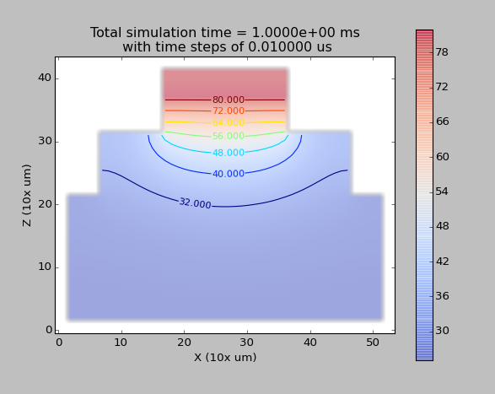

Slide 23
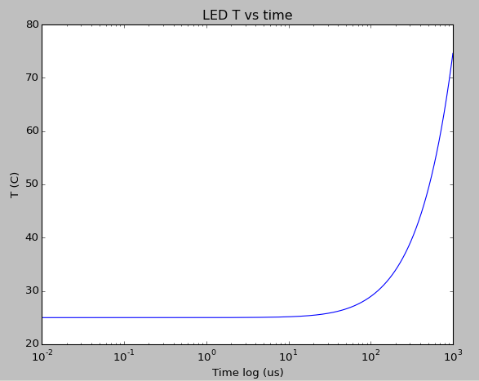
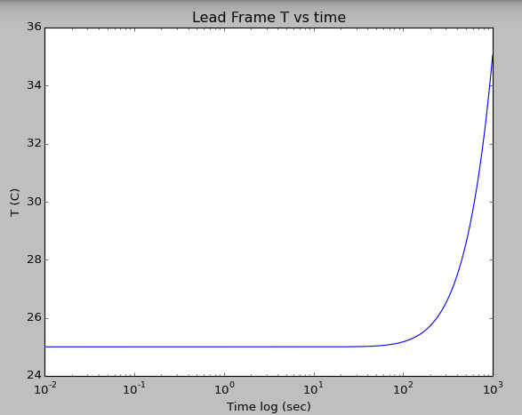
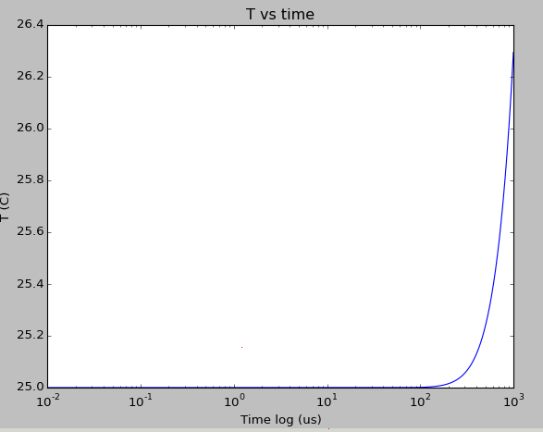
IMS

Slide 24
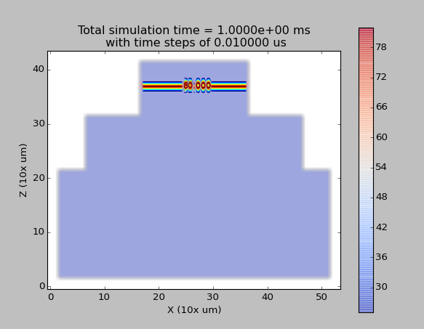
5

Slide 25
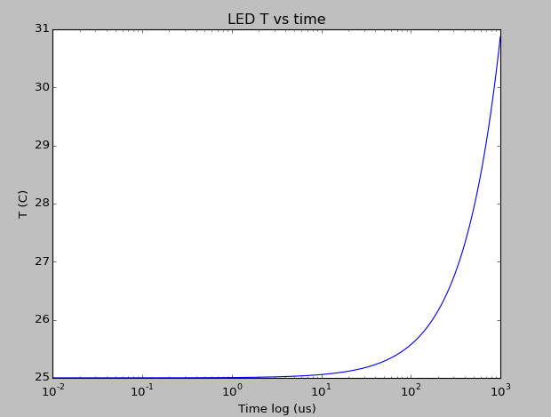
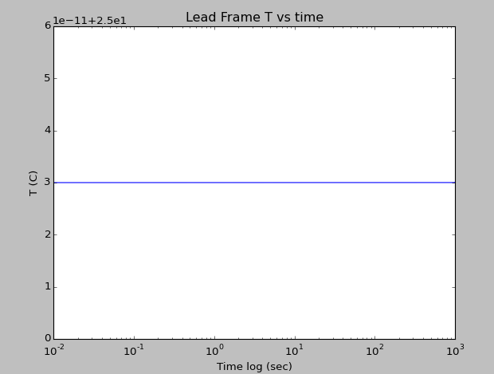
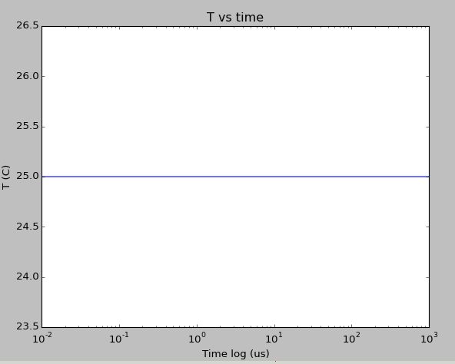

Slide 26
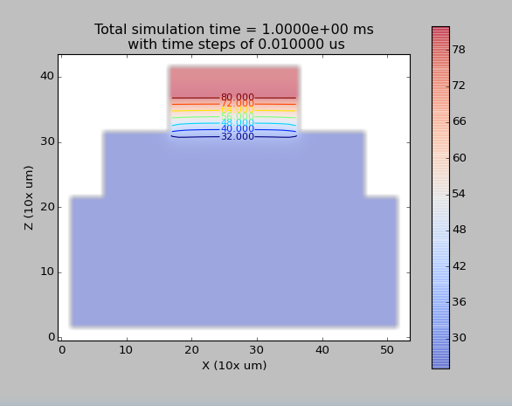
model1 = mm.MKModel(model_id= 1, model_size=(20, 50, 50), D = 1.2e-1, initial_condition = 25) # IMS-PCB Alu
model2 = mm.MKModel(model_id= 2, model_size=(10, 40, 40), D = 3.4e-3, initial_condition = 25) # Lead Frame... epoxy
model3 = mm.MKModel(model_id= 3, model_size=(10, 20, 20), D = 3.1e-1, initial_condition = 25) # GaAs P-N junction semiconductor

Slide 27
