Slide 1
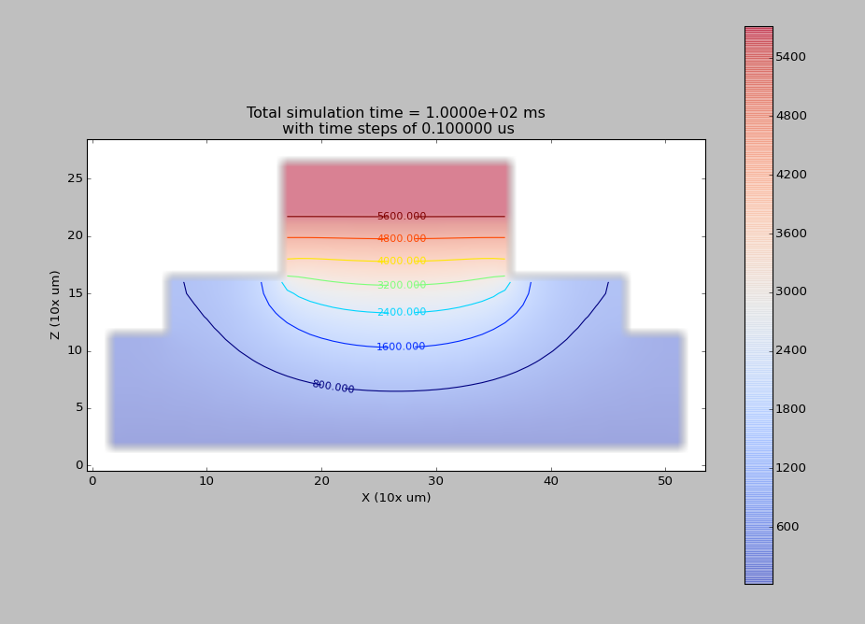

Slide 2
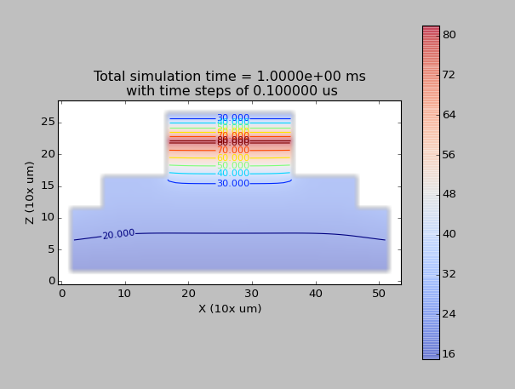
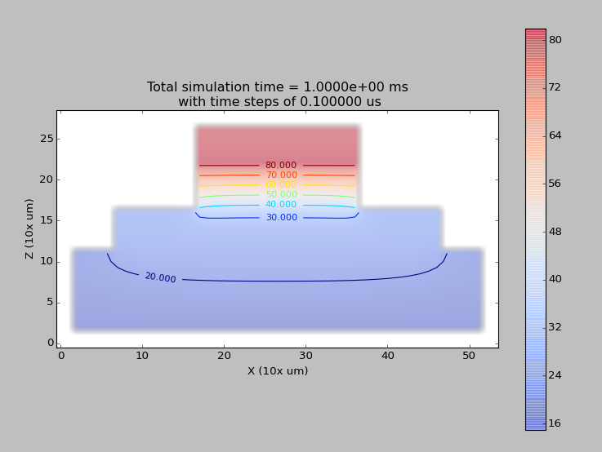
D
No Neumann
Diri_z_bottom = 15
With neumann

Slide 3
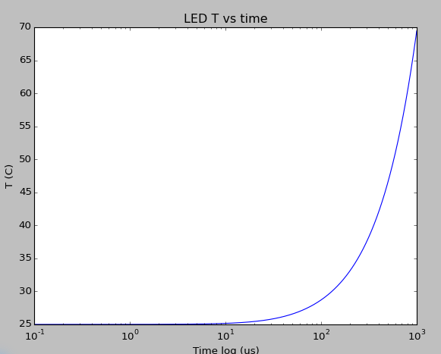
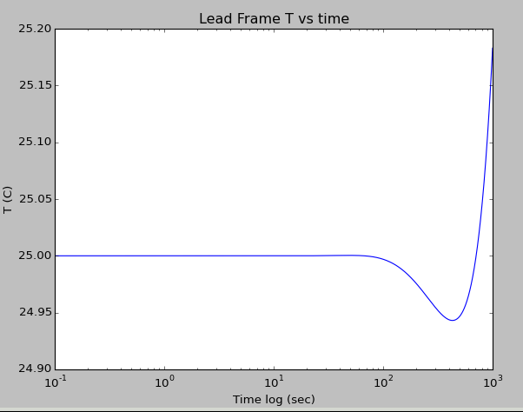
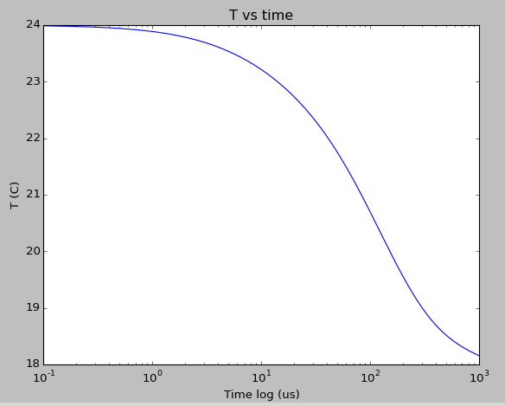
With neumann
IMS

Slide 4
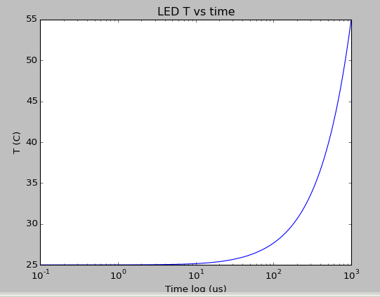
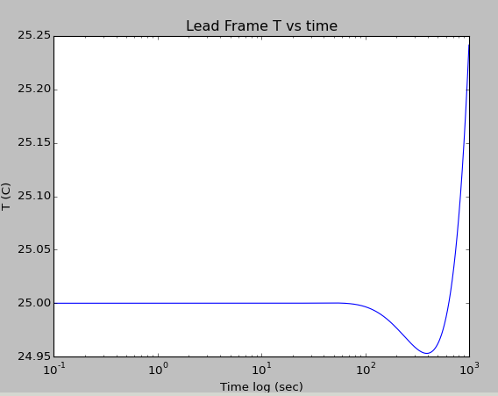
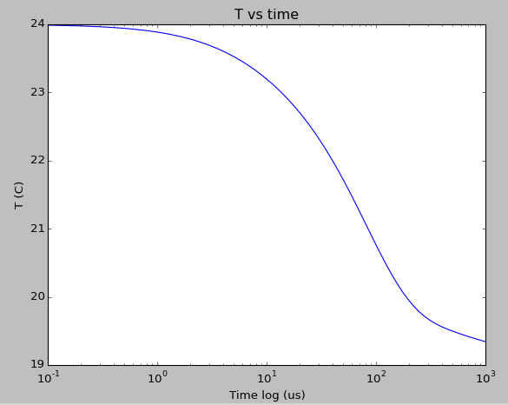
Without Neumann

Slide 5
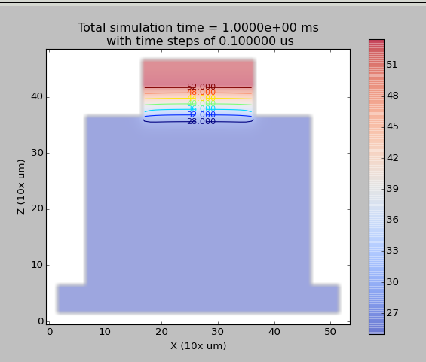

Slide 6
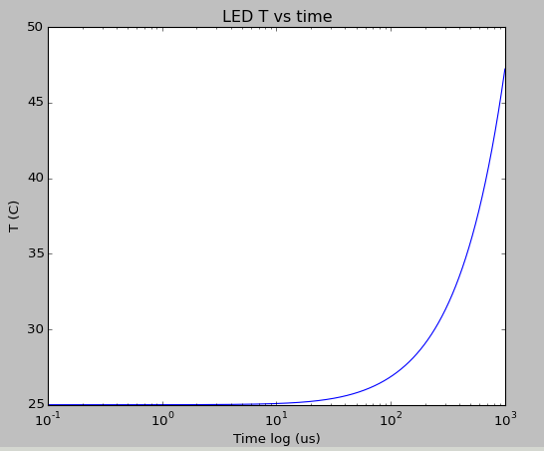
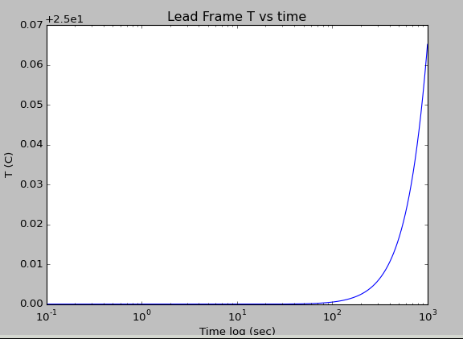
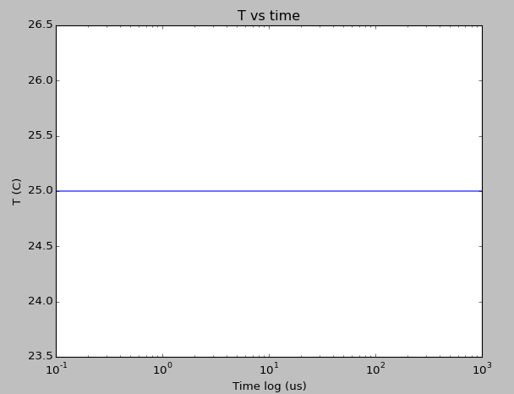

Slide 8
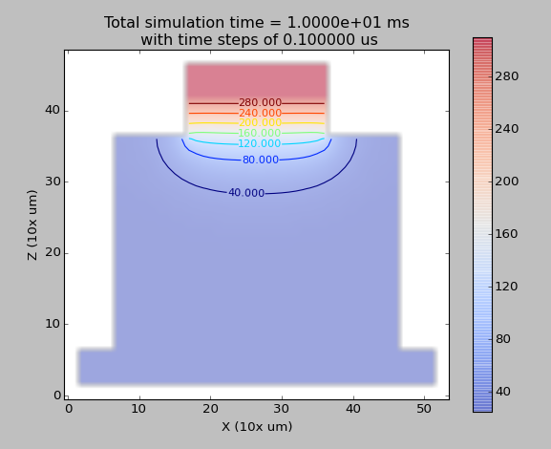
D_LED = 3.1e-5 m2/s
D_LF = 3.4e-7 m2/s
D_IMS = 1.2 e-5 m2/s
Dirichlet = 25 C at the bottom
Every other wall is Neumann du/dt = 0

Slide 9
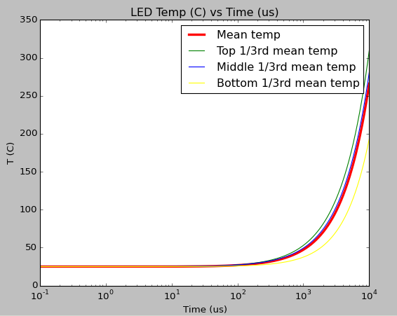
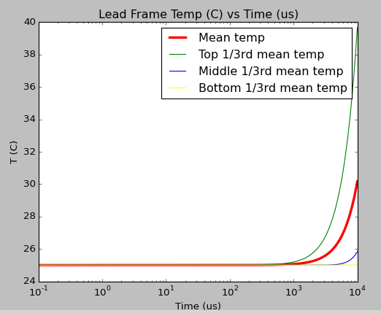
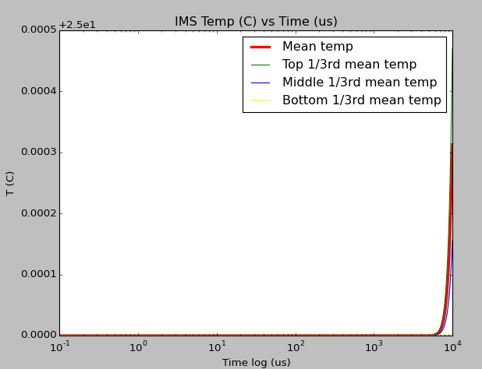

Slide 10
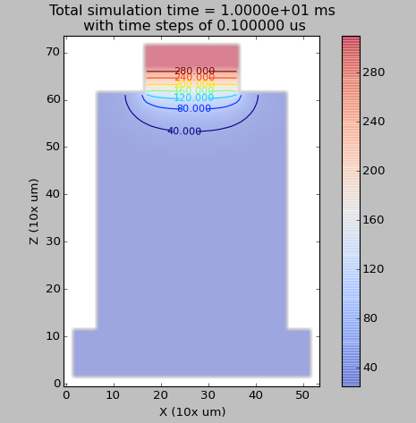
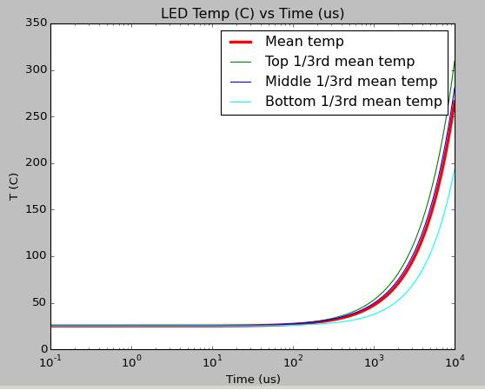
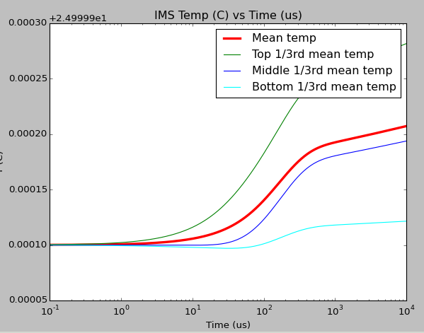
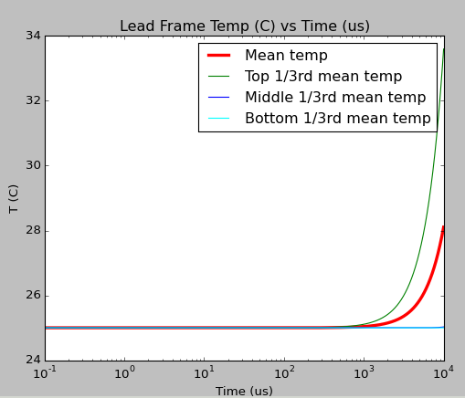
Neumann = 0.1 C/s
Diri = 25 bottom

Slide 11
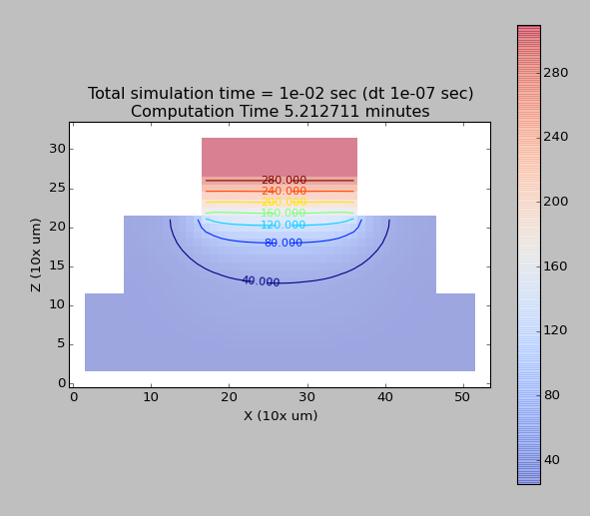
D_bottom = 25 C
Rest is neumann 0

Slide 12
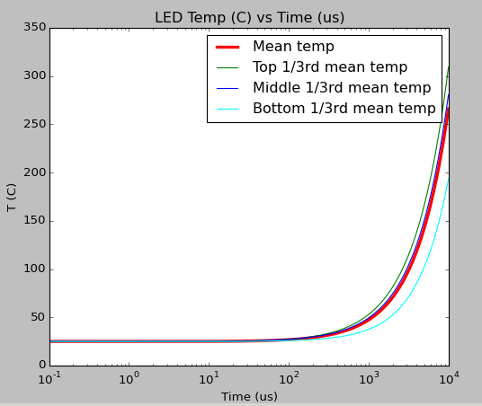
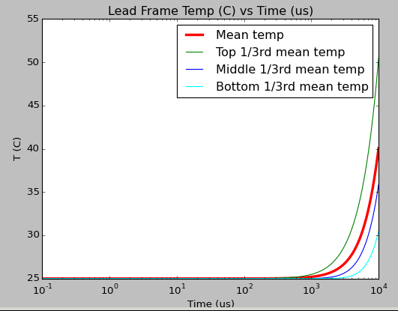
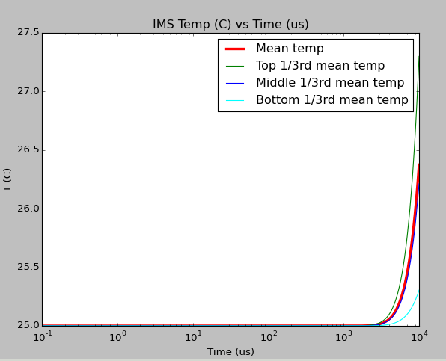

Slide 13
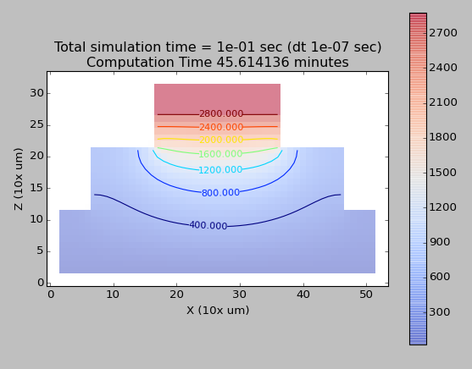
Diri = 25C at the bottom
Neumann = 0

Slide 14
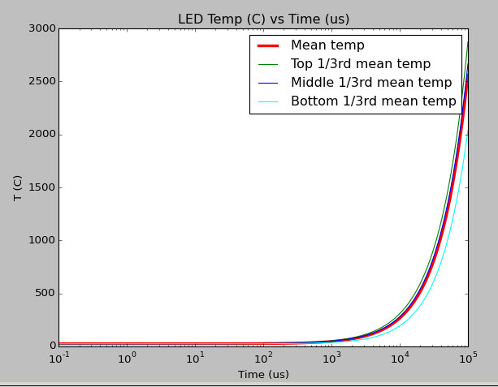
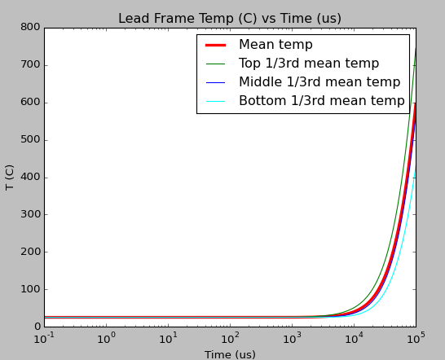
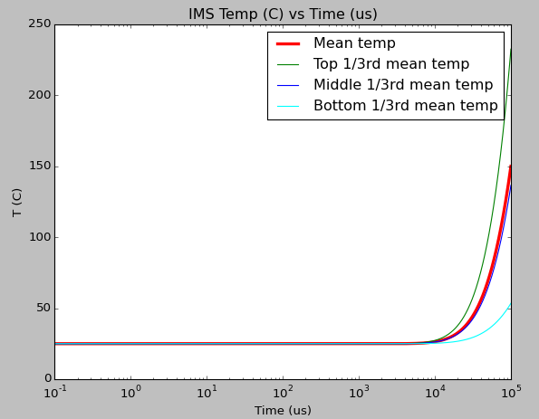

Slide 15
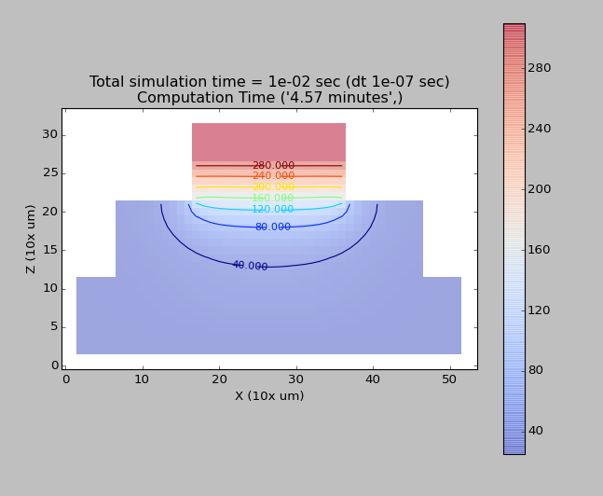
Neumann 0
Diri bottom = 25
50% of 16mA 2.5 V, ---> 20mW

Slide 16
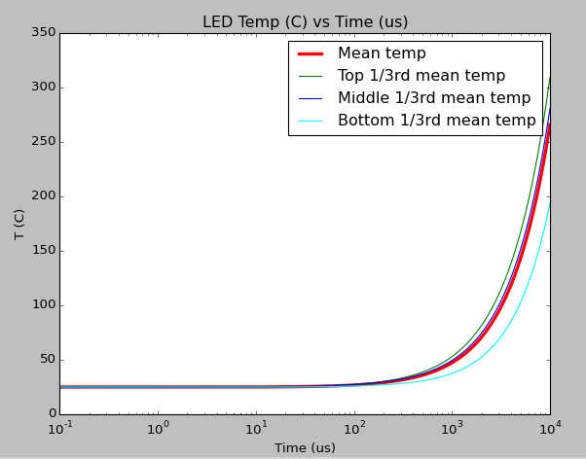
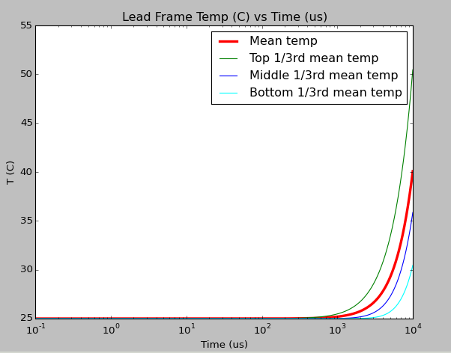
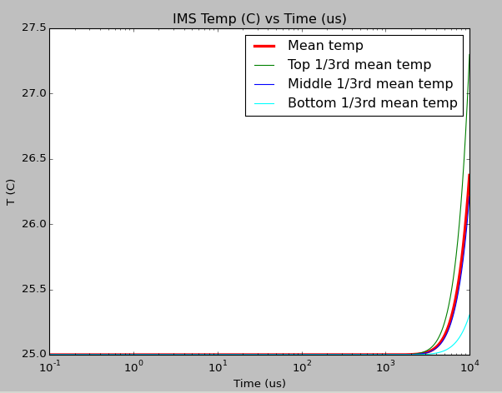

Slide 17
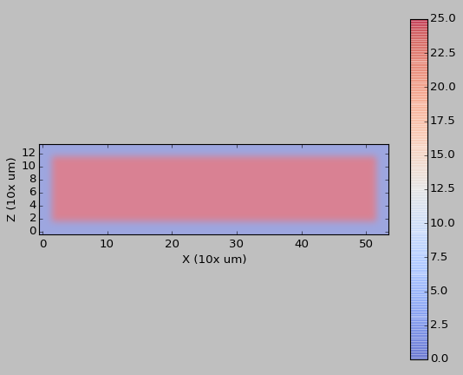
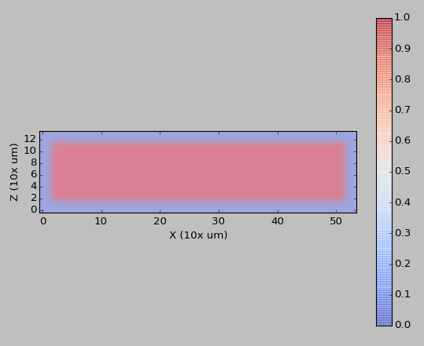
Simple system
No Dirichlet BC, Neumann = 0
50% of 16 mA, 2.5V, Power 20 mW
Volume 500x500x100 um3

Slide 18
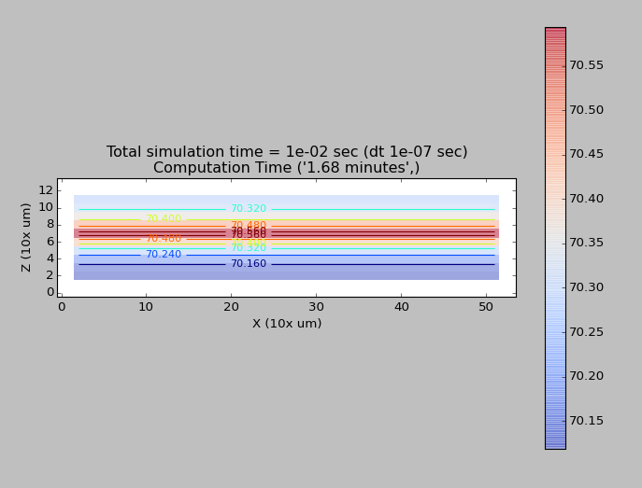
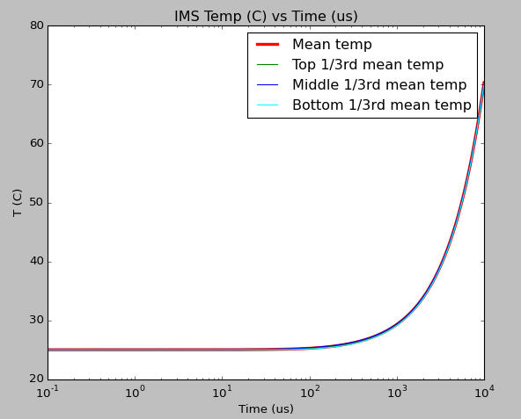

Slide 19
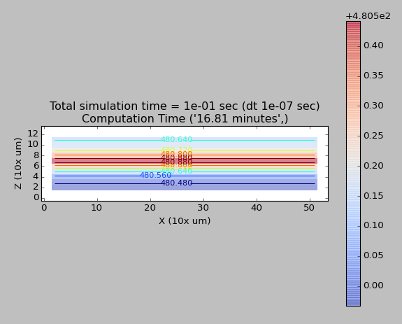
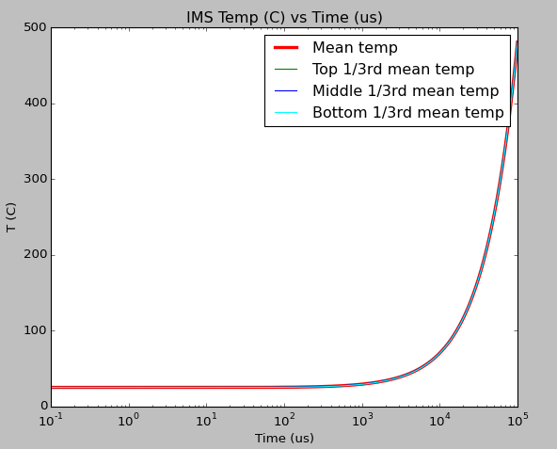

Slide 20
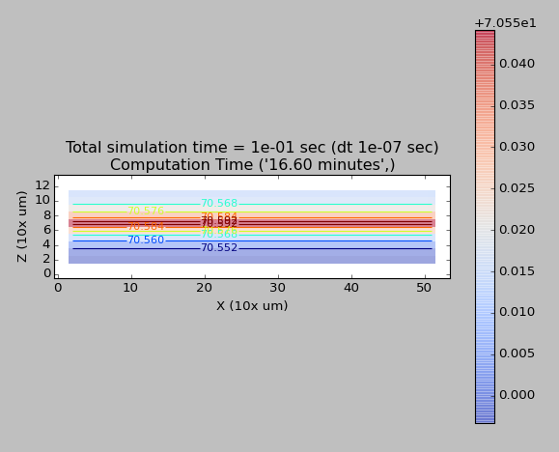
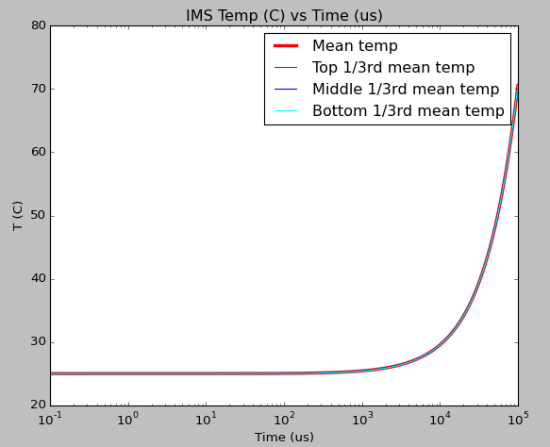
Heat source is divided by entire volume 500x500x100 um3
But heat is generated at the red plane

Slide 21
Simple system
No Dirichlet BC, Neumann = 0
50% of 16 mA, 2.5V, Power 20 mW
Volume 500x500x100 um3

Slide 22
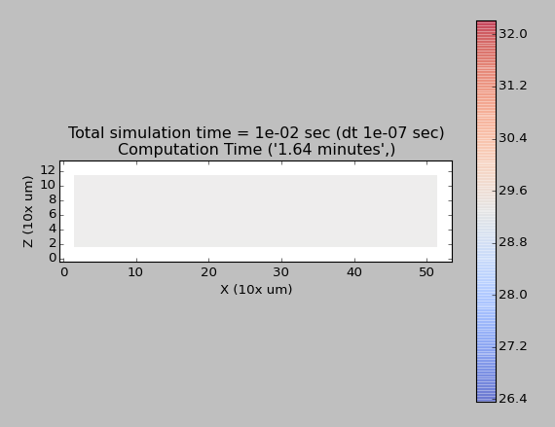
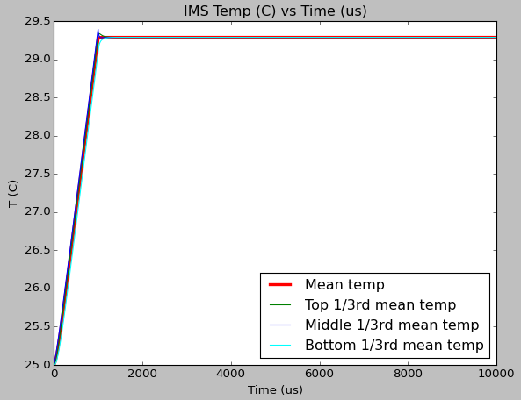
Heat source turned off at 10e-3 second
No Dirichlet BC, Neumann = 0
50% of 16 mA, 2.5V, Power 20 mW
Volume 500x500x100 um3
Heat source turned off at 10e-3 second

Slide 23
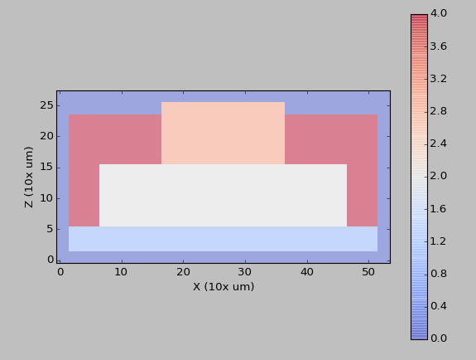
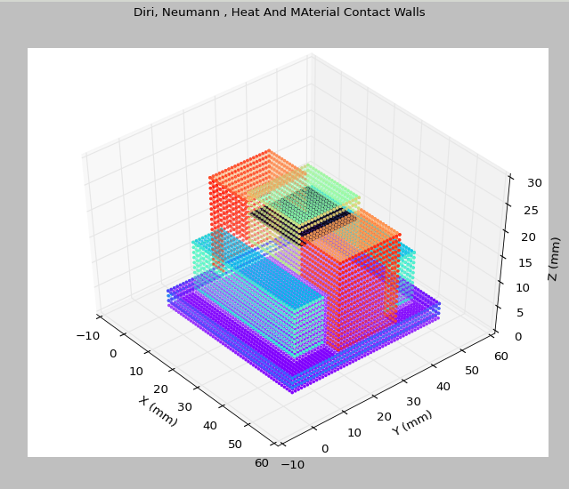
Gold connector added
XZ-plane at y = 35

Slide 24
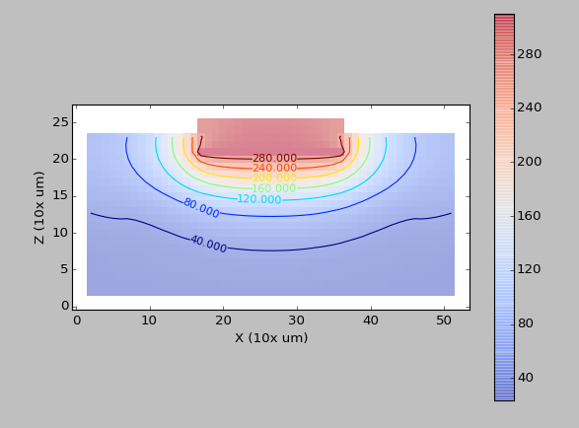
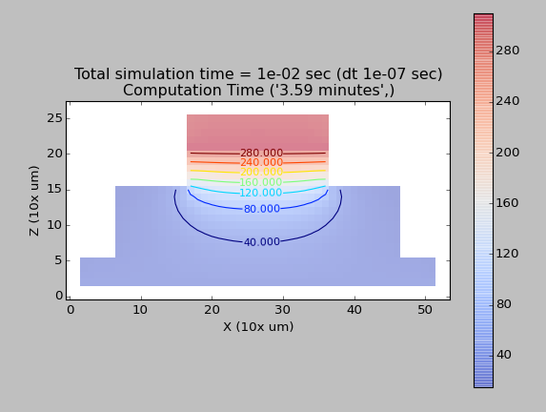
YZ Section
XZ Section
Neumann 1000
Diri 25

Slide 25
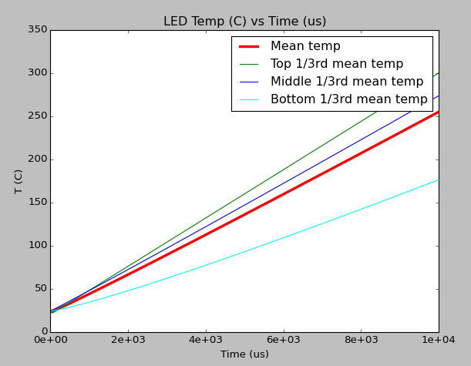
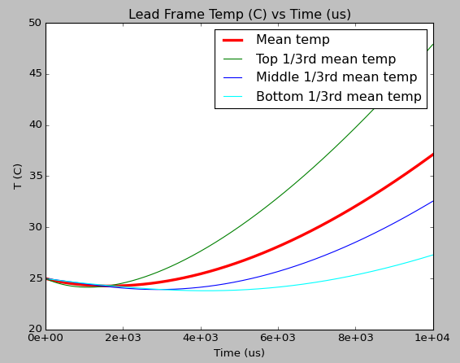
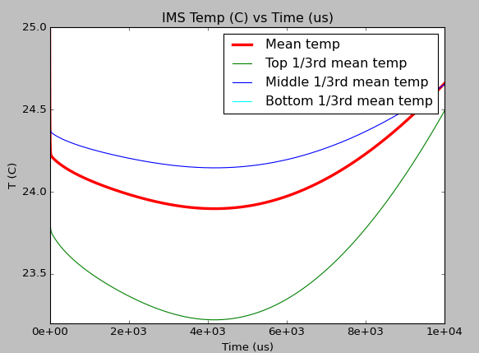

Slide 26


Neumann 0
Diri 25

Slide 27




Slide 28


Diri 25
Initial temp = 25
Neumann 0
Power 16mA*2.5V = 40 mW

Slide 29




Slide 30


Assuming that the whole LED is a heat source

Slide 31




Slide 32



Slide 33


For GaAs
BB r ~ T4-T04
Convection ~ T-T0
At 200 C
DT/dt = 0.1 C/ms
With convection
At 200 C
DT/dt = 0.01 C/ms
With BB radiation

Slide 34


Diri 25
Initial temp = 25
Neumann 0
Power 16mA*2.5V = 40 mW

Slide 35




Slide 36


Diri 25
Initial temp = 25
Neumann 0
10% of Input Power 16mA*2.5V = 40 mW = 4 mW

Slide 37




Slide 38




Slide 39


With blackbody radiation decay and newtons convection decay

Slide 40




