Slide 1


Evaluation Services
The Office of Evaluation Services (ES) at the
Southwest Educational Development Laboratory
(SEDL) designs and implements evaluation plans
for SEDL's major projects. The Office of Evaluation
Services also provides programmatic evaluation for
external clients including schools, universities and
other educational entities.
Enhances client's ability to effectively achieve program goals and ensure that their programs, products, and services are of the highest quality and utility.

Slide 2


About SEDL
Non-profit corporation dedicated to improving teaching and learning for all children
37-year history supporting state improvement efforts in New Mexico and the Southwest
RD&D Programs
  Improving school performance
  Strengthening teaching & learning in content areas
  Involving family & community in student learning
  Integrating technology in learning
  Connecting disability research to practice
  Improving policy development through research
Core Capabilities
  Research and Evaluation
  Development
  Dissemination

Slide 3

Current Internal Projects
Currently, ES provides internal programmatic evaluation for the following projects:
The Regional Educational Development Laboratory (REL)
The Eisenhower Southwest Consortium for the Improvement of
Mathematics and Science Teaching (SCIMAST)
The SouthCentral Regional Technology in Education Consortium (SC-RTEC)
The Languages Other Than English Center for Educator Development
(LOTE CED)
The Southeast Comprehensive Assistance Center (SECAC).

Slide 4
Current External Projects
Currently, ES provides external programmatic evaluation for the following projects:
Howard University School of Medicine — to evaluate an NIH grant,
Project DiSH (Diabetes, Stroke, Hypertension).
Killleen ISD — to evaluate Project Integrate 2003, a technology integration model used in Killeen ISD and 16 other school districts funded by the Technology Applications Readiness Grants for Empowering Texas (TARGET)
Louisiana State University (LSU) In-School Math Labs Project — to evaluate a Louisiana Board of Regents grant to establish math labs in four middle and high schools in partnership with LSU and Southeastern Louisiana University (SLU)
National Staff Development Council (NSDC) — Project to develop an instrument
to be used by schools to measure the degree to which the school's professional development program adheres to NSDC's standards for staff development.
Oklahoma Professional Development Institute Evaluation — to evaluate all of the Professional Development Institutes implemented by the Oklahoma Commission of Teacher preparation and Oklahoma's National Board Certified Teacher Program.
Weslaco ISD — to evaluate a USDE Teaching American History program for a
three year grant.

Slide 5

Meeting Your Needs
Designing an Evaluation Plan — identifying evaluation questions that can be used to determine program success.
Collecting Data — using various methodological data collection methods (surveys, interviews, focus groups, observations, etc.).
Conducting Statistical and/or Qualitative Analysis — analyzing and synthesizing numerical or descriptive summaries of the information gathered.
Preparing Reports — writing progress and final reports to communicate useful information about program activities to decisionmakers.

Slide 6

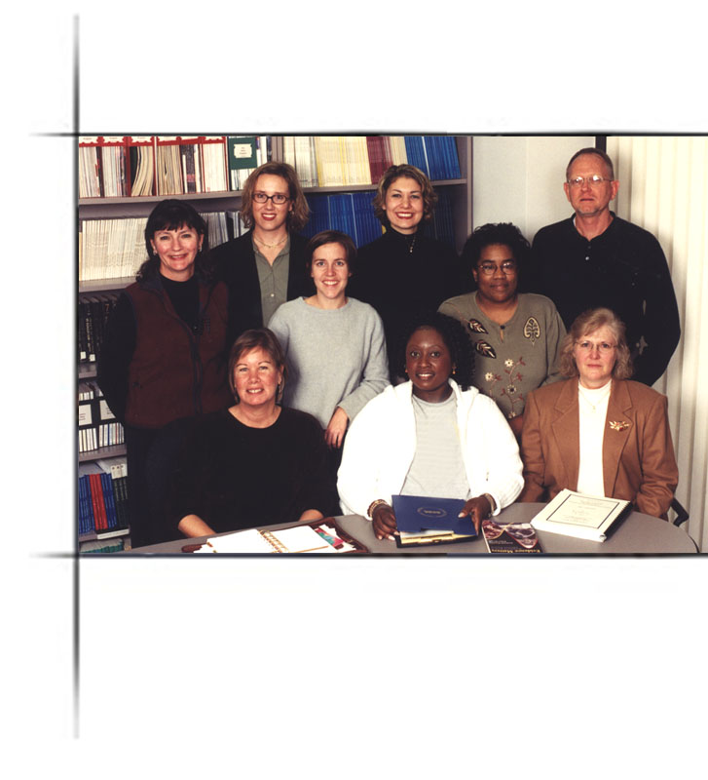
Contact Information
If you are interested in discussing external client services, please contact Dr. Sue Street at (512) 476-6861, x. 297 or sstreet@sedl.org.
Southwest Educational Development Laboratory
The Office of Evaluation Services
211 East Seventh Street (Second Floor)
Austin, Texas 78701-3281
(800) 476-6861 or (512) 476-6861

