Slide 1
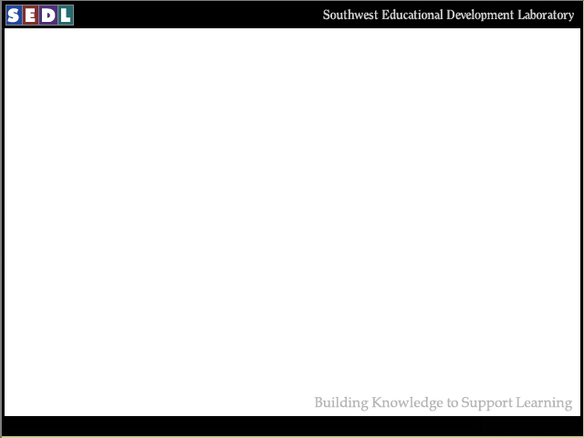
Southwest Educational Development Laboratory
Building knowledge to support learning

Slide 2

Office of Institutional Communications
Positions SEDL as a key resource for
research-based products, information, and expertise
Supports SEDL staff in the development and production of
print and non-print resources
Supports communications with key publics about SEDL’s RD&D work

Slide 3
Communications Objectives
To meet our goals, SEDL communications professionals carry out the following
objectives:
Communicate with internal and external publics about SEDL’s RD&D work
Serve as in-house consultants to SEDL staff
Project coherent corporate identity and deliver consistent messages
Extend outreach to potential and current customers

Slide 4
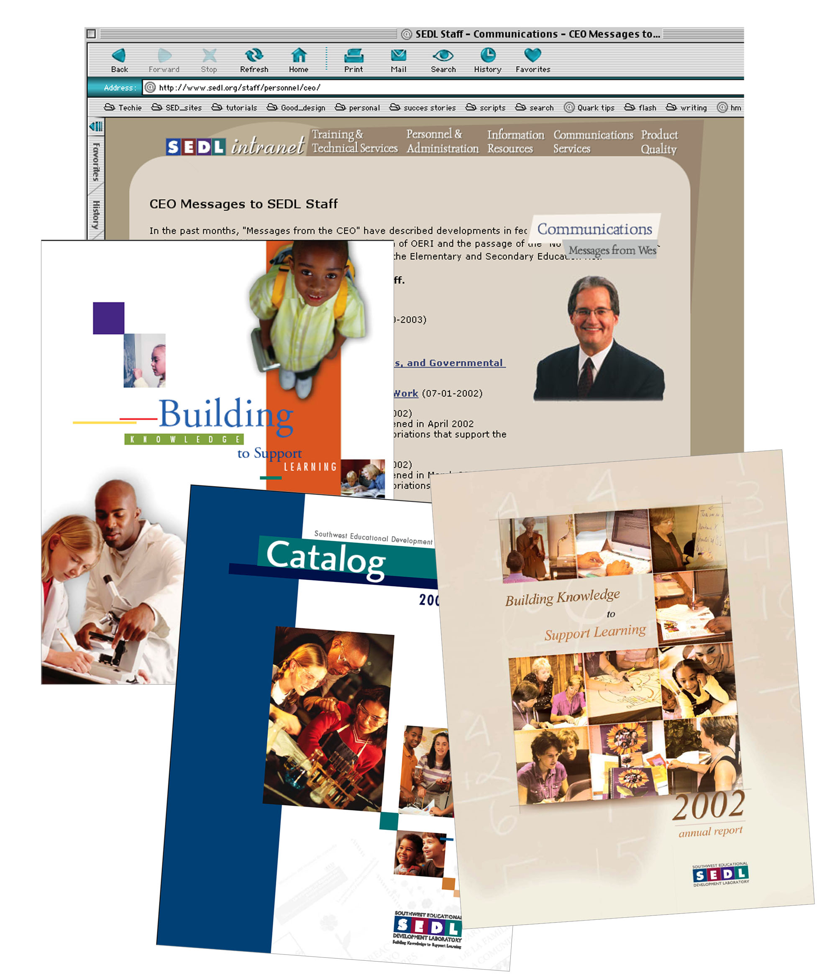
Project Coherent Corporate Identity
Communications staff have accomplished the
following activities that address this objective:
Designed new logo for print and Web
Redesigned stationery
Designed corporate folder
Completed 2002 Annual Report
Supported “Messages from the CEO”
for corporate intranet
Communications support for government relations
Maintain consistent look of corporate brand elements on corporate Web presences
Developed and maintain online version of SEDL style guidelines

Slide 5
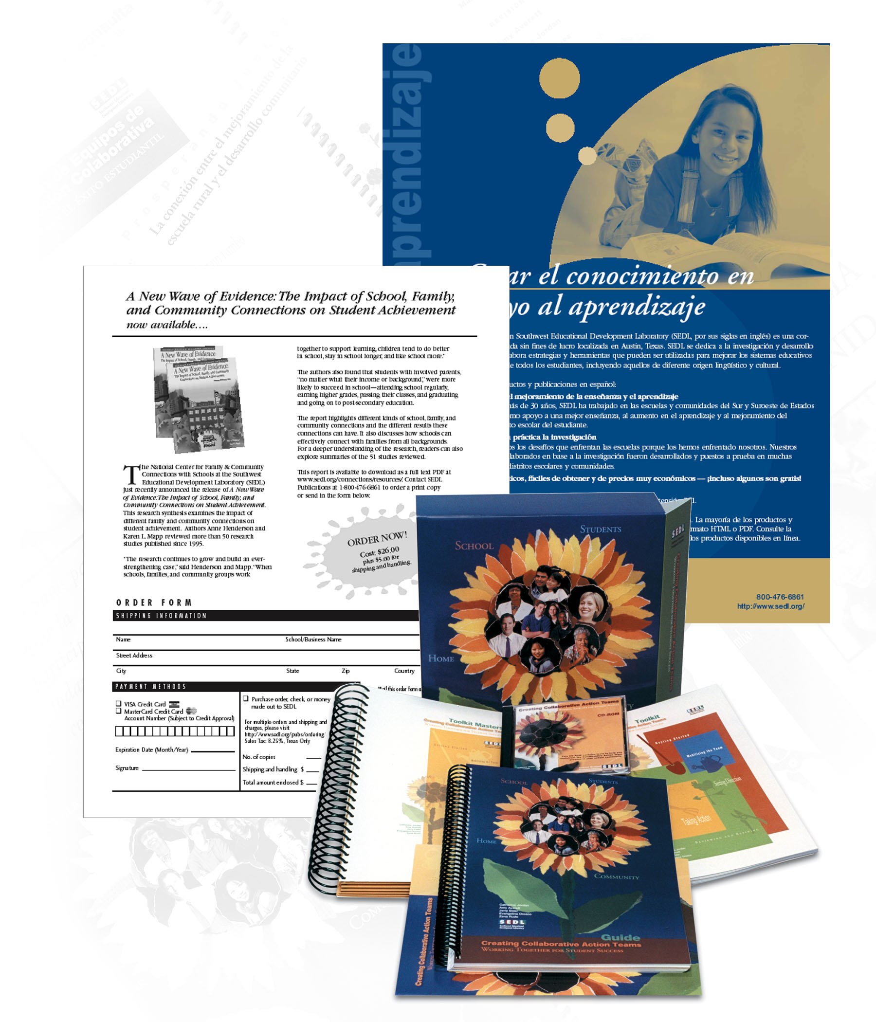
Extend Outreach to SEDL’s Customers
OIC staff accomplished the following activities to reach
SEDL customers:
Developed collateral materials to promote
targeted products
Updated online product catalog
Promote using Bulletin@sedl.org
Revised corporate exhibit
Corporate presence at selected conferences
1st quarter sales 59% over same quarter, 2002
Developed collateral materials, Web presences for professional development, evaluation services

Slide 6
First Quarter Sales FY03
SEDL outreach and sales promotion have resulted in the following sales compared by quarter:
2001 2002 2003
1st Quarter $9,225.35 $21,540.15 $34,164.40
2nd Quarter $21,921.55 $40,063.77
3rd Quarter $17,369.95 $31,293.33
Total Sales $70,359.78 $117,517.55

Slide 7
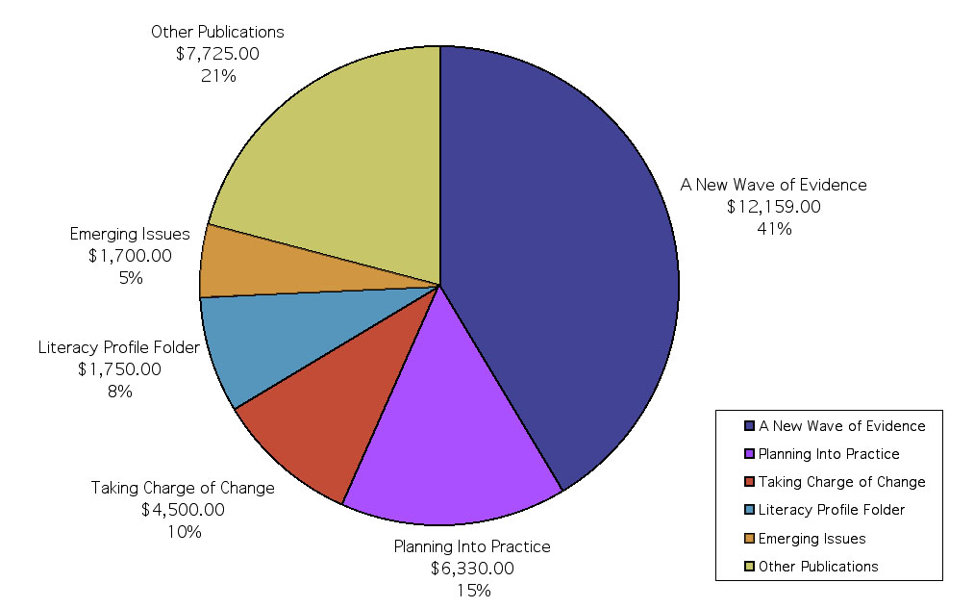
Top Publication Sales (First Quarter FY03)

Slide 8
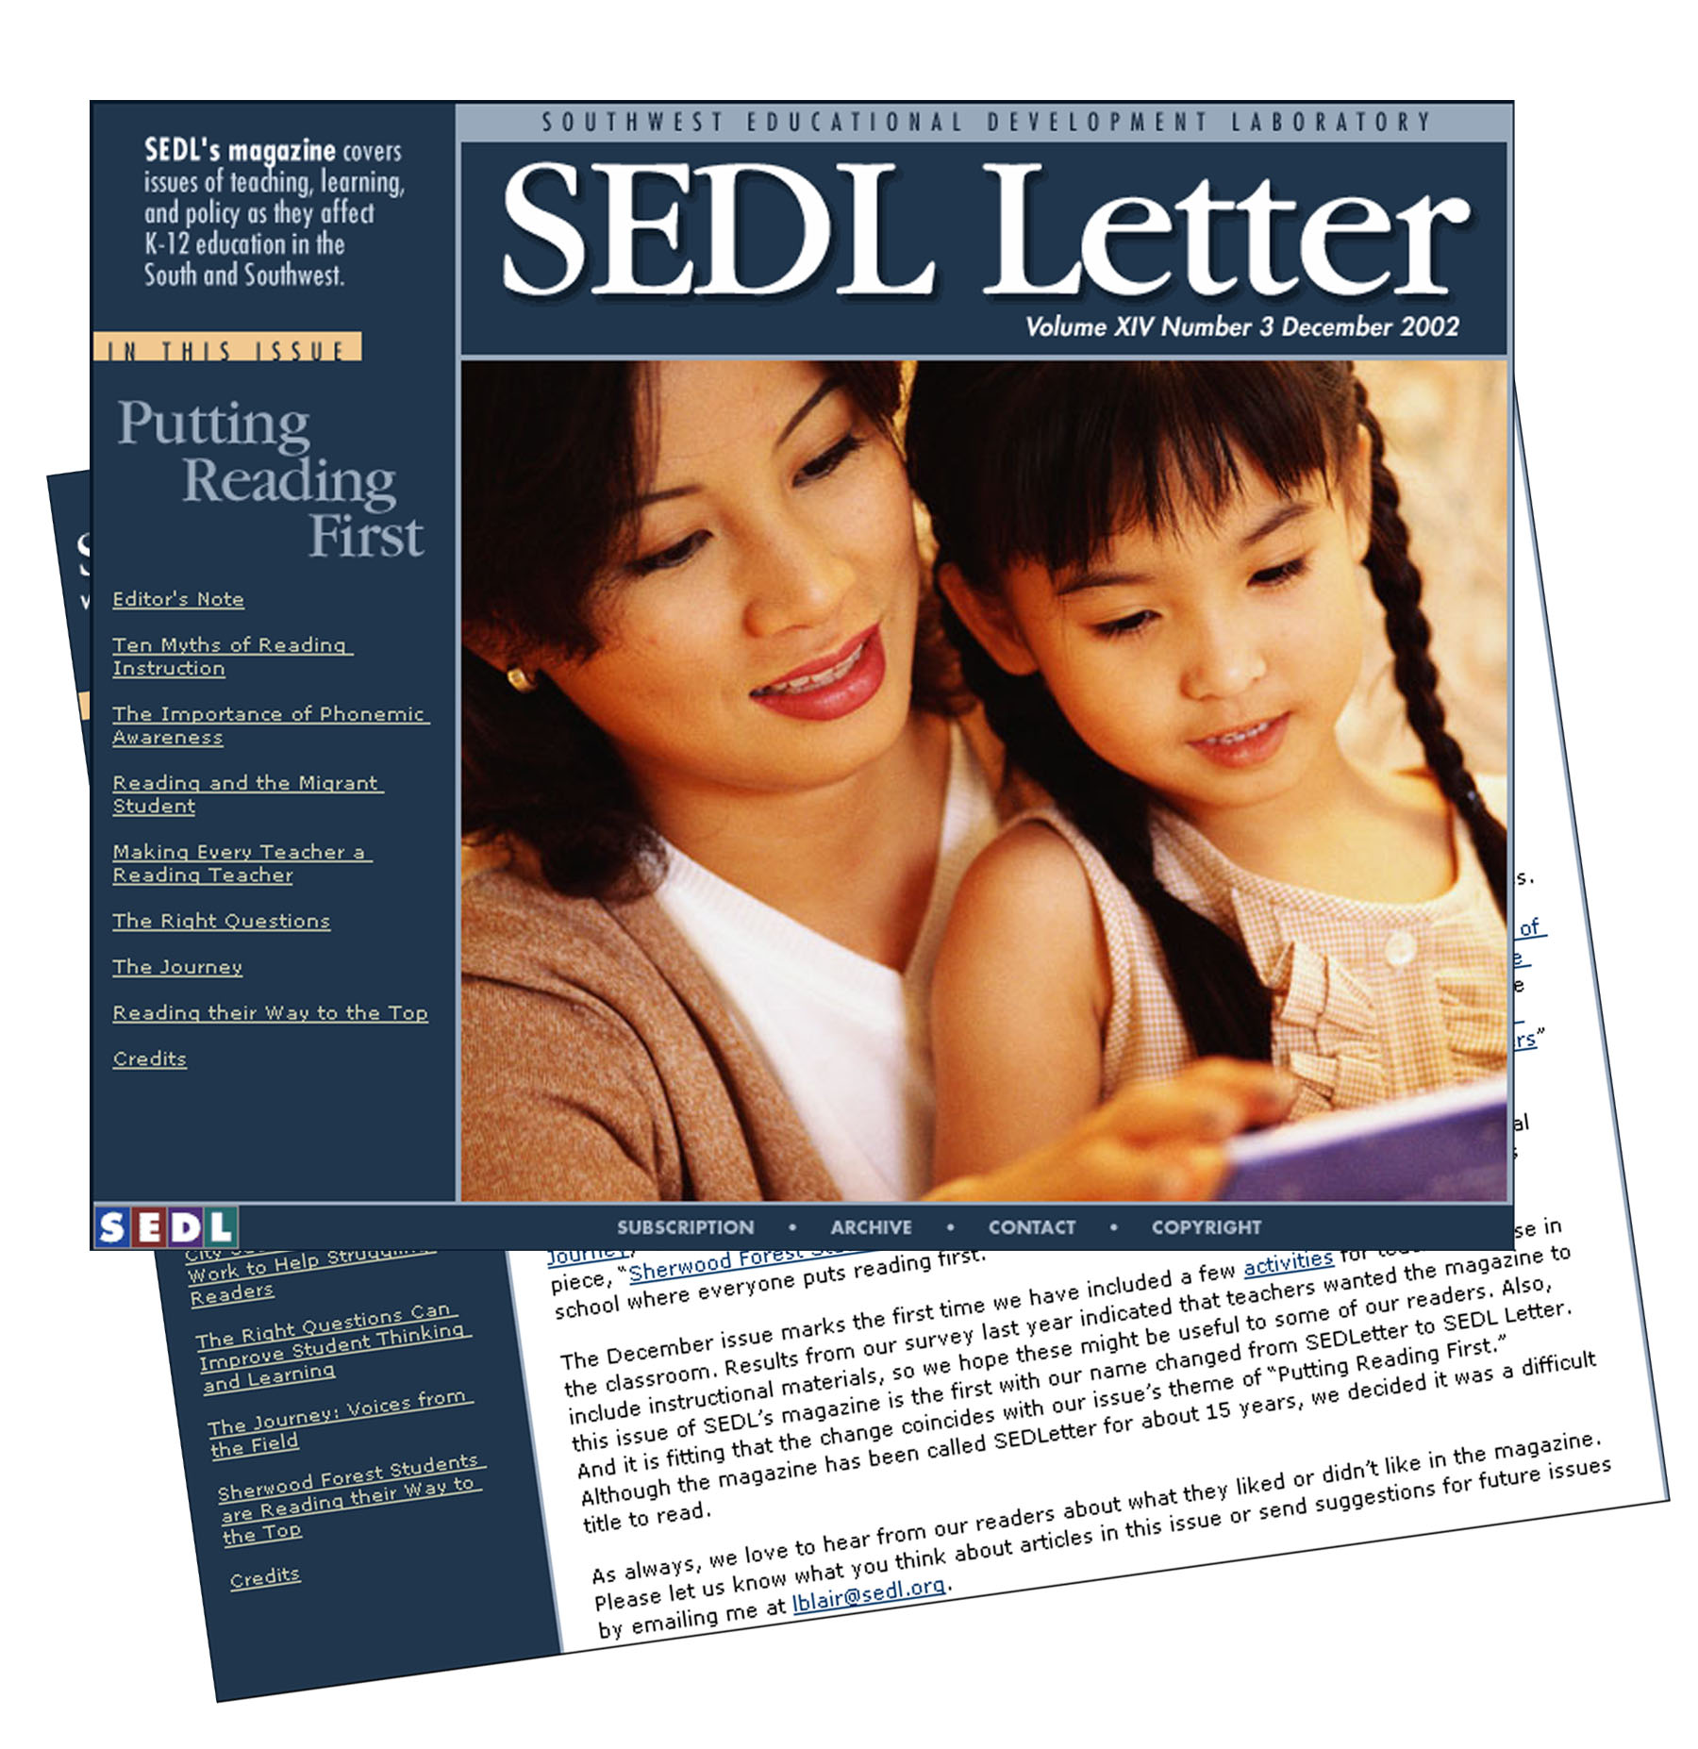
Communicate with Key Publics
OIC staff accomplished the following activities to communicate with internal and external publics about SEDL’s RD&D work:
Redesigned logotype for SEDL Letter, institutional magazine
Designed new SEDL Letter database, online template to increase access to SEDL content
Focused editorial mix to focus on RD&D

Slide 9
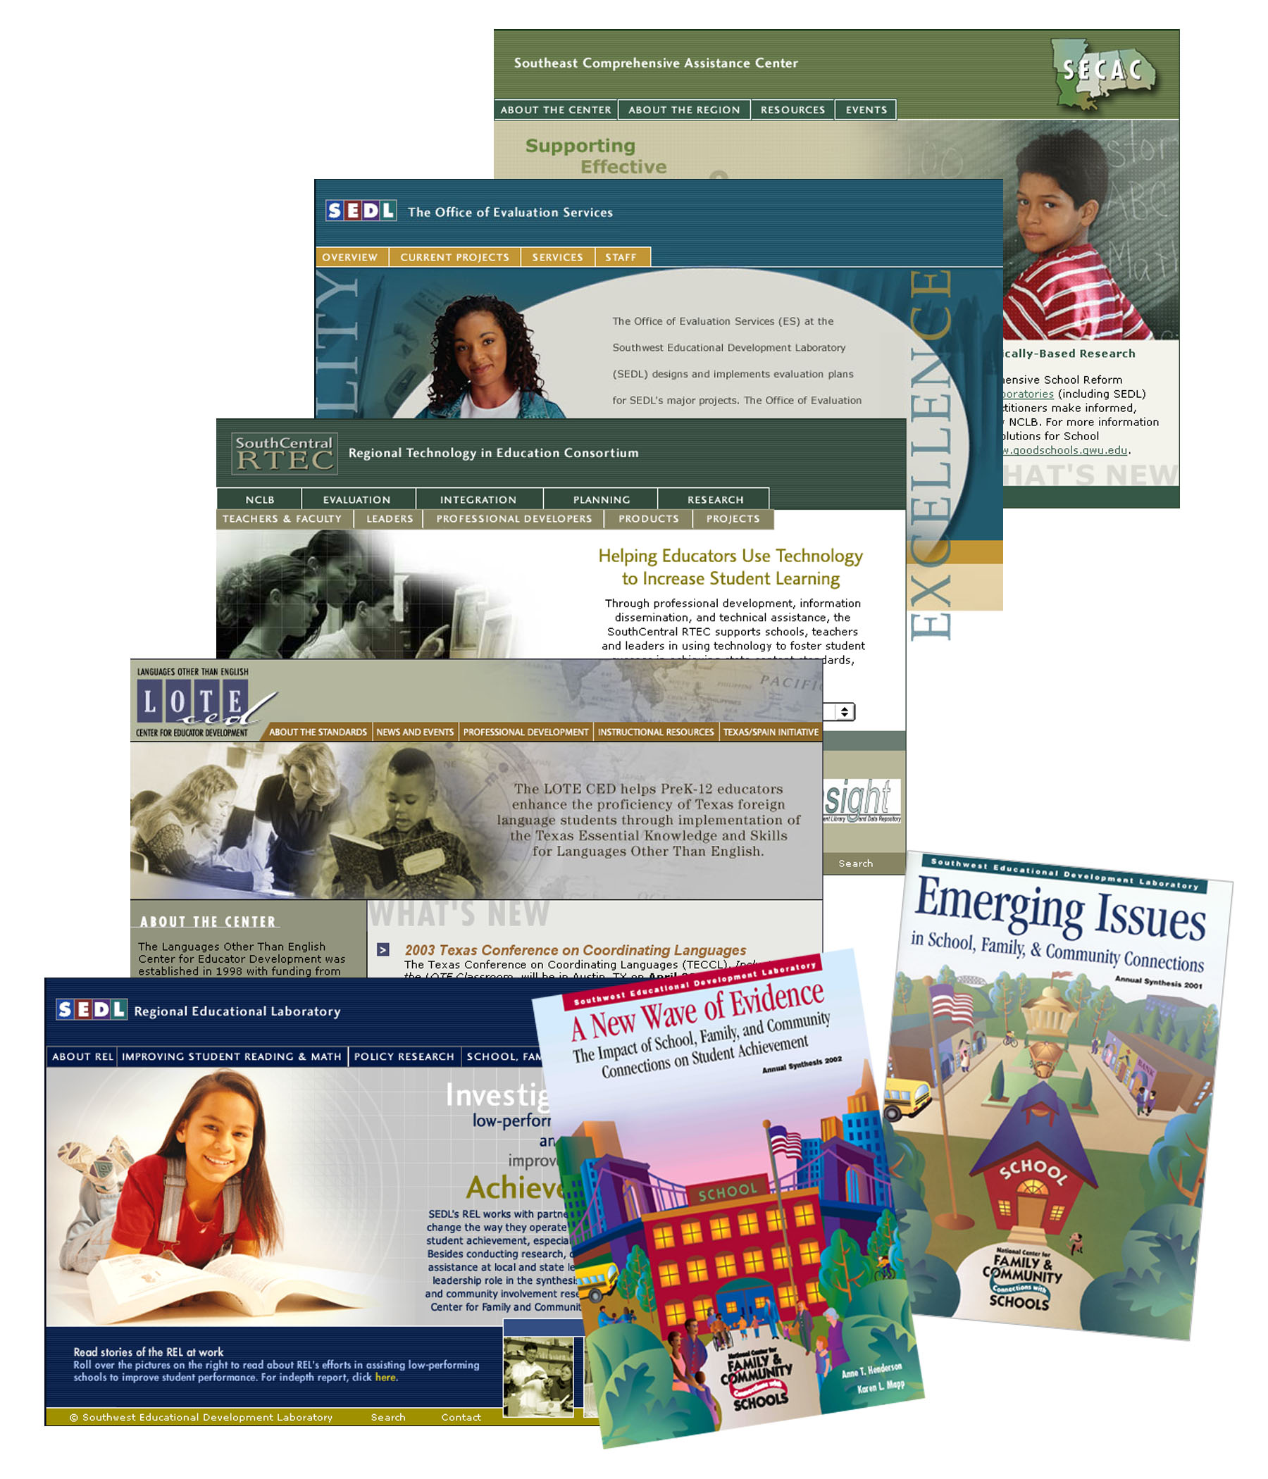
Communicate with Key Publics
Supported design or redesign of corporate Web presences:
  REL
  LOTE CED
  SouthCentral RTEC
  National Center for Connections
  SECAC
Supported publishing and media relations
Produced SEDL Links bulletin

Slide 10

Serve as In-house Consultants
OIC staff serve as consultants to SEDL staff:
Web and database applications development
Editorial services and support
Communications services
Computer applications, database staff development
Graphics design, art direction, print
management
Information services
Spanish-language communications
services
Oversee corporate staff resources:
  Intranet
  Computer Lab
  Information Resource Center

